Slide 1
THIS PRESENTATION HAS NOTES
The text the Facilitator speaks during this training session is contained in the notes section of the presentation slides. The slide notes also contain critical facilitation information, including timings and references to the corresponding page numbers in the Facilitation Guide. It is important to review the slide notes in full before facilitating this training package, and to print them as a reference tool for your session.
The notes should appear in the dock below the image of the slide when View is set to Normal. If you do not see the notes, hold your cursor on the thin gray bar at the bottom of the window and drag the bar upwards. The notes section will appear. To view the slides with the notes in large text below them, move your cursor to the top of the window and click View, then Notes Page. To print the slide notes with images of the slides (handy for facilitating for the first time, especially for lengthy teaching segments), click Print, then under Print Layout, choose Notes Pages.
IMPORTANT!
TIP ON HIDING SLIDES
If you decide to remove slides from this presentation – for instance, because you are not doing a particular exercise – it is better practice to hide the slide rather than deleting it. This ensures that the Timing Chart in the Facilitation Guide will still reflect the correct slide numbers. To hide a slide, click on the slide. Then, under the tab Slide Show, click on the icon “Hide Slide.” This means the slide will not be shown on the screen during your slide show.
Notes:
Important!
This Presentation Has Notes
The text the Facilitator speaks during this training session is contained in the notes section of the presentation slides. The slide notes also contain critical facilitation information, including timings and references to the corresponding page numbers in the Facilitation Guide. It is important to review the slide notes in full before facilitating this training package, and to print them as a reference tool for your session.
The notes should appear in the dock below the image of the slide when View is set to Normal. If you do not see the notes, hold your cursor on the thin gray bar at the bottom of the window and drag the bar upwards. The notes section will appear.
To view the slides with the notes in large text below them, move your cursor to the top of the window and click View, then Notes Page. To print the slide notes with images of the slides (handy for facilitating for the first time, especially for lengthy teaching segments), click Print, then under Print Layout, choose Notes Pages.
Tip on Hiding Slides
If you decide to remove slides from this presentation – for instance, because you are not doing a particular exercise – it is better practice to hide the slide rather than deleting it. This ensures that the Timing Chart in the Facilitation Guide will still reflect the correct slide numbers. To hide a slide, click on the slide. Then, under the tab Slide Show, click on the icon “Hide Slide.” This means the slide will not be shown on the screen during your slide show.

Slide 2
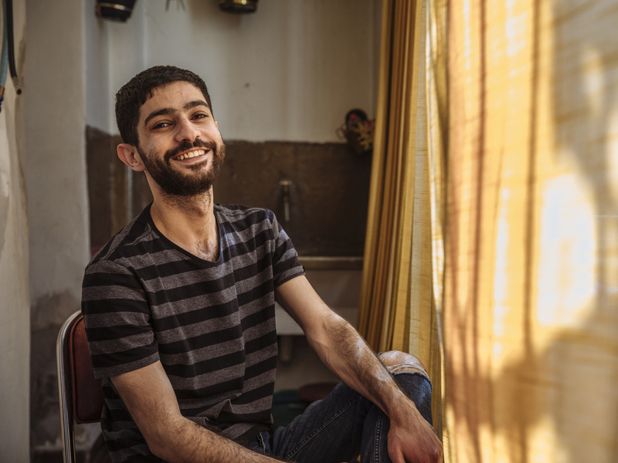



Sexual Orientation, Gender Identity, Gender Expression and Sex Characteristics (SOGIESC)
in Forced Displacement and Migration
DATE / TIME / OTHER NOTES
Notes:
Opening Slide
[Image description: a person sitting in a chair smiling at the camera; a yellow curtain to the right filters in sunlight.]

Slide 3
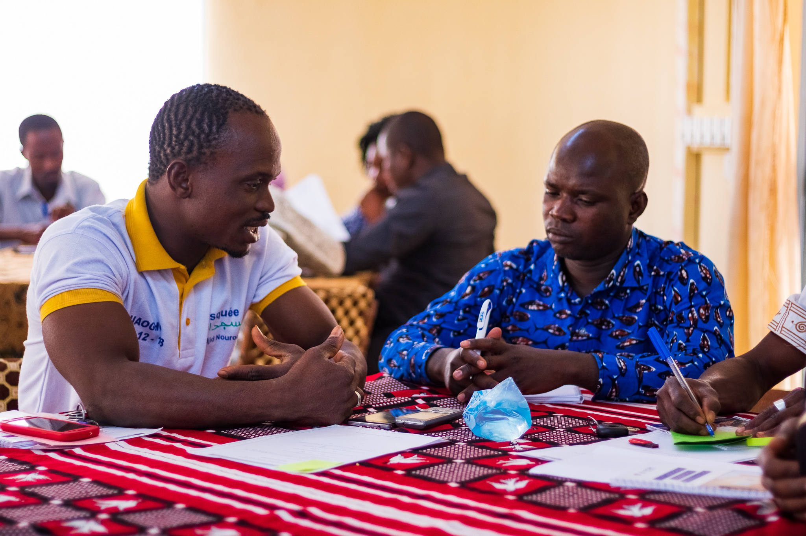
conducting interviews
modules 8-9
3
Notes:
Welcome: Modules 8-9
Welcome to Modules 8-9 of SOGIESC in Forced Displacement and Migration. The focus of modules and 8 and 9 is on conducting respectful interviews with people with diverse SOGIESC. The interview is one of the most important parts of our work with people with diverse SOGIESC, whether we’re engaged in programmatic work, protection, refugee status determination or durable solutions.
It is critical that any information you require is gathered in a way that is supportive and non-judgmental and maintains the humanity, dignity and respect of the individual you are interviewing. For most interviews, you do this with a view to gather only the information that is necessary in a non-invasive and comfortable manner for the individual. If you are conducting Refugee Status Determination (RSD) interviews, you do this with a view to elicit a full and truthful account relating to the individual's profile and experiences in the country of origin.
Module 8 is Interviewing Basics, which includes an introduction to the PEACE model and basic guidance on thematic areas to explore during interviews, as well as questions we should not ask people with diverse SOGIESC. We will also discuss working with interpreters.
Module 9, on Interview Techniques, will give you the opportunity to practice conducting interviews and to explore different scenarios that may arise in the course of conducting interviews.
Facilitation Note – Refugee Status Determination (RSD) Variation of Module 8-9: Modules 8-9 have two variations: a standard variation for learners who do not conduct RSD interviews or for mixed audiences where some learners conduct RSD interviews or oversee staff members who conduct RSD interviews, and an RSD variation for learners who only conduct RSD interviews. The RSD variation is noted in slides, exercises and discussions throughout the modules. As a Facilitator, you should present the variation that will best serve the profiles of your learners.
[Image description: IOM training community actors from the Central-Eastern Region of Burkina Faso. Two people sit at a table with printed materials and focus on looking at the questions and techniques provided for them.]

Slide 4

8
INTERVIEW
BASICS
4
Notes:
Module 8: Interview Basics
Module 8 is Interview Basics.
----
Total Module Time: 3 hours for standard variation; 3 hours 30 minutes for RSD variation.

Slide 5
MODULE 8
OBJECTIVES
01
02
03
THE PEACE MODEL
SAFER
INTERVIEW SPACES
TIPS AND WHAT
TO AVOID
Explain how to conduct respectful interviews by
using the PEACE model and exploring thematic areas
  Describe how to create
  safer interview spaces that encourage open, dignified and secure communication
  Share tips for conducting successful interviews and the questions and stereotypes interviewers should avoid
1
1
5
Notes:
Objectives
Let’s review our objectives for Module 8. By the end of this module, you should be able to:
Explain how to conduct respectful interviews using the PEACE model and exploring thematic areas.
Describe how to create safer interviewing spaces that encourage open, dignified and secure communication.
Share tips for conducting successful interviews and questions and stereotypes to avoid.
----
Time: 1 minute.

Slide 6

Mock Interview
Scripts
GROUP
Exercise
Workbook - PAGE 5
Notes:
Exercise: Mock Interview Scripts
We will start this module with an exercise called Mock Interview Scripts. Please turn to the page in your Workbook that is on the screen. This exercise allows us to explore the ways in which interviews with people with diverse SOGIESC can be conducted poorly and think about what we can do better. For this exercise, we will read two short sample interview scripts.
Please keep in mind that these mock interview scripts are not representative of actual interviews. An actual interview would be much longer and more comprehensive. In other words, we understand this interview is not realistic. It is meant for demonstration only.
Please turn to the first interview script. I need two volunteers to read – one to read for the interviewer and one to read for the interviewee. Please come up front to read.
As they read, please mark the things the interviewer says that you think are inappropriate and the things the interviewer says that you think are appropriate.
After the reading is done–
Thank you for reading for us. You did an excellent job. You can return to your seats. Now, let’s go through the script line-by-line together and discuss whether we thought each question or statement was appropriate or inappropriate.
Conduct the discussion for Mock Interview Script One using the Facilitation Guide Exercise Key.
Now please turn to the second interview script. I need two more volunteers to read – one to read for the interviewer and one to read for the interviewee. Please come up front to read.
As they read, you should again mark the things the staff member says that you think are inappropriate and the things the interviewer says that you think are appropriate.
After the reading is done–
Let’s again go through the script line-by-line and discuss whether we thought each question or statement was appropriate or inappropriate.
Conduct the discussion for Mock Interview Script Two using the Facilitation Guide Exercise Key.
----
Facilitation Note: See the Facilitation Guide page 134 for more information about this exercise, alternative facilitation ideas and talking points for the post-exercise discussion.
Time: 1 hour 20 minutes. 10 minutes to read each script; 30 minutes to discuss each script.

Slide 7
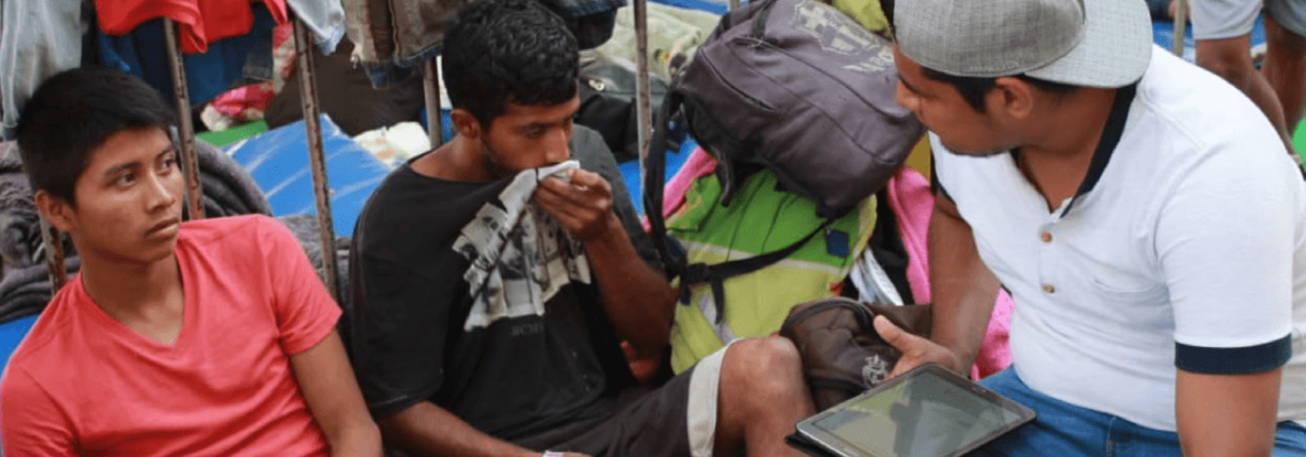
A NOTE ON LANGUAGE
PEACE MODEL
GUIDANCE - PAGE 10
7
Notes:
The PEACE Model
We will now learn about a model for conducting interviews that allows us to gather the information we need while supporting the interviewee in leading their narrative, rather than being led by specific questions.
Let’s start our exploration of the PEACE model by imagining, what does a successful interview with a person with diverse SOGIESC look like?
Examples of answers:
Confidential
Safe and secure
Interviewer and interpreter are well trained and receptive
Interviewee feels comfortable and supported
Questions are asked in a respectful and dignified way
Interviewee clearly understands the purpose of the interview and why particular questions are being asked
Interviewee understands how the information will be used
Interviewee’s SOGIESC is accepted on testimony and not challenged by the request for inappropriate or invasive information, documentation or exams
The next steps to the process take into account the best interests of the interviewee and maintain their safety, security, dignity and privacy
How do we achieve this successful interview? Let’s now learn more about the PEACE model.
----
Time: 2 minutes.
Section Time: 1 hour 32 minutes.
Facilitation Note: Please refer to page 148 of the Facilitation Guide for more information on the PEACE model.
[Image description: a staff member sits outside with two migrants with masculine gender expression asking questions while holding a tablet in his lap.]

Slide 8

PEACE Model
INTERVIEW
01
02
03
04
05
Plan and
Prepare
Engage
and Explain
Closure
Account
Evaluation
8
Notes:
The PEACE Model Overview
The PEACE model was developed by UNHCR as a set of guiding principles on how to design and conduct interviews in way that creates comfortable and supportive space for interviewees and obtains reliable information. It is based on ethics-led sociological and psychological research into the nature of memory, eyewitness testimony, deception and decision making.
There are five phases to the PEACE model:
Plan and Prepare, in which you set the groundwork for the rapport you are able to build and maintain and how well you will be able to communicate with the interviewee;
Engage and Explain, in which you ensure the interviewee understands the purpose and objectives of the interview as well as the process and procedures;
Account, in which you obtain the necessary information and clarify it as needed;
Closure, in which you review all information and explain next steps;
Evaluation, in which you evaluate whether your interview objectives were achieved.
We will review all five phases but focus mainly on the Plan Prepare and Account phrases. We’ll also look in-depth at discuss working with interpreters in the context of interviews with people with diverse SOGIESC, the types of thematic areas you might explore in interviews and the types of questions you want to avoid.
----
Time: 2 minutes (1 hour 32 minutes for PEACE Model section).

Slide 9

Plan and Prepare
01
CASE PLANNING
MENTAL PREPARATION
PHYSICAL PREPARATION
DISCUSSION
What are common barriers to planning and preparing for interviews?
9
Notes:
Phase One: Plan and Prepare
The plan and prepare phase is critical to ensuring a successful interview. During this phase, you will consider the objectives of your interview, identify what you want to achieve, review what information you have, and determine what the interviewee needs to share with you. You also need to consider the physical setting and working with an interpreter.
Decades of research show that planning and preparing for each interview is key to its success. What are some of the common barriers to planning and preparing for interviews?
Examples: Time constraints, heavy workload, exhaustion, repetition of interviews, lack of guidance on planning, lack of tools to plan.
As we move through this section, think about how you might overcome some of those barriers in order to ensure you incorporate this critical step in your interview process.
----
Time: 2 minutes (1 hour 32 minutes for PEACE Model section).

Slide 10
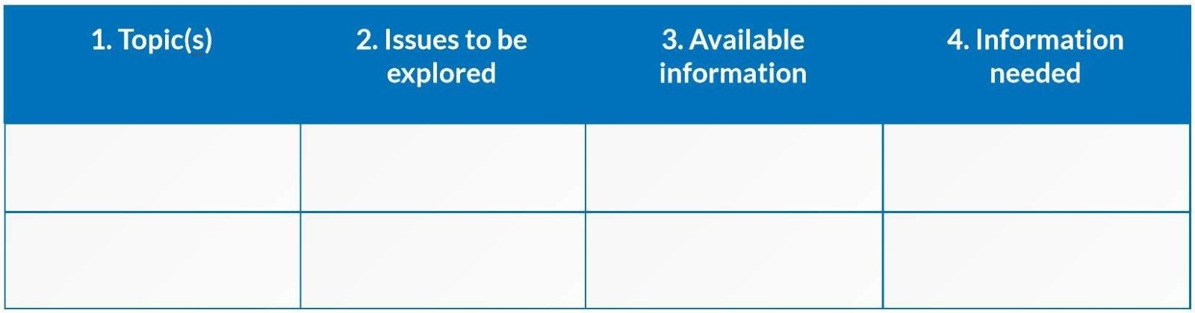
Plan and Prepare
01
Case planning
Establish the purpose and objectives of the interview
Review the available information and documentation
Analyze any issues that you will need to explore
Identify any information you need from other sources
If you are aware of diverse SOGIESC, review key terms and issues relevant to that individual
Develop a plan for the interview
The Interview Planning Matrix
10
Notes:
Phase One: Plan and Prepare – Case Planning
First let’s look at interview planning.
In relation to the particular case, you should:
Establish the purpose and objectives of the interview;
Review the available information and any documentation;
Analyze any issues that you will need to explore given the objectives of the interview;
Identify any information you may need to obtain from other sources; and
If you are aware of diverse SOGIESC, review key terms and issues relevant to that individual;
Develop a plan for the interview using the interview planning matrix.
In relation to SOGIESC, what kind of information might you want to obtain from other sources in order to help prepare you for your interview?
Examples: Information about country conditions for people with diverse SOGIESC, laws and social practices, information about possible referral pathways, and core information about SOGIESC that might require review, such as your Glossary and Guidelines on Gender-Inclusive Communication which are being shared during this training. Recall key information you need to know about the particular aspect of SOGIESC that is relevant to the individual.
One useful tool is the Interview Planning Matrix, which can help you analyze new information obtained during the interview, identify any concerns with and gaps in information, and strategize how to approach the remainder of the interview.
Now let’s consider mental preparation. Your attitude and behaviour as the interviewer can affect the interviewee’s ability and willingness to share information. You must be open-minded, flexible and strategic and ensure you are aware of biases and how they impact what you hear. Let’s think back to the earlier discussions we had on bias. How do you think your bias could impact an interview with a person with diverse SOGIESC?
Pause for answers.
----
Time: 4 minutes (1 hour 32 minutes for PEACE Model section).

Slide 11
Plan and Prepare
01
Mental Preparation
Am I aware of my own state of mind and views on the case and how this can affect me?
Am I biased in any way?
Am I able and willing to see the interviewee’s perspective?
How will I minimize the power imbalance?
Do I fully recognize the purposes of the interview and appropriate limits to my lines of questioning?
11
Notes:
Phase One: Plan and Prepare – Mental Preparation
We must keep in mind that our life experiences are limited to our context. If we approach the interview through the lens of our own experiences, there is a risk we may be more receptive to statements consistent with our experiences, and give less importance to or filter out statements not consistent with own experiences. What questions we ask, and how we ask them, in order to gather information may also be affected by our experiences and, more generally, our background, so we must always hold an awareness about this as we are conducting interviews.
In preparing mentally for an interview, you should ask yourself:
Am I aware of my own state of mind and views on the case and how this can affect me?
Am I biased in any way?
Am I able and willing to see the interviewee’s perspective?
How will I minimize the power imbalance?
Do I fully recognize the purposes of the interview and appropriate limits to my lines of questioning?
What do you think each of these mean in the context of an interview with a person with diverse SOGIESC?
Examples: one’s state of mind about diverse SOGIESC, positive or negative, can influence the way information is interpreted; unconscious bias can be engrained due to societal, cultural and religious backgrounds; one must be aware at all times to look at the narrative from the perspective of the interviewee; the interview itself puts the interviewer in a position of power, which can be balanced by the interviewer encouraging the interviewee to lead their own narrative; and the interviewer should recognize that there are limits to what can be asked of a person with diverse SOGIESC given we wish to avoid invasive and intimate questions.
If you feel discomfort with the interview for any reason or feel that you hold any prejudice related to diverse SOGIESC, you may wish to question whether you are the right person to be conducting the interview.
Now let’s consider physical preparation. The interview setting can affect the interviewee’s ability and willingness to share information. What is important in an interview setting with a person with diverse SOGIESC?
Examples: Individuals can gain entry without being exposed to harassment by guards or other interviewees; the interview is in an enclosed space where others cannot overhear; the space is comfortable and safe; there is access to water and gender-appropriate toilets, if needed.
----
Time: 4 minutes (1 hour 32 minutes for PEACE Model section).

Slide 12
Plan and Prepare
01
Physical Preparation
Do I have a confidential space?
Is my space accessible (e.g., security points, waiting rooms)?
Does my space have reasonable accommodations (e.g., gender neutral toilets,
safe waiting areas, private nursing areas)?
Is the physical environment comfortable and safe?
Am I displaying my support for people with diverse SOGIESC when and where possible?
Is the interpreter prepared and appropriate for this interview?
12
Notes:
Phase One: Plan and Prepare – Physical Preparation
In relation to physical planning, you will need to think about where the interview will be, when it will be, what you need to bring with you and how you will ensure accessibility, safety and security and reasonable accommodation for the participants. Specifically, you should ask:
Do I have a confidential space?
Is my space accessible (e.g., can individuals can gain entry with dignity, for instance through security and in the waiting room)?
Does my space have reasonable accommodations (e.g., gender neutral toilets, if needed)?
Is the physical environment comfortable and safe?
Am I displaying my support for people with diverse where and when possible?
Is the interpreter prepared and appropriate for this interview?
Keep in mind that physical preparation extends beyond your individual interview room. Especially for individuals with diverse gender identity and expression, and same-gender couples and families, just getting into our buildings through security and sitting in our waiting rooms can pose a threatening situation. Security guards should be trained on handling ID cards that do not match an individual’s gender expression and safe waiting spaces should be provided to individuals as needed. You also should ensure that gender-neutral toilets and private nursing areas are available for those who need them.
We’ll now take some time to talk about interpretation in the context of interviews with people with diverse SOGIESC.
----
Time: 3 minutes (1 hour 32 minutes for PEACE Model section).

Slide 13
Plan and Prepare
01
Key Challenges with Interpretation
Discomfort
Reluctance
Discrimination
Discomfort due to the attitude of the interpreter.
Reluctance of individual to share information based on the gender, nationality or attitude of interpreter
or their assumptions about interpreter.
Discrimination or abusive language on the part of the interpreter, especially if they are not trained.
Misunderstandings
Breaches
Misunderstandings or incorrect language.
Breaches of confidentiality by interpreter.
13
Notes:
Phase One: Plan and Prepare – Interpretation
There are several key challenges to successful interpretation.
The first is the discomfort of an individual due to the attitude of the interpreter,
or discomfort of the interpreter due to the diverse SOGIESC of the person being interviewed. An interpreter may demonstrate through non-verbal cues or words that they are not comfortable working with the individual.
The second is reluctance of an individual to share information based on factors like the gender, nationality or the attitude of the interpreter or assumptions the individual makes about the interpreter.
This is especially common when the interpreter is from the same cultural community as the individual. The individual may assume, due to experiences with that community, that the interpreter will be prejudiced or not maintain confidentiality.
The third challenge is discrimination or abusive language on the part of the interpreter, especially if they are not trained.
A staff member who does not speak the language of the individual may not realize the interpreter is using words or phrases that are disrespectful, and the individual may feel unable to speak up.
The fourth challenge is misunderstandings or incorrect language.
Even if an interpreter is not using abusive or derogatory language, they may lack an understanding of terminology related to SOGIESC, and they may lack training on the subject in general. They thus may not correctly interpret what the individual is saying, which can lead to a host of challenges in assisting the individual.
The final challenge is breaches of confidentiality by the interpreter.
This is a real concern if the interpreter is not committed to the organization and its code of conduct in a sustained manner, or if the interpreter is prejudiced.
----
Time: 3 minutes (1 hour 32 minutes for PEACE Model section).

Slide 14
Plan and Prepare
01
Operational Barriers with Interpretation
COMMUNITY
CHANGE
Community members are at times the only interpreters available.
Interpreters may change often, making training difficult.
NON-STAFF
CIRCUMSTANCES
Interpreters may not be staff members, meaning they do not always adhere to the same standards of conduct.
Rare circumstances may require using a family member as an interpreter.
14
Notes:
Phase One: Plan and Prepare – Interpretation (continued)
There are also several operational barriers to successful interpretation.
First, community members are at times the only interpreters available.
This can lead to the individual being reluctant to share information.
Second, interpreters may change often, which makes training difficult.
Sometimes, you use different interpreters every time you visit a location. It can be difficult to retain quality interpreters and hire new interpreters.
Third, interpreters may not be staff members, meaning they do not always adhere to the same standards of conduct.
Finally, rare circumstances may require using a family member as an interpreter.
An example is a location where the family is the only group that speaks the language in question and telephonic interpretation is not an option.
----
Time: 2 minutes (1 hour 32 minutes for PEACE Model section).

Slide 15
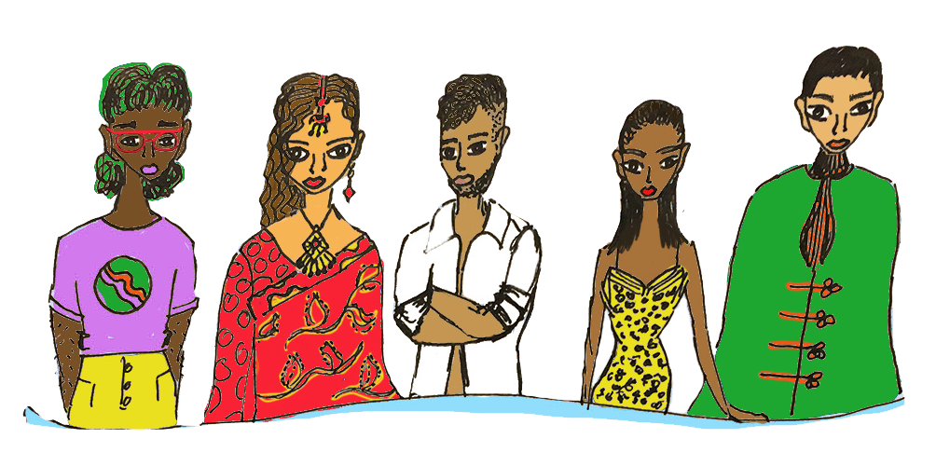
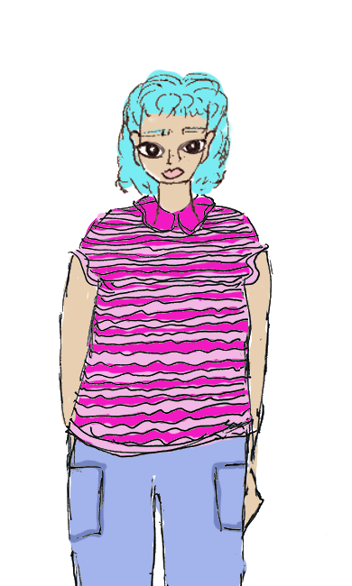
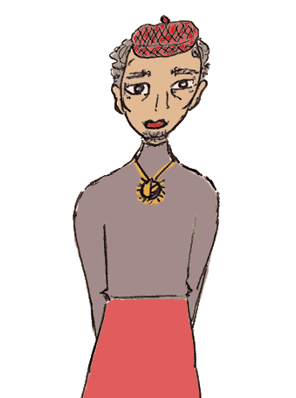
Plan and Prepare
01
GROUP DISCUSSION ON INTERPRETATION
Q1 What impact could the gender, nationality, ethnicity or linguistic group of an interpreter have on an interview?
Q2 How can we confirm interpreters are comfortable interpreting for LGBTI people? How can we provide training?
Q3 Should interpreters be allowed to “opt out” of LGBTI interviews?
Q4 What alternatives are available if an individual will not interview with an interpreter from their community?
Q5 What are the challenges you’ve faced using interpreters, and what are the best practices you’ve used to address those challenges?
15
Notes:
Phase One: Plan and Prepare – Interpretation (continued)
Let's discuss the questions on the screen as a group.
What impact could the gender, nationality, ethnicity or linguistic group of an interpreter have on an interview?
How can we confirm interpreters are comfortable interpreting for people with diverse SOGIESC? How can we provide training?
Should interpreters be allowed to “opt out” of interviews with people with diverse SOGIESC?
What alternatives are available if an individual will not interview with an interpreter from their community?
What are the challenges you’ve faced using interpreters, and what are the best practices you’ve used to address those challenges?
Before we move on to the next phase of the PEACE model, let’s go back now to our mock script exercises. What could the interviewers have done better to plan and prepare?
----
Time: 10 minutes (1 hour 32 minutes for PEACE Model section).
Facilitation Note: See the Facilitation Guide page 151 for suggested answers to these discussion questions.

Slide 16
Engage and Explain
01
02
01
Step 1
ENGAGE
Aimed at building rapport and encouraging conversation (should be maintained throughout
02
EXPLAIN
the purpose of the interview, the form it will take
Step 2
People with diverse SOGIESC may require a more supportive environment and have greater difficulty articulating information, so establishing trust and confidentiality is key
16
Notes:
Phase Two: Engage and Explain
The second phase of the PEACE model is Engage and Explain. The first minutes of an interview are crucial – they will set the tone for everything that follows and will have a significant impact on whether or not the purpose of the interview is achieved.
What do you think it’s important to do during the engage and explain phase when interviewing a person with diverse SOGIESC?
Examples: Set the person at ease, establish rapport, explain why they are there, go over the structure of the interview, share information about safe spaces and confidentiality, ensure they are comfortable with the interpreter, and answer any initial questions the individual has.
----
Time: 2 minutes (1 hour 32 minutes for PEACE Model section).

Slide 17
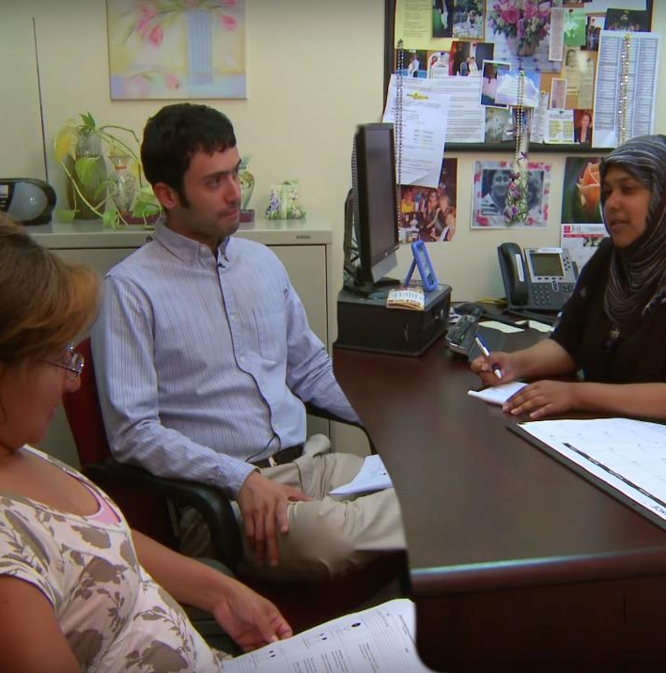
Engage and Explain
01
02
Explain
The purpose and procedure of the interview
The role of the interpreter
The duty of confidentiality and safe space information
A reminder that the interviewee can stop at any time and an agreement on a “stop” signal to make sure they can remain in control
An acknowledgement of how difficult it may be to answer certain questions and a note that the interviewee can let you know when something is too difficult
17
Notes:
Phase Two: Engage and Explain (continued)
In the first moments, you have the opportunity to put the interviewee at ease, create an atmosphere of safety and trust, understand the priorities or needs of the interviewee, communicate your expectations for the interview and of the interviewee, and introduce the interpreter and explain their role.
The Explain step should always include the following:
The purpose and procedure of the interview
The role of the interpreter
The duty of confidentiality and safe space information
A reminder that the interviewee can stop at any time, and an agreement on a “stop” signal to make sure they can remain in control
An acknowledge of how difficult it may be to answer certain questions and a note that the interviewee can let you know when something is too difficult
It’s also important to start a conversation and engage with the person in front of you because this will help establish a rapport, which is important considering the person will be sharing sensitive personal information with you that may evoke feelings of shame, stigma and upset. Having a good rapport will help them feel more accepted, relaxed and willing to share.
How do we establish good rapport?
Pause for answers before moving to the next slide.
----
Time: 2 minutes (1 hour 32 minutes for PEACE Model section).
[Image description: an interpreter sits with a migrant and a case worker inside an office environment.]

Slide 18
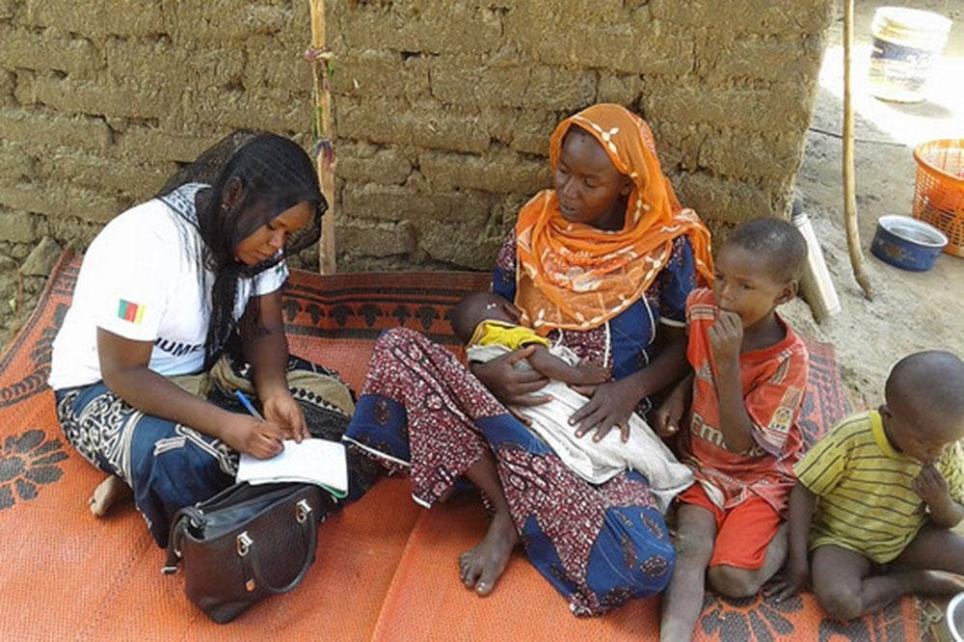
Engage and Explain
01
02
Engage
How can we build rapport?
Creating a supportive and welcoming space
Using both verbal and non-verbal communication to convey acceptance and safety
Approaching every individual in a non-judgmental manner
Asking if the individual is comfortable with the interpreter
For persons who have a diverse gender identity, asking or confirming current name and pronouns
Beginning the interview with simple, non-sensitive topics
18
Notes:
Phase Two: Engage and Explain (continued)
There are many different ways to build rapport. Some of them include:
Creating a supporting and welcoming space
Use both verbal and non-verbal communication to convey acceptance and safety
Approaching every individual in a non-judgmental manner
Asking if the individual is comfortable with the interpreter
For persons who have a diverse gender identity, asking or confirming their current name and pronouns
Beginning the interview with simple, non-sensitive topics
What else would you add to this list?
----
Time: 2 minutes (1 hour 32 minutes for PEACE Model section).
[Image description: an interviewer sits on a tapestry outside in Cameroon writing on a pad as they interview a person holding a baby and a young child sitting next to them.]

Slide 19
Engage and Explain
01
02
Questions you may use to begin an interview with a person with diverse SOGIESC, when relevant
May I record information about your [sexual orientation, gender identity, gender expression or sex characteristics] in [file, database, etc.]?
May I share information about your [sexual orientation, gender identity, gender expression or sex characteristics] with [person, entity, etc.]?
Do your family members know about your [sexual orientation, gender identity, gender expression or sex characteristics] ? If so, may we discuss it in front of them?
Do you have a partner or spouse who may also need assistance?
[For individuals who have disclosed a diverse gender identity only] What gender, name, pronoun and title would you like us to use?
19
Notes:
Phase Two: Engage and Explain (continued)
Finally, let’s think back to the Foundation Topics module on Inclusive Communication. In that module, we learned some of the basic opening questions you might ask someone with diverse SOGIESC when you meet with them, if relevant to their particular situation and that interview. Several of those questions are displayed on the screen.
They include:
May I record information about your [sexual orientation, gender identity, gender expression or sex characteristics] in [file, database, etc.]?
May I share information about your [sexual orientation, gender identity, gender expression or sex characteristics] with [person, entity, etc.]?
Do your family members know about your [sexual orientation, gender identity, gender expression or sex characteristics]? If so, may we discuss it in front of them?
Do you have a partner or spouse who we may also assist?
[For individuals who have disclosed a diverse gender identity only] What gender, name, pronoun and title would you like us to use?
Recall that when we ask about someone’s current gender, name, pronouns and title we should explain, if relevant, that:
We will note your gender, name, pronoun and title in our records.
For legal reasons, the sex and name that is listed on your official documents may be used on our forms as your primary information. This is required by the organization and we apologize for the discomfort this might cause.
Keep in mind that you often will not know you are interviewing a person with diverse SOGIESC until they disclose that information to you, so you should launch every interview you conduct using the same basic tenets of openness and respect and be ready for a disclosure at any time.
Now let’s go back now to our mock script exercises. What could the interviewers have done better to engage and explain?
----
Time: 3 minutes (1 hour 32 minutes for PEACE Model section).

Slide 20
ACCOUNT
01
02
03
OBTAIN
analyse
CLARIFY
Free Account
Reliable
Relevant
Detailed
20
Notes:
Phase Three: Account
The third phase of the PEACE model is Account.
This phase starts with obtaining a free account on each relevant topic. A free account lets the interviewee share their story, fears or concerns in their own words, at their own pace, and with minimal interference from the interviewer.
After you obtain a free account, you can analyse which aspects need to be explored further, then ask for clarification on certain topics if needed. Analysis can include comparing the information gathered to the interview plan. You may need to go back and forth between analysing and clarifying until you have all the information you need. You then move on to the next topic and repeat the same steps.
The goal of the free account is to collect reliable, relevant and detailed information from the interviewee in order to achieve the purpose of the interview. What do you think reliable, relevant and detailed mean?
Pause for answers.
Reliable means the information can be relied upon to reach a decision or take a particular course of action; relevant means the information speaks to one or more topics you’ve identified as key to your objectives of the interview; and detailed means you have reached sufficient level of detail required for that type of interview.
The way in which the Account phase is structured is consistent with our understanding of how people remember past experiences. By following the steps of the Account phase for each topic and performing the corresponding tasks in the order and manner described, you increase the likelihood of gathering information that is both relevant and reliable.
----
Time: 3 minutes (1 hour 32 minutes for PEACE Model section).

Slide 21
ACCOUNT
01
02
03
Ensure you prepare the interviewee to give a free
account during the explain
and engage phase
Demonstrate that the interviewee is in charge
Delay questions that prematurely interrupt the narrative and/or raise sensitive subjects
Pose open-ended questions first
Pose focused questions later
Tell, Explain, Describe
Probing Questions
5WH (opened/closed)
Closed/leading questions
21
Notes:
Phase Three: Account – The Reliability Hierarchy
Preparing the interviewee for providing the free account during the Explain and Engage Phase – both by encouraging them to be active and speak freely in as much detail as possible and by demonstrating you are listening without interrupting – will make it easier to obtain a free account. By allowing the interviewee to freely tell their story, we demonstrate to them that they are in charge of their narrative and that it is a safe and welcoming space for them to share the information.
Be careful during a free account not to interrupt with questions that will impede the flow of the narrative, because questions asking for further detail can impede recall or imply you only want to hear about a particular topic. When you ask a question, first consider what information you need to gather, if the question is phrased appropriately, and if it is the right time to ask that question.
One way to consider asking questions is using the reliability hierarchy. It consists of three levels of question types in a “funnel” organized by the degree to which they enable the interviewer to obtain detailed and reliable information.
The reliability hierarchy has at the top TED questions, or tell, explain and describe, which will elicit the most information. It then has probing questions, or the five WHs – who, what, when, where and why. And finally, at the bottom of the hierarchy and eliciting the least information are closed questions.
----
Time: 2 minutes (1 hour 32 minutes for PEACE Model section).

Slide 22
ACCOUNT
01
02
03
TED QUESTIONS
Tell, Explain, Describe
You indicated you experienced harm because of -------. Can you tell me more about that?
Thank you for sharing that with me. How did that experience impact you?
If someone articulates
their SSOGI identity
Tell me about your experiences as ---.
Any other
suggested questions?
22
Notes:
Phase Three: Account – TED Questions
TED questions mean Tell, Explain and Describe.
On the screen are different ways to ask TED questions, for example:
Tell me about your experiences as -----;
You indicated you experienced harm because of ----. Can you tell me more about that?
Thank you for sharing that with me. How did that experience impact you?
What are some other ways you can think of to ask TED questions?
----
Time: 2 minutes (1 hour 32 minutes for PEACE Model section).

Slide 23
ACCOUNT
01
02
03
Thematic Areas to Explore
Difference, stigma and shame, and their impact
on the individual’s life
The stereotypes and prejudices surrounding same-gender relationships in the society
Discrimination, criminalization, harassment, abuse and threats, or fear of, in families, communities, and societies, and their impact on the individual’s life
Current or past same-gender relationships, if any
Discomfort or unfamiliarity surrounding terms related to SOGIESC
Knowledge of others in similar situations subject
to continuing harm
The interviewee’s cultural, economic, family, political, religious and social background, which may impact how they express their sexual orientation, gender identity, gender expression or sex characteristics, or may explain the reasons why they did not live openly
Interactions with government authorities and
access to justice
Descriptions of friends or social networks
Ability to access and maintain dignified housing, employment, education and medical care
Lack of trust in confidentiality of processes or
with particular assisting organizations
Familial, social or other pressures and the
emotional consequences
23
Notes:
Phase Three: Account – Thematic Areas to Explore
When asking TED questions, there are a wide range of thematic areas you may wish to explore with an individual who is discussing their diverse SOGIESC. Remember to use these categories as a guide only, and to let the individual lead the interview.
Difference, stigma and shame, and their impact on the individual’s life
Discrimination, criminalization, harassment, abuse and threats, or fear of, in families, communities, and societies, and their impact on the individual’s life
Knowledge of others in similar situations subject to continuing harm
Interactions with government authorities and access to justice
Descriptions of friends or social networks
Ability to access and maintain dignified housing, employment, education and medical care
Familial, social or other pressures and the emotional consequences
The stereotypes and prejudices surrounding same-gender relationships in the society
Current or past same-gender relationships, if any
Discomfort or unfamiliarity surrounding terms related to SOGIESC
The interviewee’s cultural, economic, family, political, religious and social background, which may impact how they express their sexual orientation, gender identity, gender expression or sex characteristics, or may explain the reasons why they did not live openly
Lack of trust in confidentiality of processes or with particular assisting organizations
What do you think should be added to this list?
----
Time: 3 minutes (1 hour 32 minutes for PEACE Model section).

Slide 24
ACCOUNT
01
02
03
WHO
WHAT
where
why
when
Probing questions – what is appropriate?
Be non-judgmental
Be non-intrusive
Be non-adversarial
Not be based on assumptions
Maintain dignity and respect by
avoiding questions of a sexual or
invasive nature
Probing Questions Should:
Think about what information is relevant and what is not. Remember that your focus is on the way in which individuals face protection issues based on non-adherence to expected gender-based roles and behaviours.
24
Notes:
Phase Three: Account – 5WH Questions
The next tier in the reliability hierarchy is probing questions, or 5WH questions. 5WH questions are used to clarify information provided or fill in gaps. For example, if an individual shares with the interviewer that they were arrested, the interviewer might ask:
What were you told about being arrested?
Do you know why you might have been arrested?
When were you arrested?
Where were you arrested?
Who arrested you?
The questions should be non-judgmental, non-intrusive, non-adversarial, not based on assumptions, and maintain dignity and respect. We must think about what information is relevant and what is not and remember that when we’re interviewing people with diverse SOGIESC, we should focus on the ways in which individuals face protection issues based on their non-adherence to expected gender-based roles and behaviours.
----
Time: 2 minutes (1 hour 32 minutes for PEACE Model section).

Slide 25
ACCOUNT
01
02
03
GROUP ACTIVITY
Questions and Common Stereotypes to Avoid
WORKBOOK - PAGE 38
25
Notes:
Phase Three: Account – Questions and Common Stereotypes to Avoid
Please turn to the page in your Workbook that is on the screen. This is a list of some of the questions and common stereotypes you want to avoid when conducting interviews. We explored many of these stereotypes in Foundation Topics in the Module on Myths and Realities.
We’re going to discuss these in small teams. Please split into groups of three. You will have 10 minutes to go through the list together. While you are reviewing them, pick one that you feel would be most commonly asked or assumed in the interviews that you do. Prepare to share it with the group and explain why it should be avoided.
After 10 minutes, ask several small teams to share with the group the questions or stereotypes they thought were most common in their interviews, and why they should be avoided.
Are there any questions or stereotypes on this list that you believe we should reconsider or talk about more? Do you feel comfortable conducting interviews without relying on these questions or stereotypes?
----
Time: 15 minutes (1 hour 32 minutes for PEACE Model section).

Slide 26
ACCOUNT
01
02
03
Interviewing Specific Individuals
People with Diverse Sexual Orientation
Harm by
non-state
ACTORS
Intersection
of gender and sexual orientation
Inferior
VISIBILITY
MARRIAGE
FORCED
economic and/
or social status
conversion therapy
COERCION
Perceived as
GAY OR LESBIAN
26
Notes:
Phase Three: Account – Interviewing Specific Individuals
Now let’s discuss special considerations when interviewing specific individuals.
What do you think we need to keep in mind when interviewing women with diverse sexual orientations?
Pause for input before displaying answers on the screen.
Persecution occurs at the intersection of gender and sexual orientation, and often less visible for women.
Lesbians and bisexual women are more likely to be married, despite their sexual orientation, and are more likely to experience harm at the hands of non-state actors (including family members), such as abuse, honor crimes, rape, corrective rape, domestic violence, incest and forced marriage.
Gay and bisexual men may also be coerced into marriages and may face more public harm
Bisexual individuals cannot “choose” whom they feel attracted to; even if they are in a different-sex relationship, they may face persecution due to being perceived as gay or lesbian.
Inferior economic and/or social status in many countries makes it harder for women to flee, migrate and access protection, and harder for them to support themselves in the country of asylum or migration.
Youth with diverse sexual orientation may face forced conversion therapy in their countries of origin, asylum or migration.
----
Time: 2 minutes (1 hour 32 minutes for PEACE Model section).

Slide 27
ACCOUNT
01
02
03
Interviewing Specific Individuals
People with Diverse Gender Identities
Current name
RECALL
and pronoun
there a variety of pronouns
Trans/Transgender
Ask about TERMS
=
RESPECTFUL
27
Notes:
Phase Three: Account – Interviewing Specific Individuals (continued)
What do you think we need to keep in mind when interviewing people with diverse gender identities?
Pause for input before displaying answers on the screen.
Refer to the person by their current name and pronoun; ask what they are if you are unsure.
In general, you should refer to a transgender woman (an individual who was assigned the sex of male at birth but identifies as a woman) as “she,” and to a transgender man (an individual who was assigned the sex of female at birth but identifies as a man) as “he”. Individuals who identify as non-binary, agender or in another way may prefer “they,” another pronoun or no pronouns. Always ask the individual rather than making assumptions about what pronouns they use.
When in doubt, use the term “transgender” rather than “transsexual” or “transvestite.”
If relevant, ask during the interview whether the individual uses any particular terms to describe their identity.
----
Time: 2 minutes (1 hour 32 minutes for PEACE Model section).

Slide 28
ACCOUNT
01
02
03
Interviewing Specific Individuals
People with Diverse
Sex Characteristics
Intersex -- not a discrete category
Wide spectrum of natural bodily diversity
Sex characteristics do not equal sexual orientation or gender identity
When in doubt, ask
Avoid stigmatizing language (“disorder” or “hermaphrodite”)
28
Notes:
Phase Three: Account – Interviewing Specific Individuals (continued)
What do you think we need to keep in mind when interviewing people with diverse sex characteristics?
Pause for input before displaying answers on the screen.
When interviewing intersex individuals, keep the following in mind:
Intersex is not a discrete category. It represents a wide spectrum of natural bodily diversity.
Refer to an intersex person by their name, pronouns, title and gender they specify.
Do not assume that a person with diverse sex characteristics has a diverse gender identity or sexual orientation.
When in doubt, ask the individual if they have a preference for particular terminology and avoid stigmatizing language including “disorder” or “hermaphrodite.”
----
Time: 2 minutes (1 hour 32 minutes for PEACE Model section).

Slide 29
ACCOUNT
01
02
03
Tips Sheet
Tips for Supporting
a Free Account
WORKBOOK - PAGE 42
29
Notes:
Phase Three: Account – Tips for Supporting a Free Account
Please turn the page in your Workbook that is on the screen. Before we do a case study exercise, we’ll review some tips for supporting a free account together.
The Facilitator may wish to ask different participants to read the information out loud.
Start with a topic that is less sensitive, to allow the individual time to feel more comfortable.
Open each topic with encouragement to give a free account. An example is the following: “Now I would like you to tell me about the problems you are facing. When you are telling me, please include as much information as possible such as the time and place things happened. Remember that I was not there, so do not know any details. Don’t worry about what we may need from you or how to express things, or if you forget or skip anything. It’s my role to help you share information with us. I will support you to provide a full account and ask more detailed questions later to understand events. For now, you will be doing most of the talking and I will listen and not interrupt unless you give me a sign. I am ready to listen to you now.”
Give the interviewee time to think and formulate answer without rushing them.
Actively listen while the interviewee speaks; this requires attention, focus, empathy and patience.
Encourage the interviewee to continue speaking until they have shared all of the information they can remember.
Remember that an interviewee may feel particularly reluctant to disclose information about their SOGIESC, and may take a long time, or several meetings, to feel comfortable enough to disclose the information.
Keep neutral body language that encourages the individual to continue speaking.
Try to establish a safe space with individuals who have a difficult time sharing much information.
Be patient with individuals who have a great deal of information to share.
If you don’t understand the term an individual uses, ask them to explain what it means to them. Individuals will use a wide range of terms to describe having diverse SOGIESC.
Be careful not to conflate sexual orientation, gender identity, gender expression and sex characteristics. Refresh your memory regularly on terms and concepts.
Think back now to our mock scripts. Were either of the interviewees encouraged to give a free account? What kinds of questions were used most often? What might have changed about the information they provided if they had been encouraged to give a free account?
----
Time: 5 minutes (1 hour 32 minutes for PEACE Model section).

Slide 30
ACCOUNT
01
02
03
Case Study
An interviewee, R., expresses protection concerns because he is “different.” You are required to identify the reason for R.’s protection concerns. How would you explore R.’s “difference” in the interview?
30
Notes:
Phase Three: Account – Case Study
Now let’s look at a case study. An interviewee, R., expresses protection concerns because he is “different.” You are required to identify the reason for R.’s protection concerns. How would you explore R.’s “difference” in the interview?
Pause for answers before moving to the next slide.
----
Time: 3 minutes (1 hour 32 minutes for PEACE Model section).

Slide 31
ACCOUNT
01
02
03
Case Study
DO
DON’T
Rely on a particular model related to difference or hold the expectation that someone who expresses being different has a particular set of experiences
Ask R. what he means by being different
Use a checklist of behaviours or experiences premised upon stereotypes or bias
Ask R. to describe his experience of realizing he was different
Ask R. about sexual experiences
Ask R. to describe his personal experiences of being stigmatized, excluded or harmed
Assume if R. has diverse SOGIESC he will identify using any particular term
Assume if R. has diverse SOGIESC he will have shared that with others
Ask probing questions if necessary to clarify the narrative
Assume R. will be aware of any LGBTIQ+ organizations or centers
Assume if R. is married, he may not have a diverse sexual orientation – people get married for a wide range of social, cultural, religious and economic reasons
31
Notes:
Phase Three: Account – Case Study (continued)
Here are some dos and don’ts related to R’s interview.
Do:
Ask him what he means by being different
Ask him to describe his experience of realizing he was different
Ask R. to describe his personal experiences of being stigmatized, excluded or harmed
Ask probing questions if necessary to clarify the narrative
Do not:
Rely on a particular model related to difference or hold the expectation that someone who expresses being different has a particular set of experiences
Use a checklist of behaviours or experiences premised upon stereotypes or bias
Ask R. about sexual experiences
Assume if R. has diverse SOGIESC he will identify using any particular term
Assume if R. has diverse SOGIESC he will have shared that with others
Assume R. will be aware of any LGBTIQ+ organizations or centers
Assume if R. is married, he may not have a diverse sexual orientation – people get married for a wide range of social, cultural, religious and economic reasons
----
Time: 2 minutes (1 hour 32 minutes for PEACE Model section).

Slide 32
ACCOUNT
01
02
03
Case Study
Closed/leading questions
Can you confirm that you stated you left Country X in August 2021?
Closed questions are
productive when applied to:
check your understanding
“So you're telling me you're gay, but you’ve never actually been in a relationship?”
clarify and verify
Not to obtain new information
32
Notes:
Phase Three: Account – Case Study (continued)
Try to avoid closed or leading questions except when strictly necessary, for instance to clarify specific information. Closed questions typically produce only yes or no answers and are not useful for eliciting a full account.
Who can give examples of the types of closed questions that were used in the mock interview scripts?
----
Time: 1 minute (1 hour 32 minutes for PEACE Model section).

Slide 33
ACCOUNT
01
02
03
Incorporating the DSSH Model
Tell me more about the difference you described experiencing.
Can you describe to me
how the stigma you said you experienced affected your [education, religious practices, family life, etc.]?
DIFFERENCE
STIGMA
HARM
SHAME
Can you explain how the shame you felt affected your daily life?
Can you tell me more about the harm you experienced in relation
to your [sexual orientation, gender identity, gender expression, sex characteristics]?
33
Notes:
Phase Three: Account – Incorporating the DSSH Model
If you previously utilized the Difference, Stigma, Shame, Harm model of interviewing individuals with diverse SOGIESC, this method of gathering a free account can feel quite different and possibly unstructured.
Keep in mind that within the PEACE model of conducting interviews, you can still explore themes related to difference, stigma, shame and harm as the interviewee raises them. You will see in SOGIESC-related interviews that these topics often arise. The difference here is that you are not prompting the individual to discuss these themes, but rather exploring them only if they arise.
Considering difference, stigma, shame and harm as thematic topics, alongside many other thematic topics an interviewee could raise, is useful because it removes the implication that every person with diverse SOGIESC will have had these experiences or be able to talk about these themes.
On the screen you will see some DSSH-related questions that could be asked if the theme arises within the interview context.
In our two mock scripts, how were questions related to DSSH used?
----
Time: 2 minutes (1 hour 32 minutes for PEACE Model section).

Slide 34
CLOSURE
01
02
03
04
Summarizing the interview
what did you hear?
Reviewing and summarizing the information gathered
Ensuring the interview record accurately and fully reflects the interviewee’s statements
Allowing the interviewee to clarify any information
Checking with the interviewee and interpreter to see if there were any communication issues during the interview
Ensuring the interviewee is satisfied with the way the interview was conducted
Addressing any concerns the interviewee may have
Explaining next steps and the timeframe for a response, if any
Making any necessary referrals
34
Notes:
Phase Four: Closing
The fourth phase of the PEACE model is closing the interview.
Regardless of the outcome of the interview, we should always allocate sufficient time for closing. Closing entails:
Reviewing and summarizing the information gathered
Ensuring the interview record accurately and fully reflects the interviewee’s statements
Allowing the interviewee to clarify any information
Checking with the interviewee and interpreter to see if there were any communication issues during the interview
Ensuring the interviewee is satisfied with the way the interview was conducted
Addressing any concerns the interviewee may have
Explaining next steps and the timeframe for a response, if any
This would also be the time to make any useful referrals to the interviewee. We discuss referral pathways more in-depth in the protection modules.
----
Time: 2 minutes (1 hour 32 minutes for PEACE Model section).

Slide 35
EVALUATION
01
02
03
04
05
Questions to Ask Yourself
WORKBOOK - PAGE 23
Q1 Did the interview meet its purpose?
Q2 Did you accomplish what was on the Interview Planning Matrix?
Q3 Can you answer all of the evaluation questions?
35
Notes:
Phase Five: Evaluating
The final phase of the PEACE model is evaluating the interview. This is critical to the success of this and future interviews.
First ask if the interview met its purpose. You can answer this by looking back at the Interview Planning Matrix to see if you gathered the information in a methodical manner.
You can then ask yourself the questions that are on page 22 of your Workbook:
Did I factor in the interviewee’s individual and contextual circumstances and respond well to them?
Did I build rapport throughout the interview?
Was I able to help the interviewee keep engaged in the interview and help them understand the interview process?
Did I obtain information through free account and follow up by using the reliability hierarchy?
Was the interview conducive to the interviewee remembering and recounting information?
Did I provide the interviewee with the opportunity to clarify statements and provide additional information?
Did I confirm the accuracy of the interview with the interviewee?
Was the interviewee able to correct their information or add new information as they reviewed their statements?
Did I maintain the dignity of the interviewee throughout the interview by asking questions that were appropriate and respectful?
Was my body language and were my reactions supportive of the interviewee, regardless of the information being shared?
What did I miss? How do I now gather that missing information?
----
Time: 3 minutes (1 hour 32 minutes for PEACE Model section).

Slide 36
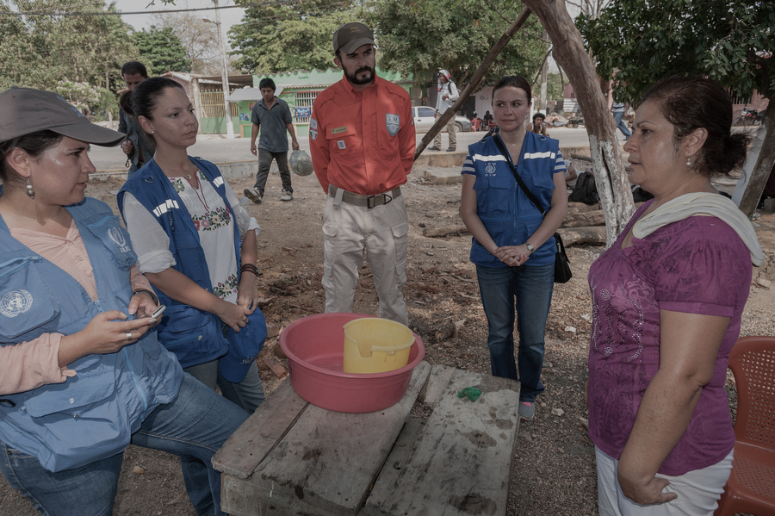
ADRESSING CREDIBILITY CONCERNS
36
Notes:
Addressing Credibility Concerns
When conducting RSD interviews, there may be issues raised that cause credibility concerns. Let’s explore this topic further now.
----
Time: 30 minutes for the Addressing Credibility Concerns section, which includes time for the Facilitator to elaborate upon slide text and hold a Q&A, particularly on the topics of concealment, credibility and corroborating evidence, keeping in mind these topics are further addressed in the module on Refugee Status Determination.
Facilitation Note: This slide is optional and should only be used for RSD audiences who are not taking the full module on RSD. If using this slide, un-hide it by moving your arrow to the left navigation pane, right-clicking on this slide and choosing “Hide Slide.” The slide color in the navigation pane will shift from opaque to transparent and the slide will appear when the presentation is in Slide Show mode. If you later wish to hide it again, you can do so by moving your arrow to the left navigation pane, right-clicking on this slide and choosing “Hide Slide.” Do not delete this slide, as the slide numbers in the remainder of the presentation will then be incorrect in reference to the Facilitation Guide Timing Charts.
[Image description: several UNHCR staff members talk with a Central American migrant beside the railroad tracks in Medias Aguas.]

Slide 37
Assessing credibility in SOGIESC claims
keep in mind that:
  It is not our job to decide if the applicant has a diverse SOGIESC.
  Applicants do not have to prove their sexual orientation, gender identity, gender expression or their sex characteristics.
  Beware of the tendency to judge applicants’ claims according to your own expectations of how applicants with diverse SOGIESC should look, behave, or feel.
WORKBOOK - PAGE 44
37
Notes:
Addressing Credibility Concerns (continued)
First, keep in mind that:
It is not our job to decide if the applicant has a diverse SOGIESC.
Applicants do not have to prove their sexual orientation, gender identity, gender expression or their sex characteristics.
Beware of the tendency to judge applicants’ claims according to your own expectations of how applicants with diverse SOGIESC should look, behave, or feel.
Note that in your Workbook on the page displayed on the screen is a list of ways in which you can create safer interview spaces within the RSD context. Keeping these in mind will help ensure you establish a supportive environment.
----
Time: 30 minutes for the Addressing Credibility Concerns section.
Facilitation Note: This slide is optional and should only be used for RSD audiences who are not taking the full module on RSD. If using this slide, un-hide it by moving your arrow to the left navigation pane, right-clicking on this slide and choosing “Hide Slide.” The slide color in the navigation pane will shift from opaque to transparent and the slide will appear when the presentation is in Slide Show mode. If you later wish to hide it again, you can do so by moving your arrow to the left navigation pane, right-clicking on this slide and choosing “Hide Slide.” Do not delete this slide, as the slide numbers in the remainder of the presentation will then be incorrect in reference to the Facilitation Guide Timing Charts.

Slide 38
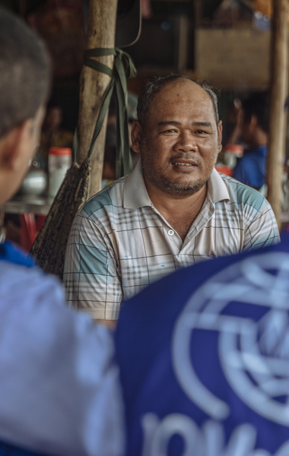

SUFFICIENT DETAIL
Gather sufficient detail to clarify inconsistencies.
MORE TIME AND ATTENTION
Recall that LGBTIQ+ claims may take more time and attention because they will have to be drawn out more delicately.
CONCEPTS AND EXPERIENCES
Explore what the concepts and experiences the person has shared mean to them.
ADRESSING
CREDIBILITY CONCERNS
LGBTIQ+ CASES VARY
Consider each claim on an individual basis. The experiences of LGBTIQ+ people vary extremely widely.
38
Notes:
Addressing Credibility Concerns (continued)
One should assess credibility concerns in an interview with a person with diverse SOGIESC as one would do in any interview. You should:
Gather sufficient detail to clarify inconsistencies.
Explore what the concepts and experiences the person has shared mean to them.
Recall that LGBTIQ+ claims may take more time and attention because they will have to be drawn out more delicately.
Consider each claim on an individual basis. The experiences of LGBTIQ+ people vary extremely widely.
----
Time: 30 minutes for the Addressing Credibility Concerns section.
Facilitation Note: This slide is optional and should only be used for RSD audiences who are not taking the full module on RSD. If using this slide, un-hide it by moving your arrow to the left navigation pane, right-clicking on this slide and choosing “Hide Slide.” The slide color in the navigation pane will shift from opaque to transparent and the slide will appear when the presentation is in Slide Show mode. If you later wish to hide it again, you can do so by moving your arrow to the left navigation pane, right-clicking on this slide and choosing “Hide Slide.” Do not delete this slide, as the slide numbers in the remainder of the presentation will then be incorrect in reference to the Facilitation Guide Timing Charts.
[Image description: a many facing two persons sitting side by side; the person on the right is wearing a blue IOM vest.]

Slide 39
REASONABLE EXPLANATIONS
There may be reasonable explanations as to
why the individual didn’t disclose their SOGIESC earlier – for example, traumatic experiences, fear of the consequences, discomfort in the interview or that they have never told anyone.
MAY TAKE MANY MEETINGS BEFORE DISCLOSURE
It may take someone many meetings to feel comfortable sharing the reason for flight. “Hiding” coping mechanisms include isolation, adopting “masculine” or “feminine” mannerisms or living closeted lives, which can reinforce low self-esteem.
ADRESSING
CREDIBILITY CONCERNS
FOLLOW-UP QUESTIONS
Follow-up questions should be asked to clarify uncertainties and credibility concerns must be put to the applicant to give them an opportunity to explain.
39
Notes:
Addressing Credibility Concerns (continued)
Also remember that:
There may be reasonable explanations as to why the individual didn’t disclose information about their SSOGI earlier – for example, traumatic experiences, fear of the consequences, discomfort in the interview or that they have never told anyone.
It may take someone many meetings to feel comfortable sharing the reason for flight. “Hiding” coping mechanisms include isolation, adopting “masculine” or “feminine” mannerisms or living closeted lives, which can reinforce low self-esteem.
Follow-up questions should be asked to clarify uncertainties and credibility concerns must be put to the applicant to give them an opportunity to explain.
----
Time: 30 minutes for the Addressing Credibility Concerns section.
Facilitation Note: This slide is optional and should only be used for RSD audiences who are not taking the full module on RSD. If using this slide, un-hide it by moving your arrow to the left navigation pane, right-clicking on this slide and choosing “Hide Slide.” The slide color in the navigation pane will shift from opaque to transparent and the slide will appear when the presentation is in Slide Show mode. If you later wish to hide it again, you can do so by moving your arrow to the left navigation pane, right-clicking on this slide and choosing “Hide Slide.” Do not delete this slide, as the slide numbers in the remainder of the presentation will then be incorrect in reference to the Facilitation Guide Timing Charts.
[Image description: a many facing two persons sitting side by side; the person on the right is wearing a blue IOM vest.]

Slide 40
NOT LIVING OPENLY
Many LGBTIQ+ people have had to keep aspects of their lives secret and may have not lived openly or had intimate relationships before.
SUPRESSING SOGIESC
Many people have suppressed their diverse SOGIESC to avoid persecution.
SUPRESSION AND CREDIBILITY
Having suppressed in the past, or possessing an ability to do so in the future, is not a reason to question their credibility.
ADRESSING
CREDIBILITY CONCERNS
CONCEALMENT CAN CAUSE HARM
Remember the individual cannot be expected to change their sexual orientation or gender identity to avoid persecution, as it is fundamental to their human dignity. Concealment can cause
psychological harm.
40
Notes:
Addressing Credibility Concerns (continued)
There are several issues to note related to concealment:
Many LGBTIQ+ people have had to keep aspects of their lives secret and may have not lived openly or had intimate relationships before.
Many people have suppressed their SOGIESC to avoid persecution.
Having suppressed in the past or possessing an ability to do so in the future, is not a reason to question their credibility.
Remember the individual cannot be expected to change their sexual orientation or gender identity to avoid persecution, as it is fundamental to their human dignity. Concealment can cause psychological harm.
----
Time: 30 minutes for the Addressing Credibility Concerns section.
Facilitation Note: This slide is optional and should only be used for RSD audiences who are not taking the full module on RSD. If using this slide, un-hide it by moving your arrow to the left navigation pane, right-clicking on this slide and choosing “Hide Slide.” The slide color in the navigation pane will shift from opaque to transparent and the slide will appear when the presentation is in Slide Show mode. If you later wish to hide it again, you can do so by moving your arrow to the left navigation pane, right-clicking on this slide and choosing “Hide Slide.” Do not delete this slide, as the slide numbers in the remainder of the presentation will then be incorrect in reference to the Facilitation Guide Timing Charts.
[Image description: a many facing two persons sitting side by side; the person on the right is wearing a blue IOM vest.]

Slide 41
SHARED BURDEN
In general, there is a shared burden on the individual and the interviewer.
TRUTHFUL ACCOUNT
The applicant discharges their burden by providing a full and truthful account of their experience. This may be more difficult in LGBTIQ+ cases due to the personal nature of claims.
CORROBORATING DOCUMENTS
ARE LESS LIKELY TO OBTAIN
Because of the personal nature of LGBTIQ+ claims, individuals are much less likely to have corroborating documents.
ADRESSING
CREDIBILITY CONCERNS
MAY NEED MORE ASSISTANCE FROM OFFICER
This may result in a greater burden on the officer
to assist the individual in articulating their claim. Questions related to the PEACE Model and thematic areas of daily life should be explored.
41
Notes:
Addressing Credibility Concerns (continued)
In relation to corroborating evidence:
In general, there is a shared burden on the individual and the interviewer.
The applicant discharges their burden by providing a full and truthful account of their experience. This may be more difficult in LGBTIQ+ cases due to the personal nature of claims.
Because of the personal nature of LGBTIQ+ claims, individuals are much less likely to have corroborating documents.
This may result in a greater burden on the officer to assist the individual in articulating their claim. Questions related to PEACE model and thematic areas of daily life should be explored.
----
Time: 30 minutes for the Addressing Credibility Concerns section.
Facilitation Note: This slide is optional and should only be used for RSD audiences who are not taking the full module on RSD. If using this slide, un-hide it by moving your arrow to the left navigation pane, right-clicking on this slide and choosing “Hide Slide.” The slide color in the navigation pane will shift from opaque to transparent and the slide will appear when the presentation is in Slide Show mode. If you later wish to hide it again, you can do so by moving your arrow to the left navigation pane, right-clicking on this slide and choosing “Hide Slide.” Do not delete this slide, as the slide numbers in the remainder of the presentation will then be incorrect in reference to the Facilitation Guide Timing Charts.
[Image description: a many facing two persons sitting side by side; the person on the right is wearing a blue IOM vest.]

Slide 42

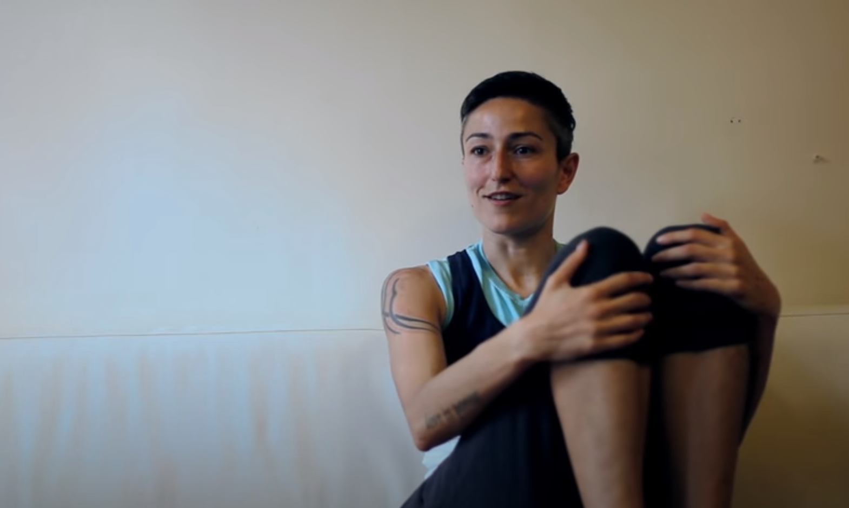
Video
Majda’s Story
Immigration Equality (5:44)
42
Notes:
Video
We’ll wrap up Module 8 by learning more about the lived experiences of people with diverse SOGIESC. This video is about Majda, who fled Serbia due to threats and discrimination, and was granted asylum in the US.
----
Video Link: https://www.youtube.com/watch?v=jdg0CRjKaPI
Time: 6 minutes.
Alternate Videos:
The following are alternate videos that may be used for trainings. Note that this list will be updated as new videos become available. See the video slide prior to the Key Learning Points slide in each module for additional videos about the lived experiences of people with diverse SOGIESC.
Bringing out the voices of LGBTI youth in Kinshasa, DRC (Children’s Radio Foundation, French with English subtitles, 3:12) https://www.youtube.com/watch?v=UrK_OiSciZo
Sogi’s Story: LGBTI in Africa (Australian Human Rights Commission, English, 2:40) https://www.youtube.com/watch?v=mZJ_X9ysHSo
A Look at the LGBT+ Rights Ghana Group (LGBT Rights Ghana, English, 3:50) https://www.youtube.com/watch?v=XCb2nkjJEIk

Slide 43
Key Learning Points
Safe, accessible and comfortable spaces
Acknowledge your own biases
Explain the process to build rapport
Support a full account using the PEACE model
Close and evaluate your interview properly
01
02
03
04
05
43
Notes:
Key Learning Points
Finally, here are several key learning points to keep in mind:
Ensure the individuals you are interviewing are entering safe, accessible and comfortable spaces.
Mentally prepare for interviews by acknowledge your own biases and stereotypes.
Engage and explain the interview process to the interviewee in order to build rapport.
Support a full account using the PEACE model by focusing on TED questions and thematic areas.
Close and evaluate your interview properly in order to ensure you have gathered reliable and necessary information.
----
Time: 1 minute.

Slide 44

9
INTERVIEW
techniques
44
Notes:
Module 9: Interview Techniques
Module 9 is Interview Techniques.
----
Module Time: 2 hours 20 minutes for standard variation; 3 hours 35 minutes for RSD variation.

Slide 45
MODULE 9
OBJECTIVES
01
02
03
supportive practice interview
USEFUL
THEMATIC AREAS
RESPECTFUL AND APPROPRIATE QUESTIONS
Describe how you conducted a safe and supportive practice interview
  Highlight key thematic areas that you found useful to explore during the course of your practice interview
  Explain the ways in which
  you asked respectful and appropriate questions during your practice interview
1
1
45
Notes:
Objectives
Module 9 is a practical module comprised of several interviewing exercises.
By the end of this module, you should be able to:
Describe how you conducted a safe and supportive practice interview
Highlight key thematic areas that you found useful to explore during the course of your practice interview
Explain the ways in which you asked respectful and appropriate questions during your practice interview
----
Time: 1 minute.

Slide 46
GROUP ROLE-PLAY
Exercise
46
Notes:
Exercise: Group Role-Play
In this module, we'll do three exercises that will let you practice and discuss interview techniques. The first is a Group Role-Play Exercise.
Before the training, I asked two [four if doing two role-plays in the RSD variation] of our learners to participate in this exercise. One will play the interviewee and one the interviewer. They have been provided with some basic information about their role. The learner playing the interviewee has a detailed narrative. The interviewer has some basic background information.
Note the interviewer has not seen the narrative and the interviewee has not seen the interviewer notes. Let’s have them come to the front and do the role-play. We’ll have 20 minutes [50 minutes / 25 minutes] to have them do the role-play, and then 20 minutes [50 minutes / 25 minutes] to discuss.
Before we begin, I’d like to highlight several overarching goals.
This role-play is intended to demonstrate the types of questions that are appropriate to ask using the PEACE model and highlight any questions that are inappropriate or not relevant to the interview.
It is also intended to demonstrate the thematic areas that can be explored during the course of an interview and to demonstrate positive lines of questioning that can be employed.
Finally, the role-play will demonstrate how sensitive topics should be approached and how sensitive information can be drawn out over the course of an interview. Let’s begin.
After the role-play is completed–
Thank you to our participants. Let’s now discuss the role-play. Who would like to begin? Let’s talk about the questions that worked, questions that didn’t work, thematic topics that were useful and any other points you want to highlight.
Suggested questions to engage participants in discussion:
How did you feel about the comfort level in the room?
What did you feel about the body language of the interviewer and interviewee?
What did the interviewer do to encourage Fadi/Grace/Veronica to talk?
What other ways can you show the interviewee you are listening?
How can you be self-aware about your own personal actions during an interview?
What would you have done differently, had you been the interviewer?
Did the interviewee feel certain that the space was confidential?
What can you offer the individual in order to shift the dynamics (e.g., a break or a glass of water)?
How can you make the atmosphere more conversational?
What were the indicators during the course of the interview that you would have flagged to explore in more detail (e.g., responses, body language or silence)? How would you have explored them further?
----
Facilitation Note: See the Facilitation Guide page 154 for more information about this exercise and alternative facilitation ideas.
Time: 45 minutes for standard variation (5 minutes for description; 20 minutes for one role-play; 20 minutes for discussion) and 1 hours 45 minutes for RSD variation (5 minutes for description; 50 minutes for one role-play; 50 minutes for discussion OR 5 minutes for description; 25 minutes for each for two role-plays; 25 minutes for each for two discussions, if using two role-plays.)

Slide 47
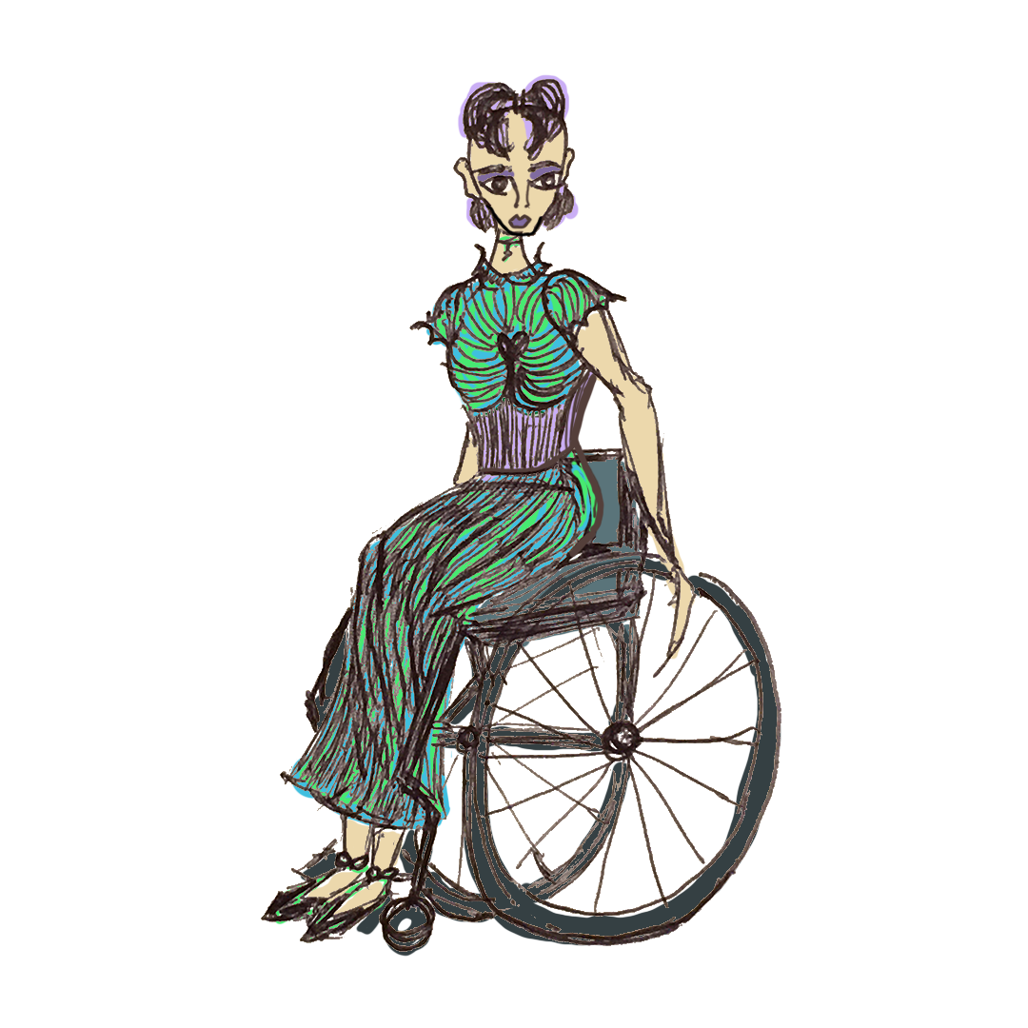
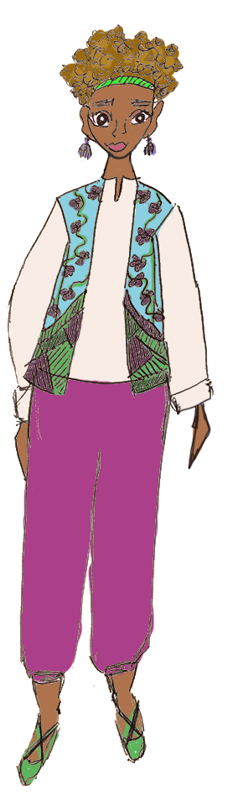
PAIRED ROLE-PLAY
Exercise
WORKBOOK - PAGE 47-50
47
Notes:
Exercise: Paired Role-Play
Now we will practice interview techniques by doing another role-play exercise.
We will now do an exercise that allows you to practice asking interview questions. Please find a partner. We will do two separate role-plays. You will each get an opportunity to play the interviewer and you will each get an opportunity to play the interviewee.
We will start with role-play number one. Decide who will play the interviewee and who will play the interviewer during role-play number one. Did everyone decide? (Confirm everyone has chosen their role.) If you are playing the interviewee, you will read the narrative sheet on page 47. If you are playing the interviewer, you will read the interviewer sheet on page 48. Take five minutes to read your sheet.
After five minutes– Your reading time is up. Please begin your session. I will alert you when your time is up.
After fifteen [twenty] minutes– Your time for the first interview is up. We will now move to number two. If you played the interviewer in role-play number one, you should now play the interviewee. If you played the interviewee in role-play number one, you should now play the interviewer. If you are playing the interviewee, you will read the narrative sheet on page 49. If you are playing the interviewer, you will read the interviewer sheet on page 50. Take five minutes to read your sheet. After five minutes – Please begin your session.
After the role-plays are completed–
Now that you have completed your role-plays, let’s discuss as a group.
How did it feel to play the interviewer? How did it feel to be the interviewee?
As the interviewee, was it difficult offering information?
As the interviewee, which questions did you respond best to? Which did you not respond well to?
As the interviewer, how did it feel to explore this topic? What questions did they respond best to?
----
Facilitation Note: See the Facilitation Guide page 162 for more information about this exercise and alternative facilitation ideas.
Time: 60 minutes for standard variation (5 minutes for description; 20 minutes for role-play one; 20 minutes for role-play two; 15 minutes for group discussion) and 1 hour 15 minutes for RSD variation (5 minutes for description; 25 minutes for role-play one; 25 minutes for role-play two; 20 minutes for group discussion.)

Slide 48
Situational
Awareness
Exercise
WORKBOOK - PAGE 51
48
Notes:
Exercise
We'll now do an exercise that will allow you to consider common situations that occur in relation to interviews with people with diverse SOGIESC.
This brief exercise will allow us to consider a potential scenario you may encounter when interviewing people with diverse SOGIESC and decide how you would address the situation.
For this exercise, we'll split into four groups. Please raise your hand if you work in RSD (split them into two groups). You are groups one and two and will work on scenario one. Everyone else, please split into two groups. You are groups three and four and will work on scenario two. I've placed the numbers one through four on the tables. Please go to your number. [Note: if not one is working in RSD, split the room into four groups and have each group take scenario 2.]
You have fifteen minutes to discuss. After fifteen minutes, you will join the other team that is working on the same scenario and discuss as a group.
After fifteen minutes–
Please join together with another group [for mixed audiences: working on the same scenario] and discuss how you would address the situation.
While the group(s) are discussing, the Facilitator should listen and moderate the discussion if needed. The Facilitator may also wish to have the learners discuss the scenarios in plenary.
----
Facilitation Note: See the Facilitation Guide page 167 for more information about this exercise.
Time: 30 minutes. 15 minutes for description and team activity; 15 minutes for small group discussions.

Slide 49
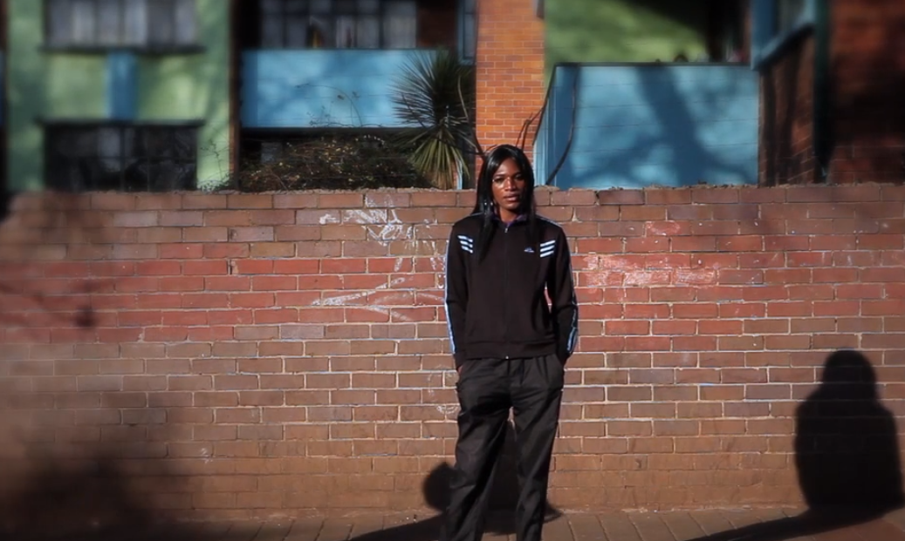
Video
As I Am: Understanding the Sexual
Orientation and Gender Identity of Refugees
ORAM (2:25)
49
Notes:
Video
We’ll wrap up this module by learning about the lived experiences of people with diverse SOGIESC. This video is about a refugee from Zimbabwe named Tiny.
----
Video Link: Play from 7:42 – 10:07 (2:25): https://vimeo.com/58754985
Time: 3 minutes.
Alternate Videos:
The following are alternate videos that may be used for trainings. Note that this list will be updated as new videos become available. See the video slide prior to the Key Learning Points slide in each module for additional videos about the lived experiences of people with diverse SOGIESC.
Bringing out the voices of LGBTI youth in Kinshasa, DRC (Children’s Radio Foundation, French with English subtitles, 3:12) https://www.youtube.com/watch?v=UrK_OiSciZo
Sogi’s Story: LGBTI in Africa (Australian Human Rights Commission, English, 2:40) https://www.youtube.com/watch?v=mZJ_X9ysHSo
A Look at the LGBT+ Rights Ghana Group (LGBT Rights Ghana, English, 3:50) https://www.youtube.com/watch?v=XCb2nkjJEIk

Slide 50
Key Learning Points
Create a supportive and welcoming space
Explore thematic areas of daily life using the PEACE model
Gathering information from people with diverse SOGIESC may be more difficult
01
02
03
50
Notes:
Key Learning Points
Finally, here are several key learning points to keep in mind:
Focus on creating a supportive and welcoming space. Approach the individual in a non-judgmental manner.
Focus on discussing issues related to thematic areas of daily life in a respectful way using the PEACE model.
Recall that gathering information from people with diverse SOGIESC may be more difficult due to the intimate and personal nature of the information.
----
Time: 1 minute.

Slide 51
Key Learning Points-RSD
“Proving” SOGIESC may violate human rights
Focus on identity / perception
of the persecutor(s)
Testimony may the primary evidence used to determine credibility
Difficulty in testimony in LGBTIQ+ claims
Discuss with the individual what happens to people like them in their country
01
02
03
04
05
51
Notes:
Key Learning Points
And here are several other key learning points to keep in mind in relation to RSD:
Remember that some efforts employed to “prove” SOGIESC may violate the applicant's human rights. Focus on eliciting testimony in a respectful way and observing whether it is detailed and consistent.
Focus on the identity of the individual and the perception of the persecutor(s).
Remember that COI may be lacking and testimony may the primary evidence used to determine credibility.
Recall that testimony can be more difficult to draw out in LGBTIQ+ claims due to the intimate and personal nature of the information.
As in other interviews, examine reports or discuss with the individual what happens to people like them in their country.
----
Time: 1 minute.
Facilitation Note: This slide is optional and should only be used for RSD audiences who are not taking the full module on RSD. If using this slide, un-hide it by moving your arrow to the left navigation pane, right-clicking on this slide and choosing “Hide Slide.” The slide color in the navigation pane will shift from opaque to transparent and the slide will appear when the presentation is in Slide Show mode. If you later wish to hide it again, you can do so by moving your arrow to the left navigation pane, right-clicking on this slide and choosing “Hide Slide.” Do not delete this slide, as the slide numbers in the remainder of the presentation will then be incorrect in reference to the Facilitation Guide Timing Charts.

Slide 52

WRAP UP
52
Notes:
Wrap-Up
We’ve now reached the end of conducting interviews. Does anyone have any questions?
----
Facilitation Note: If you gathered questions at the beginning of the training session, this is a good time to review them and determine which questions have been answered by the module content, which questions may be answered in upcoming modules, and which questions may need further attention at this time. See the “Frequently Asked Questions” and “Answering Difficult or Unexpected Questions” sections of the Facilitation Guide for more guidance.

Slide 53

Bureau of Population, Refugees and Migration (PRM) of the United States Department of State
The development of this training package was made possible through the generous support of the American people through the Bureau of Population, Refugees and Migration (PRM) of the United States Department of State as part of the project, “Sensitization and Adjudication Training on Refugees Fleeing Persecution Based on Sexual Orientation and Gender Identity.” The content does not necessarily reflect the views of PRM or the United States.
Notes:
The development of this training package was made possible through the generous support of the American people through the Bureau of Population, Refugees and Migration (PRM) of the United States Department of State as part of the project, “Sensitization and Adjudication Training on Refugees Fleeing Persecution Based on Sexual Orientation and Gender Identity.” The content does not necessarily reflect the views of PRM or the United States.

Slide 54

CONTACT US
For more information about this training package, please contact:
IOM: Global LGBTIQ+ / SOGIESC Focal Point LGBTIFocalPoint@iom.int
UNHCR: Community-Based Protection, Division of International Protection hqts00@unhcr.org
Please also visit the Social Inclusion in IOM Programming website at https://www.iom.int/social-inclusion-iom-programming for the most updated resources and training materials.

