Slide 1
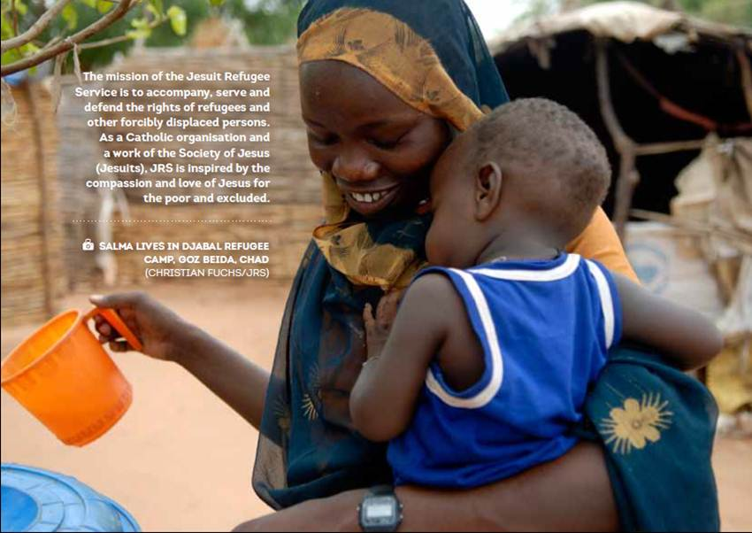

Strengthening child protection systems in emergencies.
JRS Education

Slide 2
JRS Education Paper
For forcibly displaced persons education has a critical role in sustaining and saving their lives throughout a crisis…
and has a preventive dimension, a future dividend, which stems from its power to support the development of reasoning, decision-making, self-esteem, and self-awareness…

Slide 3
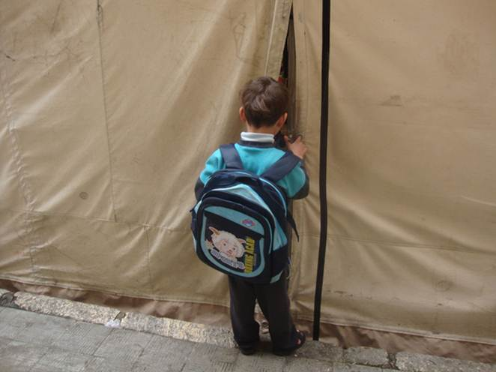
JRS Education Paper
Education assists forcibly displaced persons to develop a daily routine which can bring with it a sense of normalcy and stability, and it affords an avenue to meaningfully use the time of exile…

Slide 4
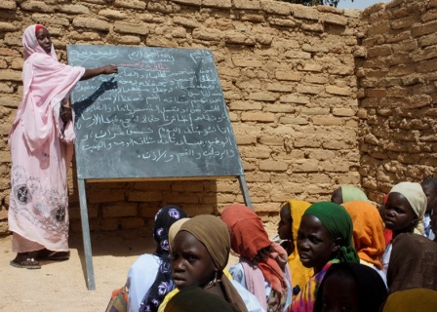
JRS Education Paper
It also provides a mechanism whereby the safety of children can be monitored and fostered, and it offers a means to build a better future for the individual and for his/her participation in whichever community a durable solution will eventually lead him/her...

Slide 5
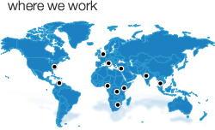
JRS Education Worldwide
10 Regions, 57 countries. More than 222,000 children, young people and adults benefited by JRS Education programs (formal and non formal).

Slide 6
How education and schools actually work to protect?
Physical safety: schools give kids a safe place to be when their parents are occupied trying to work, get firewood etc. Syria, DRC.
Teachers can monitor children for signs of neglect and abuse and arrange interventions. They can teach life skills that address some common threats to health and safety. DRC
Psychological well-being: schools can aid in recovery from past trauma and give hope for the future. Syria

Slide 7
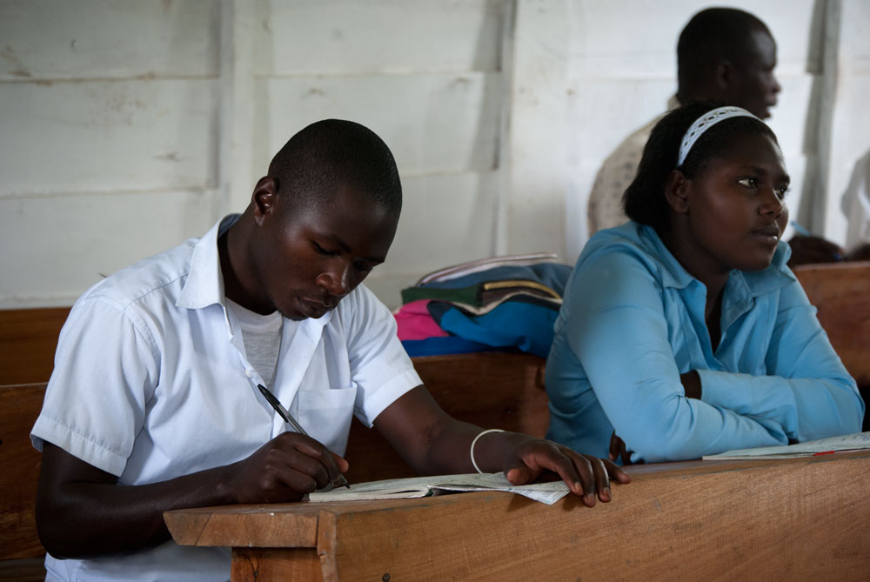
DRC Education

Slide 8
How education and schools actually work to protect?
Schools can help protect girls from abuse such as through early marriage and give them alternatives, reducing dependence. DRC
Schools can give children some protection from recruitment as child soldiers, and provide a preventative to anti-social activities that arise from idleness. DRC - Rwanda
Adult education can restore dignity and hope, and give people potential access to livelihoods not otherwise available. DRC

Slide 9
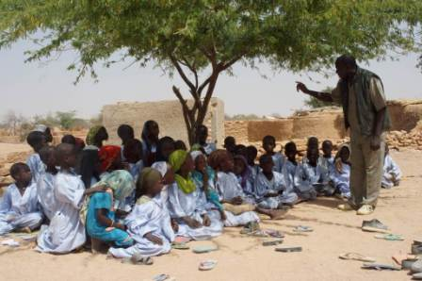

Slide 10
How education and schools actually work to protect?
Literacy and numeracy prevent people from exploitation by the unscrupulous. DRC
Special education is especially important to people with handicaps. JRS provides training in sign language for the deaf and similar skills for those with mental handicaps. These programs both provide a sheltered environment for the disabled, who are too often subject to abuse, provide a sense of self-worth, and emphasize their dignity and capacities to the whole community. Syria

Slide 11
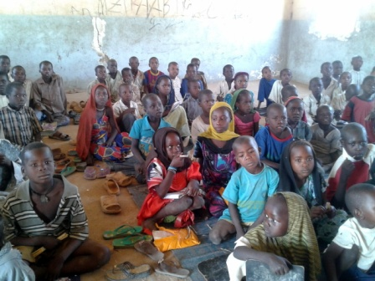

Slide 12
How education and schools actually work to protect?
When education programs include both refugee and local children, with parent’s associations involving both communities, schools can be a powerful influence in countering xenophobia and the protection challenges that arise from community tensions. DRC
Education is the only thing that we can give a refugee that no one can ever take away. This knowledge and self-awareness affords a dignity which in itself is a form of lifelong protection.

Slide 13
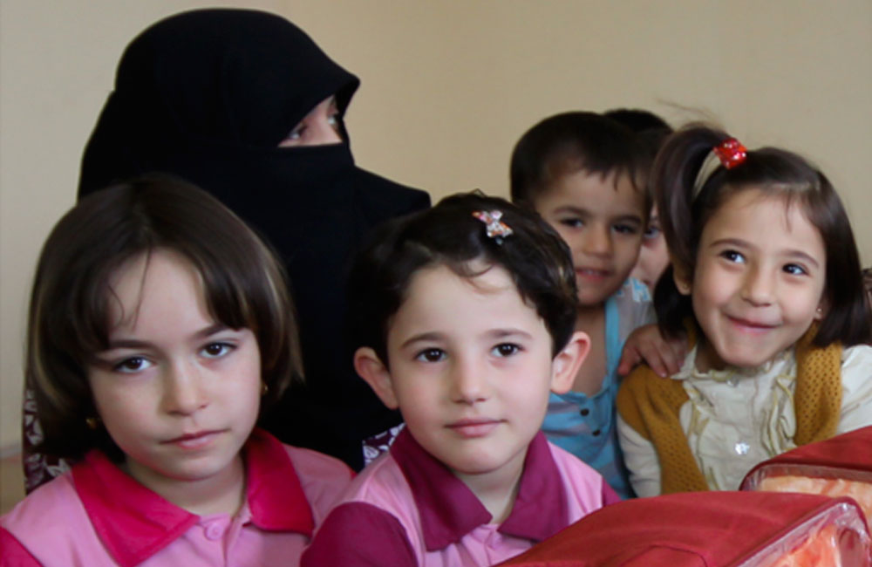

Slide 14
Recommendations
Giving priority to Education in Emergencies = Protection of children. Education still receives the smallest share of humanitarian funding (2%, in 2010).
Education is not just Primary school.
“Education activities are an important method of passing on not only academic knowledge, but also practical knowledge, awareness and life skills that can help children care for and protect themselves and their peers”*
*Minimum standards for child protection in humanitarian action, 2012

