Slide 1
HPC Guidance Module 2: What is a Protection Severity Scale and how do we produce it? Speaker: Emma Wynne

Slide 2
This module covers:
Critical and most common Q&A on Severity Scales
Step by Step Guidance
Severity Scale tips and examples
Overall objective of this module:
Sectoral Severity Scale shouldn’t represent more than 10% of the overall dedicated time to the HNO for coordinators and IMOs

Slide 3
What is a Protection Severity Ranking?
Q&A
Protection
Severity Scales
Protection actors use the severity scale as a measuring tool to score and identify the geographical areas most affected by the crisis. The severity ranking used by the Protection Clusters is the same as the JIAF Inter-sectoral severity scale (levels 1 to 5).

Slide 4
What is the overarching Protection Severity Scale?
Q&A
Protection
Severity Scales
The overarching Severity Scale is the overall severity score for a given area for the whole Protection Cluster - including AoRs, based on indicators from both Protection and AoRs. This overarching Protection Severity score is then used in the Protection Chapter of the HNO.

Slide 5
What is the AoR specific Protection Severity Scale?
Q&A
Protection
Severity Scales
AoR specific Protection Severity Scale is the Severity Scale score for a specific AoR based solely on their own indicators. AoRs can make use of their selected indicators for the overarching Severity or use additional or different ones.
It includes AoR specific indicators and is the scale reflected in the AoR chapters of the HNO. Each of the active AoRs in the country of operations should have a specific scale.

Slide 6
Where can I find the Protection indicators for producing the Protection Severity Scales? (1)
Q&A
Protection
Severity Scales
You can find the consolidated lists of Protection and AoRs indicators in the JIAF 1.1 guidance:
Indicators Reference Table: This is the list of household level indicators together with the proposed severity thresholds. The protection indicators are categorized by Protection, Child Protection, Gender-Based Violence, House, Land & Property, and Mine Action.

Slide 7
Where can I find the Protection indicators for producing the Protection Severity Scales? (1)
Q&A
Protection
Severity Scales
You can find the Indicators Reference Table in JIAF 1.1 guidance (page 6):

Slide 8
Where can I find the Protection indicators for producing the Protection Severity Scales? (2)
Q&A
Protection
Severity Scales
JIAF Non-Humanitarian Conditions Pillars indicators: This list compiles a list of area-based indicators for the context, shocks and impact pillars of the JIAF and they are categorized by Protection, Areas of Responsibility, other sectors (i.e. Food Security, Health etc) and Cross-sectoral.

Slide 9
Where can I find the Protection indicators for producing the Protection Severity Scales? (2)
Q&A
Protection
Severity Scales
N.B.: The Non-HC conditions pillars indicators can also be used for the Protection Severity Scale. If you want to use them for your severity scale, you can follow the same logic of the JIAF Protection Critical indicator for Severity 5 (50% higher of the total). You can also consult with the global team for advice.

Slide 10
Where can I find the Protection indicators for producing the Protection Severity Scales? (2)
Q&A
Protection
Severity Scales
You can find the JIAF Non-Humanitarian Conditions Pillars in Annex 3 of the JIAF 1.1 guidance (page 49):

Slide 11
Where can I find the Protection indicators for producing the Protection Severity Scales? (3)
Q&A
Protection
Severity Scales
List of JIAF indicators aligned with the PAF- To make the selection of indicators and the linkages between the JIAF and the PAF easier for country operations; we have aligned both lists of JIAF indicators with the PAF pillars and sub-pillars. The list of JIAF and PAF aligned indicators is an annex of this module.

Slide 12
Can you use the identification of affected population groups as part of your Protection Severity Scale?
Q&A
Protection
Severity Scales
Yes, you can use them for your Scale. If you want to use population groups estimates data for your severity scale, you can follow the same logic of the JIAF Protection Critical indicator for Severity 5 (50% higher of the total) You can also consult with the global team for advice.

Slide 13
Where can I find the categories of affected population groups? (1)
Q&A
Protection
Severity Scales
For the identification of affected population, the Protection Cluster uses the categories defined in the 2016 IASC Humanitarian profile Support Guidance. You can also find the categories of affected population groups included in: JIAF 1.1 Annex 3 indicators and in the list of JIAF and PAF aligned indicators.

Slide 14
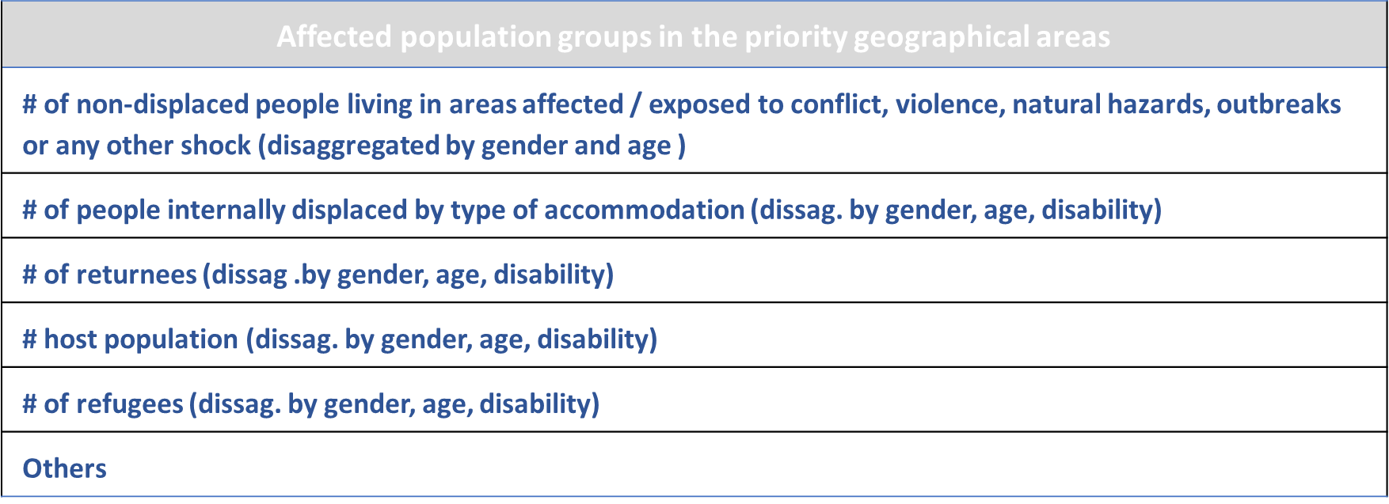
Where can I find the categories of affected population groups? (2)
Q&A
Protection
Severity Scales
Examples

Slide 15
Severity Scales
Step by Step
Step 1: Identify and select overarching and specific indicators:
The Protection Cluster and each of the AoRs will select the indicators from the consolidated lists for the Protection overarching and AoR specific Severity Scales. The selected indicators can be:
The same ones identified for the JIAF inter-sectoral analysis.
Additional ones to further refine your sectoral analysis as needed, including indicators from other sectors which are relevant for protection analysis in your country.
NB: The lists of indicators are suggested examples previously used in some country operations – Feel free to adapt them to what is relevant in context, available data etc.

Slide 16
Severity Scales
Step by Step
Step 2: Data consolidation and severity scoring
Roles in this step:
The role of the Cluster/AoR Coordinators is to select the set of indicators and confirm or agree on the thresholds.
The role of the Information Management Officers is to consolidate the data and apply a scoring to each of the geographical units of analysis.

Slide 17
Severity Scales
Step by Step
Step 2: Data consolidation and severity scoring
Scoring:
For the severity scoring IMOs can produce an average for all the indicator scores and this will be the scoring for the geographical unit of analysis.
Example: If from 6 indicators for a unit of analysis, 5 of them score level 4 in the scale, scoring for the unit will be Level 4 (Critical)
If you have some indicators that you can only apply to some of the units of analysis, you can still use it giving it a specific weight to increase/decrease the scoring.
Example: There is data on the # of schools and health facilities attacked for 6 sub-districts you can weigh this indicator and decide that in these 6 sub-districts the scoring should be directly level 5.

Slide 18
Next steps
Once you have finalized the data consolidation and scoring, next steps will be:
Expert workshops for joint analysis and interpretation (HPC Guidance module 4)
People in Need estimates (HPC Guidance module 3)
The following section of this module provides some tips and examples for the Severity Scales.

Slide 19
Tips
It is feasible to use context-based and protection inter-sectoral indicators for the overarching and AoR Specific severity scales. First action should be always to jointly decide where and how each indicator will be used.
Focus of the PC and AoR analysis should always be on the most affected areas and with the most affected population groups.
The use of other sectors’ indicators in the overarching and AoR specific scale is recommended, it will reinforce the centrality of protection of our analysis.

Slide 20
Tips
AoR specific Severity Scales can have either the same or lower scoring but not higher than the overarching Severity Scale scoring:
Example:

Slide 21
Tips
If you find a situation where the AoR specific scoring is higher, you will need to revisit the unit of analysis where this is happening and arrive at a consensus during the joint analysis workshops.
Example:

Slide 22
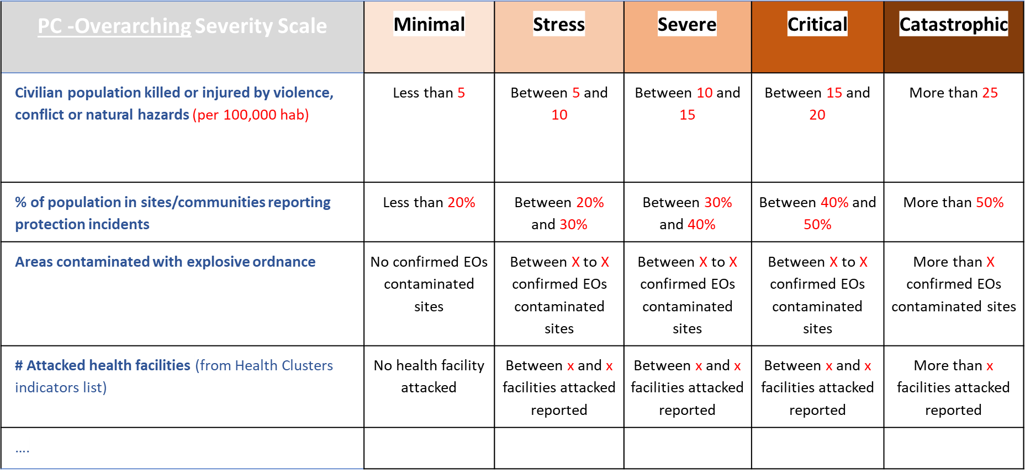
Examples
Protection overarching Severity Scale

Slide 23
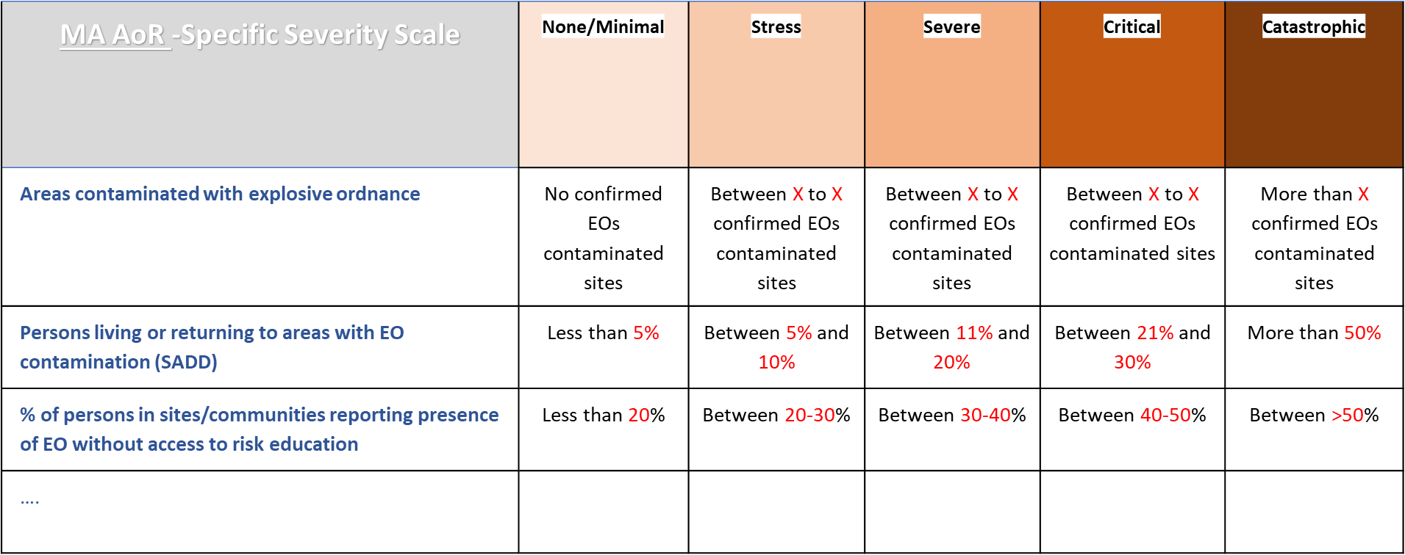
Examples
AoR specific Severity Scale

Slide 24
This is the end of HPC Guidance module 2: What is a Protection Severity Scale and how do we produce it? We invite you now to go through the following modules. Thanks for listening.

