Slide 1
Summary of Protection/Education Cluster Localisation Consultations
March 2018

Slide 2
Localisation in Coordination – Conceptual Framework
Governance & Decision Making
Influence and Participation
Partnerships
Funding
Institutional Capacity

Slide 3
Clusters – Self Assessment
Notes:
The above is a summary of the Clusters’ self assessment of their current status, in terms of localisation. This is a subjective assessment and based on feedback from cluster members in Nairobi and Mogadishu – and so should be read as a general assessment, rather than an overly scientific analysis. It does indicate, however, that in general, cluster members feel that the overall response needs to shift towards greater involvement, leadership, power and capacity towards local actors.
This can be a benchmark against which coordinators can continue to assess the degree to which the response strategy reflects the right configuration, at any given time.

Slide 4
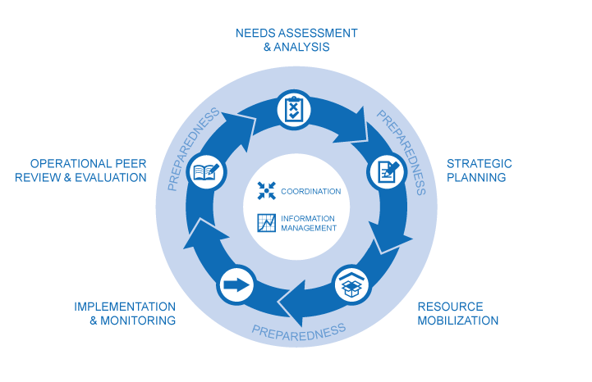
Supporting local agencies for Lead/Co-Lead positions or putting leadership transition strategies in place
Including local actors in Strategic Advisory Groups (SAG) and HCT
Modelling and monitoring a culture of principled partnerships in Clusters
Constantly reviewing service delivery and funding arrangements (such as localisation dashboards) with the SAG and AoR members and using recommendations to inform strategy and response.
Ensuring the HNO incorporates the views and data from local actors. This could also include academia, diaspora, private sector, in addition to civil society
Ensuring HNO includes both needs of affected populations and the institutional capacity needs of local actors
Prioritising service delivery by local actors HRP and cluster strategies, where possible
Developing a sectoral institutional capacity building strategy as part of the HRP
Disaggregate cluster indicators by local/international
Promoting partnerships that draw on coaching and mentoring approaches, rather than sub-granting
Including explicit references to institutional capacity building outputs (e.g reduced risk ratings) in project sheets
Ensure that Cluster membership accurately reflects the diversity of the humanitarian community – including diaspora, private sector, academia etc
Translating key communications into local languages
Facilitate onsite coaching and mentoring support from international partners
Share good practices and promote these in future response plans
Adapt the 5Ws to allow for disaggregation by implementing and funding agency
Produce and share dashboards that provide analyses disaggregated by local/international implementing agencies
Continuously identify and advocate for local actors to be supported for service provision and capacity building opportunities
Supporting local actors to contribute to FTS tracking
Prioritising approved local actors’ project sheets in funding rounds (e.g. pooled funds)
Advocate for and include investments for institutional capacity building for local partners in pooled funds

Slide 5
Opportunities for Somalia Education and Child Protection

Slide 6
Governance/Decision-Making: Currently still largely led by international Cluster members:
Develop a transition strategy for local leadership/co-leadership for next HRP
Influence/Participation: Majority of members are local – formal – NGOs, limited influence and limited opportunities for communities and other CP/Edu actors to participate:
Overlay mapping – administrative boundaries, service coverage; and clan boundaries
Support and document Somaliland effort to directly engage with community actors
Notes:
Develop a transition strategy for local leadership/co-leadership for next HRP
CP AoR has menu of options, likely to be able to seek support from Save the Children (at least technical, can advocate for financial if needed). Also worth exploring how these local actors will ensure community engagement and participation in the decision making – TwB has some ideas on this,
Overlay mapping – administrative boundaries, service coverage; and clan boundaries
All maps are available, need to be overlayed - NGO Consortium is willing to support this (e.g. to convene partners for sensitive discussions), suggested focussing on smaller area initially to allow for more open discussion.
Trial multi-year strategic partnership
This would essentially look like a PCA/partnership agreement with no confirmed budget, but a commitment to continue all other support throughout (budget or not) e.g. field monitoring, spot checks and support to institutional capacity. Cluster can help identify 1-2 partners willing to trial this.
Support to NGO consortium to design local NGO consortium partnership
The NGO Consortium has an in-principle commitment from ECHO to fund this, if they can come up with the design – they need the technical support for this. Probably about 30 days of work, could be either consultancy or in-kind support from an INGO with experience leading a consortium. Cluster should also seek support from SHF to support a consortium project sheet in next HRP.
Advocacy for common ICWG/HCT position on indirect costs and SHF to track/analyse indirect expenditure
Without this, local actors are going to continue to face challenges retaining staff, sustaining institutional capacity changes and maintaining operations between grants/partnerships. As SHF already provides indirect budget, and conducts audits/assurance of the funded partners, this would require very little additioanl resources and could provide additional support for advocacy on the importance/value of indirect budget allocations.
Include capacity recommendations line in 4Ws
This is an imperfect measure, but a chance for coordinators to start to learn more about the institutional capacity of their members – to make more informed recommendations about which local partners are ready for scale up, or which international are more effective at institutional capacity strengthening. This could be the inclusion of the # of open recommendations (from micro-assessment or audit), and the partner reports throughout the year when recommendations are closed. This could be public or not, cluster to decide.

Slide 7
Partnerships: Predominantly project based, short term and focused on sub-granting, with some examples of collaborative/joint implementation:
Identify 1-2 partners willing to trial multi-year strategic partnerships, document and use to inform future HRP
Support to NGO consortium to design local NGO consortium partnership
Cluster to promote culture of principled partnerships – can routinely monitor against baseline using PoP tools

Slide 8
Funding: SHF making strong progress, access to indirect, flexible funding remains a gap.
Advocacy for common ICWG/HCT position on indirect costs, and SHF to track/analyse indirect expenditure
Institutional Capacity Strengthening: Local partners receiving support to identify and track/monitor compliance, more strategic support to implementation would be helpful. Coordinators do not have a system/access to relevant info to track institutional capacity needs.
Include capacity recommendations line in 4Ws and support partners with reporting and analysis

Slide 9
Situation

Slide 10
Governance and Decision Making (Child Protection)
SAG currently being established so membership not available
Notes:
Currently, leadership/co-leadership positions are predominantly held by international organisations. Seems to reflect funding, rather than membership.
CRC is more balanced. Historically, co-leadership has been held by a local organisation. As capacity does exist in Somalia, and local NGOs could be supported if necessary to strengthen their coordination capacity, a transition to local co-leadership could be considered. Given the clan influence, finding a single representative organisation may be difficult, so creative options could also be considered – rotating co-leadership, consortium or opportunities to shadow international co-leaders in the interim, investing in stronger sub-national leadership?
SAG members are being selected now – and is an opportunity to ensure local representation. Additional coaching support to these partners should be considered.

Slide 11
Governance and Decision Making (Education)
Notes:
Leadership/co-leadership and SAG positions are largely international organisations. As with CP, it may be worth articulating minimum conditions for local co-leadership and exploring transition options (even if this is a multi-year strategy).

Slide 12
Governance and Decision-Making
Many partners raised that they did not know how decisions were taken and indicated that there was a disconnect between NBO, Mog and regional coordination groups
Co-leadership arrangements – there is currently no transition plan or capacity building strategy in place to promote local co-leadership
Strategic Advisory Groups and Cluster Review Committees are in place and offer an opportunity for local actors to be part of decision-making.

Slide 13
Influence and Participation
Notes:
Both CP and Education coordination groups are largely constituted by local actors (which is in contrast to the leadership structure). There is no participation from non-formal structures (community groups, leaders, social movements etc), private sector and academia – which is a missed opportunity to broaden the discussion from funding to sectoral strategy. The coordination group in Somaliland is going to trial bringing a community member to the meetings (through ActionAid) and this would be an opportunity to explore how/if the meeting structure and processes might change to accommodate this. This is an opportunity to more clearly articulate the different roles and functions of the NBO, Mogadishu and sub-national groups.
The clusters do not have any systematic engagements with diaspora – there is an opportunity to link with DEMAC and their diaspora partners. The Nomad Innovation initiative is such example – this small team has mapped a number of needs across Somalia, as reported by communities; and are linking these communities with diaspora (who in turn, are providing funding support – they raised over 100k last year). They also have a verification system that includes consultation with community leaders, which could potentially contribute to the clusters AAP and broader assessment and monitoring.
Information flow – sub-national groups still feel that they are not fully involved in decision making, but are rather performing communication and administrative functions. They also find many of the OCHA communications too complex (one partner described how some local actors refer to them as “blah blah” emails). Translation into Somali is done (occasionally) at sub-national level only. Discussions in meetings tend to centre around OCHA processes, rather than sector strategy – which is a missed opportunity for engaging donors and international partners in discussions about partnership strategy, institutional capacity investments etc. Sub-national dashboards could be one way to engage these coordination groups in more strategic discussions, a sample has been shared with coordinators.
4Ws reporting – sometimes funding partners are reporting their implementing partners results – leading to double counting and lack of visibility for the local actors. The IMOs are aware and planning to address this this year. Systematically disaggregating data by type of agency (UN, INGO, NNGO) in national and sub-national dashboards would be a way of continuing to monitor local actors’ role and stimulate discussion about this in meetings.

Slide 14
Influence and Participation
A majority of members are national actors – from formally structured agencies. No private sector, diaspora, community groups at present
Other coordination mechanisms exist, outside the Cluster system – NGO consortiums, private sector, diaspora, social movements etc – there are not yet processes in place to systematically engage with these
Access remains a major barrier
Somali is common language but most formal communication and decision making forums take place in English
Currently 4Ws reach data reflects the funding partner, rather than the implementing partner.

Slide 15
Partnership - Cluster
Notes:
There is a general lack of awareness within the Clusters on the principles of partnership.
Interesting to note the difference between Education and Child Protection. Education Cluster seems to have a more consistent perception between national and international actors about the way the Cluster interacts with members. There is a more pronounced difference between international and national members of the CP group. This does not indicate why, but suggests that the CP coordination team may want to invest in additional efforts with members to ensure common understanding.
Both Clusters appear to have members who do not fully perceive that members’ complementary roles are being respected, utilised to fully effect.
It may be worth exploring why Education members feel that the principles of partnership are being applied more effectively – and applying this learning to the CP group.

Slide 16
Partnership - Cluster

Slide 17
Partnership (Principle: Results Oriented)
Top Constraints | Regarding
Reported by | National Actors | International Actors
National Actors | Funding Don’t know Technical capacity Staff Turnover Project gaps | Funding Don’t know Internal procedures
International Actors | Funding Don’t know Technical capacity Institutional capacity Context challenges Reporting | Funding Don’t know Access HR processes
Notes:
Most partnerships are more contractual or sub-granting in nature. They are almost invariably centred around a budget and given the short term nature of funding and the lack of alternative/complementary funding streams, this continues to promote project based approaches and limited opportunities for sustainable institutional growth. For example, many partners receive 6mth grants from UNICEF, based on 6mth strategies, leading to service delivery gaps (e.g. school year is 10mths).
Local partners consistently described having limited involvement in the design of partnerships – this is consistent with the finding that less than 40% of local partners fully agree with their programme strategy (compared with almost 80% of international partners). There is also around 20% of local partners who are in partnerships where they believe the targets are not reasonable.
There appears to be a lack of understanding of constraints – whilst many partners could identify their own constraints, funding was the only consistent perceived constraint between international and national partners’ perceptions of each others’ constraints.

Slide 18
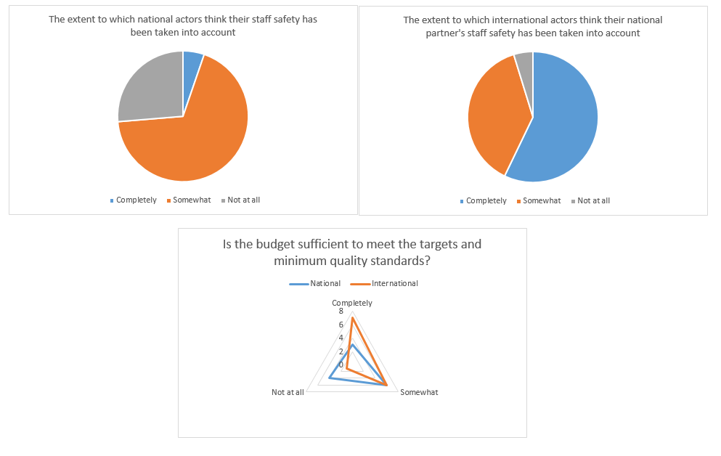
Partnership (Principle: Responsibility)
Notes:
In general, partnerships tend to include the transfer of risk from international to national partners – but there is a difference of opinion between international and national partners about the degree to which they believe national staff safety is taken into account. There is a similar difference of opinion regarding the extent to which they believe that the budget is sufficient to meet minimum quality standards.
Whilst the survey does not confirm whether these perceptions are accurate, it does suggest that partnerships would benefit from greater frank discussion about constraints and the degree to which both sides feel they can meet their obligations in the partnership (bearing in mind that most local partners reported that they have to follow where funding is available and therefore are more likely to agree to conditions and opportunities that they do not agree with).

Slide 19
Partnership (Principle: Equality)

Slide 20
Partnership
Almost all partnerships are structured around a budget (and timebound by budget)
Many partners have been working together, relatively consistently, for 5-10 years
There appears to be little explicit conversation about complementarity and/or roles
There are examples of joint implementation (e.g. Intersos in Baidoa)
Virtually no awareness across Cluster of principles of partnership
UNICEF has largely shifted to local partnerships

Slide 21
Funding
Notes:
As children targeted and reached is reported through funding partner, it obscures the role and proportion of children reached through local partners.

Slide 22
Funding – Education and Protection Clusters 2017

Slide 23
Funding
SHF has incrementally increased allocation to local NGOs (now over 40%)
SHF does not allow sub-granting, however, so some INGOs are directly implementing in locations where they also work with local partners where other funding is available
SHF due diligence remains a main concern for local NGOs
No other examples (other than SHF) of indirect funding allocations
International agencies report not passing on indirect funding due to limited funding from donors

Slide 24
Institutional Capacity

Slide 25
Institutional Capacity
Capacity Area | Recommendations (requiring budget) | Recommendations (which could be achieved through mentoring/technical support)
Governance | Develop a multi-year strategic plan | Develop a charter for the Board
HR | Provide regular staff training Improve filing system | Strengthen recruitment processes
Finance | Establish computerised accounting system | Revise manual to include missing guidelines
M&E and Program Management | Establish routine monitoring systems and train all staff | Develop M&E policy Use data to inform programming
Audit | Engage external auditors | Regularly review and track audit recommendations
Assets/Supply | Regular stock counts and routine checks Hire a logistics officer | Develop database of suppliers

Slide 26
Institutional Capacity
Remains a major gap – no systematic approach (this is linked to project style funding)
There is a high degree of consistency regarding capacity needs across the multiple assessments and partners – opportunity for coordinated approach
Heavy investment by UN/INGO in assessment and compliance monitoring of own resources (and high transaction cost for partners), but limited investment in capacity strengthening
Some local NGOs have examples of securing experts to help with institutional capacity building, but this is done outside of INGO agreements
Limited evidence of coaching and mentoring approaches, reportedly due to access constraints

Slide 27
Example of Self-Assessment – Child Protection and Education Groups

Slide 28
Governance and
Decision-Making:
Influence and
Participation:
Partnerships:
Funding:
Institutional Capacity
Strengthening:

Slide 29
Governance and Decision Making
Local Desired Now International
Recommendations:
Review ToRs of leads/co-leads and decision making committees
Coaching of local leads/co-leads to perform coordination functions
Explore different local leadership models – consortium/shared/rotational
Support local actors to engage/hire coordination experts directly

Slide 30
Participation and Influence
Local Desired Now International
Recommendations:
More regular communications from Cluster to members and simplify complex cluster communications
More engagement with non-formal actors (community members, leaders etc)
Meeting in more accessible locations

Slide 31
Partnerships
Local Desired Now International
Recommendations:
More strategic partnerships – sustainable, long term, including funding
Cluster/OCHA to prioritise proposals with strong emphasis on institutional capacity building
Survey NNGO partnerships to monitor capacity building activities and outcomes (e.g. improvement in reporting style, if capacity not improving international partners to be held accountable too)

Slide 32
Funding
Local Desired Now International
Recommendations:
Advocate for 10% overheads/unearmarked funding
Better balance between direct implementation and capacity building so local actors can direct funding

Slide 33
Institutional Capacity
Local Desired Now International
Recommendations:
Cluster to develop an institutional capacity strengthening strategy
Cluster Lead Agency to provide institutional capacity building support across the sector, not just own partners
Cluster to track capacity strengthening (in 5Ws?)
Peer to peer learning and development opportunities (diaspora?)

