Slide 1
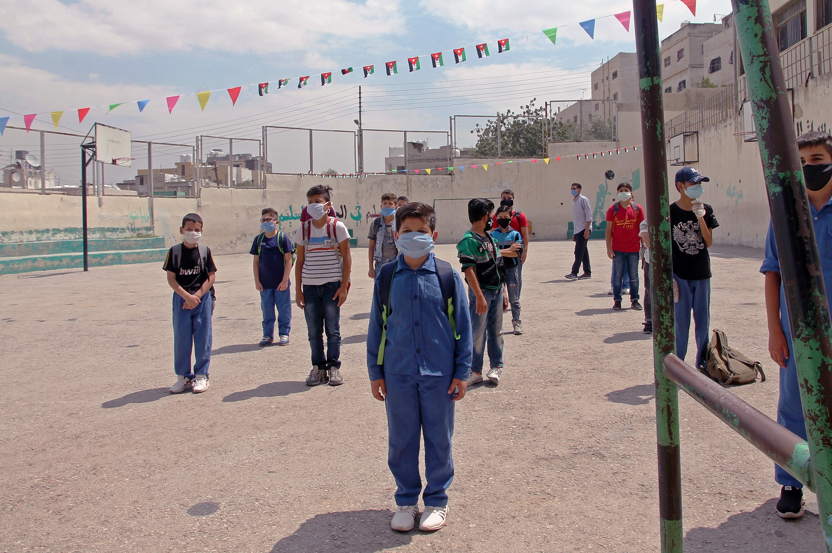
Safely Back to School (SB2S) Campaign
Aug 2020

Slide 2
Background
100,000 numbers targeted by ArabiaCell with one simple message around encouraging parents to register their children in school. This helped us identify the active numbers. This was based on data received from Open Emis on children who did not sit for the online assessments in DSS, L4A data for the past three years and Makani Bayanati data.
Active numbers were targeted with a Rapid Pro mini-questionnaire. (add description of the questionnaire)
Results from the Rapid Pro identified a total of around 9,457 households, which were targeted by phone calls.

Slide 3
Safely back to school (SB2S) Campaign Data
Outreach Activities:
In camps through door to door outreach activities conducted by SATs (Syrian volunteers) in both Zaatari and Azraq.
In HC through phone calls by a group of 30 volunteers. To this purpose, a questionnaire was developed and uploaded on Kobo
National Helpline. The SOPs were updated based on questions included in Kobo.
Makani outreach activities for the next registration cycle.
Note. Targeted age group 5-18 years old, and the outreach activities run as following:
Host community: Phone calls started on the (9th August till 27th Aug 2020)
Camps: outreach completed the campaign in both camps (9th Aug till 22nd Aug 2020)
Helpline: From Jun 2020 till Sep 2020 (Con’t)
Makani: For Aug and Sep 2020

Slide 4
Safely back to school (SB2S) Campaign data
The campaign reached a total of 27,066 Children.
The total of 6,343 are out of school children.

Slide 5
Safely back to school (SB2S) Campaign data
Out of 6,343 OOSC

Slide 6
Safe back to school (SB2S) Campaign data
Out of 6,343 OOSC

Slide 7
Safely back to school (SB2S) Campaign data
Out of 6,343 OOSC

Slide 8
National Helpline

Slide 9
Safely back to school (SB2S) Helpline cases
560 cases have been reported to UNICEF’s hotline as of September 30th
462 (83%) cases have been closed, but this doesn't mean they are successfully enrolled.
30 (5%) rejection cases and (12%) pending and ongoing cases.
560 out-of-school cases reported the following reasons for not registering:
Financial constraints
Lack of documentation
School too far/ lack of transportation
Disability
No KGs

Slide 10
Host community
(Phone calls)

Slide 11
Charactrisicts Out of School Children
639
518
99
77
Nationality | Number of OOSC
Syrian | 1,160
Jordanian | 132
Other | 26
Palestinian | 15
Total | 1,333

Slide 12
Charactrisicts Out of School Children
Out of school children= 1,333

Slide 13
Reasons for Being Out of School

Slide 14
Camps (Door to door visit)

Slide 15
Charactrisicts Out of School Children
718
418
53
49

Slide 16
Charactrisicts Out of School Children
Out of school children= 1,238

Slide 17
Reasons for Being Out of School

