Slide 1
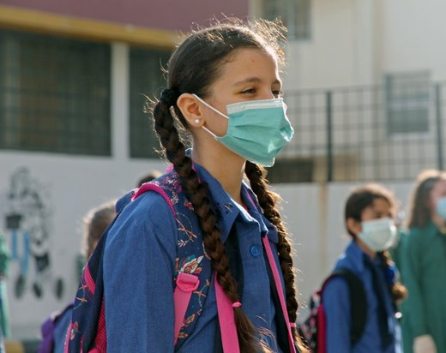
Humanitarian Partners Forum in Jordan Back to School and Continuous Learning
16 September 2020
Amman

Slide 2
1. Back to School in Jordan
Safely Back to School with national media campaign and outreach by phone and home visits. 22,500 children were contacted in camps and host communities, of whom close to 2,700 are out of school. Follow ups and referrals by partners underway
Schools opened on 1st September, with safe school health protocols implemented based on UN guidance i.e. provision of additional hygiene materials, IPC training, masks and physical distancing and rotation in school settings.
Camps in schools not opened and from 17th September, all schools will be partially closed for 14 days and shifted towards remote learning, for Grades 1, 2, 3 and 12 in attendance is optional.
DARSAK II online learning platform launched with lessons available on TV. DARSAK is zero rated from 6am to 4pm.
Learning Bridges is a national blended learning program for 850,000 children from Grade 4 to 9 supported by up to 500 community organizations. Home learning packages for KG2 to G3 planned in camps.
Higher education: Public universities are scheduled to open on 27th September and private universities on 18th October. Teaching methods are going to be blended with regular face-to-face and online remote education. However, this may change, depending on the COVID-19 situation.

Slide 3
2. UN considerations for school reopening
The WHO-UNICEF-UNESCO guidance published on 14 September regarding school-related public health measures in the context of COVID-19.
Whether to close or reopen schools should be guided by a risk-based approach and taking into consideration the following factors:
Epidemiology of COVID-19 at the local level;
Capacity of educational institutions to adapt their system to operate safely;
Impact of school closures on educational loss, equity, general health and wellbeing of children; and
The range of other public health measures being implemented outside school.

Slide 4
3. Ongoing Education SWG response
Developed Safe School Health Protocols for public schools based on UN guidance
National Safely Back to School campaign with MOE and partners
Outreach to 22,000 vulnerable children to support re-enrollment and referrals
Infection, Prevention and Control (IPC) training for Directorates and schools, and hygiene materials
Home visits for over 1,000 children with disabilities to support continued learning
‘Learning Bridges’ developed with MOE as a blended learning for 850,000 students in Grades 4-9, including online training for teachers
School readiness for 1,300 children in camps, including use of blended learning with parents
Regular distributions of learning materials, games and activity packs to over 20,000 children in camps and ITS
Online safeguarding training for teachers rolling out, and already in place for all NGO partners
Distributing 200,000 masks to Syrian students in camps and double shifted schools, and vulnerable groups in ITS;
Providing data bundles to all 9,000 vulnerable households with children enrolled in camps
Distance learning for up to 5000 students in Non-Formal Education and 20,000 vulnerable children in Learning Support Services, including in camps and ITS
Mental health and PSS for boys and girls; cash distributions; transportation, hardware (tablets)
ESWG meets regularly and facilitates coordination and knowledge-sharing to inform evidence-based education response planning, various needs assessments
KOLIBRI app and Learning Passports launched to provide access to learning for young people
Supported MOE to develop and implement Education During Emergencies Plan, with equity focus
Supported MOHE to admit university students with disabilities to enroll and benefit from regular programme in Jordanian public universities and supported those willing to bridge public and private universities.
Supported the Vocational Training Corporation and the Ministry of Youth in conducting TVET training and issue certificates for successful trainees.

Slide 5
4. Challenges
Children need to catch up on lost learning and then accelerate learning given reduced time in classroom. Likely to be significant impact on learning outcomes and retention lasting for at least five years.
During school closures, not all students have the data, devices, connectivity or parental support; with 23% of vulnerable families with no access to internet (UN Rapid Needs Assessment, April 20) and girls’ less access to online (UNICEF, 2020). Exacerbating gender and income inequalities in learning
Need to evidenced based and localized approach to future school closures. MOE has four scenarios based on local epidemiological situation, which we hope will be basis for decision making
Blended learning requires mix of modalities, including printed materials for the most vulnerable. DARSAK II lessons need to be complemented by interaction with teachers (assignments/feedback)
There is a persistent need to advocate for the registration of all refugee children in public schools, including those without documentation (i.e. MOI card, UNHCR card, rent document, residence etc).
Child protection concerns as raising child marriage and labour, as well as GBV.

