Slide 1
Training on Protection in Cash-based Interventions Building Capacity to Maximize Benefits and Minimize Risks
IMPROVING CASH-BASED INTERVENTIONS
MULTI-PURPOSE CASH GRANTS AND PROTECTION
Enhanced Response Capacity Project 2014–2015
Notes:
This participatory curriculum developed by the Women’s Refugee Commission (WRC) and the Office of the UN High Commissioner for Refugees (UNHCR) is based on the ECHO-ERC supported, UNHCR-led, inter-agency developed Guide for Protection in Cash-based Interventions.
Cash-based interventions (CBI) have become an essential part of humanitarian response to crisis and are gaining recognition for their potential to provide dignified, market-based, timely and flexible assistance to affected communities in camp and out-of-camp settings. Recognition for and the application of protection in CBIs is an essential aspect of this frontier. It is critical that humanitarian agencies institutionalize protection in CBIs and for agency staff to be knowledgeable about protection in response analysis when considering and implementing CBIs across sectors. Ensuring protection in CBIs should not only reduce the risks faced, but enhance the benefits of humanitarian interventions for affected communities.

Slide 2
Training Objectives
Familiarize practitioners with the Guide for Protection in Cash-based Interventions (CBIs).
Practical instruction for analyzing and monitoring protection risks and benefits in CBIs.

Slide 3
You will:
Strengthen knowledge of protection mainstreaming throughout the programme cycle.
Become familiar with the Guide for Protection in Cash-Based Interventions.
Be able to use the Protection Risks and Benefits Analysis Tool.
Feel confident analyzing and monitoring protection risks and benefits in CBIs and developing prevention/mitigation mechanisms.
Notes:
Learning outcomes:
Strengthen knowledge of protection in response analysis.
Become familiar with the Guide for Protection and Cash-Based Interventions and key resources so as to enhance decision making capacities for modality choice and design with regards to a) mainstreaming protection in CBIs and/or b) operationalizing CBIs for protection outcomes.
Be able to use the Protection Risks and Benefits Analysis tool to inform response analysis.
Develop confidence analyzing and monitoring protection risks and benefits in cash-based programming and prevention or mitigation measures so as to reduce risks and enhance benefits.
Present Agenda after this slide.

Slide 4
Overview of Protection and Cash-Based Interventions
Notes:
Do the Ice Breaker with protection definition before showing the next slide.

Slide 5
Protection
“…encompasses all activities aimed at obtaining full respect for the rights of individuals in accordance with human rights, refugee and humanitarian law.
Protection can involve either removing individuals or groups from a risk, threat or situation of violence that may adversely affect their fundamental rights or freedoms or intervening at the source of the violence to stop or reduce it.”
- (IASC, 2006)

Slide 6
What are the Sphere Protection Principles?
Principle 3:
Principle 2:
Protection from violence and coercion
Impartial assistance
Safety and Dignity
Meaningful Access
Accountability
Participation & Empowerment
Principle 4:
Principle 1:
Claim rights and access remedies
Do no harm
Notes:
Humanitarian practitioners in all sectors should be familiar with the Sphere Protection Principles. Integrating these principles throughout the program cycle can help ensure that protection risks and benefits are considered in CBI, as part of all humanitarian assistance and protection.
Avoid exposing people to further harm as a result of your actions.
Ensure people’s access to impartial assistance – in proportion to need and without discrimination.
Protect people from physical and psychological harm arising from violence and coercion.
Assist people to claim their rights, access available remedies and recover from the effects of abuse.
These principles have informed the definition of key areas for protection mainstreaming: safety and dignity; meaningful access; accountability; participation and empowerment.

Slide 7
Risk Equation
Risk =
Threat × Vulnerability
Capacity
Notes:
What is the equation for risk?
Thus goal of the intervention and desired impact is:
Reduction of threat and vulnerability
+
Increase of capacity
THREAT is the potential for physical or psychological harm and/or potential barrier to access. Potential perpetrators could be armed forces, militia groups, community members, family members, or even aid workers. Potential barriers to access could be a physically inaccessible entrance to facilities, or management of a service by a particular ethnic group to the exclusion of other groups.
The VULNERABILITY is what makes the potential victim susceptible to the risk: e.g. their location, the timing of the activity, lack of knowledge about rights or safe practices, their gender, their age, their ethnic/religious group, their disability.
The CAPACITIES represent the strengths both individuals and communities have to keep themselves safe: e.g. designated safe spaces, community plans, linkages with protection-sensitive institutions, awareness of rights and responsibilities.
Source: Global Protection Cluster (2014)
Give contextual examples of reduced threat, reduced vulnerability, and increased capacity.

Slide 8
Example
Unacceptable living conditions | Inability to afford quality housing (vulnerability) | Livelihood/ cash transfer | Increased income | Decent (safe and dignified) living conditions
 | Discrimination (threat/vulnerability) | Community-based protection mechanisms | Support network
 | Exploitation from landlord (threat/vulnerability) | Case management | Awareness and referrals
Protection Risk | Threat or Vulnerability | Program Response | Protection Capacity | Outcome
Notes:
Breaking down the risk to outline the threat / vulnerability / possible response that will result in increased capacity and the final intended outcome.
Freedom from threat of exploitation: how to recognize issue, know their rights and go for help

Slide 9
Cash-based Interventions (CBIs)
Notes:
CBIs are a tool, not a program.
CBIs have great potential (choice, affected communities know their needs/priorities, market-based to strengthen the local economy, timely, flexible, reinforce community relations).
CBIs should be designed, implemented and monitored with protection at their core through: the right mechanisms, staff, skills and attitudes to mainstream protection and ensure safe and conflict-sensitive cash and voucher interventions.
Cash-based interventions can be divided into three rough categories:
• Cash for work programs, where the beneficiaries are paid cash for work on public or community works schemes.
• Vouchers, which give the beneficiaries access to pre-defined commodities. Vouchers can be given as a grant or in exchange for work.
• Cash grants, where cash (in envelopes, cards, mobile phones etc) is provided.
“Unrestricted” denotes that the cash is not restricted to certain types of expenditures or vendors (sector-specific).
There is some debate as to whether vouchers are restricted; they may not be in terms of items but as they must be linked to certain vendors, unless they cover all vendors of goods and services in a given area than they are restricted in terms of the range of goods or services offered by the vendors chosen for the project.
“Unconditional” refers to the fact that beneficiaries do not need to meet conditions for behaviour (such as attend a training, produce receipts or a first phase of construction, send their children to school) to receive cash. They will only need to meet the eligibility criteria.
Multipurpose Cash Grants (MPGs) are unrestricted cash transfers that place beneficiary choice and prioritisation of his/her needs at the forefront of the response.
When is cash appropriate?
Monetized economy
Reactive markets able to respond to an increase demand without causing inflation.
Beneficiary acceptance and ‘literacy’ of the aid modality
Availability of sufficient and safe delivery options
Timeliness and feasibility, e.g. from a skills and capacity perspective
Security and adequate protection

Slide 10
CBI Programme Cycle
Step 1:
Participation
Engage Stakeholders
Step 5:
Step 2:
Monitor and Learn
Assess needs and capacities
Ensure cross-cutting issues
Step 4:
Step 3:
Plan, Design and Implement
Response Analysis
AGD
Notes:
We have used the term ‘programme cycle’ here to refer to the standard terminology. UNHCR calls this the Operations Cycle.
Response analysis is a process to determine whether or not cash-based interventions, either alone or in combination with other types of assistance, are an appropriate and feasible method to meet refugee needs and reflect their preferences.
The result of response analysis should not be either/or but rather what option(s) maximize benefits and minimize risks.
What kind of approach should go around this whole circle?
Ensure that AGD and participatory approaches is applied throughout the program cycle and across response analysis.
What does AGD mean? What is a participatory approach?
A comprehensive AGD approach is required in order to ensure inclusion and prevent discrimination against individuals, households and communities affected by crisis.
Protection information gathering and analysis should span the program cycle.

Slide 11
What are common assumptions regarding the risks of CBIs?
Response Analysis
Program Design
Mitigation
Conflict in the family.
Additional burden on women.
Safety issues.
Corruption.
Disincentive to work.
Antisocial spending.
Lack of data protection.
Notes:
What are the assumptions about CBI risks?
Many of the assumption about CBIs are common to in-kind assistance, many of which can be mitigated through good program design, after thorough assessments and response analysis.
Failure to use an AGD approach can lead to protection risks, while its use enhances the benefits of CBIs.
It is critical to assess specific vulnerabilities (such as (un)married adolescent girls, unaccompanied minors).
Protection risks, mitigation measures and benefits should always be considered and analyzed in CBIs with a specific focus on the gender and the social impacts of cash.

Slide 12
How do we maximize benefits and minimize risks?
Incorporate protective elements to mitigate risks
^{Design interventions}
^{that mitigate}
^{unintended consequences}
Design and revise programs to enhance protection benefits
Ensure participation, accountability and meeting the needs of different groups/individuals
Notes:
When we talk about maximizing benefits and minimizing risks, what do we mean?
To minimize the risks of CBIs we need to:
Incorporate protective design, implementation and monitoring elements into CBIs so that the programming does not increase, and rather helps to mitigate, risks for beneficiaries or persons of concern.
Design interventions that mitigate unintended consequences related to the introduction of cash (so as to not exacerbate community tensions, relationships between beneficiaries and non-beneficiaries of assistance, and within households), monitoring risks and making design adjustments as necessary.
To maximize the benefits of CBIs we need to:
Design and revise programs so that CBIs enhance protection benefits (such as improved household and community relations, dignity through choice, and safe, impartial access to assistance).
Build upon the inherent potential of CBI to contribute to participation, accountability and meeting the needs of different groups and individuals.
Example: Design to avoid risks during delivery, or to protect data.
Example from IRC Jordan study 2014: cash to refugees had a multiplier effect on the local economy, and improved relations between refugees and the host community. This was a positive consequence of the cash modality, but not the (only) objective of the programme, which intended to meet basic needs of refugees.

Slide 13
Walking Through the Guidance Step-by-Step
Programme Cycle:

Slide 14
Programme Cycle
Needs Assessment
Market Analysis
Protection Risk and Benefit Analysis
Benefits
Vulnerability Analysis and Targeting
Delivery Mechanism Selection
Design and Implementation
Monitoring
Risks
Notes:
Programme Cycle or Operations Cycle includes the following steps, with the omission of Evaluation, which is not covered in the Guide or this Training.
There is a degree of overlap – the guide is not meant to be chronological but rather to highlight key points at key steps. Delivery mechanism selection is specific to CBI, and is thus drawn out here, but is part of the both response analysis (which options are available and feasible) and design process (deciding on the delivery mechanism).
Throughout the program cycle:
Use a participatory approach and/or support a community-led process.
Look within and beyond the household unit: disaggregate information or include samples of individuals using an AGD approach.
Establish an accountability framework for multi-channel feedback throughout the phases.
Note than needs assessment and situation analysis will often overlap with response analysis.

Slide 15
Needs Assessment
Gather pre-existing and new situational protection information on sources of threats.
Flag economic/livelihoods-related causes of protection risks.
Use an age, gender and diversity lens.
Notes:
[threats – could include violence, harassment or discrimination]
What questions do you ask in needs assessments (general)?
Then with protection lens:
What protection information sources would you use?
Remind to disaggregate needs by groups and sub-groups such as adolescent girls, married or unmarried, or people with disabilities, mental or physical, etc.

Slide 16
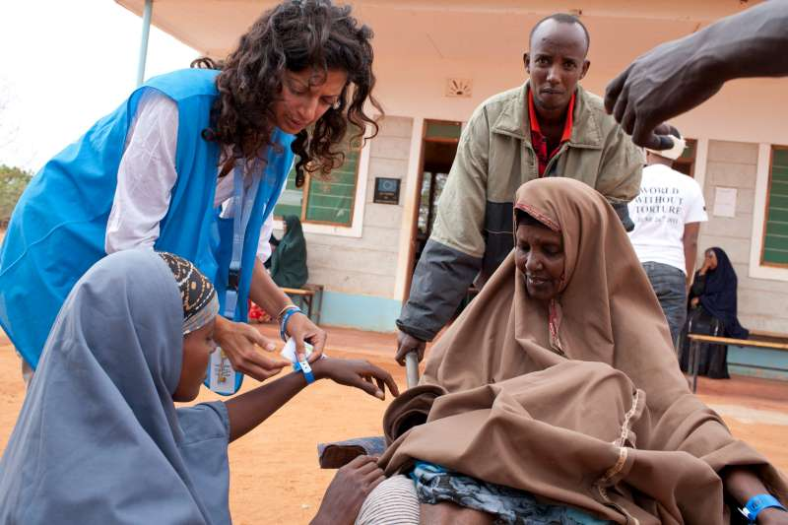
STOPLIGHT
Have you considered the recommendations of this step?
If not, pause until these can be addressed. Consult protection colleagues as needed.

Slide 17
Market Analysis
Consider safe and equitable access to markets.
Consider protection-related market systems for goods and services.
Consider social relations.
Notes:
What are the questions you would ask in market analysis (general)? Examples: supply of goods and services, prices, relationships between actors in key markets, if markets are functioning after a crisis, key barriers for market functionality.
Then with protection lens:
Consider restriction of movement, illegal bribes, supplier agreements with local traders. See Protection Benefits and Risk Analysis Tool.
What are examples of protection-related market systems?
[These will be used for group work]:
Alternative care
Health
Legal services
Transport
Communications
Education
Birth registration
Social relations – example- traders from host community discrimination against refugee or minority customers

Slide 18
Protection Risk and Benefit Analysis
Ask affected communities to identify protection risks and benefits.
Analyze relative importance (likelihood and impact) for different groups.
Analyze manageability (prevention or mitigation) for different groups.
Notes:
Do Quiz after this slide.

Slide 19
Decision Tree
Identify and assign context-specific weights/importance to protection risks and benefits in terms of safety and dignity, access, data protection, market impacts, people with specific needs and risks, social relations, fraud and diversion, and durable solutions/early recovery.
Is each protection risk specific to CBI?
YES
NO
Consider different CBI modalities (cash, voucher) and delivery mechanisms (cash, electronic card, mobile phone, etc.) Explore the community and agency measures and aspects of program design that could mitigate protection risks.
Explore the community and agency measures and aspects of program design that could mitigate protection risks.
Notes:
Talk through the whole Protection Risk and Benefit Analysis tool, starting with the Decision Tree.
Questions?
The information in the tool (the blank worksheet) should be updated regularly.

Slide 20
STOPLIGHT
Have you considered the recommendations of this step?
If not, pause until these can be addressed. Consult protection colleagues as needed.

Slide 21
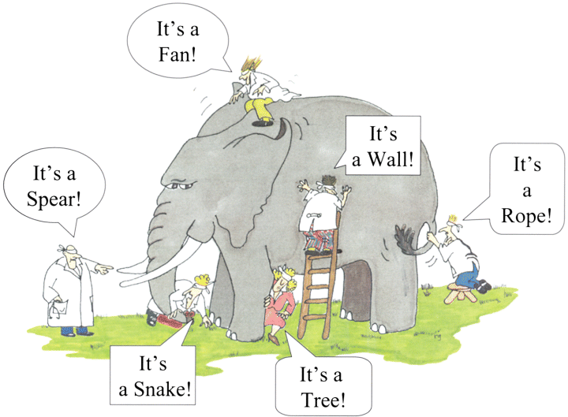
How do we mitigate risks?
Notes:
What do you think this picture represents?
What are examples of risks? [Draw out specific protection risks – child protection, SGBV, etc.)
What are examples of mitigation strategies?
[remember self-protection and community-based mitigation strategies]
Make sure to examine risks from multiple perspectives.
Risks will vary based on age, gender and diversity.
In order to ensure inclusion and non-discrimination, risks must be identified and protective elements incorporated into program design, implementation and monitoring.
[Hand out Risk Examples A and B.]

Slide 22
Example A
Risk | Consequences | Mitigation measures / Opportunities | Likelihood
Tensions between PoC and host communities | Potential hostility and violence | Complementary community support projects | High
 |  | Inclusion of a proportion of hosting vulnerable families in the assistance scheme
 |  | Information and sensitization campaigns
 |  | Support to most vulnerable can relieve burden on hosting communities
Notes:
Elements incorporated into program design, implementation and monitoring.
This is one example from Risk Example A. It is not meant to be a ‘best practice’ but just a recent field example for your discussion.

Slide 23
Risk Mitigation
Ensure an AGD approach.
Identify who is at risk, how and why – during crisis and after.
Incorporate mitigation mechanisms into program design and account for specific vulnerabilities.
Notes:
Account for specific vulnerabilities faced by women, men, girls and boys, elderly, persons with disabilities and sexual and other minorities.

Slide 24
Vulnerability Analysis and Targeting
Discuss differences/overlaps between specific needs, protection risks and economic vulnerability.
Examine vulnerability (physical, social, economic and environmental).
Analyze which aspects can be addressed through CBI.
Notes:
Eligibility criteria: Standards or characteristics by which inclusion or eligibility in the programme may be decided.
Targeting is “the process of identifying the intended beneficiaries of a program, and then ensuring that, as far as possible, the benefits actually reach those people and not others.”
The goal is to link people to interventions most appropriate for them.
To address different types of needs, Cash/economic and Protection colleagues should discuss needs, vulnerabilities and risks together and with communities to develop a targeting strategy.
Generally we need to explore the linkages (or lack of linkages) between protection and socio-economic characteristics and work together in this regard to inform vulnerability analysis and targeting. There may or may not be correlations (links) between economic and protection needs.
Are there any aspects of protection risks that could be addressed by CBI? This point links back to market analysis, and identifying protection-related market systems.
CBIs may address an economic need or entry point related to a protection issue. These entry points will be context- and individual-specific.

Slide 25
Vulnerability Analysis and Targeting
Identify and assess people with specific needs or protection risks, and refer them to other assistance if CBI is not relevant for them.
Engage communities throughout the targeting process.
Notes:
People with specific protection risks or specific needs should always be identified and assessed, and referred to other assistance if CBIs are not relevant.
To be most effective, targeting should engage communities throughout the targeting cycle, ensuring the views of affected communities – and particularly those of potentially marginalised and most vulnerable groups – can influence the targeting process.
For further advice on Targeting and Cash, refer to the Multipurpose Cash Grant Toolkit section on Targeting.
[Conduct exercise on targeting.]

Slide 26
Needs Assessment
Market Analysis
Programme Cycle
Protection Risk and Benefit Analysis
Benefits
Vulnerability Analysis and Targeting
Delivery Mechanism Selection
Design and Implementation
Monitoring
Risks
Notes:
Recap the Programme Cycle and key points that have come up from the group.

Slide 27
Delivery Mechanism Selection
Consider safety, freedom of movement and preferences.
Ensure service provider selection reflects protection risk and benefit analysis as well as cost and capacity.
Include data protection and confidentiality in service agreements/SOPs.
Notes:
Consider multiple delivery mechanisms if part of your beneficiary group requires an alternate mechanism. For example, if the elderly are not comfortable with bank cards.

Slide 28
Design and Implementation
Consider transfer size and frequency by age, gender, other characteristics and how needs may change over time.
Build in flexibility for ongoing referrals.
Notes:
When did you adapt a program due to risks identified after the start of implementation/when mitigation measures were not working? (CBI or other)
When did you pause/stop a program due to reports of protection violations/issues? (CBI or other)
Ensure that program design includes mitigation measures for ALL risks identified during assessments.
Ensure that program design has a sustainable exit strategy.

Slide 29
Design and Implementation
Adjust frequency, amount and duration to address economic drivers of vulnerability and beneficiaries’ preferences.
Reconsider delivery mechanism and modality if necessary.
Notes:
Ad-hoc adjustment of amount, frequency and duration as needed to respond to risks, seasonal variation, transaction costs (formal and informal)
Portability (cash vs. in-kind)
Register alternate recipient if requested

Slide 30
Design and Implementation
Data protection, confidentiality and opt-out clauses in service agreements and SOPs.
Consider specific risks and mitigation mechanisms related to child protection and SGBV.
Exit strategy is essential and critical in order to “Do No Harm”.
Notes:
Data protection, confidentiality and opt-out clauses are essential components of service agreements and standard operating procedures (SOPs).
Design should consider specific risks and mitigation mechanisms related to child protection and GBV, in particular for women and girls.
Program design must consider durable solutions and address early recovery needs.
An exit strategy is essential and critical in order to “Do No Harm.”

Slide 31
Monitoring
Include risks identified in monitoring and accountability frameworks.
Consider changes in protection risks and benefits and socio-economic vulnerability.
Use feedback/response mechanisms to inform program adaptation.
Notes:
There are a number of models for “post-distribution monitoring” of CBIs, but not one global template. They may be adapted based on context, but generally focus on the process of delivery the CBI, and in some cases on the expenditures of recipients. They are generally carried out 2-4 weeks after the delivery of CBI, and on a regular basis in the case of multiple installments.

Slide 32
Monitoring
Indicators should focus on the reduction of protection risks:
How mitigation measures for protection risks in CBIs are working.
How CBIs could help mitigate protection risks and how cash could enhance people’s capacity to cope.
Result or impact indicators for protection benefits.
Notes:
How CBIs could help mitigate protection risks and how cash could enhance people’s capacity to cope.
– complementary advocacy could contribute to reducing protection threats.
Result or impact indicators for protection benefits – context specific, based on consultations with affected populations and program objectives.

Slide 33
Monitoring
Red Flag Indicators:
% of children dropping out to participate in income-generating activities.
# of reports of intimate partner violence.
# of reports of increased tension within or between communities.
Notes:
These would need to be compared to a baseline, and would be measured as percentage change.

Slide 34
Programme Cycle
Needs Assessment
Market Analysis
Protection Risk and Benefit Analysis
Benefits
Vulnerability Analysis and Targeting
Delivery Mechanism Selection
Design and Implementation
Monitoring
Risks
Notes:
Recap Programme Cycle and main points from the group.

Slide 35
Practice Session
Decision-making on CBI and Protection:

Slide 36
Using the Protection Risks and Benefits Analysis Tool
Case Study A
Case Study B
Mainstreaming Protection in CBIs to meet basic need(s)
CBIs contributing to protection outcomes
Groups 1 & 2
Groups 3 & 4
Notes:
Share instructions for practice session.

Slide 37
Review Session
Decision-making on CBI and Protection:
Notes:
Response analysis and decision-making about modality and delivery mechanism will differ significantly depending on context.
Analysis of gender and social impacts of cash is essential in order to indicate protection risks, mitigation measures and benefits.
A clear exit strategy is required.

Slide 38
Reviewing the Case Studies
Each group will present and receive feedback on:
Possible results and impact.
Intended/unintended consequences.
Possible heightened risks and mitigation.
Response decision and justification.
Any comments on using the PRBA Tool.
Notes:
Share instructions for the plenary session.
Did the group take forward the proposed intervention and why or why not? How did they change the proposed response (to better mainstream protection)?
How did they use the PRBA tool, and was it helpful? Any comments?

Slide 39
Decision Tree
If no feasible mitigation measures exist consider in-kind assistance or no material assistance (other services or protection work instead).
If mitigation measures and/or another CBI delivery modality or delivery mechanism is possible, weigh the risks and mitigation measures along with potential protection benefits of CBI, discuss with communities and decide whether and how to implement CBI.
Notes:
Return to the Decision Tree Handout, bottom section.
For practical purposes the case studies used here had CBIs as an inevitable modality. However, be sure to follow the Decision Tree and to design programing accordingly.

Slide 40
Wrap-Up
Notes:
[Consider during coffee breaks/lunch break the major points coming out from participants throughout the day and insert here in the notes, to give a recap back to the group.]

Slide 41
What are the Sphere Protection Principles?
Principle 3:
Principle 2:
Protection from violence and coercion
Impartial assistance
Safety and Dignity
Meaningful Access
Accountability
Participation & Empowerment
Principle 4:
Principle 1:
Claim rights and access remedies
Do no harm
Notes:
Reminder of the Protection Mainstreaming Principles

Slide 42
Programme Cycle
Needs Assessment
Market Analysis
Protection Risk and Benefit Analysis
Benefits
Vulnerability Analysis and Targeting
Delivery Mechanism Selection
Design and Implementation
Monitoring
Risks
Notes:
Ask everyone to write on a post-it or card one thing they learned today, referring to a phase of the programme cycle. Ask to share in plenary if they wish.

Slide 43
Remember!
Consider context-specific protection risks and benefits.
Ask yourself if protection risks and benefits are specific to cash.
Monitor changes in protection risks, benefits and the effectiveness of mitigation mechanisms. Adapt!
Work jointly across protection and program/cash teams.

Slide 44
Learning Outcomes
Have you strengthened knowledge of protection in response analysis?
Are you familiar with the Guide for Protection in Cash-Based Interventions?
Are you able to use the Protection Risks and Benefits Analysis Tool?
Do you feel confident analyzing and monitoring protection risks and benefits in CBIs and developing prevention/mitigation mechanisms?
Notes:
Which of these learning outcomes were achieved?Which of these learning outcomes require additional support?

Slide 45
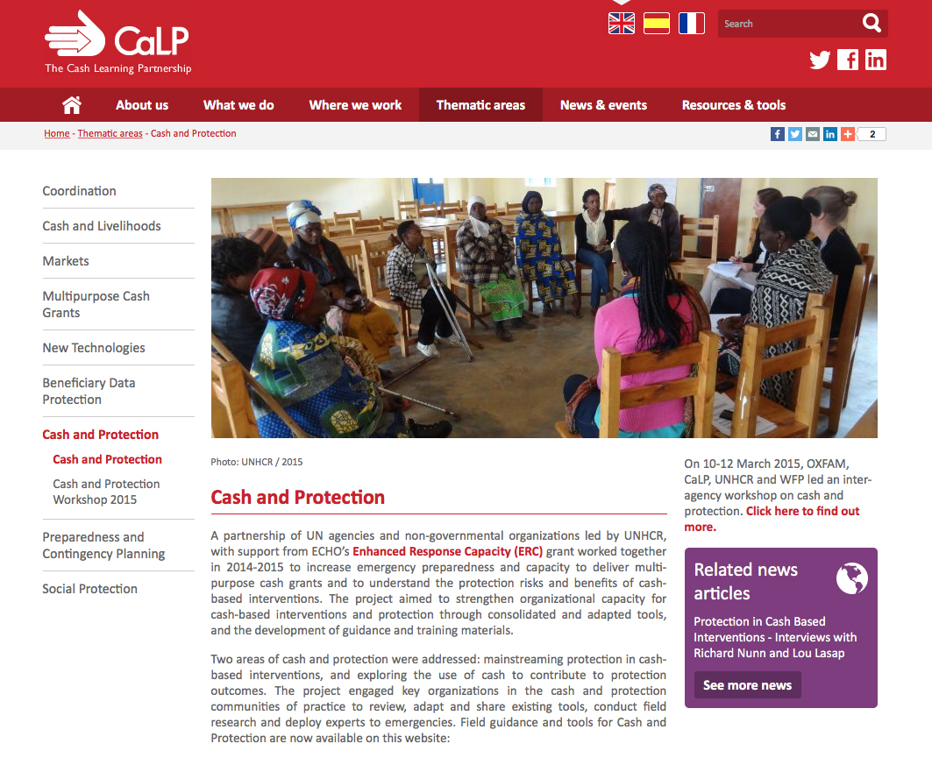
Resources
Visit CaLP’s Cash and Protection thematic page
www.cashlearning.org/protection
Notes:
The Guide for Protection in Cash-based Interventions alongside other ERC grant resources are hosted on the CaLP Cash and Protection thematic page.
The Guide includes a list of resources which is not meant to be exhaustive, but rather highlights the most useful, field-friendly guidance and tools currently available, with specific references to cash-based interventions and protection. In addition, other key protection resources that do not necessarily reference cash are included.

Slide 46
Thank you!
Notes:
Thank you for your engagement and congratulations for completing the training on Protection in CBIs!

