Slide 1
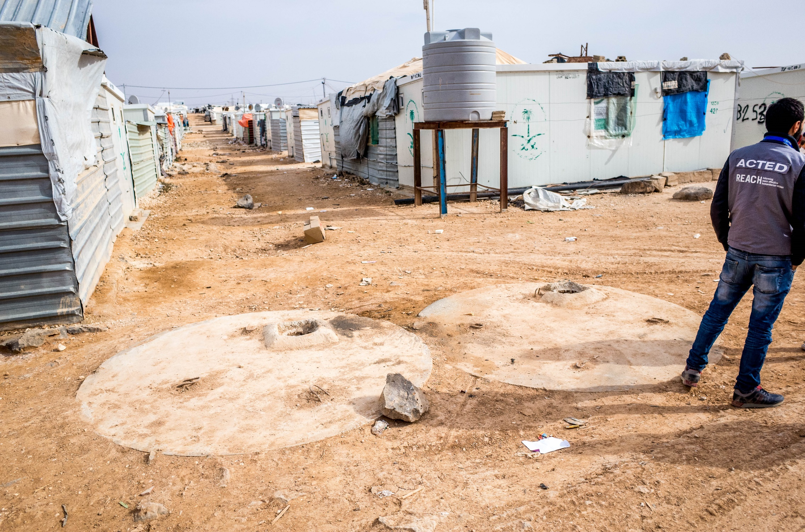

Za’atari Web Maps
Jordan, 4 April 2017

Slide 2
Motivations Behind the Web Map
Throughout 2016, REACH has been involved in wastewater network mapping
Traditionally, these products have been provided as a hardcopy or PDF soft copy
As the complexity of map data grew, it became more difficult to represent all attributes on a static map
July 2016: initial version of the wastewater network created to visualize household connections

Slide 3
Evolution of the Web Map
Project began as a way to show more information on a map, but added more features as new use cases arose
Ability to view maps on mobile phones would greatly expand accessibility and promote information sharing
Need was demonstrated for a map that could be used in the field, offline capability would be required for this
Once in the field, it would be useful to see current location
For this to be used by the most number of field staff, the app would need to be translated in Arabic
All these features made it into the web map, and serve as a template for creating new interactive maps in the future

Slide 4
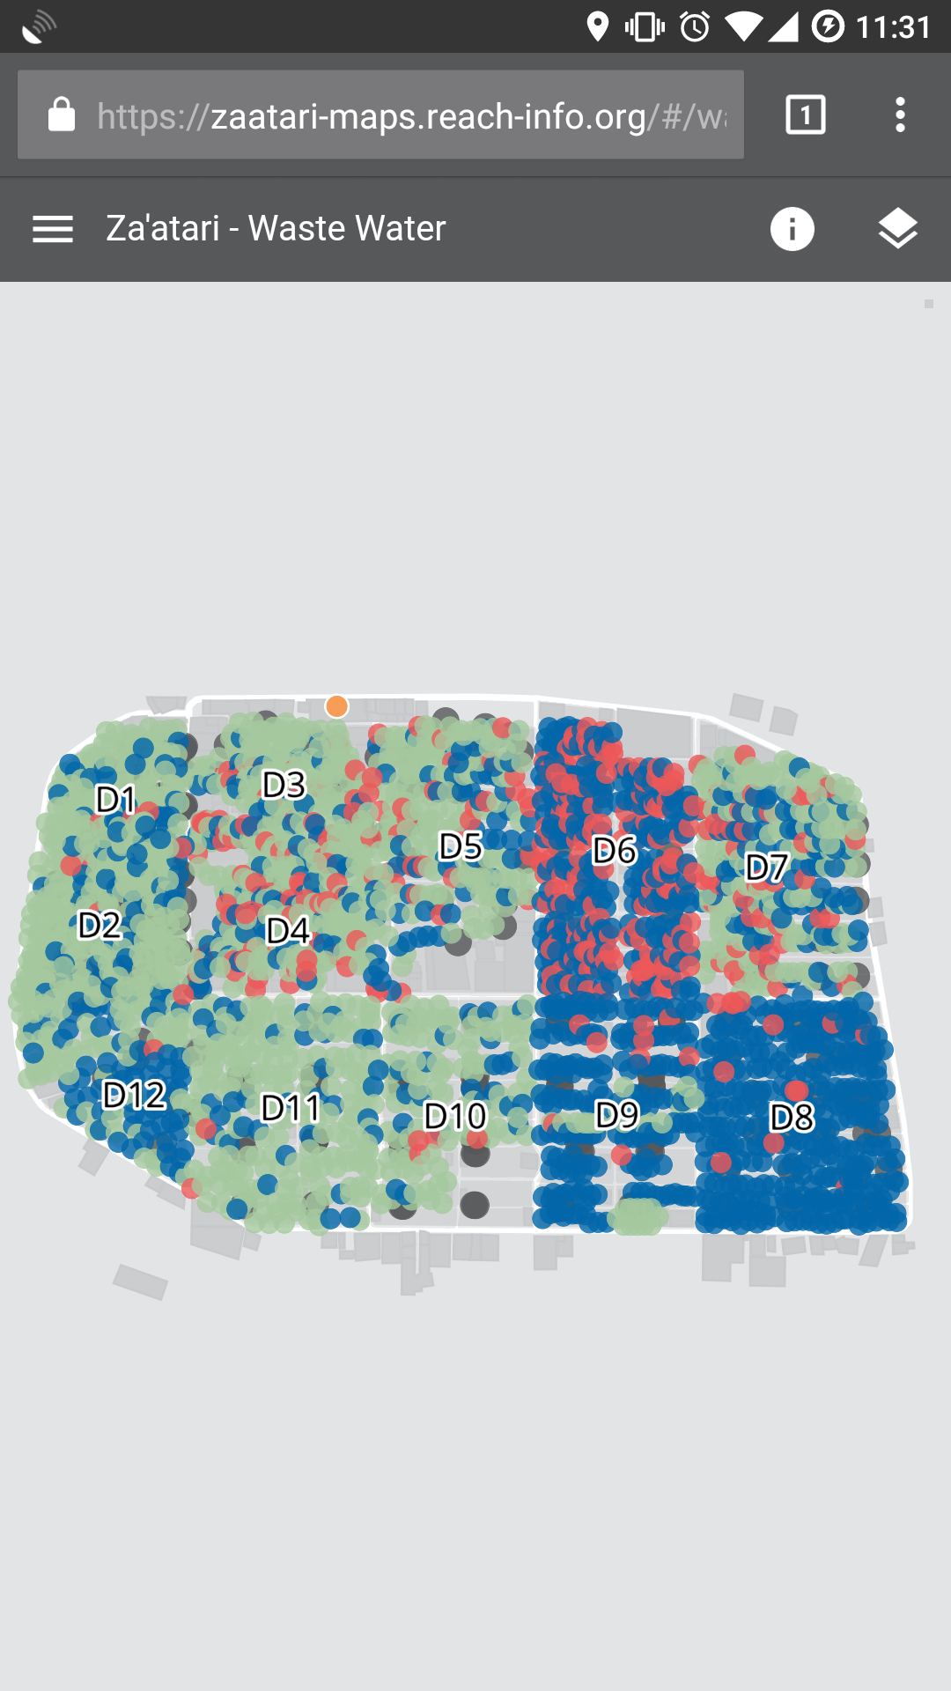
zaatari-maps.reach-info.org

Slide 5
Za’atari Web Map – Wastewater
Produced in collaboration with UNICEF, with partner data collected by ACTED, JEN, and Oxfam, externally verified by UNOPS
Gives engineers a tool to find septic tanks in the field given a tank address
Shows the relationship network between septic tanks and the houses they are connected to
Using an engineer’s current location, shows where pipes and other buried features are.
Allows desludging operators to access extended attributes about a tank, such as ventilation pipe length
https://zaatari-maps.reach-info.org/#/waste-water

Slide 6
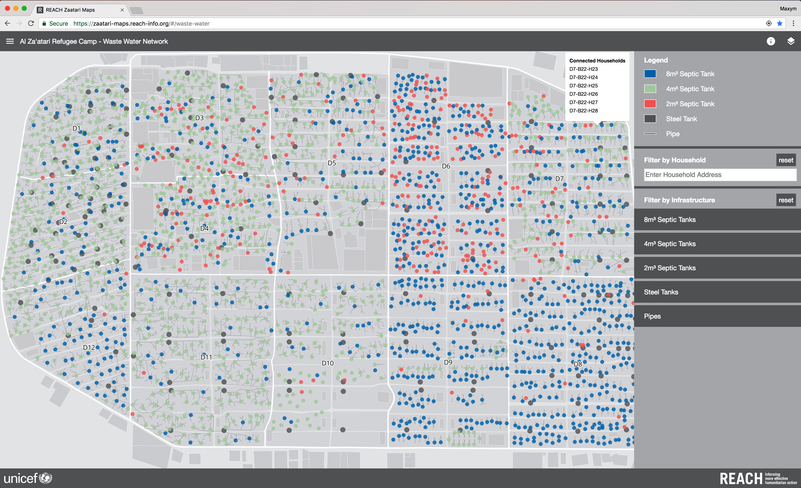

Slide 7
Installing App for Offline Access
Without internet access, the map must already be loaded in the browser to keep using it
Installing the app on a mobile phone allows it to be opened any time without a network connection
Android: full support for opening the app offline
iOS: a little harder to get working on some devices

Slide 8
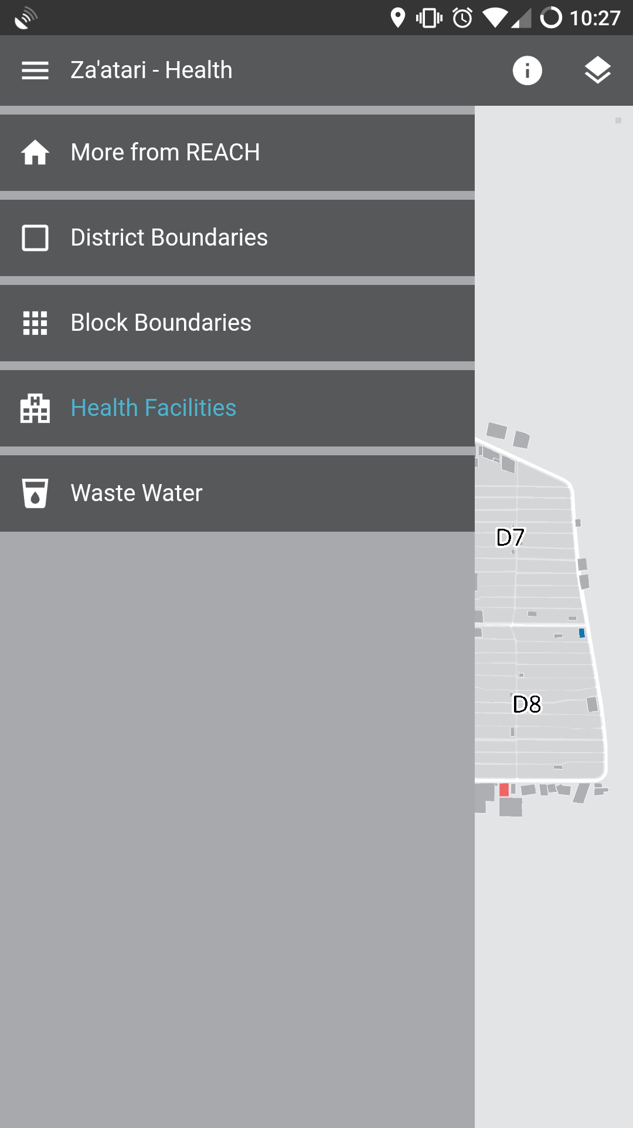
Find out More
Technical details for installing the map for offline use are available on the Za’atari data portal
There, you can also download source data for use in: ArcGIS, Google Earth, MAPS.ME, Excel
To report updates or suggestions, email: jordan.mapping@reach-initiative.org

