Slide 1
Site Monitoring System

Slide 2
Site Monitoring System
Site Monitoring System:
Multi-sectorial (clusters/sectors) & inter-agency (data collection, analysis, products)
Repeated frequently - monthly, bi-monthly, quarterly depending on context
Data collected: Population data, locations & needs/gaps (linked to indicators/standards)
Analysis of overall situation in sites, individual site analysis/profiles, highlighting urgent needs/gaps
Humanitarian Profile (OCHA) & HNO/HRP process alignment
Population data covered
PEOPLE AFFECTED
Displaced |  |  |  |  |  | Non-Displaced
Camp/Camp-Like |  |  | Private or Individual Accommodation |  |  | Host | Non-host
Planned Settlements | Collective Accommodation | Unplanned Settlement | Self-Settled | Hosting arrangement | Renting Arrangements

Slide 3
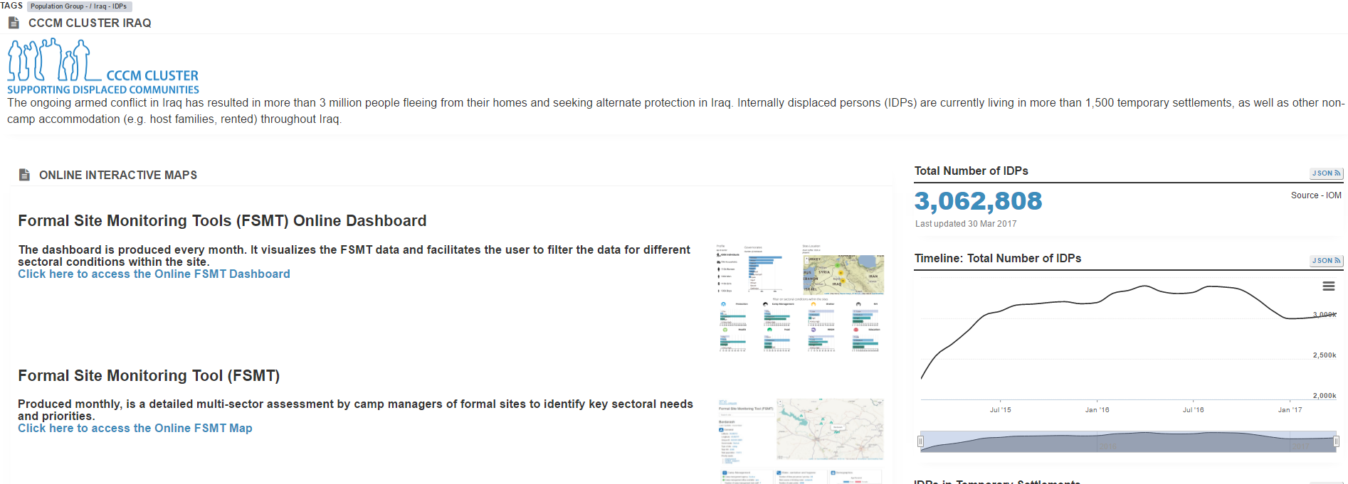
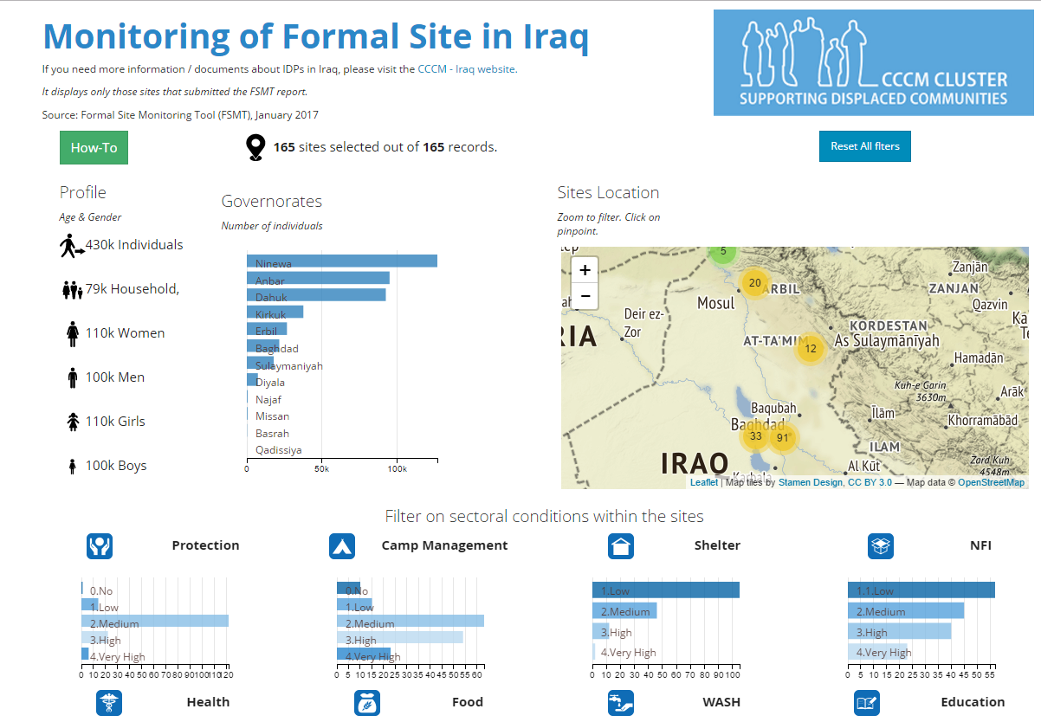
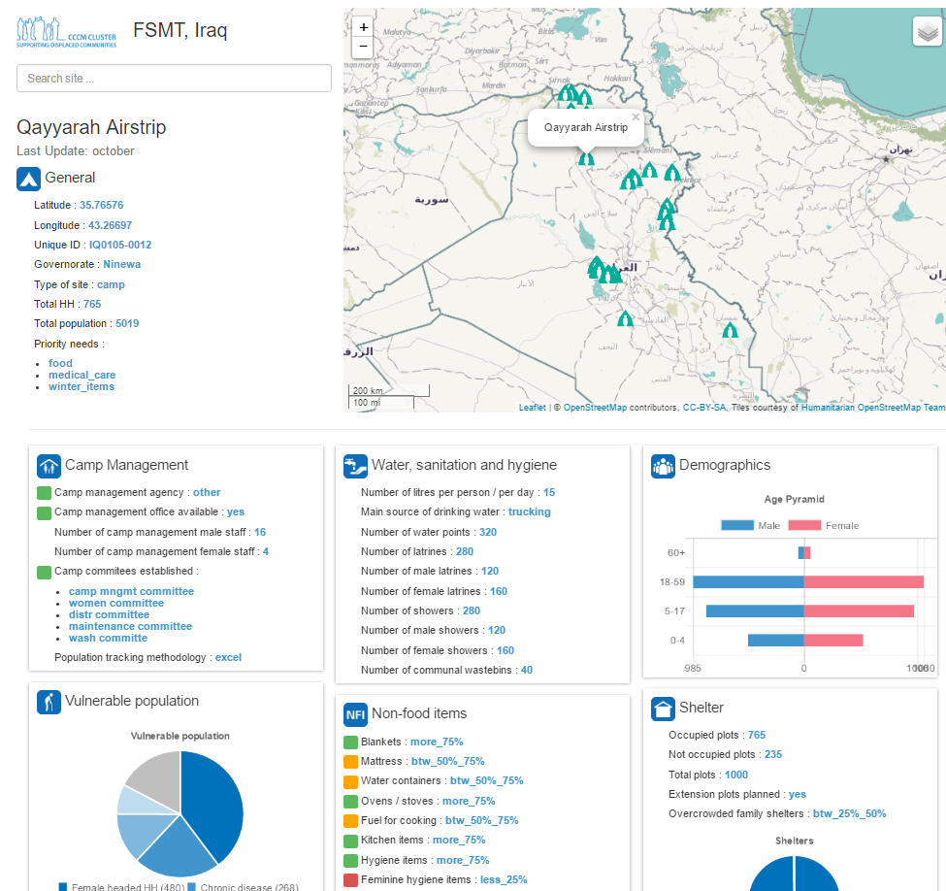
Site Monitoring System
UNHCR Kobo server
Data cleaned
Aligned with standardised indicators
Converted to CSV format
Mobile Data Collection
Dec 2016
Latest dataset
Data Storage Platform
Nov 2016
Historical Dataset
Oct 2016
Historical Dataset
Offline Site Profiles & Dashboards
Operation Data Portal (ODP)
Online Dashboards
Operation Planning Site Monitoring And Profiling (OPSMAP)

Slide 4
Site Monitoring System
Online Products/Dissemination:
OPSMAPs – Operational Site Monitoring And Profiling
Rapid RASP – http://maps.unhcr.org/en/irq_cccm_rapid_rasp
FSMT – http://maps.unhcr.org/en/irq_cccm_fsmt_map
Full RASP - https://cccmiraq.github.io/RASP/ Somalia - https://cccm-cluster-somalia.github.io/OPSMAP/
Dashboards
Iraq Dashboard – https://cccmiraq.github.io/FSMTdashboard/
Syria/Turkey Dashboard – https://unhcr-xborder-turkey.github.io/ISIMM/
Country Pages
CCCM Iraq – http://iraq.cccmcluster.org/
CCCM Myanmar – http://myanmar.cccmcluster.org/
CCCM Somalia – http://somalia.cccmcluster.org/

