Slide 1
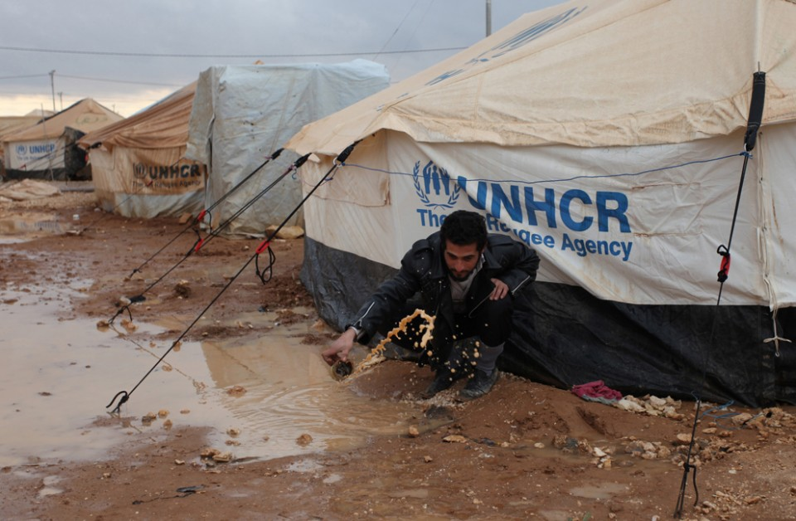
Winterization
Informal settlements
Lessons learned

Slide 2
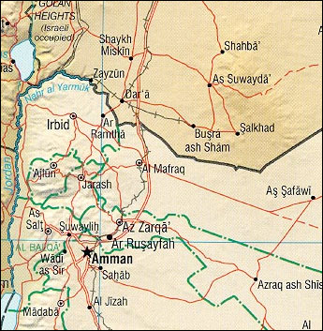
North Jordan

Slide 3
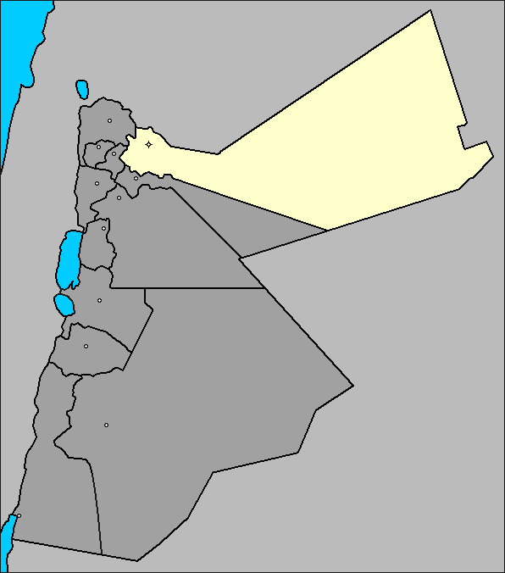
MAFRAQ المفرق
Mafraq governorate
- Districts
North east Badya
2. North west Badya
3. Mafraq Qasaba
Amra
Dafyana
Umm Al Jimal
Um Al Quttein
Nayfa
Sabhah
Al Mansourah
Al Matallah
Jabir As Serhan
Rabba As Serhan
Sama As Serhan
Hweija
Al Makzomya
Al Manshiya
Az Zaatari
Al Kaldya
Mafraq Town

Slide 4
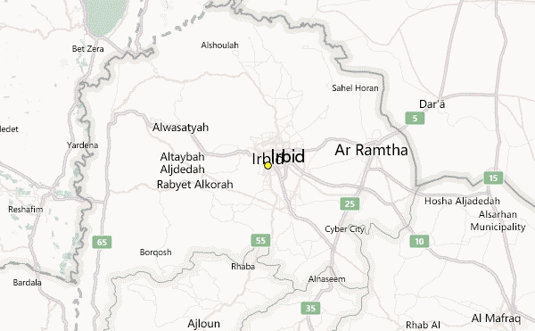
IRBID أربد
IRBID governorate
Districts
Alramtha
2. Irbid
Thnaybeh
Emrawa
Shajarah
Bwaydah Ekayder Braygah Alhamrah Al Torra
Hawara
Sal Bushrah Mghayer Irbid town

Slide 5
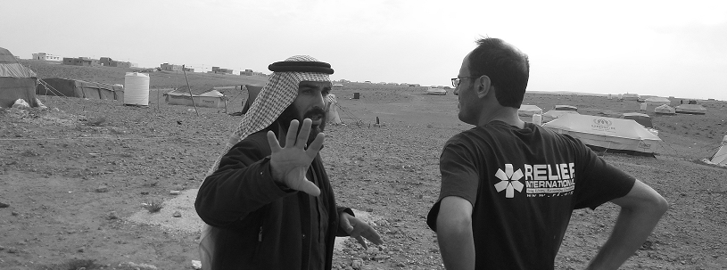
Community
BEFORE
Participatory identification and prioritisation of appropriate items should be done with the community if possible during the rapid assessment.
A clear, detailed description of the item is required when ordering, along with an indication of the item’s priority.
NFIs should be packaged for ease of handling and transportation by beneficiaries
A registration list of beneficiaries’ households is required (indicating male, female, anyone with a disability or special needs, children, elderly people, and any other vulnerable group (e.g. female or child headed household) and the total number of household population/occupants).
Where possible provide people with samples of items so that they can choose according to preference e.g. materials for women’s menstrual protection or items available on the local market..

Slide 6
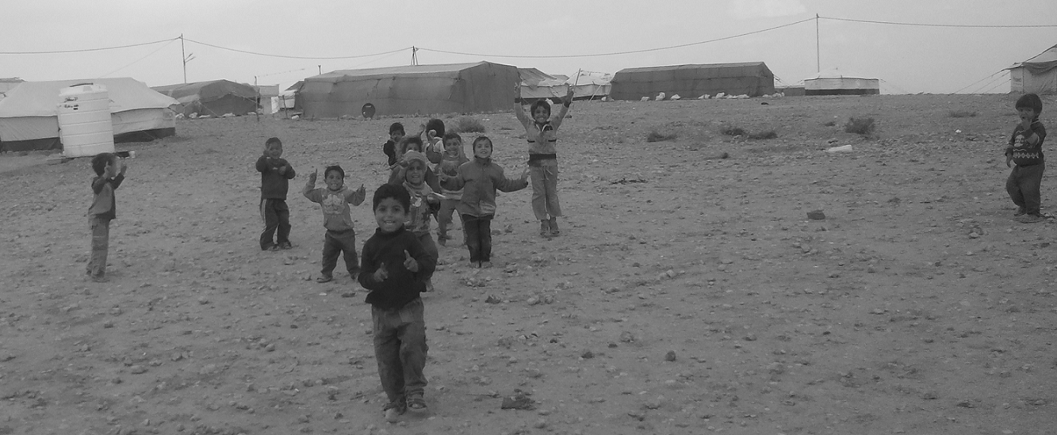
Assessment
DURING
Ensure that beneficiaries understand the criteria for beneficiary selection, NFI content and use, in order to encourage transparency. They will also need to made aware of their rights in regard to distribution (specifically that the distribution is free) and the complaints procedure, should the need arise.
Try to address queries or complaints as they arise and ensure that disruptions to the distribution are dealt with quickly and effectively.
Where possible, ensure that the materials distributed are intact and functioning e.g. standard sizes of blankets for individuals, Coats sizes fit with beneficiaries needs … etc .

Slide 7
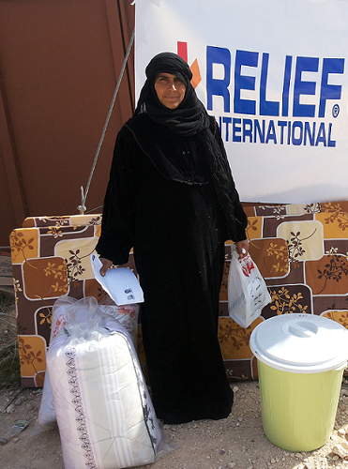
Distribution
AFTER
Monitor beneficiary satisfaction with the distribution process and the hygiene items.
Monitoring may also highlight where items have been sold in order to purchase items that are considered more important e.g. food or medicines, and may thus highlight other unmet needs.
Compile distribution reports of items distributed, the number of people receiving items and their level of satisfaction with the items received.
Reconcile stock levels with broken or defective items etc. Document emerging issues and lessons learnt.
Ensure that lessons learnt feed into subsequent distributions.

Slide 8
Lessons learned
LESSONS LEARNT
It's important to considered items quality insuring the satisfaction and safety of beneficiaries. And longer period of usage.
It's important to ensure providing enough quantity regarding to Criteria fit with real basic needs. Consideration of enough quantity and next distribution date.
It's important to take into confederation to ensure affected population participation choosing items depends on priorities and real needs.
It's important to provide the affected population with item samples during assessments.
It's important to provide leaflet to accompany the materials distributed. This should clearly explain the contents of the kit, and related key massages
Ensure knowledge and distribution mechanism fit with existing cultural practices. E.g. shame to wait at line, shame to be recognised by others at line.
Ensure making communication channels with beneficiaries, encase of location removal.
Ensure that items fit with beneficiary's basic cultural and personal satisfaction.

Slide 9
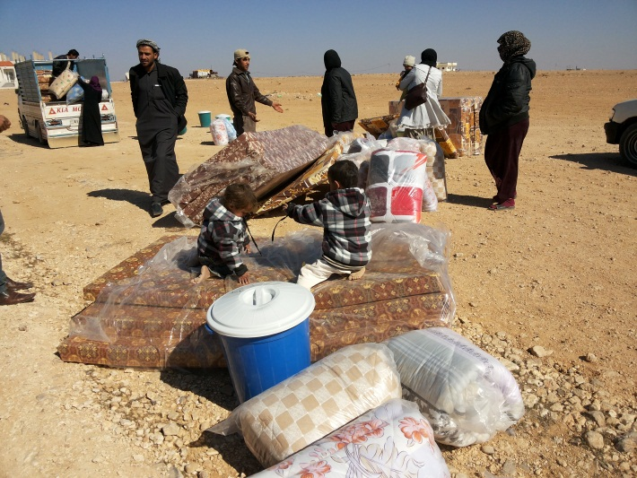
distribution
Ensure at central point Distribution,
- Coordination with local Authorities,
Providing safe central distribution location, security,…
- Coordination with community leaders,
1. Closer distribution location to beneficiaries, avoiding transportation costs, and transportation obstacles.
2. Identify locations in order to conduct FGDs and community sessions.
3. Identify mechanism with community and community leaders to be involved choosing items.
4. Follow-up with community leaders any removal HHs from location to another.
- Coordination at INGOs level insuring NO overlap and duplications.
- ensure to identify the criteria used to beneficiaries, why they are listed, and why others not.
- ensure possibility of distribution location with two gates avoiding crowded in 2 ways.

Slide 10
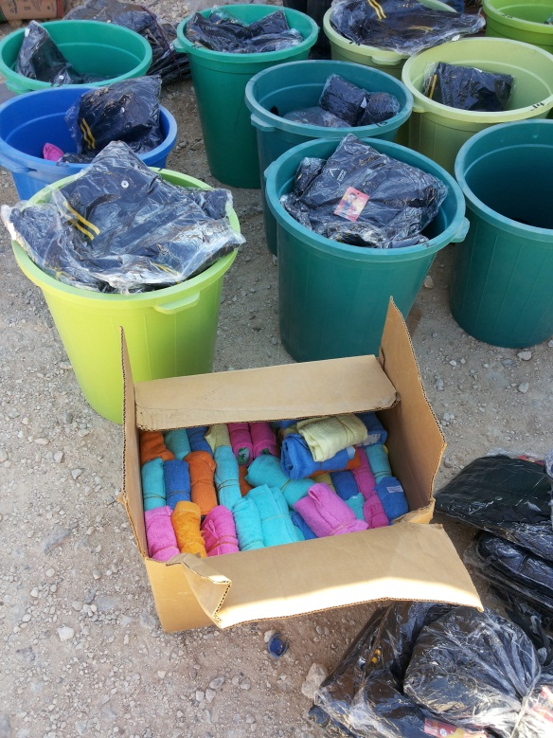
Lessons learned
Ensure to monitor affected population and their level of satisfaction with the items received.
Ensure to monitor affected population and their level of satisfaction of distribution process.
Ensure and before distribution activity checking items level with broken, defect or any other storing errors.
Reconcile stock levels with broken or defective items etc. Document emerging issues and lessons learnt.
Ensure that lessons learnt to avoid obstacles and challenge to improve overcomes at subsequent distributions.
Thank you

