Slide 1

UNHCR‘s Policy on the Protection of Personal Data of Persons of Concern
- An introduction
(October 2016)

Slide 2
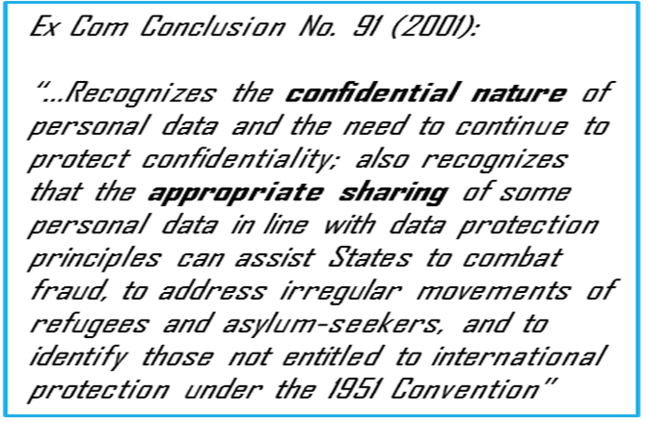
UNHCR and Data protection
The right of every person under international human rights law to be protected against the arbitrary or unlawful interference with his or her privacy (Universal Declaration of Human Rights and ICCPR)
Awareness of the particular sensitivities related to the personal data of refugees and asylum seekers
Weighted against the need to share information with Governments and partners to effectively provide protection, assistance and durable solutions to persons of concern
UNHCR developed the first UN policy on data protection in May 2015

Slide 3

UNHCR‘s new Data Protection Policy (2015):
Basic principles:
Legitimate and fair processing
Purpose specification
Necessity and proportionality
Accuracy
Respect for the rights of the data subject
Confidentiality
Security
Accountability

Slide 4
What is considered personal data?
Any data related to an individual who can be identified from that data; from that data and other information; or by means reasonably likely to be used related to that data.
Personal data includes biographical data (biodata) such as name, sex, marital status, date and place of birth, country of origin, country of asylum, individual registration number, occupation, religion and ethnicity, biometric data such as a photograph, fingerprint, facial or iris image, as well as any expression of opinion about the individual, such as assessments of the status and/or specific needs.

Slide 5
Why is it important to protect personal data?
Refugees are fleeing persecution (violation of fundamental human rights)
Refugees lack the protection of their state for fear of being targeted
Refugees are in need of international protection
To ensure refugee assistance and protection, UNHCR and partners collect and record personal data of refugees
Refugee information is confidential and can be shared only following an explicit consent from the concerned individual
Personal data cannot be shared with the country of origin of the refugee
Personal data can be shared on a need-to know basis for a specific purpose to target assistance and/or protection, provided the consent of the refugee is given
Notes:
Objective of this slide: to give the background of the importance of the refugee protection principles in the framework of data protection and confidentially
To highlight: negative implications if data is handled carelessly: risk of refoulement, risk of fraud, inadequate and even dangerous response to the specific needs of the refugee and his/ her family
Importance of the consent. However, the consent needs to be an informed one. That is why, the purpose of the personal information (data) collection, use and sharing with partners other than the ones who are collecting the data.
Examples and making analogy to refugee situations will be more reflective and will help bring home the message.

Slide 6
What is my obligation as an enumerator to ensure that personal data is protected?
Provide counseling to the refugee about the purpose of the personal data collection
Obtained informed consent from all the adults in the family/ household
If there are any concerns expressed by the refugee about the sharing of personal information with other parties, bring this situation to the attention of your supervisor and UNHCR focal point
Do not disclose information about the refugee to those who are not authorized to have access to such data
Do not share information electronically or otherwise collected other than through the means and procedures as detailed in the standard operation procedures
Notes:
Objective of this slide: to explain the duties and obligations of an enumerator in the framework of the data protection policy
To highlight: data protection of refugees depends of our understanding of the procedures and our implementation of the procedures.
Main obligations:
Provide counselling
Obtain consent
Do not share and disclose

Slide 7
What should you do if you consider there was a personal data breach?
Steps as recommended in the SOPs

Slide 8
Consent
This form should be read to the principal applicant /primary caregiver (in the case of a PA under 18 years of age) in his/her first language. It should be clearly stated that the principal applicant is under no obligation to give his/her consent.
☐ I confirm that the volunteer _____________ [insert name] conducted the home visit on __________ [insert date] and that the volunteer introduced him/herself clearly, that he/she explained the purpose of the questions, and that the questions were asked in a way I was able to understand.
☐ I give my consent for my name, contact details and UNHCR case number to be shared with UNHCR partner organizations providing assistance and responding to refugee needs in Jordan.
☐ I do not wish to share my information. I choose for my information to be hosted exclusively by UNHCR [and the partner agency conducting the Home Visit –
INSERT NAME HERE].
☒ I understand the importance of providing accurate and complete information and to keep UNHCR [and partner agency conducting Home Visit –
INSERT NAME HERE] informed of any changes to my situation (births, deaths or marriages etc. in the family) by calling the UNHCR HelpLine at + 962 640 08000 from Sunday to Thursday [or INSERT PARTNER AGENCY METHOD FOR CHANGING DATA HERE].
It has been explained to me that opting not to share my information may impact on my ability to access certain services. I will, however, continue to access services relating to health, education and protection regardless of whether I consent to share the information provided by me in this Home Visit.
It has been explained to me that shared information will be strictly limited to what is necessary for extension of services and will not be shared further.
It has been explained to me that I can change my mind about sharing my information by calling the UNHCR Help Line at + 962 640 08000 from Sunday to Thursday.
It has also been explained to me that if I have concerns about the way my personal information is being used, I can file a complaint with (i) UNHCR Jordan by contacting the HelpLine at +962 640 08000, or (ii) The Inspector General’s Office of UNHCR in Geneva either by phone (+41 22 739 88 44 – not toll-free, telephone charges apply), fax (+41 22 739 73 80 – not toll-free, telephone charges apply), by confidential email (Inspector@unhcr.org) or by using the online complaint form (http://www.unhcr.org/pages/52e11bc16.html).
Principal applicant’s signature: Date (dd/mm/yyyy)

Slide 9
Thank you

