Slide 1
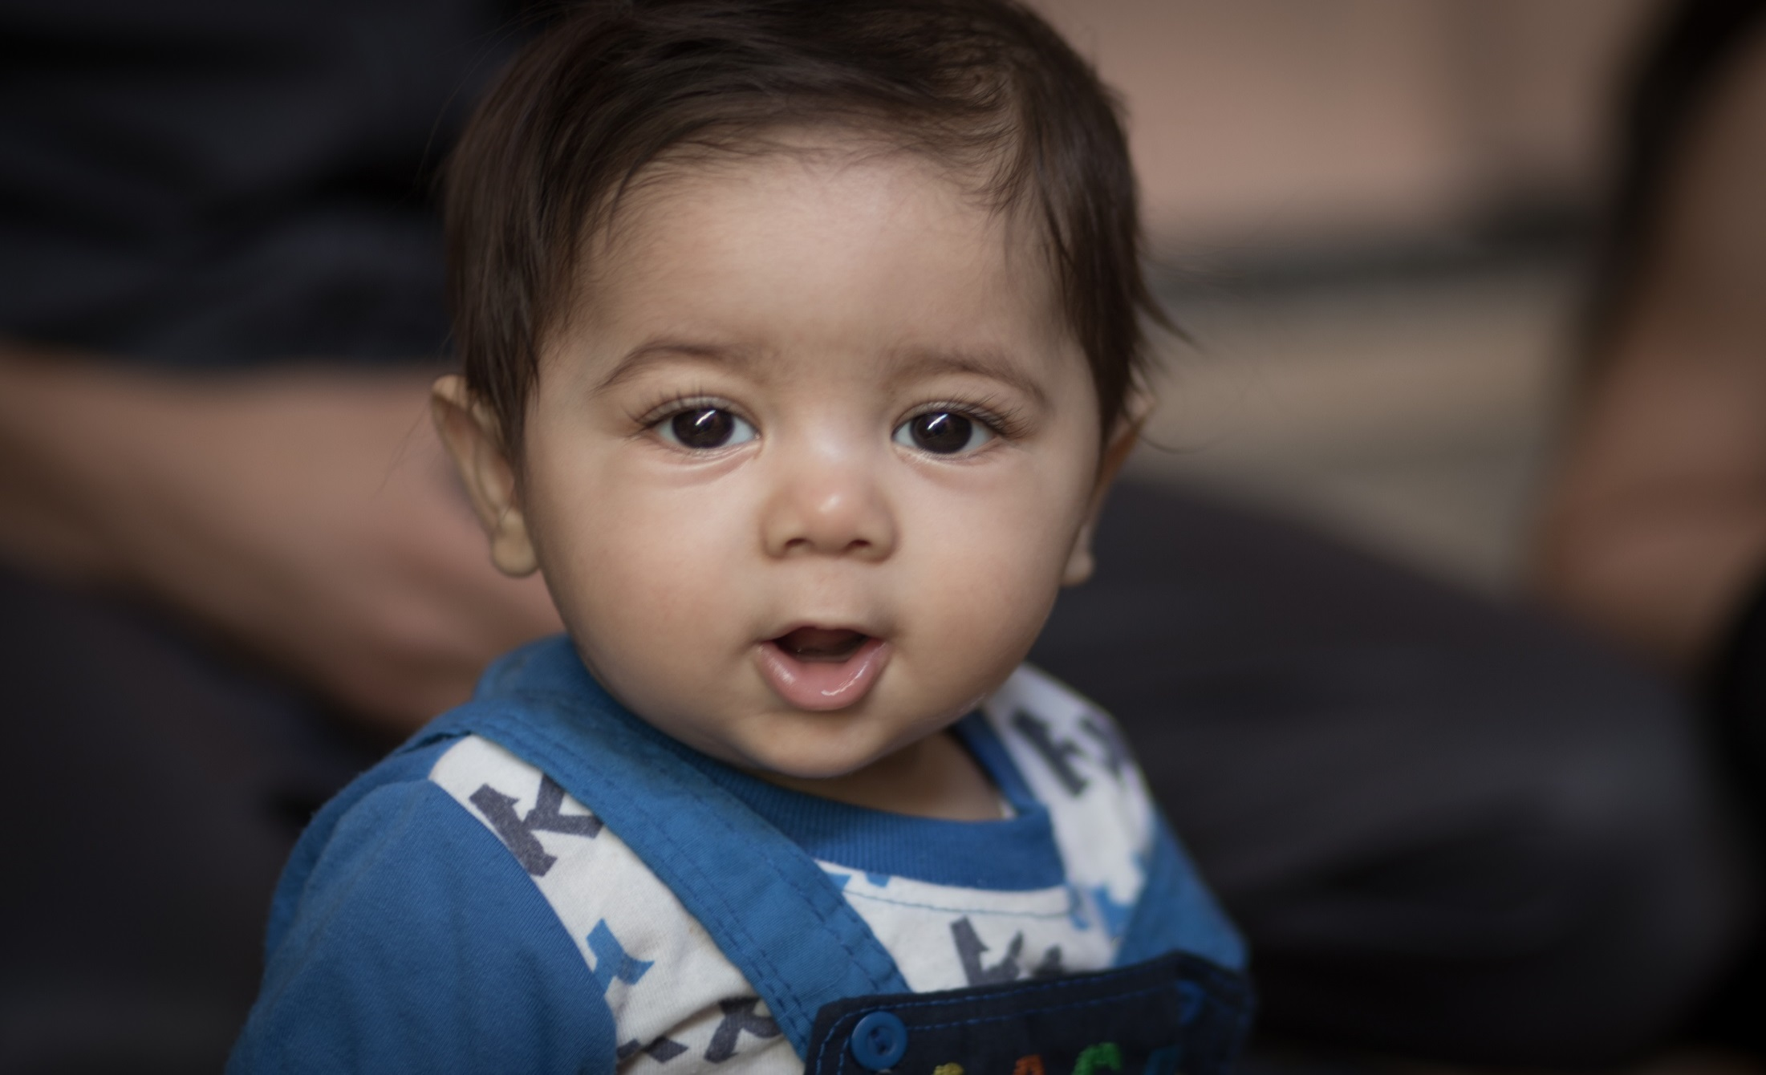
UNICEF Child Cash Grant Programme Post Distribution Monitoring (February – August 2015)
Jawad Aslam
Social Policy Specialist
Basic Needs Working Group
09 November, 2015 (Monday)

Slide 2
Outline of Presentation
UNICEF Child Cash Grant Programme
Purpose of Post Distribution Monitoring
M&E Framework: Theory of Change
Methodology
PDM Analysis: Key Findings

Slide 3
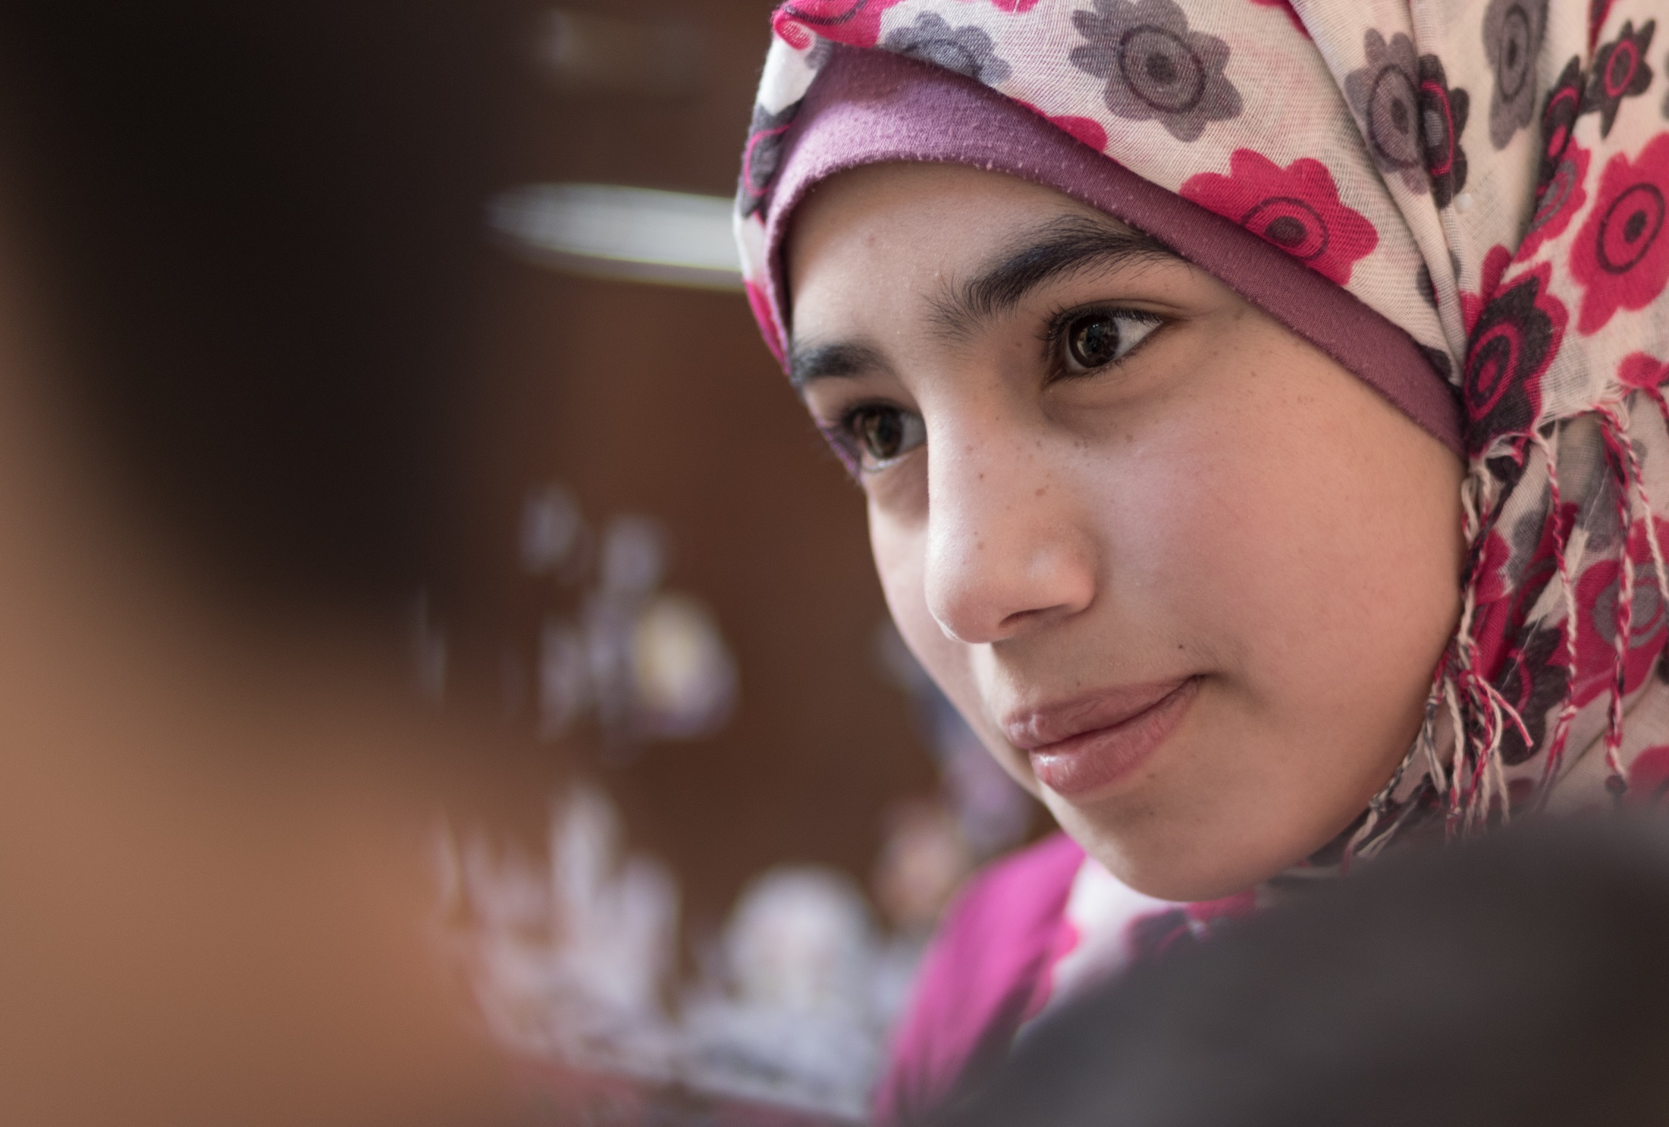
UNICEF Child Cash Grant Programme

Slide 4
Unconditional Child Cash Grant
February 2015, targets the most vulnerable children and their families out of 84% Syrian refugees living in the host communities.
UNICEF CCG current coverage is 23% of the most vulnerable Syrian refugee children living in the host communities in Jordan.
JOD 20 (USD 28) per month per child.
Partnership with UNHCR to work through common targeting and payment system: minimum operational costs while maximizing the actual share of donor funding received by beneficiaries.
Change in the number of children per month

Slide 5
Data: August 2015
Total number of children: 55,091
Number of children: age and gender

Slide 6
Number of children: under abject poverty, absolute poverty and with specific needs

Slide 7
Number of unaccompanied and separated children, children with disability and special protection needs

Slide 8
Number of children per governorate

Slide 9
Number of children per family (FHH and MHH)

Slide 10
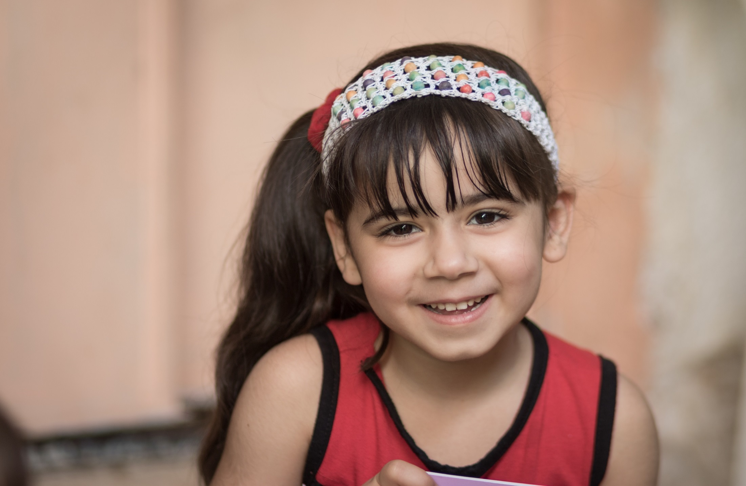
Purpose of Post Distribution Monitoring
“Once I receive the text message, my children started jumping out of happiness”. (FGD 1, Participant 10)

Slide 11
Independent third party monitoring
Core element of UNICEF CCG Programme which enables UNICEF to effectively and efficiently measure progress at the activity, output and outcome levels.
Regular (bi-monthly) data
To determine whether the CCG programme progress as planned? Programme achieving intended results at output level? Any trends are observed at the outcome level?
Track immediate intended and unintended results
Expenditure patterns especially those related to children basic needs, and use of negative coping mechanisms.

Slide 12
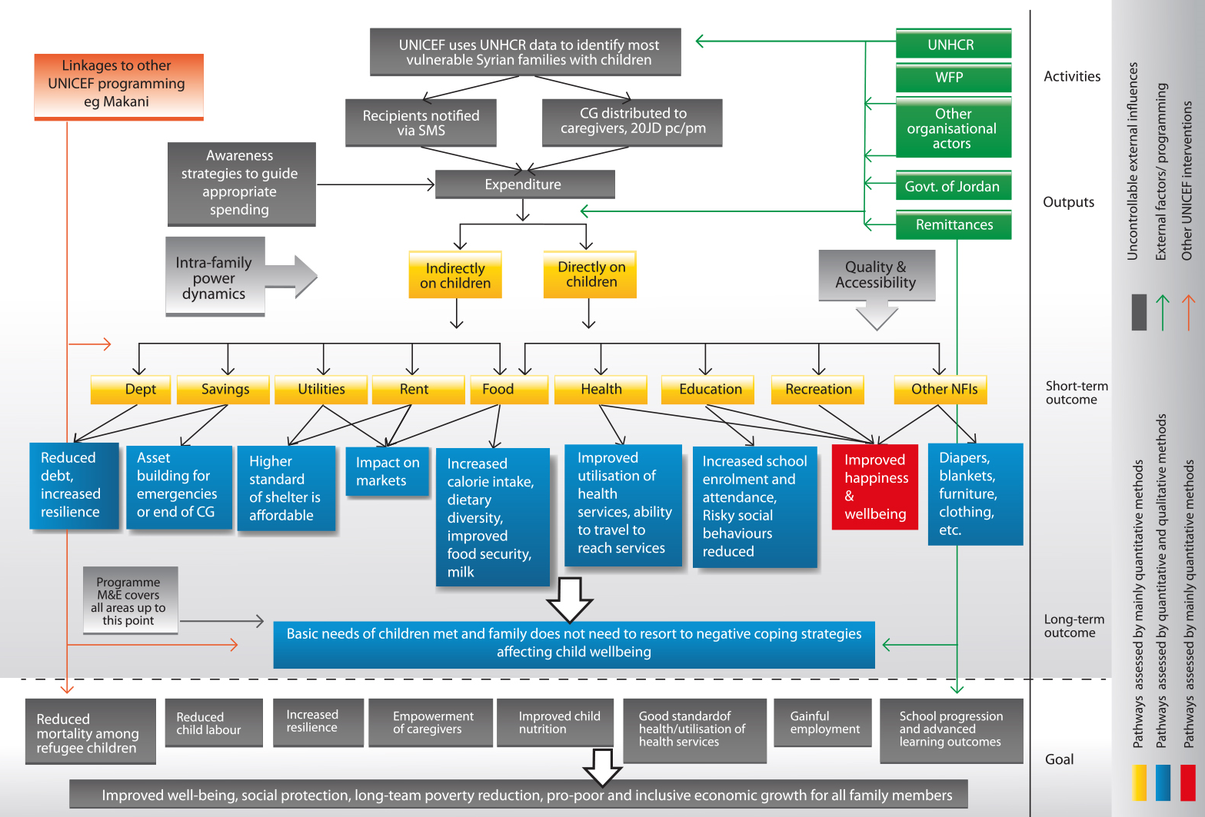
M&E Framework: Theory of Change

Slide 13
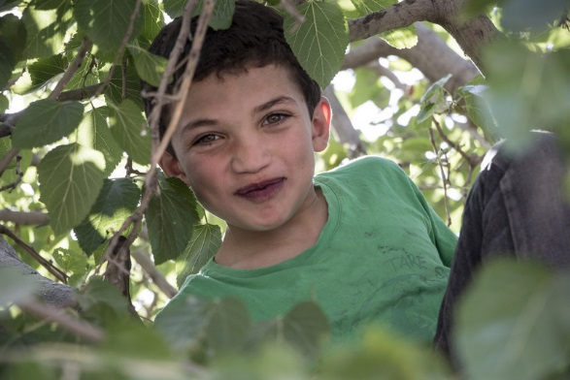
Methodology
“The cash grant for me is like I’ve been in a desert and I’m so thirsty, and someone gave me a cup of water”. (FGD 1, Participant 10)

Slide 14
Combination of Quantitative and Qualitative Methods
PDM Questionnaire main sources of quantitative data. Geographically representative 500 Syrian refugee families out of more than 15000 beneficiary families.
Focus group discussion and case study interviews are main sources of
qualitative data.
Five Focus Group Discussions:
PDM 1: Irbid (1) FFH under abject poverty, Amman (1) MHHH under absolute poverty.
PDM 2: Amman (2) FFH under absolute poverty, MHH under abject poverty, and Irbid (1) MHH special protection needs.
2 case study interviews (1 in each round of PDM).
Data collection conducted in the month of June (PDM 1) and August (PDM2).

Slide 15
PDM Analysis: Key Findings
“I used to feed my children only twice per day, now I feed them three times”. (FGD 2, Participant 10)

Slide 16
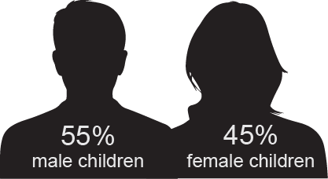
Sample Characteristics
Sample distribution by poverty level and gender
58%
Age of children of sample families and gender

Slide 17
Income
Sources of income and main contributors

Slide 18
Awareness of CCG and Distribution Mechanisms
High level of awareness of both purpose of child cash grant and its source: 99%
Awareness of UNICEF CCG Duration

Slide 19
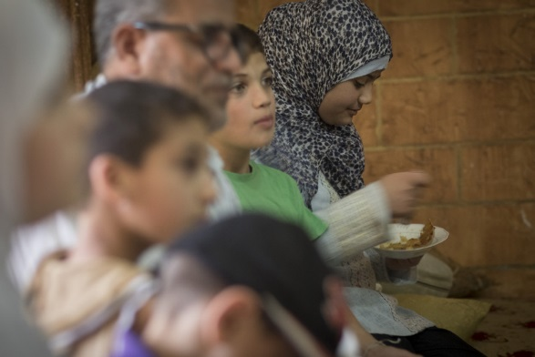
Expenditure Patterns

Slide 20
Main Expenditure items on which Cash (incl. UNHCR) is spent
(% of mentions by respondents)

Slide 21
Main Expenditure items on which Cash (incl. UNHCR) is spent
PDM 1 and 2 compared

Slide 22
Main expenditure items on which total cash assistance is spent

Slide 23
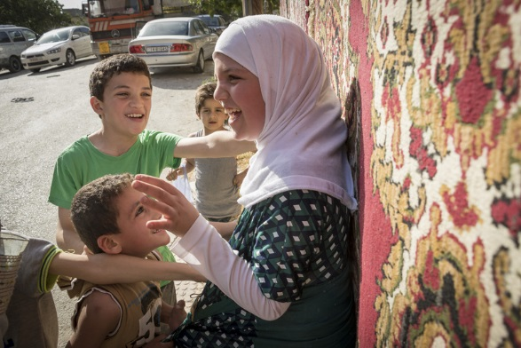
Child Specific Expenditure

Slide 24
Improvement in overall living conditions
UNICEF CCG contribution to improving family wellbeing

Slide 25
Fulfilling basic needs of children
Extent to which UNICEF’s CCG covered basic needs of children
Extent to which UNICEF’s CCG covered basic needs of children – Poverty Level

Slide 26
Child specific expenditures on which UNICEF’s CCG is spent

Slide 27
Child specific expenditures on which UNICEF’s CCG is spent
PDM 1 and 2 compared

Slide 28
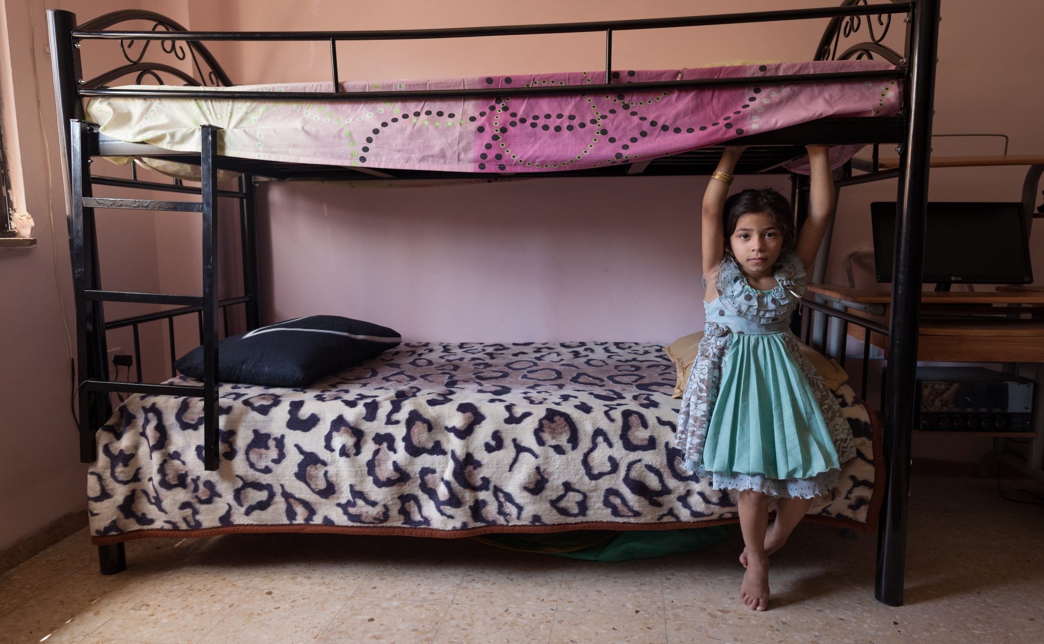
Use of Coping Mechanisms

Slide 29
Most common coping mechanisms currently in use

Slide 30
Coping mechanisms stopped/avoided due to receipt of UNICEF’s CCG

Slide 31
Coping mechanisms stopped/avoided due to receipt of UNICEF’s CCG
PDM 1 and 2 compared

Slide 32
Thanks

