Slide 1
Child Protection Information Management System In Jordan
Briefing for regional child protection workshop

Slide 2
What is the CP IMS?
The Child Protection Information Management System facilitates inter-agency case management and data analysis through the implementation of common protocols and forms by agencies involved in case management
It supports safe and confidential sharing of Child Protection Case management data for protection and programme purposes

Slide 3
Purpose
Consolidated reports will be collected on the basis of child protection (CP) cases managed by CPIMS partners and will serve the following purposes:
Facilitate CP case management, particularly in emergencies;
CP prevention and response program planning, monitoring and evaluation;
Identification of programming and service delivery gaps;
Prioritization of actions and follow up;
Improved timeliness and service delivery;
Policy and advocacy;
Resource mobilization;

Slide 4
Organizations
Coordination:
UNHCR & IMC
Compilation:
UNHCR & IMC
Data gathering Agencies:
NHF/IFH
JRF
IRC
IMC
UNHCR
UNICEF (MRM)
Technical support:
UNICEF

Slide 5
Locations in Jordan
Amman Governorate
Zarqa
Mafraq Governorate (including Zaatari Camp)
Irbid Governorate (including Cyber City and King Abdullah Park)
Emirate Jordanian Camp
Azraq Camp
South of Jordan ( including Ma’an, Aqaba,Tafileh)
Jordan Valley (including Balqa and Madaba)
North ( including Ajloun and Jerash)

Slide 6
Information sharing
Information Sharing and Data Sharing Protocols ( ISP and DS) are currently being finalized by the CPIMS Task Force.
The CPIMS module in RAIS (Refugee Assistance Information System) was created by UNHCR in June 2014 in consultation with the UASC & CPIMS Task Force. Final compilation of data is conducted through the module.
The information collected in the CPIMS module in RAIS can be easily exported and imported from the Inter-Agency CPIMS without compromising the confidentiality and security of the data. As such, CPIMS Task Force members may opt (to use) either of the information gathering and case management systems as per the procedures preliminary established in the ISP and DS Protocols;
Children files can be shared automatically through the online module and electronically through the standard inter-agency modules. The CPIMS indicates the status and progress of the case.
Compiled Tracking sheet will be shared with all the CPIMS Task Force members of a monthly basis. Analysis and statistical reports will be shared with pre-approved actors twice a year.
Any request from external actors for access to consolidated CPIMS information must be directed to the UNHCR and IMC Focal points.

Slide 7
Components of the CPIMS in Jordan
standard set of forms
data
protection
protocols
Information sharing protocols
database

Slide 8
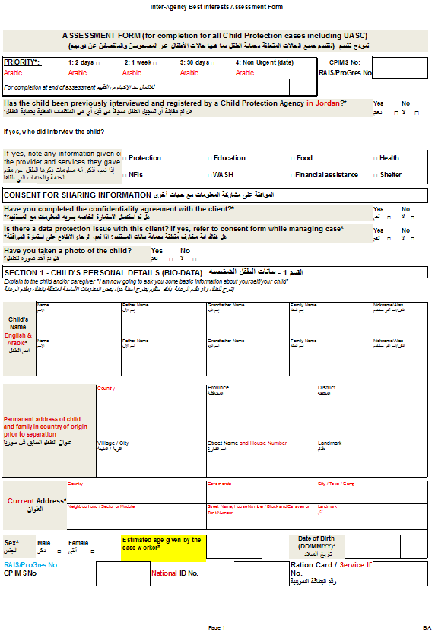
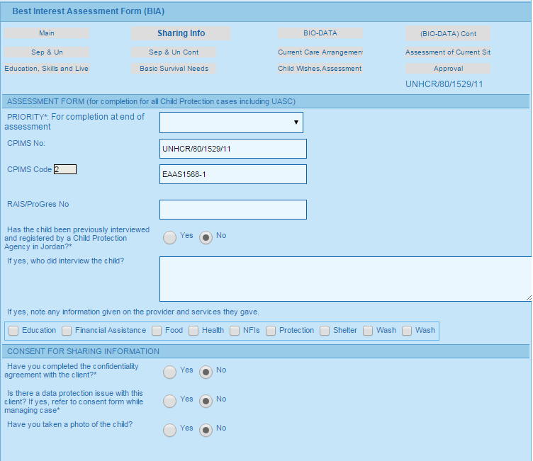
Best Interest assessment

Slide 9
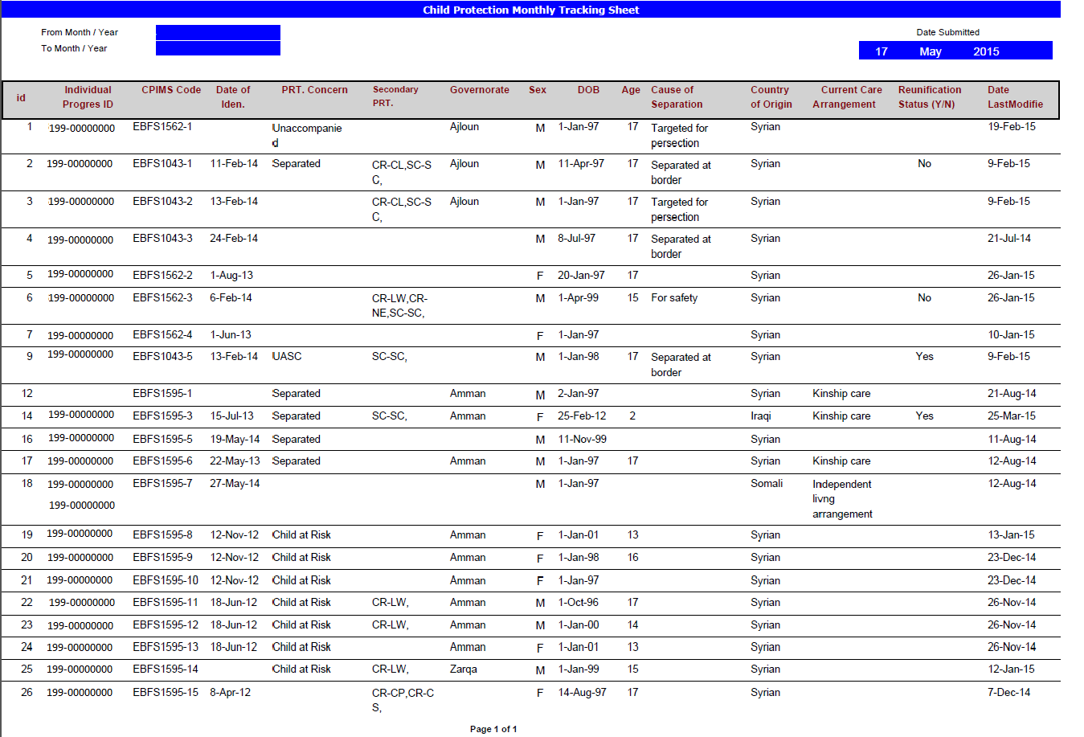
Common Tracking Sheet

Slide 10
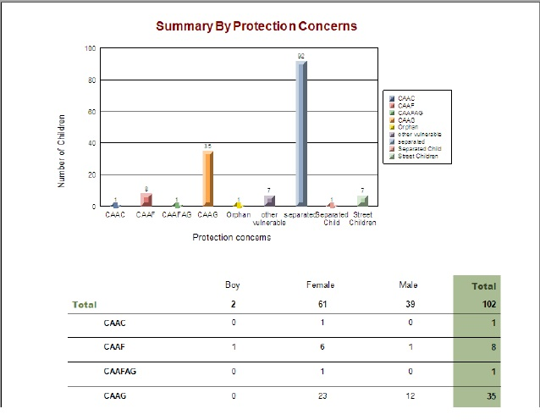
Sample of annual statistics reports
Caseload summary by Protection concern

Slide 11
Any Questions?

