Slide 1
Data sharing practices in the region
Interagency Tool for:
Vulnerability Scoring requesting new beneficiary lists
VAF Module
JORDAN Mission
Notes:
*Please note that this module is only available to VAF Partners who have signed an MOU with UNHCR. For more details on how to become a VAF partner please contact JORAMDAT@unhcr.org
*To get access to the VAF module after your organization has become a partner individual users can please contact JORAMDAG@unhcr.org to add the module to your user profile

Slide 2
The Vulnerability Assessment Framework (VAF) defines vulnerability as:
“the risk of exposure of Syrian refugee households to harm, primarily in relation to protection threats, inability to meet basic needs, limited access to basic services, and food insecurity, and the ability of the population to cope with the consequences of this harm.”
A key objective of the Jordan Refugee Response has been to ensure that humanitarian resources have been used efficiently and effectively, as a commitment to both donors, the Government of Jordan and to the refugees themselves. Targeting of assistance to the most vulnerable refugees is a part of this commitment. As a result in January 2014, the Vulnerability Assessment Framework (VAF) process was launched in Jordan with the primary objective of developing a robust model that could be applied across the Syrian non-camp based population to assess multiple vulnerabilities and provide the humanitarian country specific information at Kingdom wide, district and household levels. The VAF is a combination of a number of components all of which build on the development of the Vulnerability Assessment Framework.

Slide 3
The VAF process seeks to put in place an observation and reporting system that, using a mixture of static and dynamic indicators, supports the humanitarian community to:
1. Establish a profile of vulnerability across Syrian refugee households and enable monitoring of changes in vulnerability over time;
2. Target assistance in a more efficient and equitable manner, based on the application of common vulnerability criteria; and
3. Strengthen coordination and decision making of the delivery of humanitarian assistance.
Access to already pre-assessed vulnerability scored cases is accessible through the VAF RAIS Module through becoming a VAF partner; for more info contact JORAMDAT@unhcr.org

Slide 4
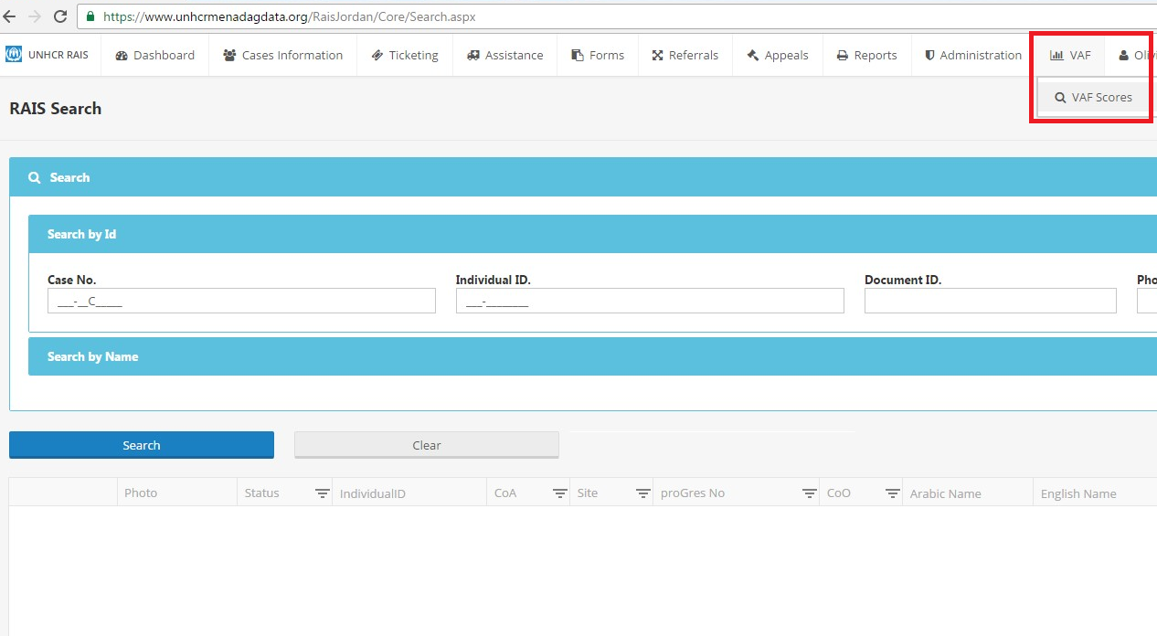
Notes:
Select module
*Please note that this module is only available to VAF Partners who have signed an MOU with UNHCR.
For more details on how to become a VAF partner please contact JORAMDAT@unhcr.org

Slide 5
For new data requests:
Who can submit a VAF data request?
VAF partners – also required to have RAIS access to enable them to access the module.
VAF partners will have to submit an Annex 1 specifying the exact selection needed.
Annex 1 enables partner partners to request the refugee biodata with the VAF scores which correspond. I.e. Case ID, PA name, address, phone number and family size, + VAF scores.
This allows partners to access Biodata and VAF scoring for new beneficiaries.
Non- VAF partners can make a request by contacting JORAMDAT@unhcr.org and will have to sign a formal MOU prior to the release of data.
How is this different to the VAF module search function?
The VAF module search function does not display any refugee biodata in the screen; and is limited to Case ID, PA Gender, Governorate and district. This allows partners to access VAF scoring for their existing beneficiary lists. But for additional information for new beneficiaries a data request has to be created.

Slide 6
When to submit a VAF data request
When to submit a VAF data request?
Organizations request data from UNHCR for sector led programmatic interventions. In the event that an organization receives a new tranche of funding and needs additional or new beneficiaries including their biodata. To begin the process an Annex 1 needs to be submitted to JORAMDAT@unhcr.org and online request through RAIS for VAF partners ONLY.

Slide 7
Go to VAF scores page:
Notes:
Select Form: VAF_ver1
Select Scores required
Create data request after Annex 1 has been submitted and sent to JORAMDAT@unhcr.org

Slide 8
Select relevant fields required:
Notes:
Select your biodata fields needed:
Case No, Location, PA Name, PA mobile phone, PA sex and submit request.

Slide 9
Check status of request: VAF Data Requests
Notes:
Once signed Annex 1 request received by JORAMDAT team
Data request to be approved by UNHCR.
After approval organizations can go to the VAF Data Request Module screen and download file as below via the download icon.

Slide 10
Download data directly from RAIS once approved
Notes:
Please note that individuals using UNHCR refugee biodata are subject to compliance to UNHCR’s Policy on the protection of Personal Data of Persons of Concern to UNHCR. Access to the policy can be found in hyperlink.
If you have any questions on UNHCR’s Data sharing policy please contact JORAMDAT@unhcr.org

