Slide 1
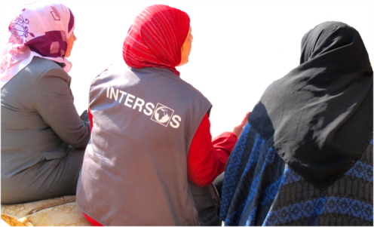


  Inter-sectorial emergency program in Irbid governorate
February
February 2014

Slide 2


  The project (I)
To provide vital relief assistance through improvement of overall living conditions
  Expected result: Improved living conditions for Syrian crisis affected population in Jordan through shelter rehabilitation, protection monitoring and hygiene kits distribution
Syrians refugees - vulnerable Jordanians
Funded by ECHO
August 2013 – May 2014
Integrated approach
SHELTER
HYGIENE KIT DISTRIBUTION
PROTECTION MONITORING

Slide 3
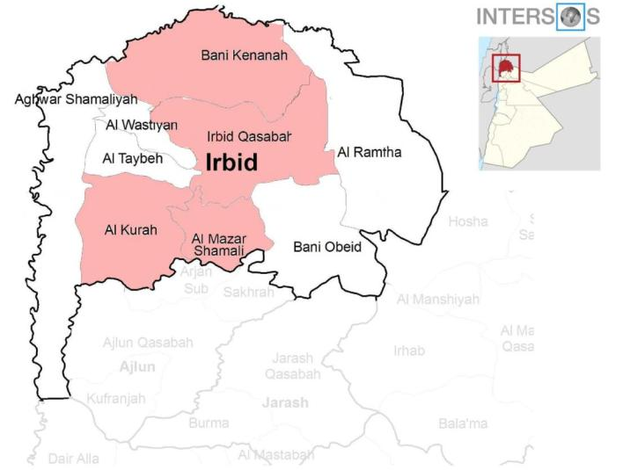
  The project (II)
Jdeta
Kufur Awan
Kufur youba
Alall
Huara
Bait ras
Duqra
Bushra wa Sal
Al Maghayr
Kharja
Samma
Sahem
Habakah
Hakama
map

Slide 4
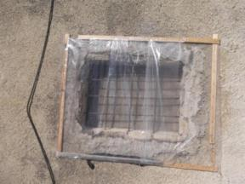
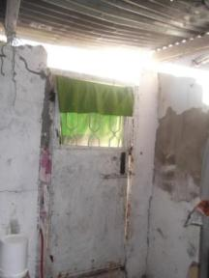
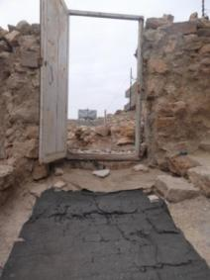
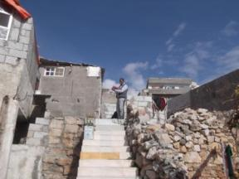

Activities/I : house rehabilitation
Target: 200 highly vulnerable HHs
Improving insulation
Improving safety and security
Reducing the risk of waterborne disease

Slide 5
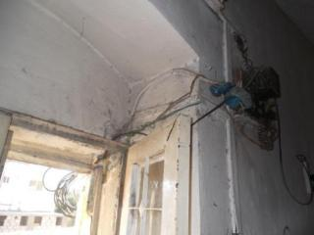
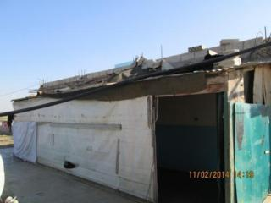
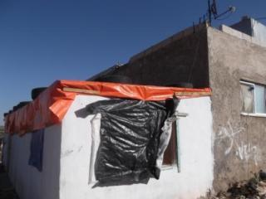
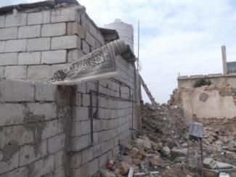
Installing of doors, windows, locks, treatment of rot and mould, rehabilitation of existing electrical system.

Slide 6
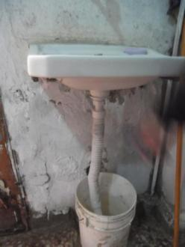
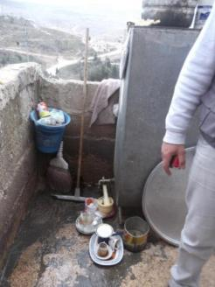
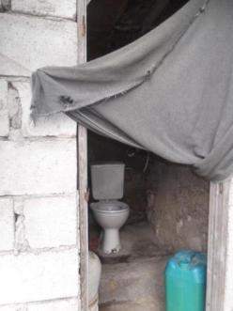
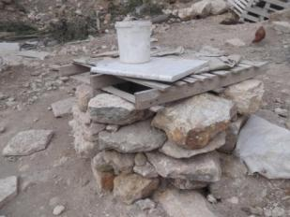
Connection to water supply is provided, WASH facilities and kitchen are rehabilitated, in order to diminish the risk of waterborne disease.

Slide 7
Activities/II : hygiene kits distribution
460 HHs identified as vulnerable will receive hygiene kits:
  200 HHs selected for rehabilitation
  An additional 260 HHs identified as vulnerable
Four kits distributions over the course of the project for the 460 targeted HHs
Hygiene kit ditribution & Hygien Promotion (WASH HP WG standardised hygiene kits for host communities)

Slide 8
Activities/III: protection monitoring
Ongoing protection monitoring
Target: previously assessed and newly arrived families
  Identification/assessment
  Referral(s)
  Direct service provision/integration with UNICEF/OCHA funded project (CFPs and PSS basic services & Community and Family support )
Identification of targeted future interventions
Increased coordination PWG/ CP WG/SGBV WP at regional and national level
Addressing gaps in protection response
Notes:
.

Slide 9
Methodology/I: Rapid Screening
August 2013: First Rapid screening through CBO Al Nama’ Al Thaqafiva database of Syrian families (857 families screened).
Development of INTERSOS vulnerability matrix : 6 macro vulnerabilities:
HHs with high vulnerability identified
Follow up visit(s) for cases of concern
Health
Housing conditions
Demographics of household
GBV protection concerns
Child protection concerns
Economic insecurity.

Slide 10
Methodology/II: Assessment
Out of the 857 families screened in August, INTERSOS is assessing the HHs which declared 4 to 5 vulnerabilities and/or special protection concerns like GBV, UASC, Child Labour, Domestic Violence (22% of the total)
Simultaneously, field teams are conducting outreach in partnership with local CBOs in each village to identify highly vulnerable HHs
This system allows the identification of :
  Newly arrived refugees
  Jordanian families
  Other vulnerable cases not included in the initial screening.
Key Priority: UASC, GBV cases, CP cases, FHH

Slide 11
Methodology/III: Selection Criteria (1)
Final beneficiary database: all assessed households
Selections are being made through the application of a two-tier scoring system, which takes into account:
shelter needs of the household based on a technical assessment. among the criteria used in the technical assessment sheet:
    WASH facilities;
    Insulation;
    Security & safety.
household vulnerability across six categories:
    Demographic data (HH size, gender, age);
    Health (medical, disabilities, PSS needs);
    Household security (including perceived risks);
    Women specific concerns (pregnancy, FHH, single mothers) ;
    Child specific concerns (child labor, school attendance, UASC);
    Economy/income (including assistance received.)

Slide 12
Methodology/III: Selection Criteria (2)
Insertion in shelter program + hygiene kit distribution:
  HHs with high vulnerability in the two macro categories (technical shelter assessment and HH vulnerability assessment across the 6 categories)
  HHs with High vulnerability in shelter & medium vulnerability in HH vulnerability assessment
Insertion in hygiene kit distribution:
  HHs with high vulnerability in HH vulnerability assessment and low vulnerability in shelter
Protection monitoring: on need basis
This selection process ensures a systematic, measurable and accountable approach to beneficiary selection

Slide 13
Methodology/IV: agreement with landlords
A system has been foreseen to guarantee the sustainability of the project in the medium-term:
Jordanian landlords will
sign a legal agreement:
not to increase
rent for the 12 months
following the end of the
project
Tenants can remain
in their newly
rehabilitated houses
without fear of
eviction

Slide 14
Methodology/V: Referrals
Protection trained field staff will identify cases of concern during household assessment and outreach activities.
Such cases will subsequently be referred to specialised service providers in the area in coherence with:
  IA procedures
  Irbid Coordination Group mechanisms
  CP/GBV SOPs.
Monitoring of protection concerns, risk, threats, vulnerabilities and identification of possible intervention in the area of operation

Slide 15
Data collected so far: HH demography
233 HHs assessments
183 HHs already analyzed (ongoing);
1345 individuals from 1st January 2014
HIGHLIGHTS
52% female,
48 % male
4% elderly (60+)
39% adults (elderly included)
61% are children:
  32% are 11 or under,
  22% are 5 or under and
  9% are 2 or under.

Slide 16
Data collected so far : HHs demography (II)
HIGHLIGHTS:
Average number of people in HH = 7
Highest number of people in HH = 27
Average (median) family size = 6
Highest number of family members = 10
35% of households surveys had more than one family sharing the accommodation
Average (median) number of families in household = 2
Average number of rooms per HH = 2
65% report overcrowding (5 or more sleeping per room) with highs of 13
80% registered with UNHCR
20% Jordanian cases

Slide 17
Data collected so far : Health
HIGHLIGHTS
23% HHs with at least one member living with disability (6% severe)
17% HHs with at least one member which reported PSS disorders, often affecting whole family.
39% HHs with at least one member with health problems (8% severe)

Slide 18
Data collected so far: socio-economic

Slide 19
Data collected so far: socio-economic
MAJOR KEY FINDINGS (to be cross-checked):
82% of HHs have been recorded as highly vulnerable (factors include: debt, income per person per month and whether or not receiving assistance)
50% of HHs place cash first on list of priorities, 100% within the top 3.
70% of HHs have income of less than 50JD per person per month
17% of HHs reported to have no income
29% of HHs reported to have an income of less 15JD per person per month
70% of HHs reported debt
83% of HHs reported to receive no cash assistance
10% HHs reported child labor
48% reported to have an income from some form of labor (average monthly salary is 150 JD)

Slide 20
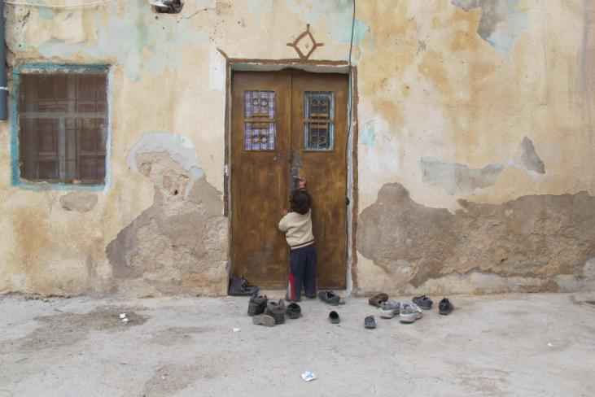
Challenges:
Avoid overlapping
Implement a comprehensive need response
Identify and strengthen existing coping mechanisms
Ensure landlords cooperation and commitment
Community participation/acceptance
Overcrowded shelters vs. limited resources

Slide 21
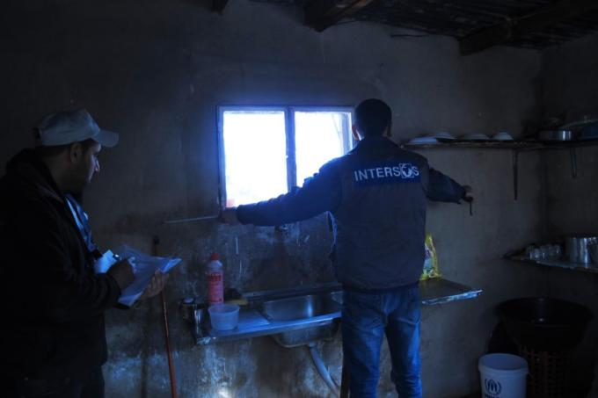
Questions?
Thank you!

