Slide 1
Data sharing practices in the region
Interagency Tool for:
Assistance Coordination:
Bulk Upload Function
JORDAN Mission
Notes:
These training sessions shall be periodically updated with system developments; please contact Joramdag@unhcr.org if you have any queries.
Background on RAIS RAIS was initially developed by UNHCR Jordan in 2009 to address the demands for a more coordinated approach by partners delivering refugee assistance. In 2009 refugee assistance targeted Iraqi refugees and included healthcare, education, and material assistance packages. Following its success in Jordan, RAIS was later rolled-out in Lebanon and Syria as part of efforts to share ‘best-practices’ across the region. In 2012 a review of the system and current operational needs was conducted which led to the release of RAIS v2. In 2014 new modules were incorporated into RAIS including the vulnerability assessment framework, assessment management, and offline functionalities. In 2015 RAIS continued to enhance with additional modules for assistance coordination, referrals and ticketing. RAIS is now the main coordination tool for assistance delivery in countries across the region (Lebanon, Jordan, Egypt, and Iraq). Over 200 partners are now actively using RAIS which represents over 500 individual users. Since June 2014, 150,000 Home Visits have been recorded on RAIS, and there are over 7 million assistance records corresponding to 1.5 million beneficiaries. New data exploration tools are now under development and RAIS will continue to be scaled-up across the region and beyond. Interest in RAIS has also been expressed by a number of other country operations such as Ecuador, Libya, India, Israel, Kenya and Yemen. In addition a number of key donors have made its use mandatory as part of their donor agreement with partners, independent of whether or not their funding goes through UNHCR.

Slide 2
Why use bulk upload?
Bulk upload streamlines the process of assistance application to multiple cases simultaneously.
It benefits organizations by spending less time on data entry by using a quick and simplistic process which is non resource intensive.
Reports can directly be extracted from RAIS again providing each organization with assistance summaries for donor reporting.
Bulk upload and application of assistance to cases enables broader operational transparency to avoid providing duplication of assistance at the interagency level. It also enables organizations to look at means to provide complementary assistance to cases = reduction in wastage and more efficient and effective assistance provision.

Slide 3
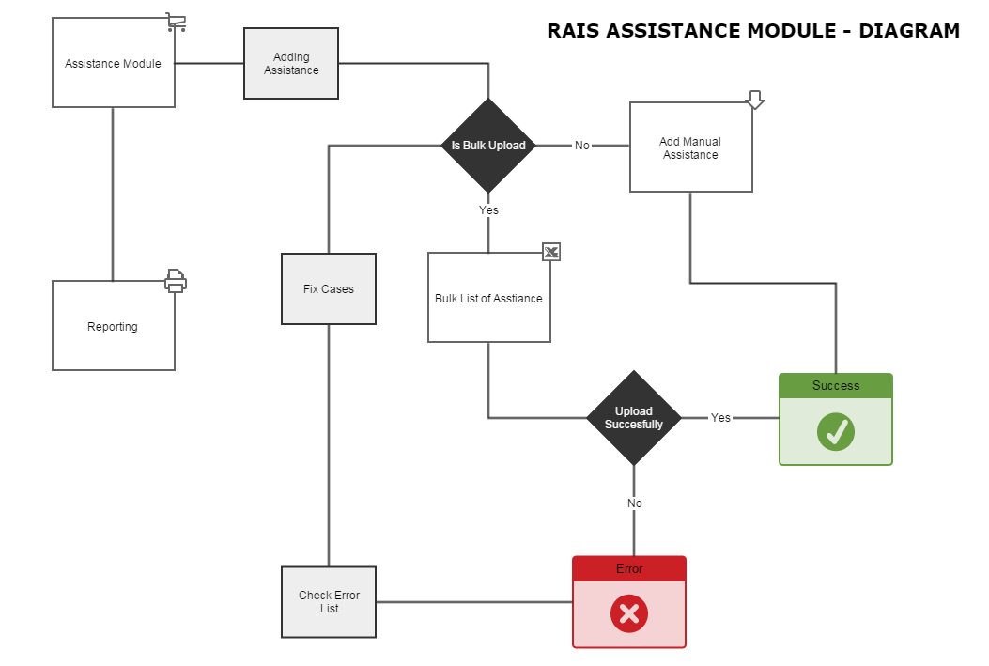
Provision of Assistance
Notes:
The assistance module in RAIS enables organizations to record, coordinate, and report on the assistance provided to persons of concern. The assistance process is outlined in the diagram on the screen.

Slide 4
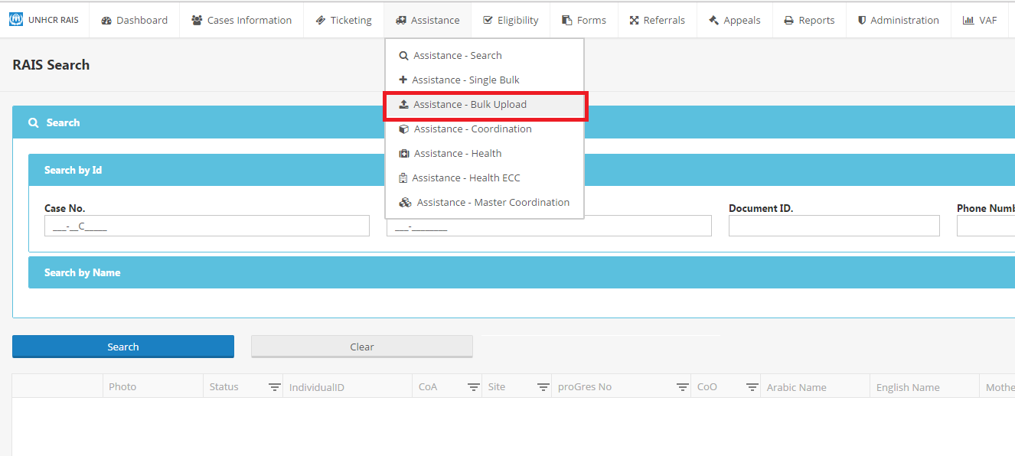
Bulk Upload Module – ‘Provision of Assistance to multiple cases’
Notes:
Select: Assistance – Bulk Upload
Note: for organizations uploading more than 10,000 instances of assistance (at any given time in one batch) please ensure that you undertake your upload either:
early morning before business hours,
after business hours, or
weekends to avoid the bulk upload module itself from failing / timeout or system interruption and traffic for other modules.
By following this advice it will prevent system traffic for everyday RAIS users given the lengthy processing time for large uploads of assistance. This will enable other RAIS user organizations to use this module without delay and without disruption to their everyday business flow.
This applies to organizations with repeat large monthly beneficiary lists i.e. WFP, UNHCR and UNICEF or large one-off distributions not inclusive of camp barcode scanning.

Slide 5
Download Bulk Upload - Excel sheet
Notes:
Download Bulk upload excel sheet:
Enter in data of required fields (do not edit the excel sheet fields – otherwise the system will reject it)
Fields to be entered in to excel sheet
Case no.
Value (JD value given if cash – for other assistance types this field can be ignored)
Fields to be entered in to on bulk upload screen
Organization
Provided By
Assistance Type
Provided Through
Frequency (should remain – one time)
Date Provide (date assistance was distributed)
Funded By
Currency (default should remain JD if cash – if other assistance type please ignore)
The reason why most of the fields should be completed in the bulk upload screen and not the excel sheet is to remove the likelihood of errors and rejections.
Save excel sheet and upload it to the UPLOAD FILE section and click upload assistance information.

Slide 6
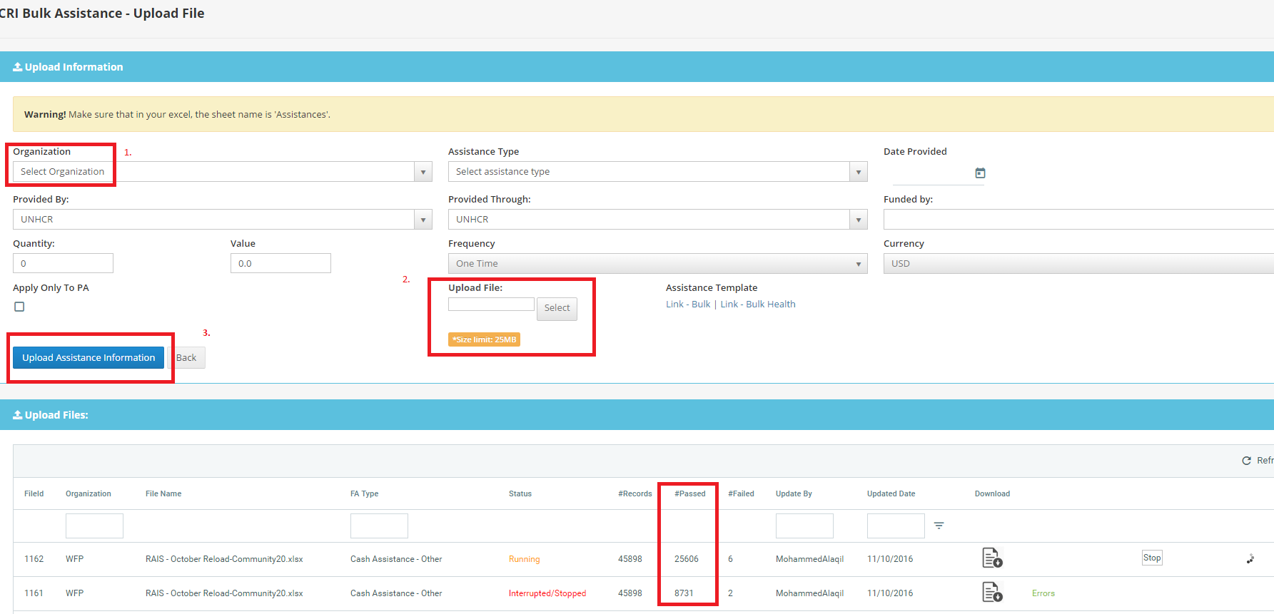
Notes:
*To avoid upload errors ensure data is entered correctly, split number of cases in to maximum files of 10,000 cases per upload to avoid timeout error and interruption. If you do receive errors then those cases shall have to be uploaded again separately.
Select Organization
Select the automatically generated Link-Bulk’ xl file
Upload Assistance Information
Status of upload visible while processing, records passed vs errors, click on ‘Errors’ in green to see explanation of why case failed processing. Cases which require synchronization ‘no designated PA’ are to be referred back to DAG Unit Jo for manual synchronization.

Slide 7
Step by step upload
Download Bulk upload excel sheet:
Enter in data of required fields (do not edit the excel sheet fields – otherwise the system will reject it)
Fields to be entered in to excel sheet
Case no.
Value (JD value given if cash – for other assistance types this field can be ignored)
Fields to be entered in to on bulk upload screen
Organization
Provided By
Assistance Type
Provided Through
Frequency (should remain – one time)
Date Provide (date assistance was distributed)
Funded By
Currency (default should remain JD if cash – if other assistance type please ignore)
The reason why most of the fields should be completed in the bulk upload screen and not the excel sheet is to remove the likelihood of errors and rejections.
Save excel sheet and upload it to the UPLOAD FILE section and click upload assistance information.

Slide 8
Understanding and addressing upload errors
Notes:
Completed Status means assistance has successfully reach the cases, you can search this through the Case search function to double check or via the reporting function.
IF Status advises ‘Completed with errors’ it means that either that all or some cases were not successfully applied with assistance.
In the example above the screen advises that there are ‘7’ failed records, to understand why these cases couldn’t be applied with assistance please click on the ‘Errors’ section on the right of the screen for further information.

Slide 9
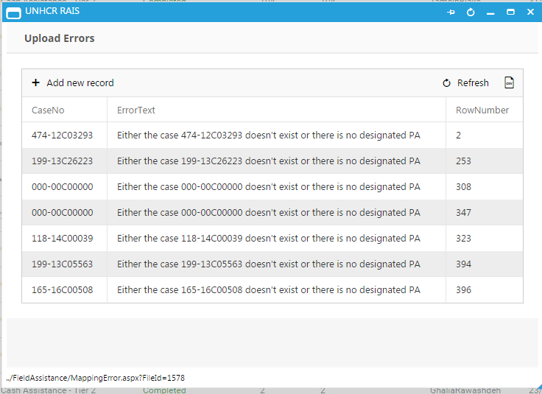
Errors explained cont.:
The Error message ‘Either the case XX doesn’t exist or there is no designated PA – (Principle Applicant)’ can mean 1 of 3 things:
Incorrect case number, case number is not in ProGres or RAIS = update, correct and re-upload with correct Case ID.
Check Case status in RAIS Search Case module:
If Case ID appears, yet presented an error in the bulk upload check case status (next to photograph – view next slide) where there will be a letter:
A = Active
C = Closed (cannot provide assistance to – case no longer in country)
I = Inactive (as referred by UNHCR protection).
3. Cases with Active status can receive assistance but bulk uploader may have rejected the upload as a result of a synchronization error due to the
merging of cases / change in family composition or circumstance and a new Case ID being created as a result. Request manual synchronization from Joramdag@unhcr.org and re-upload assistance through bulk uploader after synchronization.
Notes:
It is up to the discretion of the organization providing assistance as to whether they provide assistance to Cases which have an Inactive status, however RAIS currently as designed is unable to capture assistance provided to inactive cases.
*See Export icon, next to refresh button right of Error screen for excel version of case errors if a large list is produced.

Slide 10
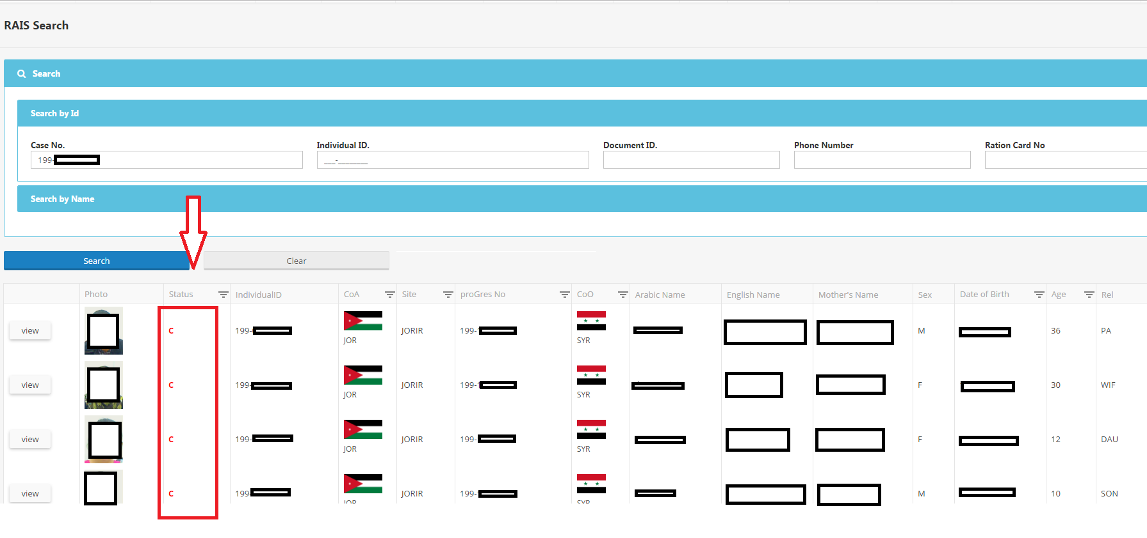
Case Status Example below:
Notes:
Check Case status as highlighted in Red
I = Inactive
A = Active
C = Closed
H = Hold

Slide 11
After error amendments – upload again

Slide 12
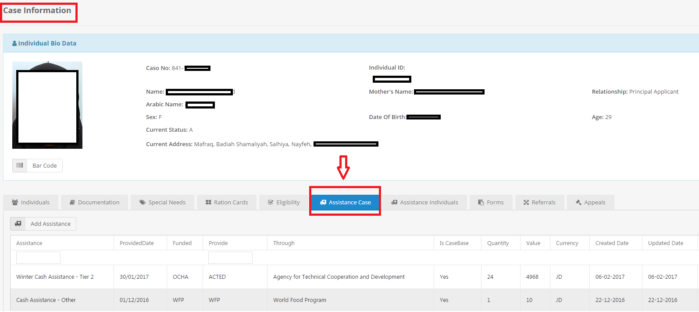
Check assistance application
Select: Case Information Module
Enter in Case ID on Search screen
View one individual in case composition and select – Assistance Case as highlighted in the screen above and details of your bulk upload should appear as below
Notes:
Select: Case Information Module
Enter in Case ID on Search screen
View one individual in case composition and select – Assistance Case as highlighted in the screen above and details of your bulk upload should appear as below.
Advising type of assistance, date, organization, conditionality on the assistance, amount, currency and date of upload. Organizations are only allowed to manually deleted assistances that have been uploaded by their own organization.
*The only exception being is the ‘Cash for Health’ assistance type is not visible on this screen as it is a confidential assistance type, but is visible in the specialized Health module.

