Slide 1


Data sharing practices in the region
Interagency Tool for:
Assistance Coordination
Winterization Response
JORDAN Mission

Slide 2
Background on RAIS
RAIS was initially developed by UNHCR Jordan in 2009 to address the demands for a more coordinated approach by partners delivering refugee assistance. In 2009 refugee assistance targeted Iraqi refugees and included healthcare, education, and material assistance packages. Following its success in Jordan, RAIS was later rolled-out in Lebanon and Syria as part of efforts to share ‘best-practices’ across the region. In 2012 a review of the system and current operational needs was conducted which led to the release of RAIS v2. In 2014 new modules were incorporated into RAIS including the vulnerability assessment framework, assessment management, and offline functionalities. In 2015 RAIS continued to enhance with additional modules for assistance coordination, referrals and ticketing.
RAIS is now the main coordination tool for assistance delivery in countries across the region (Lebanon, Jordan, Egypt, and Iraq). Over 200 partners are now actively using RAIS which represents over 500 individual users. Since June 2014, 150,000 Home Visits have been recorded on RAIS, and there are over 7 million assistance records corresponding to 1.5 million beneficiaries. New data exploration tools are now under development and RAIS will continue to be scaled-up across the region and beyond. Interest in RAIS has also been expressed by a number of other country operations such as Ecuador, Libya, India, Israel, Kenya and Yemen. In addition a number of key donors have made its use mandatory as part of their donor agreement with partners, independent of whether or not their funding goes through UNHCR.

Slide 3
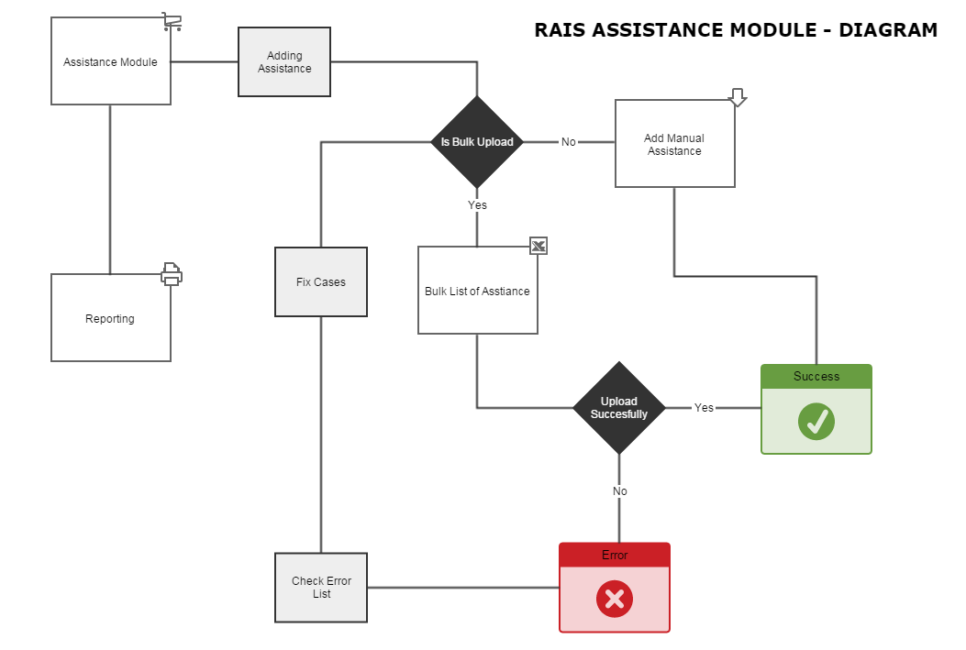
Provision of Assistance
Notes:
The assistance module in RAIS enables organizations to record, coordinate, and report on the assistance provided to persons of concern. The assistance process is outlined in the diagram on the screen.

Slide 4
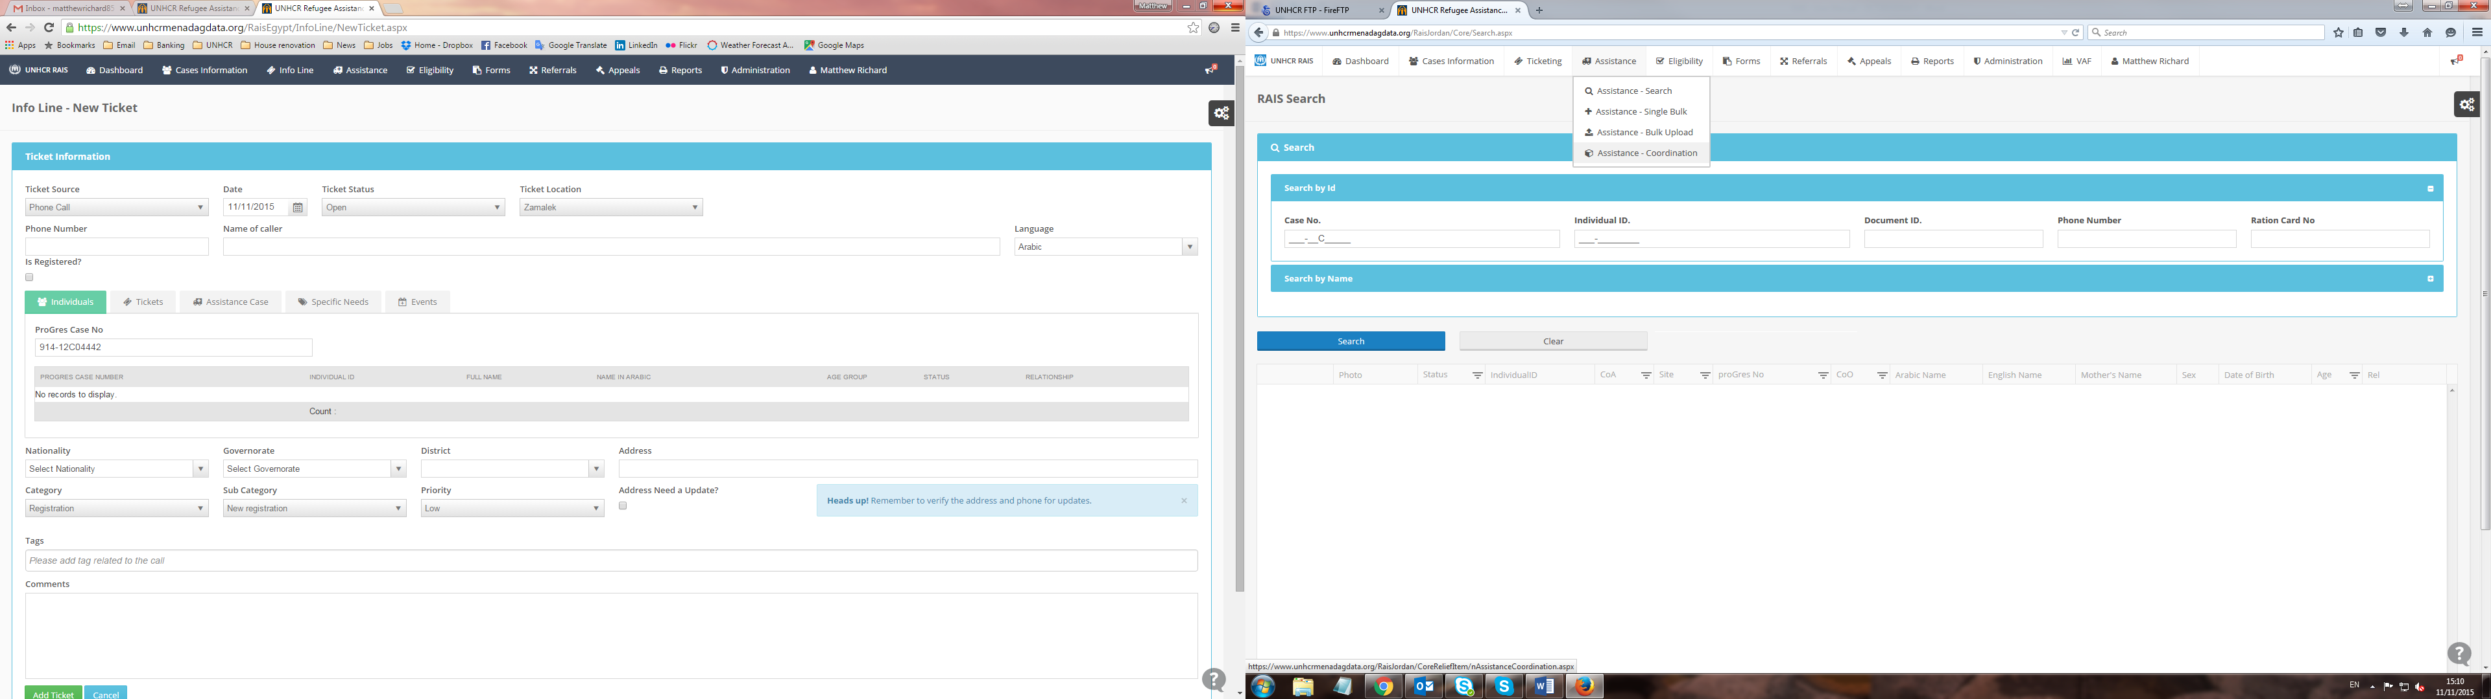
Assistance Coordination Module
Notes:
Access the Assistance Coordination Module (aka Winterization module) from the assistance menu
The Assistance Coordination module allows multiple organisations to coordinate assistance packages to beneficiaries and enter ‘blocks’ to avoid duplications. If you do not have access to this module please contact Olivia Cribb cribb@unhcr.org

Slide 5
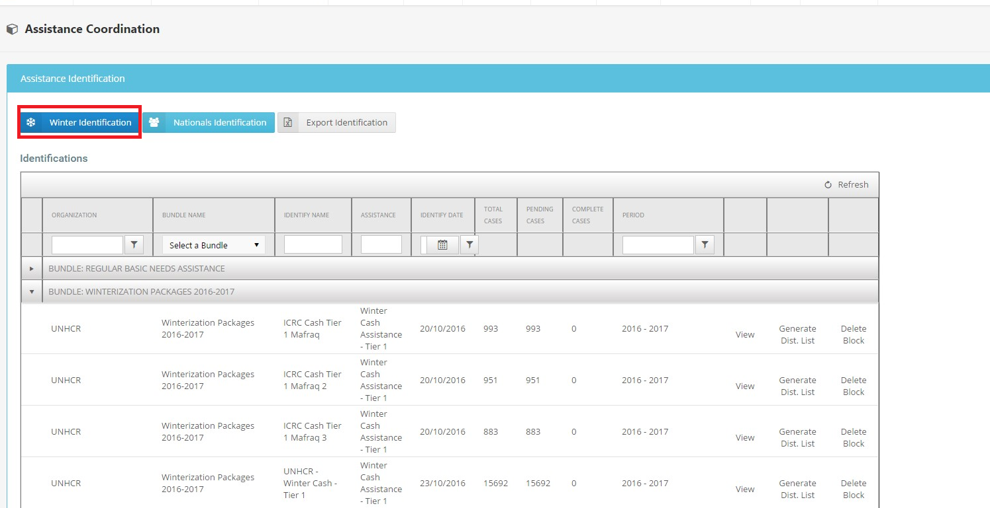
Notes:
Select Winter Identification Tab to the left

Slide 6
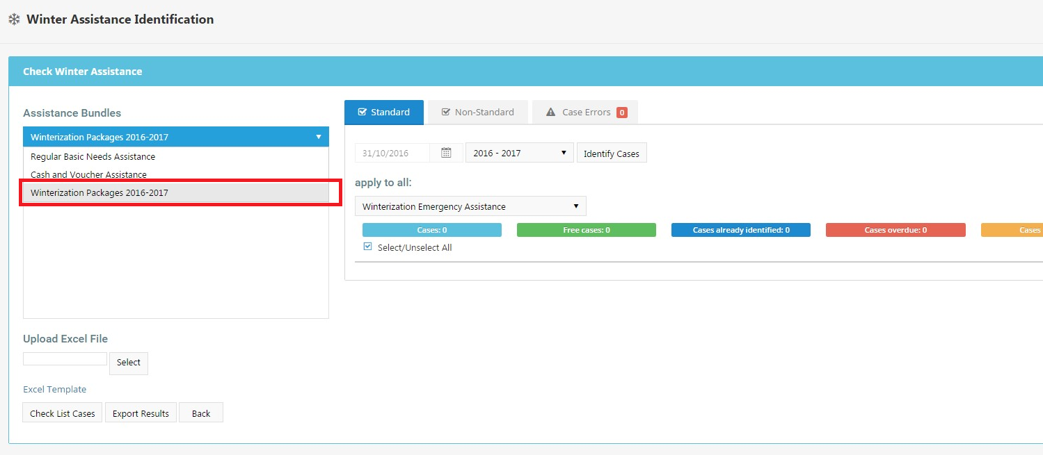
Notes:
Select correct Bundle: Winterization Package 2016-2017

Slide 7
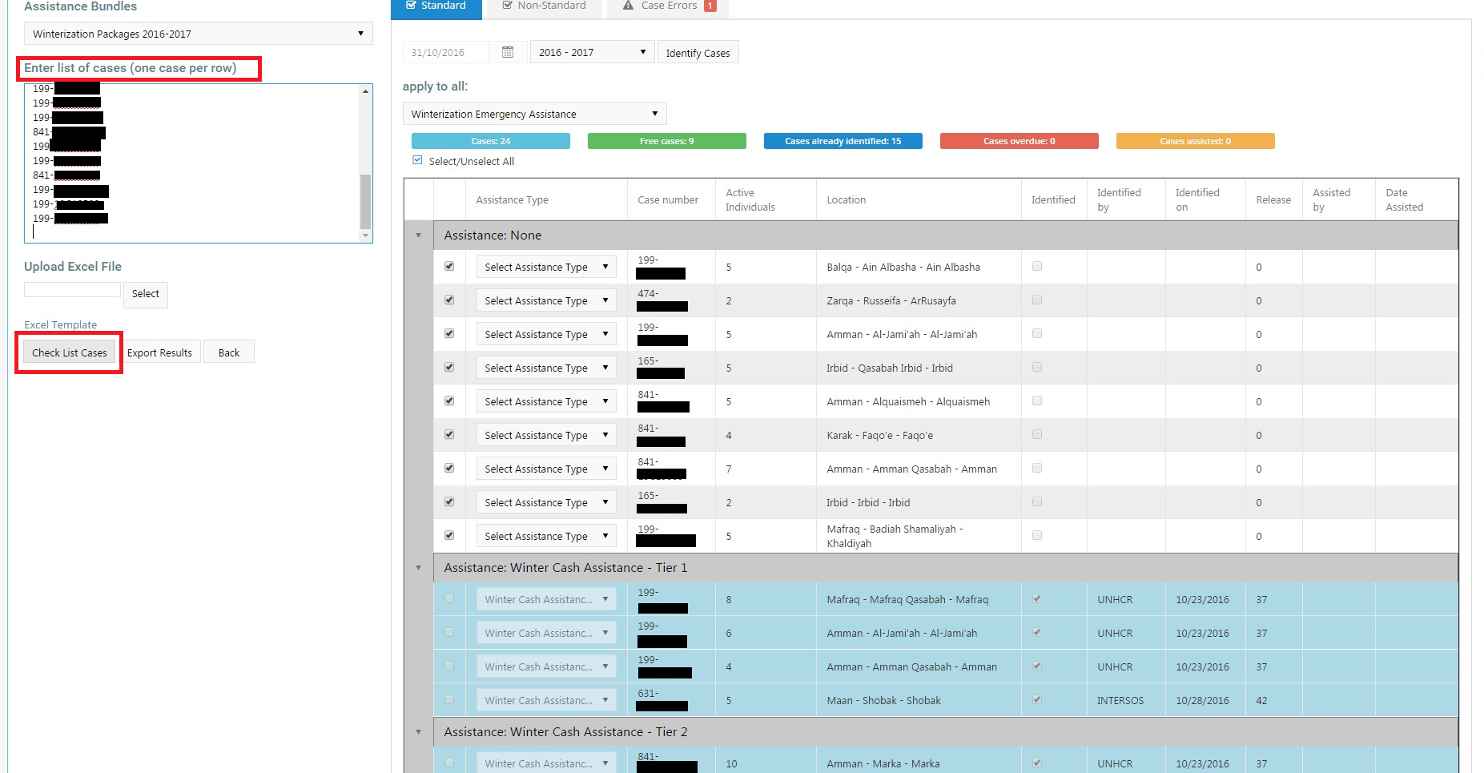
Notes:
Copy and past UNHCR Case IDs (up to 1,000 cases max) and select “Check list cases”
The module will run a cross check on all the cases entered and advise you which cases are available to receive assistance and provide you with summaries of the following:
Errors – cases which are listed as having errors means that the case does not have an ‘active’ status, and the case status is either ‘closed, inactive or on hold’.
Free cases: this means the cases are available for you to select and provide assistance to.
Cases already identified = cases that have already been selected by other organizations to receive assistance (the system will not allow duplication of standardized packages)

Slide 8
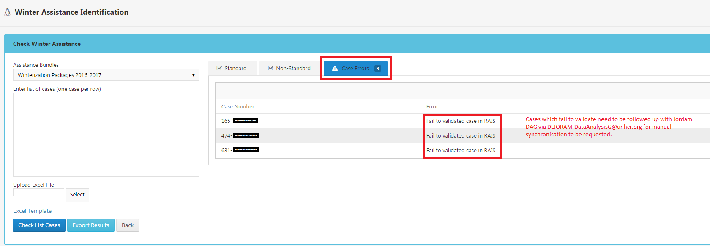
Notes:
Cases which fail to validate in RAIS need to be followed a) First by the CASE search function; which will tell you if the case status is Closed, Hold or Inactive
If the error cites the message ‘no designated PA’ then please consult Joram DAG Unit in UNHCR via DLJORAM-DataAnalysisG@unhcr.org and manual synchronization requested prior to being able to select as a beneficiary.

Slide 9
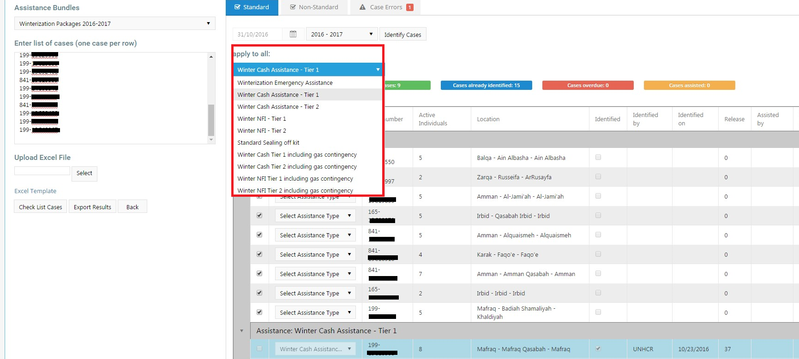
Notes:
Select from drop down menu – Type of assistance you would like to block cases under.
*Extensive list is in following slide, please also note that you can only block cases under one type of assistance, additional blocks will have to be created for each different type.

Slide 10
From the ‘Identification Results’, users can select individual case numbers and assistance bundles linked to case numbers. Users can also select to apply one assistance bundle to all case numbers by selecting from the drop-down menu above the table. The current assistance bundles available in the 2016 Winterization Package are as follows:
  Winter Cash Assistance – Tier 1
  Winter Cash Assistance – Tier 2
  Winter Cash Assistance T1 including gas contingency
  Winter Cash Assistance T2 including gas contingency
  Winter NFI – Tier 1
  Winter NFI – Tier 2
  Winter NFI T1 including gas contingency
  Winter NFI T2 including gas contingency
  Non-Standard NFI
  Non-Standard Cash Assistance
Assistance bundles and tiers have been defined by the Winterization Task Force. For further guidance on the separate assistance tiers available contact the Winterization Task Force chairs or visit the UNHCR Data Portal.

Slide 11
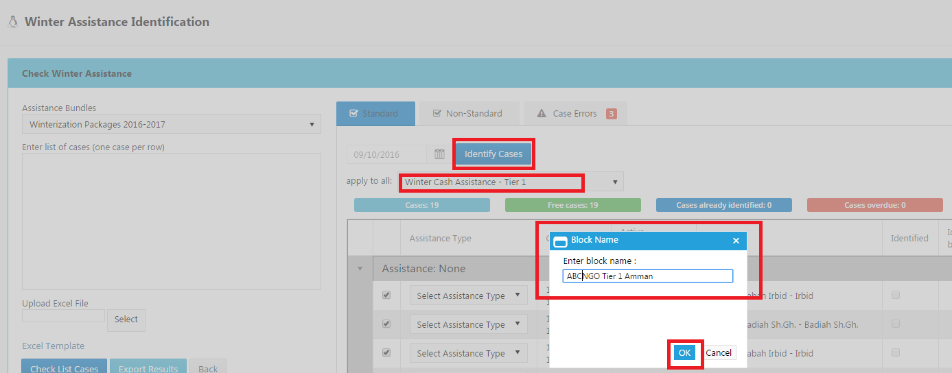
Standardized Formatting: OrgName_Tier 1 Cash_Location
OrgName_Tier 1 Cash_Location
OrgName_Tier 1 NFI_Location
OrgName_Tier 2 NFI_Location
Notes:
Beneficiaries should only be blocked when there is a confirmed distribution date and these cases have been verified by your organization and are eligible to receive assistance. This blocking function will enable organizations to ‘hold/block’ these cases for a 45 day period as advised by the Winterization Task Force, if the case has not received assistance or assistance has not been uploaded to RAIS with that period of time, the cases will automatically release and be available for other organizations to select.
Please note that in the event that you have blocked cases and should be no longer able to assist them – it is imperative for organizations to release the blocks to ensure the beneficiaries/case does not miss out on receiving assistance from another organization instead.

Slide 12
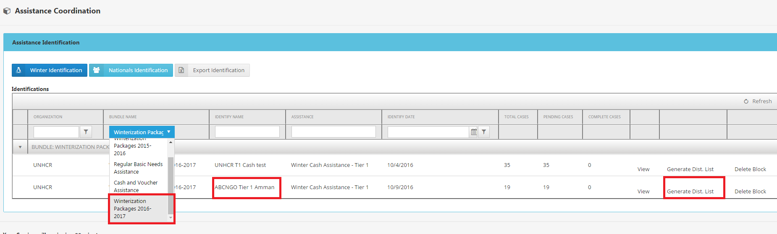
Generating your Automated Distribution List based on blocking

Slide 13
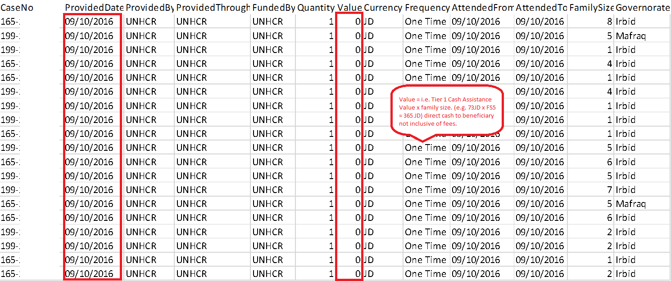
Automatically Generated Assistance Bulk-upload Excel based on blocking entry
Notes:
As list is automatically generated through the data entered by the organization – two crucial areas to double check to ensure are correct is:
Provided Date – which is date of distribution
Value – each organization is responsible for manually reporting on the exact distribution value reaching the beneficiaries direct. For example if you are supplying a Tier 1 Cash Winterization assistance – RAIS will not automatically calculate the JD value for you based on the current family size (as case/ family sizes do change frequently – automated calculation is not feasible). Total amount received by each case to be entered in only.

Slide 14
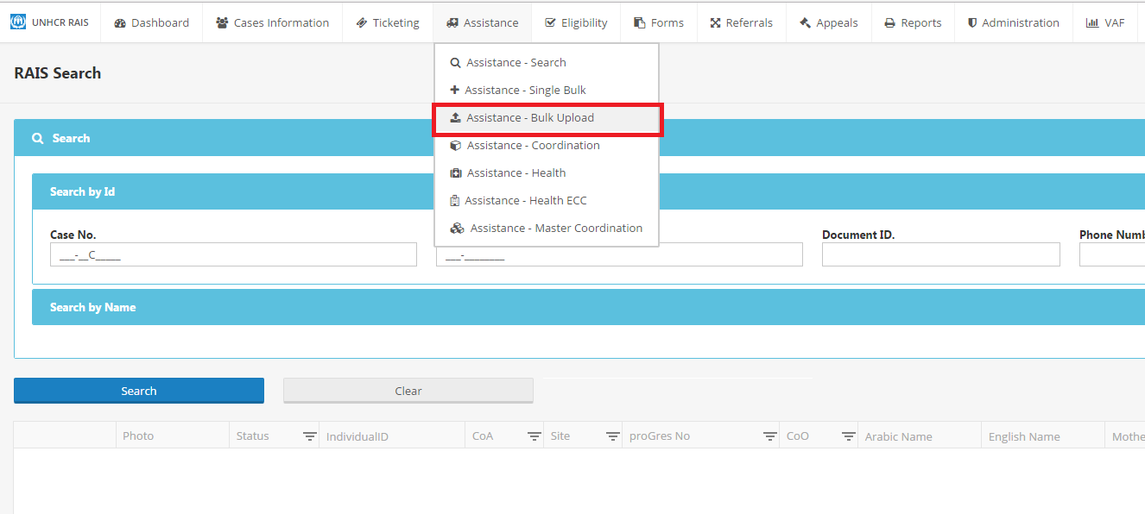
Bulk Upload Module – ‘Provision of Assistance to cases’
Notes:
Select: Assistance – Bulk Upload

Slide 15
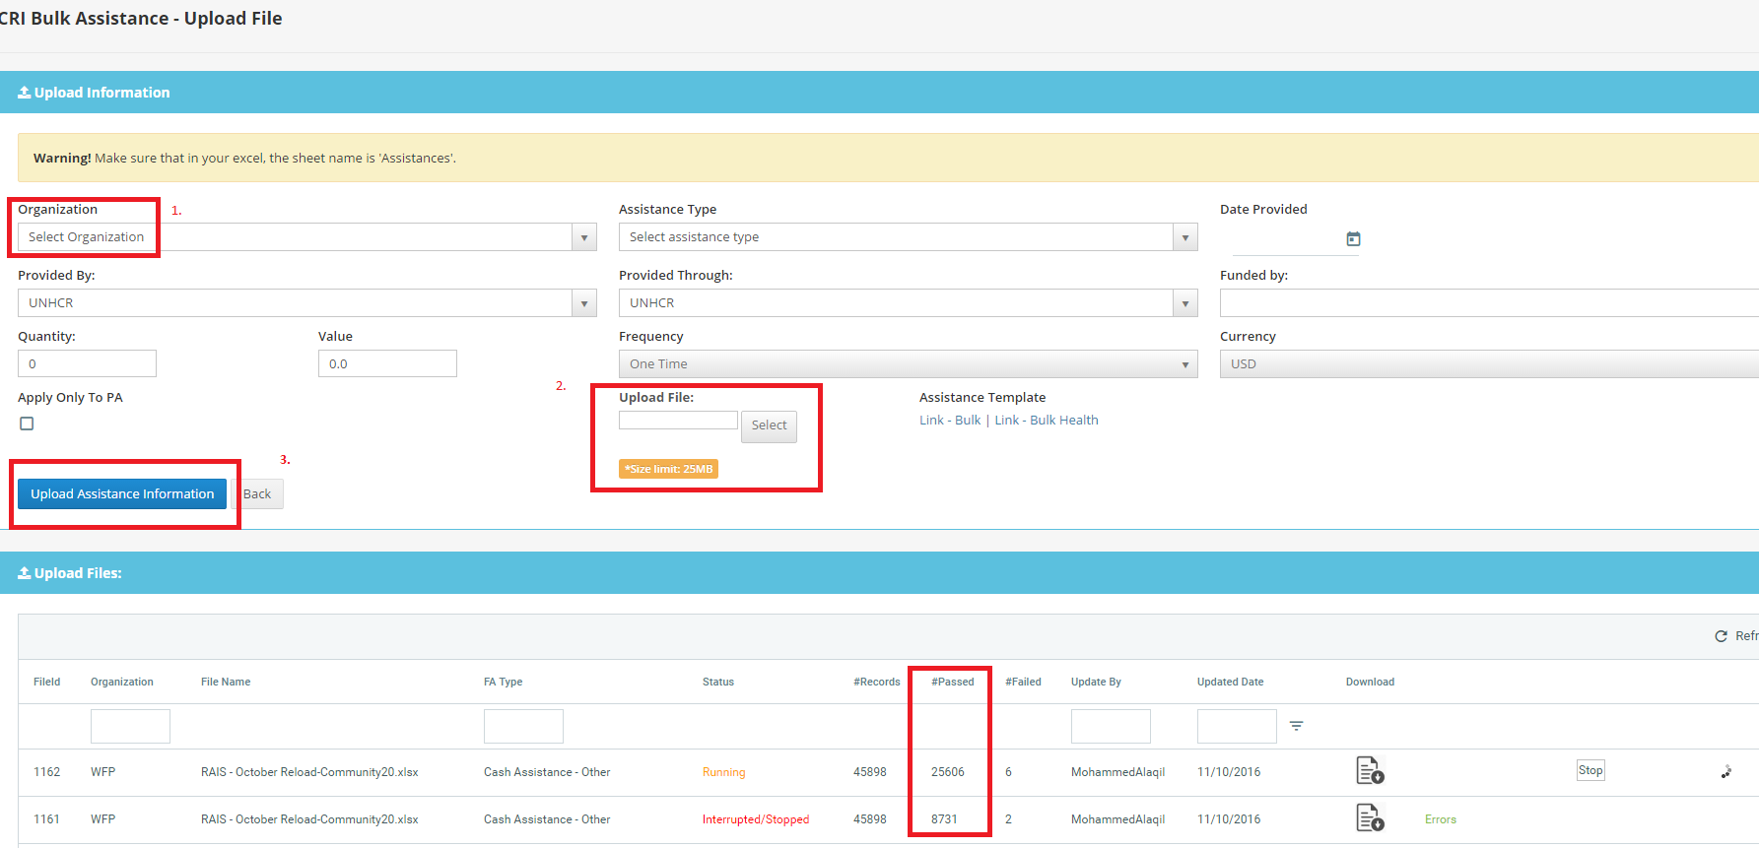
Notes:
*To avoid upload errors ensure data is entered correctly, split number of cases in to maximum files of 10,000 cases per upload to avoid timeout error and interruption. If you do receive errors then those cases shall have to be uploaded again separately.
Select Organization
Select the automatically generated ‘Distribution List’ xl file
Upload Assistance Information
Status of upload visible while processing, records passed vs errors, click on ‘Errors’ in green to see explanation of why case failed processing. Cases which require synchronization ‘no designated PA’ are to be referred back to DAG Unit Jo for manual synchronization.

Slide 16
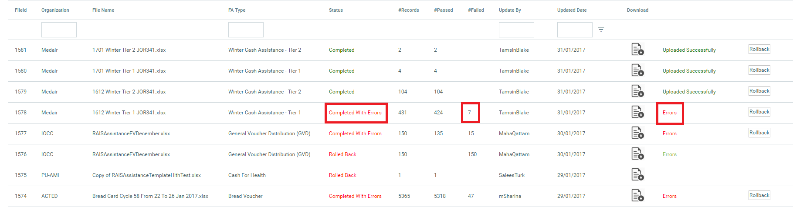
Understanding upload Errors
Notes:
Completed Status means assistance has successfully reach the cases, you can search this through the Case search function to double check or via the reporting function.
IF Status advises ‘Completed with errors’ it means that either that all or some cases were not successfully applied with assistance.
In the example above the screen advises that there are ‘7’ failed records, to understand why these cases couldn’t be applied with assistance please click on the ‘Errors’ section on the right of the screen for further information.

Slide 17
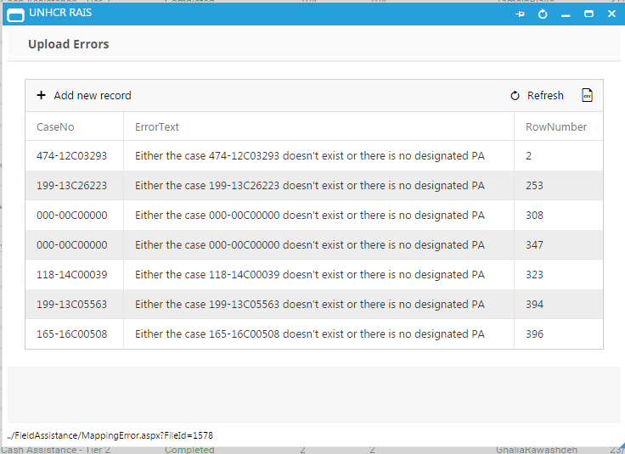
Errors Explained
Notes:
The Error message ‘Either the case XX doesn’t exist or there is no designated PA – (Principle Applicant)’ can mean 1 of 3 things:
Incorrect case number, case number is not in ProGres or RAIS = update, correct and re-upload with correct Case ID.
Check Case status in RAIS Search Case module:
If Case ID appears, yet presented an error in the bulk upload check case status (next to photograph – view next slide) where there will be a letter:
A = Active
C = Closed (cannot provide assistance to in RAIS)
I = Inactive (as referred by UNHCR protection).
3. Cases with Active status can receive assistance but bulk uploader may have rejected the upload as a result of a synchronization error due to the merging of cases / change in family composition or circumstance and a new Case ID being created as a result. Request manual synchronization from DLJORAM-DataAnalysisG@unhcr.org and re-upload assistance through bulk uploader after synchronization.

Slide 18
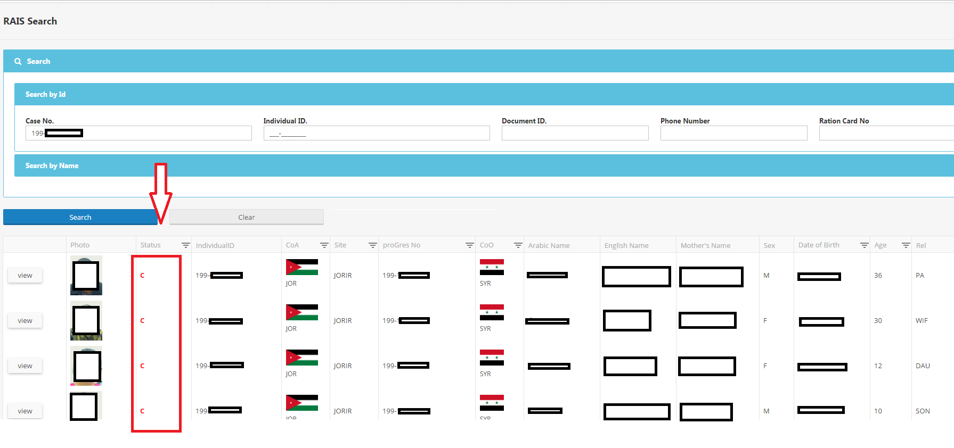
Case Status Explained
Notes:
Check Case status as highlighted in Red
I = Inactive
A = Active
C = Closed
H = Hold

Slide 19
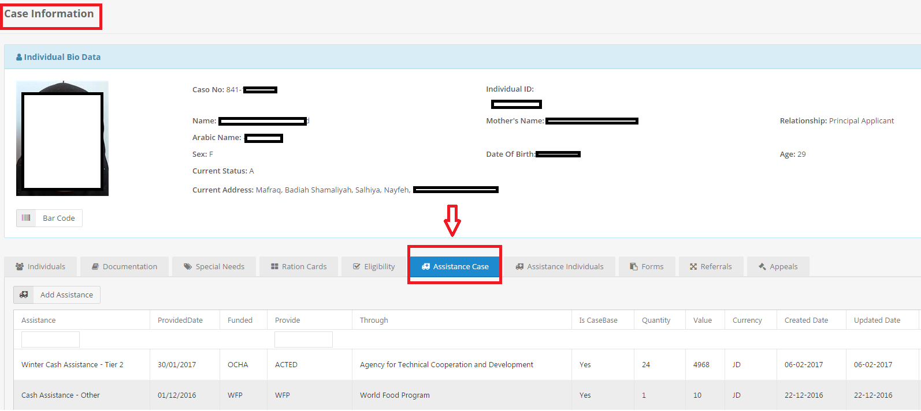
Check application of Assistance
Notes:
Select: Case Information Module
Enter in Case ID on Search screen
View one individual in case composition and select – Assistance Case as highlighted in the screen above and details of your bulk upload should appear as below

Slide 20
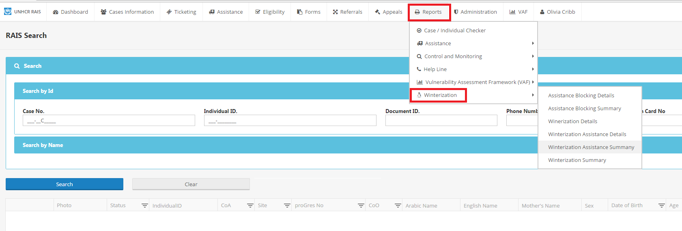
Report Generation on Assistance Provision – Reports Module
Notes:
To produce a finalized report of your winterization assistance
Go to Reports Module
Winterization tab
Select Report: Winterization Assistance Summary and add filters as required and click “show report”

