Slide 1
Social Stability Working Group 27 September 2016

Slide 2
Agenda
Welcome and introduction
Sector Updates:
a. Field Update
b. Quarter 3 progress & Dashboard
d. Conflict Sensitivity Trainings
e. Social Stability Change Stories
3. Update on LCRP Planning Process & Timeline
4. Lebanon Support Presentation – Analysis of conflict incidents in the third quarter
5. AoB

Slide 3
a. Field Update
By Sector Field Coordinators:
North (Lama Srour);
Bekaa (Rania Hammoud);
Mount Lebanon (William Barakat);
South (Checrallah Abou-Jaoude).

Slide 4
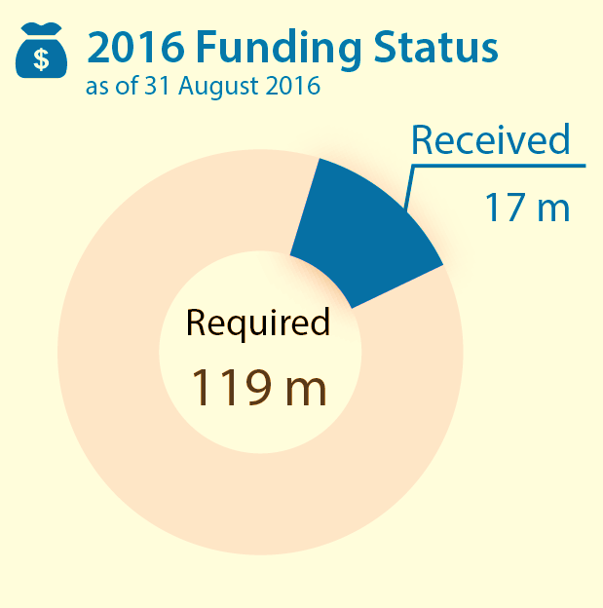
b. Q3 Progress
24 active partners: ACTED, ALEF, AND, ARCS, ActionAid, Basmeh & Zeitooneh, DAWB/NABAA, DPNA, DRC, Dorcas, IOM, IRC, Intersos, MOSA-UNDP, Mercy Corps, NRC, PU-AMI, SCI, SFCG, SIF, UN-Habitat, UNDP, UNHCR and UNRWA.
Active in 217 cadastres.
But:
Most underfunded sector: 17m USD
received so far (14% of appeal).
In 85 cadastres, only activity is MRR.

Slide 5
b. Q3 Progress
Output 1 – Support to municipalities
141 participatory processes – over 3,780 participants.
17 municipalities supported on community engagement and mediation (MSAs) + 5 UoM.
13 UoM supported on strategic planning and service delivery (RTOs).
128 projects implemented to address local priorities, worth over 11.1m USD (representing respectively a 10% and 34% increase compared to last year).

Slide 6
b. Q3 Progress
Output 3 – Local capacities for conflict prevention
24 new local dialogue/conflict mitigation mechanisms established – 419 change agents engaged.
133 peacebuilding initiatives for youth implemented – 3,317 youth and children participating.
Output 2 – Support to governors institutions
Support to 6 governors offices.
Training for 27 security cells on social stability analysis (1 at central level – 26 at district level).
Work with ISF academy, MoIM on SoPs for Municipal Police.
Output 4 – Support to media & civil society
4 media – 20 journalists engaged.
42 local CSOs supported.

Slide 7
b. Q3 Progress
Conclusion:
Support to municipalities remains strong (output 1.1).
Support to MoIM has been scaled up (output 1.2).
Soft activities have increased by over 30% compared to Q2 (output 1.3).
Support to media and civil society remains stable in Q3 (Output 1.4).

Slide 8
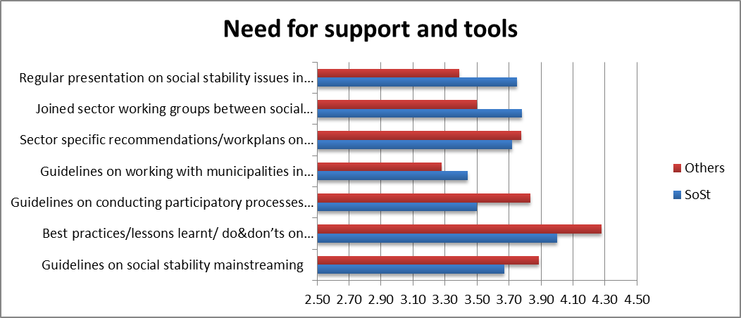
Social Stability Mainstreaming
Top needs: best practices documentation, and conflict sensitivity programming

Slide 9
c. Conflict Sensitivity Trainings
Building on a series of training sessions was delivered at the end of 2015.
5 training sessions at national and field levels organized in the coming weeks by the social stability sector & Forum ZFD – priority for non-social stability staff.
In-depth coaching sessions for interested organizations.

Slide 10
d. Social Stability Change Stories
The sector is collecting evidence and lessons learnt of partners’ impact on social stability.
Overall, 7 MSCs from 5 partners have been collected so far: ACTED (*2), Solidarites (*1), SHEILD (*1), DORCAS (*1) and UNDP (*2).
Support available to draft impact stories with interested partners.

Slide 11
LCRP Update

Slide 12
Defining Stabilization
Under SoST, GoL Ministries propose to define stabilization as:
=> “Establishing and empowering local and national mechanisms that will prevent or alleviate conflict incidences within host communities and improve social stability”.

Slide 13
Social Stability 2015-2016
Open dialogue fora and build on existing capacities for conflict prevention to mitigate sources of tensions
Relief
Support through development frameworks
Stabilization
1-1 Municipal Capacity supported
1-2 Government Crisis Response Strengthened
1-4 Civil society institutions strengthened
Support DRM
Support to Municipal Police & Security forces
MOIM Security Cells
Support to Governors offices
Participatory processes
Capacity Building
Municipal Projects & CSPs
Support Media for social stability
Local civil society support
1-3 Local capacity for conflict prevention
Dispute resolution and conflict prevention initiatives
Youth peacebuilding/community engagement initiatives
1-5 Conflict sensitivity mainstreamed
Conflict Analysis,
Monitor stability in Lebanon and set up Early Warning System
Humanitarian

Slide 14
Social Stability 2017-2020
Open dialogue fora and build on existing capacities for conflict prevention to mitigate sources of tensions
Relief
Stabilization
Support through development frameworks
1-2 Government Crisis Response Strengthened
1-4 Civil society institutions strengthened
Support DRM
Support to Municipal Police & Security forces
MOIM Security Cells
Support to Governors offices
1-1 Municipal Capacity supported
Support Media for social stability
Local civil society support
Participatory processes
Capacity Building
Municipal Projects & CSPs
1-3 Local capacity for conflict prevention
Dispute resolution and conflict prevention initiatives
Youth peacebuilding/community engagement initiatives
1-5 Conflict sensitivity mainstreamed
Conflict Analysis,
Monitor stability in Lebanon and set up Early Warning System
Humanitarian

Slide 15
3. Update on LCRP Planning Process & Timeline
Final deadline is mid-November
Sector chapters to be submitted by end of October
2017-2020 – detailed 2017 plan, indicative for 2018
Most work done at core group level
Sector steering committee first meeting
Partners to review documents by emails
Partners to prepare targets, appeal

Slide 16
Planning process and timeline
2nd September: 1st Multi Stakeholder Workshop - Lessons learnt.
16th September: 2nd Multi Stakeholder Workshop (Four-year strategy & planning assumptions).
Draft situation analysis (CG)
Review Results framework (CG)
7th October: 3rd Multi Stakeholder Workshop (Sector Needs Analysis & Preliminary Results Framework).
→ Draft Response Strategy (CG)
Determine targets and budget (CG)
First Sector Steering Committee (SSC)
Week of 17th October: 4th Multi Stakeholder Workshop (Sector Response Plan).
Partners appeal: detailed target + appeal (at sector level)
14th November: Lebanon Chapter submitted to the 3RP (with final targets/ budgets).
Week of 21st November: Launch of the LCRP 2017‐2020 and appeal for 2017.

Slide 17
4. Lebanon Support - Analysis of conflict incidents in the third quarter
PPT to be added.

Slide 18
THANK YOU !

