Slide 1
Data sharing practices in the region
Interagency Tool for:
Case Search General – User Level Functionality
JORDAN Mission

Slide 2
RAIS Background
RAIS was initially developed by UNHCR Jordan in 2009 to address the demands for a more coordinated approach by partners delivering refugee assistance. In 2009 refugee assistance targeted Iraqi refugees and included healthcare, education, and material assistance packages. Following its success in Jordan, RAIS was later rolled-out in Lebanon and Syria as part of efforts to share ‘best-practices’ across the region. In 2012 a review of the system and current operational needs was conducted which led to the release of RAIS v2. In 2014 new modules were incorporated into RAIS including the vulnerability assessment framework, assessment management, and offline functionalities. In 2015 RAIS continued to enhance with additional modules for assistance coordination, referrals and ticketing. RAIS is now the main coordination tool for assistance delivery in countries across the region (Lebanon, Jordan, Egypt, and Iraq). Over 200 partners are now actively using RAIS which represents over 500 individual users. Since June 2014, 150,000 Home Visits have been recorded on RAIS, and there are over 7 million assistance records corresponding to 1.5 million beneficiaries. New data exploration tools are now under development and RAIS will continue to be scaled-up across the region and beyond. Interest in RAIS has also been expressed by a number of other country operations such as Ecuador, Libya, India, Israel, Kenya and Yemen. In addition a number of key donors have made its use mandatory as part of their donor agreement with partners, independent of whether or not their funding goes through UNHCR.

Slide 3
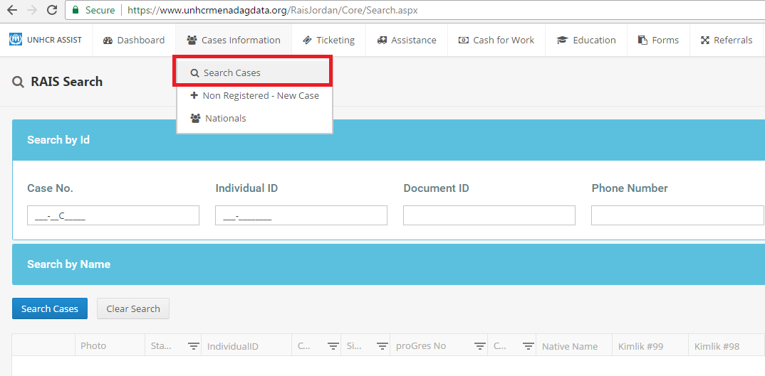
Case Information
Target Audience: All RAIS users
If you do not have access to this module please contact DLJORAM-DataAnalysisG@unhcr.org

Slide 4
Enter Case No.
Search Case
Click View left button against an individual picture
A new tab will pop up opening up the individual’s history

Slide 5
View Assistance History
Click Ration Assistance to see if case was previously registered in a camp
Click Case Assistance to see what the case is currently receiving from partner organizations in terms of assistance.
Assistance can be added manually to the case as a single instance if required through this page instead of using the bulk upload.
Organizations can manually delete, view or edit the assistances that their organization has uploaded – and cannot delete assistances uploaded by other organizations.

Slide 6
View Referrals
Click Referrals tab to view referrals
Currently RAIS only processes referrals for Assessment, Cases referred for assessment mean that the case has either a) contacted the UNHCR helpline requesting assessment or b) requesting reassessment if their circumstance has changed to determine whether they are eligible for UNHCR monthly cash assistance.
This referral will trigger an assessment / reassessment to determine the cases’ eligibility. If deemed eligible the case will be put on UNHCR’s cash waiting list until they can receive regular/monthly cash assistance

Slide 7
View Specific Needs
Cases which have individuals with specific needs that have been identified either through the registration process / ProGres data or via VAF data collection will display detail in this section

