Slide 1

Inter-Agency
Information
Management
Datasets Overview

Slide 2
Administrative Boundaries in Lebanon
Lebanon is divided into 8 Governorates…

Slide 3
Administrative Boundaries in Lebanon
…which are subdivided into 26 districts.

Slide 4
Administrative Boundaries in Lebanon
Districts are divided into approx. 1,010 municipalities.

Slide 5
Administrative Boundaries in Lebanon
Of these 1,010 municipalities, 696 are in unions of municipalities (UoMs). There are 48 UoMs.

Slide 6
Administrative Boundaries in Lebanon
There are 1,643 cadastrals…

Slide 7
Administrative Boundaries in Lebanon
…and approx. 2,742 towns, villages, localities

Slide 8
P-CODES
5 3 2 1 1 – 01 – 001
Governorate (i.e.: Bekaa)
Site category
Number in the cadastral
District (i.e.: Baalbek)
0… Shelter Types
01: IS (Informal Settlement)
04: CS (Collective Shelter)
3… Public Health Type
31: PHC (Primary Healthcare Centre)
32: SHC (Secondary Healthcare Centre)
5… Education Type
56: Technical School
Cadastral (i.e.: Iaat)
Education sector: uses CERD numbers instead (Public Schools: 1 to 4,999, Free Private Schools: 5,000 to 6,999, Private Schools: 7,000 to 9,999)

Slide 9
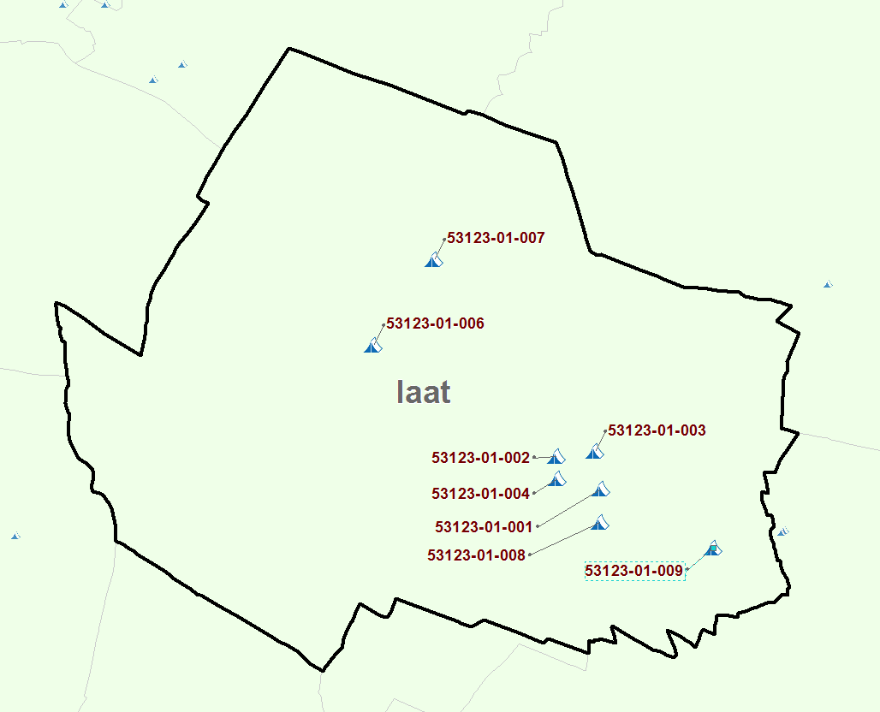
P-CODES

Slide 10

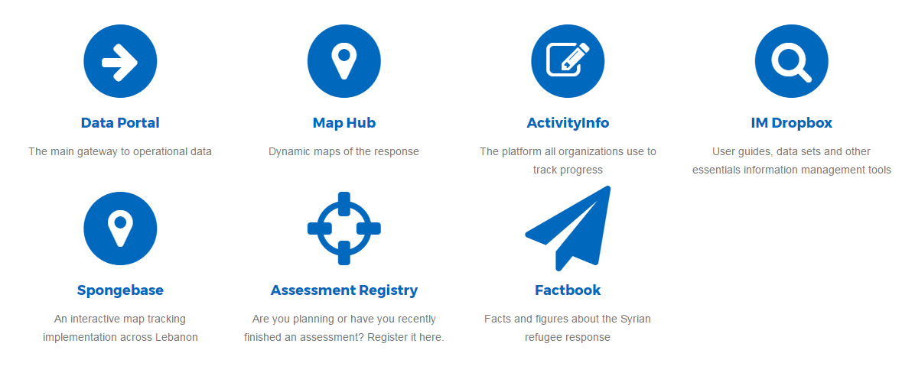
link
Lebanon Information Hub

Slide 11
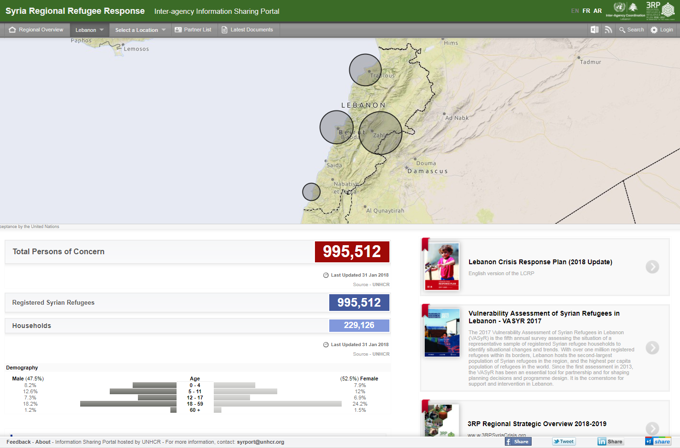
1
link
Data Portal (Information Sharing Portal)
The Data Portal is where all sectors organize and publish their...
Meeting minutes
Maps
Guidelines
Strategies
Dashboards
Calenders of events/meetings

Slide 12
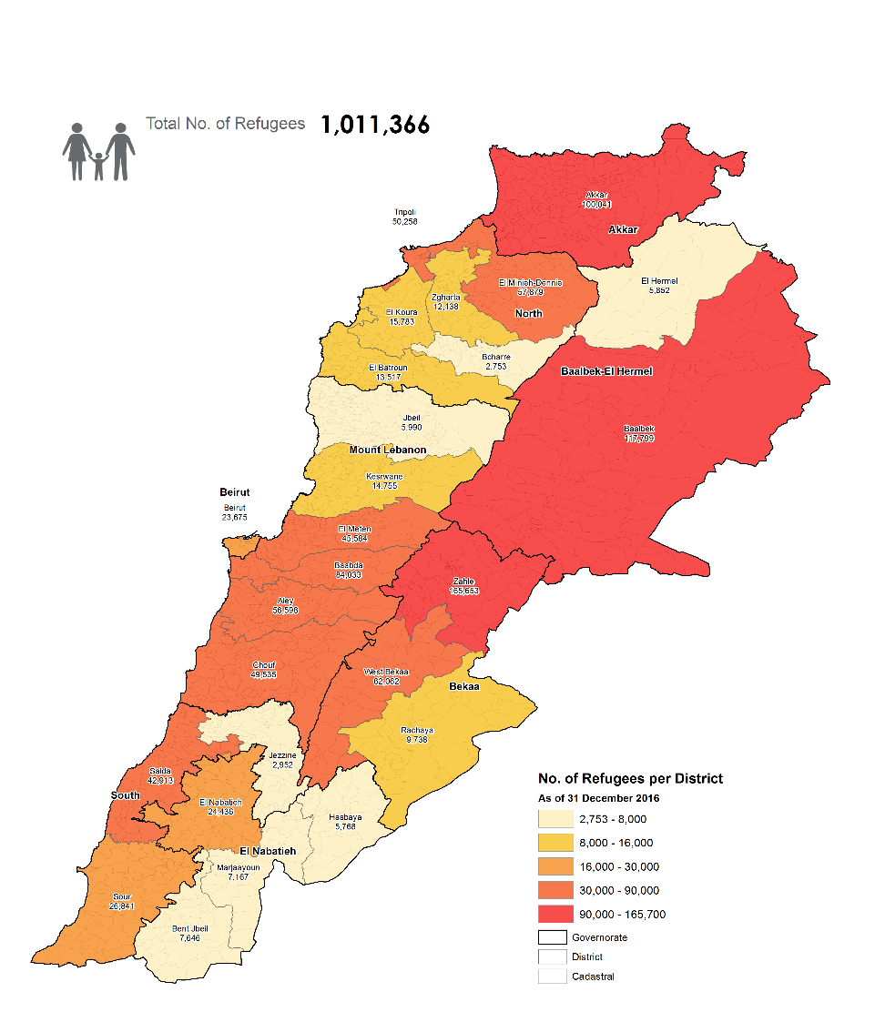
1
link
Data Portal (Information Sharing Portal)
Also includes…
UNHCR refugee population maps
Refugee population by district
Search: refugees by district in the portal

Slide 13
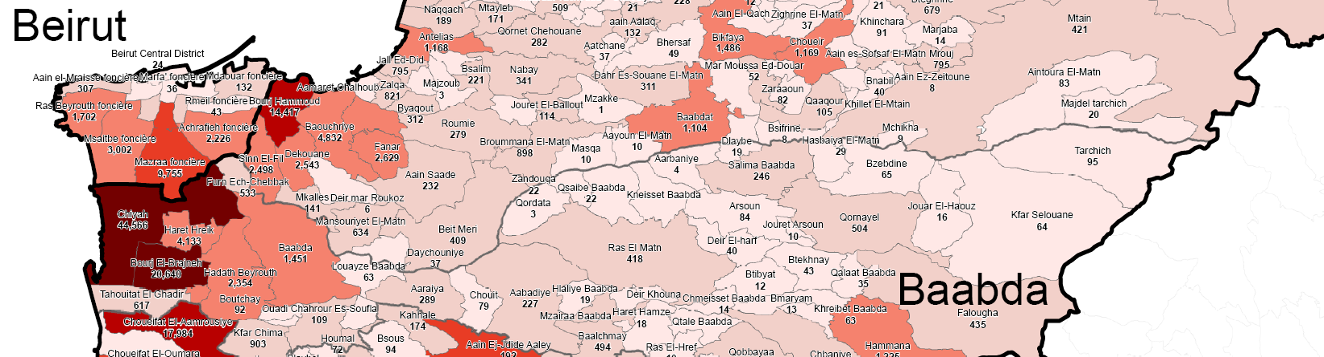
1
link
Data Portal (Information Sharing Portal)
UNHCR refugee population maps
Refugee population by cadastral
Search: registered by cadastral in the portal

Slide 14
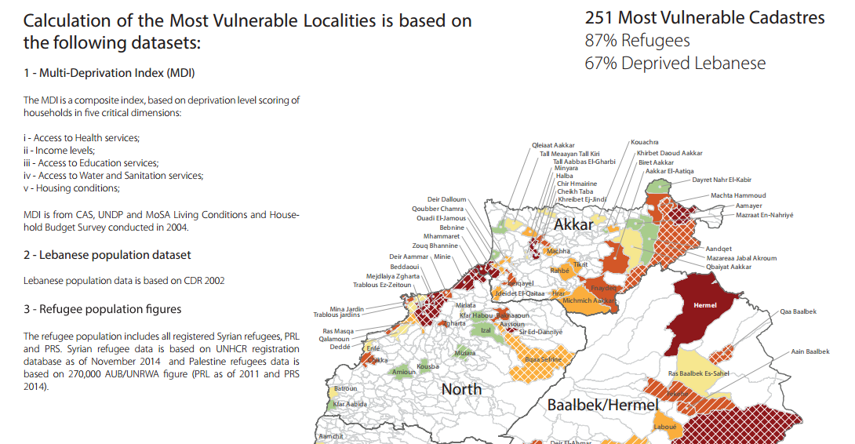
1
link
Data Portal (Information Sharing Portal)
“251 Most Vulnerable Cadastrals”, March 2015
Search: most vulnerable localities in the portal

Slide 15
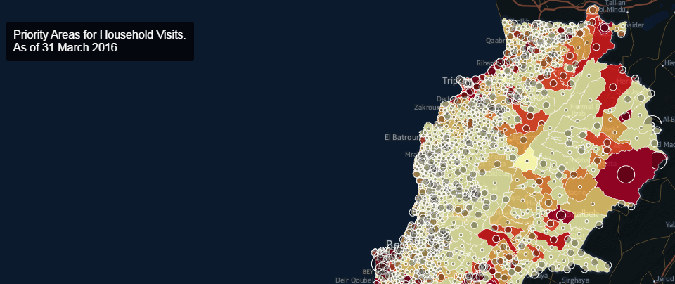
2
link
link
Map Hub
Lebanon Map Hub is the go-to place for dynamic maps related to the Syria Crisis Response in Lebanon; it hosts various thematic maps that highlight particular issues like economic vulnerabilities or out of schools children

Slide 16
2
link
Map Hub: Fundamental Operational Data Sets (FODs)
Dataset | Data source | Updates
Municipalities | Minister of Interior | As per updates from Minister of Interior
Localities | Partners | As per updates for missing locations from partners
SDCs | MoSA | As per updated list shared by MoSA
Hospitals (SHCs) | Health sector | As per updates on new contracted hospitals from Health sector
PHCs | MoPH | As per updates on new sites from MoPH and partners
Schools | MEHE | As per updates on new schools from MEHE

Slide 17
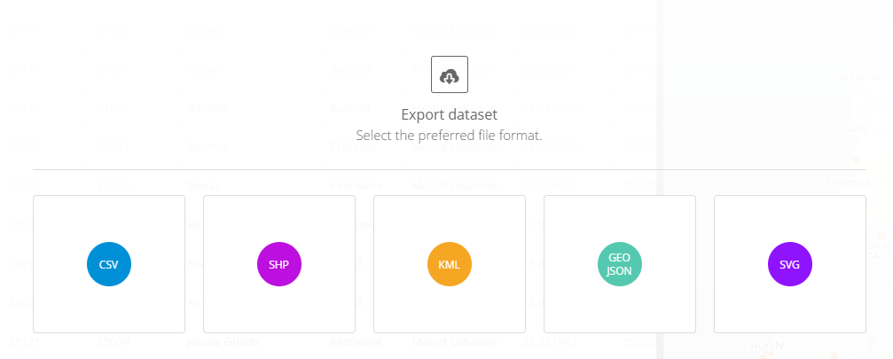
2
link
Map Hub: Fundamental Operational Data Sets (FODs)
Dataset | Data source | Frequency
Informal settlements | IAMP project | Updated data released every month; full sweep every 3 months (each sweep includes 3-4 additional indicators e.g. Access to healthcare)
Collective shelters | Partners | As per updates from partners in the field

Slide 18
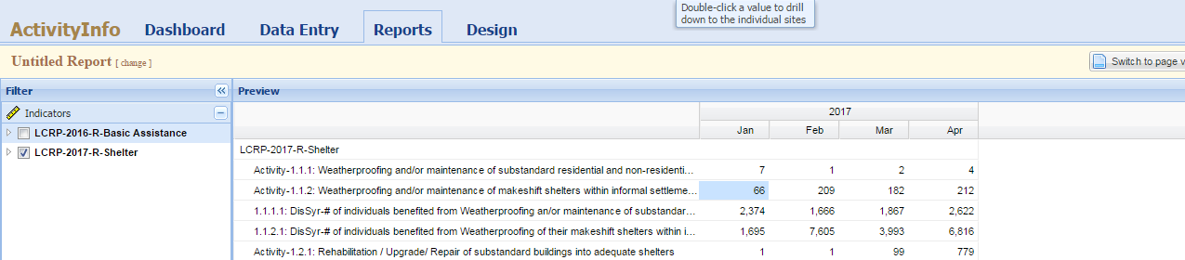
3
link
link
ActivityInfo
ActivityInfo is an open source tool for planning and reporting on aggregated activities for all sectors and agencies in the Lebanon operation. The tool facilitates coordination through the tracking of various agencies’ activities across the country as well as identifying unmet needs.

Slide 19
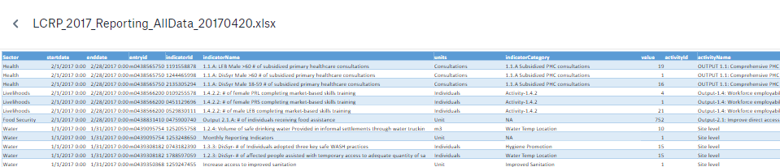
4
link
link
IM Dropbox
Includes…
ActivityInfo raw data exports
Raw ActivityInfo data is published monthly in an Excel spreadsheet in the IM Dropbox
IM Dropbox → “3. Data analysis & 3Ws” → “ActivityInfo_DataExport” → “LCRP_2016_Reporting_AllData_yyyymmdd”

Slide 20
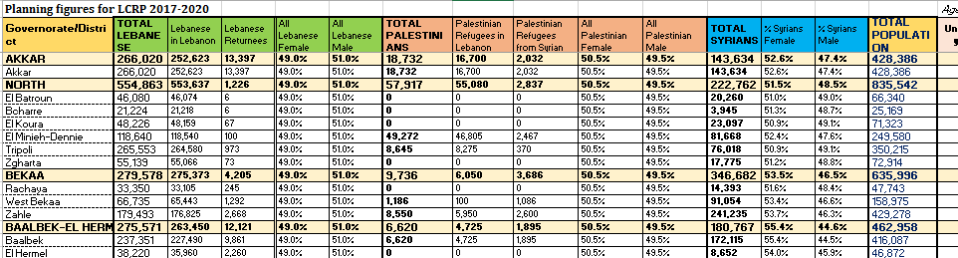
4
link
IM Dropbox
Also includes…
LCRP population package
Population of Lebanese, Syrians, Palestinians by district; age; gender
Counts of schools, PHCs, SHCs, SDCs, informal settlements by district
Updated yearly before every planning cycle

Slide 21
6
Assessment Registry
Assessment Registry Form
Allows you to submit a new assessment to the assessment registry of the interagency response in Lebanon.
List of all registered assessments
Facilitates planning and utilization of existing information
Helps coordination of activities
Lessens duplication and assessment fatigue
link
link

Slide 22
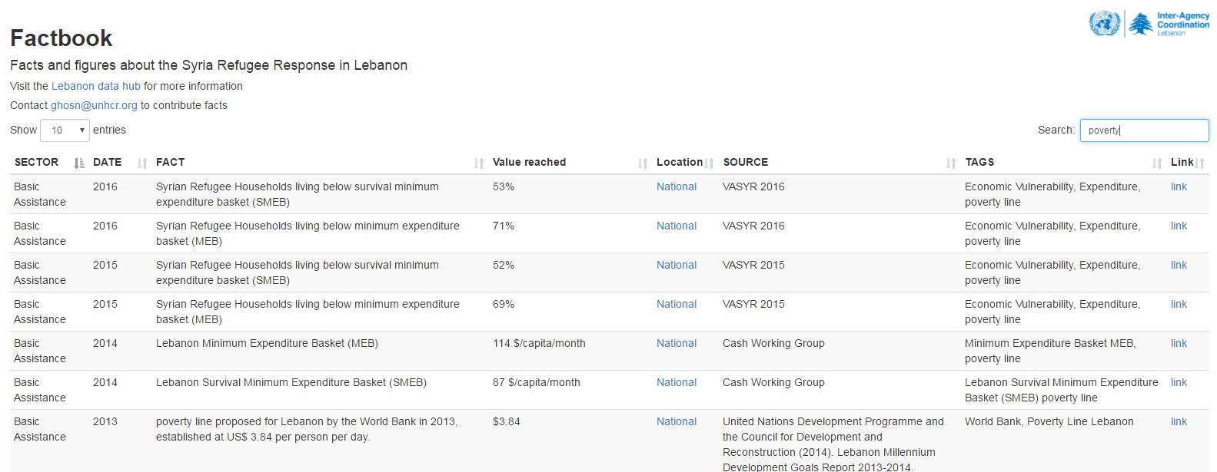
7
link
Factbook
Factbook is a searchable repository of interesting facts and figures related to the response. For example, search for “poverty” and you get all facts related to that subject.

Slide 23
Contact Lists
Sector Coordinators and IM Contact List
  Contact details of sector coordinators in Lebanon
Full inter-agency contact list in Lebanon
  Password protected; contact brownc@unhcr.org for access
Interagency Contact List Subscription
  Sign up for updates on the response or sector working groups
link
link
link

Slide 24
Inter-Agency
Information
Management
data.unhcr.org/lebanon

