Slide 1

WELOME TO THE LAUNCH
of the
Inter-Agency SEA Community-Based Complaint Referral Mechanism

Slide 2
Accountability to Refugees
Protection from Sexual Exploitation and Abuse (PSEA) by Humanitarian Personnel in Jordan
08 May 2016
Notes:
Welcome note

Slide 3
Group Discussion Questions
What is your perspective and most prevalent concerns about the issue of PSEA in the Refugee Response in Jordan?
We are all obliged to create and maintain an environment that prevents SEA and promotes the implementation of the 6 International PSEA Principles and our Codes of Conduct. As leaders, what can we do to ensure this environment in our organisations and operations in Jordan?
In your view what has been the impact of the coordinated response to SEA in Jordan?.
What are your expectations during and after the implementation of the Inter-Agency Mechanism?
Please take 25 minutes to discuss in your groups and prepare to share the key points in plenary
Notes:
25 Minutes for discussions

Slide 4
The Inter-Agency PSEA Measures in Jordan

Slide 5
Inter-Agency PSEA Measures Jordan
Heightened risk of sexual exploitation and abuse identified for Syrian Refugees in Jordan (UNHCR / IRC Reports)
Inter-Agency commitment to prevent, oppose and combat SEA
Inter-Agency Network on Protection from Sexual Exploitation and Abuse (PSEA Network) by humanitarian personnel in Jordan established early 2015
PSEA Network Work Plan: Self-Audit Check list, officially designated PSEA Focal Points, refugee consultations, PSEA Survey and, training and awareness raising of refugees and humanitarian workers, Inter-agency complaint referral mechanism
Notes:
Reports: Humanitarian agencies operating within the Syrian Refugee Response identified the heightened risk of sexual exploitation and abuse due to the protracted character of the displacement, and the limitations in accessing services and assistance, for refugees in Jordan – UNHCR “Woman Alone” and IRC Report “Are we Listening”
PSEA Network: coordinated by UNHCR, currently 55 Focal Points from 23 member agencies
members are committed to prevent, oppose and combat any form of SEA of refugees and other persons of concern perpetrated by their personnel
Primary body for awareness, prevention and oversight on PSEA of the entities providing humanitarian services to refugees in Jordan
NOT responsible for investigation or adjudication of complaints, or for dealing directly with complainants. These functions rest exclusively with dedicated bodies of individual organisations.
PSEA Focal Points
Actively promote PSEA within their own organisation, ensuring appropriate response systems are established and implemented within their organisation and with implementing partners (in line with the protocols) and ensure that refugees and host communities are engaged with the process
PSEA Focal Points are NOT considered to be the main entry point for allegations from refugees
Manage and coordinate a response to all complaints received.
Main point of contact to receive reports or referrals of SEA from within their agency, refer and following up with other entities and reporting to the PSEA Network.
Individual entities of the PSEA Network
Ensure that their personnel understand the ethical obligations placed upon them and implement internal disciplinary procedures
Raise awareness and disseminate information to personnel on their codes of conduct and of the responsibilities of personnel in regards to receiving, referring, managing and reporting complaints.
Promote PSEA amongst their own personnel, implementing partners, other entities and the refugee communities they work with
Manage and coordinate investigations of allegations of SEA by their own personnel
Provide support to their partners on PSEA; on establishing complaint mechanisms within their organisation; and on how to receive, refer, investigate and report complaints and allegations (in line with these protocols)
Individual humanitarian workers of the PSEA Network
Duty to report concerns or suspicions regarding SEA by a fellow worker, whether in the same agency or not, via established agency reporting mechanisms
Create and maintain an environment that prevents SEA and promote the implementation of their code of conduct
Managers at all levels have particular responsibilities to support and develop systems that maintain an environment that prevents SEA

Slide 6
Notes:
October 2015 results

Slide 7
Refugee Consultations
Series of consultations: 700 refugees (women, men, girls & boys / PWD, youth & elderly) – Za’atari & Azraq, Mafraq, Irbid, Amman, Ma’an & Karak
Objectives:
Identification of existing community-based complaint systems and preferred reporting and response options
To highlight key issues and factors to consider in establishing an appropriate Mechanism
Notes:
Series of consultations with refugees (women, men, girls & boys / PWD, youth & elderly) – Za’atari & Azraq, Mafraq, Irbid, Amman, Ma’an & Karak
Existing complaint mechanisms, obstacles experienced, preferred way to raise concerns and receive a response within their community and with humanitarian personnel
Results highlighted key issues and factors to consider in establishing appropriate community-based mechanism

Slide 8
Outcomes 1: Obstacles to reporting
Lack of awareness of how to report/complain
No trust in confidentiality
Retaliation by community and humanitarian personnel
Fear of losing aid or deportation
Fear of shame and discrimination amongst community
Lack of faith in responsiveness of existing mechanisms for dealing with issues
Notes:
Results highlighted key issues and factors to consider in establishing appropriate community-based mechanism
Results of community consultations highlighted key issues and factors to consider in establishing appropriate community complaint mechanisms
Take key obstacles to reporting into consideration and tackle them through awareness raising and the process to dealing with complaints i.e. fear of losing aid & increased discrimination is key factor in non-reporting; lack of trust that issues will be kept private/confidential from other people especially friends/neighbours; fear of deportation or re-location; lack of faith in current Hot-Lines to respond adequately and in a timely manner.

Slide 9
Outcomes 2: Preferred Options
Options for direct one-2-one discussion between humanitarian workers and refugees
Discuss in private with community leaders, health workers, volunteers and faith leaders, heads of family
Dedicated responsive phone-lines
Assurance of confidentiality and of a response
Notes:
Provide preferred options to raise sensitive issues i.e. provide adequate opportunities for direct one-2-one communication between refugees and humanitarian workers to raise issues in confidence; ensure Hot-Lines are responsive; raise awareness of humanitarian providers’ obligations and reporting mechanisms with key informants (those with whom refugees confide) i.e. Community Workers, faith leaders,

Slide 10
PSEA Survey October 2015
PSEA Survey for the Refugee Coordination structure, 44 agencies from all the sectors participated
Objective:
To identify SEA Complaint and Response Mechanisms in all geographical areas in Jordan
To raise awareness and identify PSEA Focal Points – was 37 PSEA focal points from 21 agencies & now 55 PSEA focal points from 30 agencies
Notes:
Conducted October 2015
(programme and SEA/misconduct)
PSEA Focal Points by geographical area and agency
Types of Complaint and Response Mechanisms
Reception and feedback tools for complaints
SEA Investigation Mechanisms
PSEA Awareness Raising tools
OUTCOMES

Slide 11
Outcome 1
Page 3

Slide 12
Outcome 2
Page6

Slide 13
Outcome 3
Page 7

Slide 14
Outcome 4
Notes:
This indicates a similarity with the ways that the community ‘preferred’ to submit complaint/report during the refugee consultations and indicates that the existing mechanisms are receiving some complaints

Slide 15
Designing the Inter-Agency SEA Community-based Complaint Referral Mechanism
Review and analysis of refugee consultations and survey with humanitarian agencies
Drafting the Inter-agency SEA Mechanism and designing awareness raising materials
  Consultation sessions with PSEA Network members
  Testing awareness materials with refugees
  Incorporating inputs
Notes:
Designing awareness
Information Campaign
Monitoring implementation
Review Mechanism May 2017

Slide 16
Scope of the Mechanism
To effectively receive and refer SEA complaints between PSEA members in a safe, confidential, transparent and accessible manner
Covers PSEA Network members within the Refugee Response in Jordan, and who are signatories of the Mechanism
Incorporates Inter-Agency Emergency Standard Operating Procedures for Prevention of and Response to Gender Based Violence and Violence, Abuse, Neglect and Exploitation of Children in Jordan (2013, 1st revision 2014)
Notes:
The CBCRM The CBCRM is the result of the community consultations, PSEA survey with agencies providing services to refugees within the Syrian Emergency Response in Jordan and through discussion and consultations amongst the PSEA Network Focal Points
Developed to enable complaints of sexual exploitation and abuse by humanitarian personnel of their agencies to be received and referred between the PSEA member agencies in an effective, safe, confidential, transparent and accessible manner
Scope
The CBCRM applies to the PSEA Network members who provide humanitarian aid to refugees within the context of the Syrian Refugee Response, and who are signatories of the CBCRM Protocols
Mechanism
Sets out the obligations of agencies and are to be implemented in line with the procedures set out in the Inter-Agency Emergency Standard Operating Procedures for Prevention of and Response to Gender Based Violence and Violence, Abuse, Neglect and Exploitation of Children in Jordan (2013 – Revised 2014)
1. Roles and Responsibilities
2. Guiding Principles
3. Receiving Complaints and Reports
4. Inter-Agency Referrals
5. Investigations
6. Supporting the Needs of Survivors, Complainants and Witnesses
7. Mandatory Reporting
8. Recording and Reporting SEA Complaints with the PSEA Network

Slide 17
Content of the Mechanism
1. Roles and Responsibilities
2. Guiding Principles
3. Receiving Complaints and Reports
4. Inter-Agency Referrals
5. Investigations
6. Supporting the Needs of Survivors, Complainants and Witnesses
7. Mandatory Reporting
8. Recording and Reporting SEA Complaints with the PSEA Network

Slide 18
Guiding Principles of Mechanism
ZERO tolerance approach
IASC 6 Core Principles, Secretary-General’s Bulletin and Statement of Commitment for PSEA
Mandatory Reporting
Confidentiality, anonymity and informed consent when dealing with SEA complaints and referrals
Notes:
Zero tolerance approach
All agencies and personnel commit to a zero tolerance approach to any form of SEA behaviour and understand their obligations to report any concerns or suspicions they have to their agency’s PSEA Focal Point
Entities must ensure that all personnel understand the standards of conduct that are expected of them and the implications of not adhering to them and, where applicable, sign the entity’s Code of Conduct
All entities are obliged to undertake necessary disciplinary action to prevent and respond to misconduct by their personnel
6 `PSEA Principles for Codes of Conduct
Where applicable, all personnel shall understand and sign the entity’s Code of Conduct, or similar document, setting out the standards of acceptable and unacceptable behaviour
The Code of Conduct, or similar document should incorporate the IASC 6 Core Principles and obligations as set out in the Secretary-General’s Bulletin and Statement of Commitment for UN and Non-UN personnel:
SEA constitutes acts of gross misconduct and are therefore grounds for disciplinary measures, including termination of employment
Sexual activity with children (persons under the age of 18) is prohibited regardless of the age of majority or age of consent locally
Exchange of money, employment, goods, or services for sex, including sexual favours or other forms of humiliating, degrading or exploitative behaviour is prohibited
Sexual relationships between humanitarian workers and beneficiaries are strongly discouraged since they are based on unequal power dynamics
If a humanitarian worker develops concerns or suspicions regarding SEA by a fellow worker, whether in the same agency or not, they must report these via established reporting mechanisms
All humanitarian workers are obliged to create and maintain an environment that prevents SEA and promotes the implementation of their code of conduct
Confidentiality, anonymity, informed consent
All entities agree to the principles of confidentiality, anonymity, informed consent, impartiality, dignity, safety and welfare when dealing with SEA
These principles are elaborated on in the Inter-Agency Standard Operating Procedures for Prevention of and Response to Gender-Based Violence and Violence, Abuse, Neglect and Exploitation of Children in Jordan (2014)
Mandatory Reporting
In consideration of mandatory reporting of humanitarian personnel to report SEA to their agency or Investigative Body where established, anyone receiving a complaint directly should explain this obligation, and reassure the complainant/survivor that all information shared will be appropriately protected and will be kept confidential between only those who are authorised to know on the basis of providing protection or taking appropriate action i.e. investigation.

Slide 19
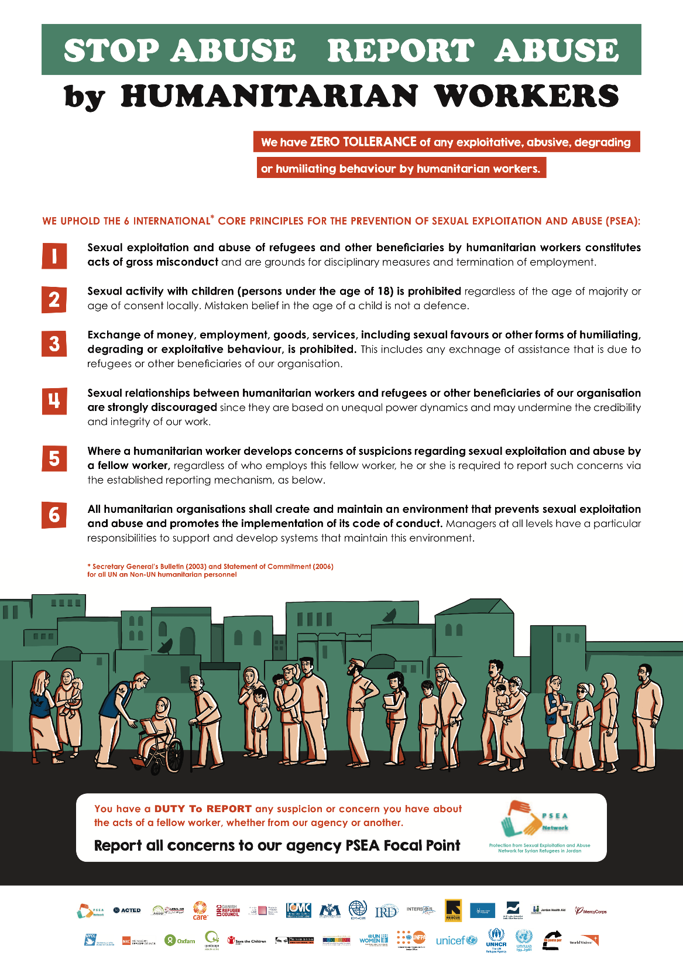
Awareness
Raising
Campaign

Slide 20


Slide 21


Slide 22
Implementation Plan
May 2016
  Inter-Agency commitment to PSEA - launch and endorsement of the Mechanism
  Training & briefing sessions on PSEA, the Mechanism & information campaign for PSEA Focal Points and key staff
  Develop Inter-Agency 2016-2017 action plan
June 2016 – May 2017 – Rollout of the Mechanism & launch Information Campaign
May 2017 – Review the Mechanism

Slide 23
Thank you for you cooperation and commitment to Protecting Refugees in Jordan
We now invite you to Endorse the Mechanism

