Slide 1


Data sharing practices in the region
Interagency Tool for:
Vulnerability Scoring using existing beneficiary lists
VAF Module
JORDAN Mission
Notes:
*Please note that this module is only available to VAF Partners who have signed an MOU with UNHCR. For more details on how to become a VAF partner please contact JORAMDAT@unhcr.org
*To get access to the VAF module after your organization has become a partner individual users can please contact JORAMDAG@unhcr.org to add the module to your user profile

Slide 2
The Vulnerability Assessment Framework (VAF) defines vulnerability as:
“the risk of exposure of Syrian refugee households to harm, primarily in relation to protection threats, inability to meet basic needs, limited access to basic services, and food insecurity, and the ability of the population to cope with the consequences of this harm.”
A key objective of the Jordan Refugee Response has been to ensure that humanitarian resources have been used efficiently and effectively, as a commitment to both donors, the Government of Jordan and to the refugees themselves. Targeting of assistance to the most vulnerable refugees is a part of this commitment. As a result in January 2014, the Vulnerability Assessment Framework (VAF) process was launched in Jordan with the primary objective of developing a robust model that could be applied across the Syrian non-camp based population to assess multiple vulnerabilities and provide the humanitarian country specific information at Kingdom wide, district and household levels. The VAF is a combination of a number of components all of which build on the development of the Vulnerability Assessment Framework.

Slide 3
The VAF process seeks to put in place an observation and reporting system that, using a mixture of static and dynamic indicators, supports the humanitarian community to:
1. Establish a profile of vulnerability across Syrian refugee households and enable monitoring of changes in vulnerability over time;
2. Target assistance in a more efficient and equitable manner, based on the application of common vulnerability criteria; and
3. Strengthen coordination and decision making of the delivery of humanitarian assistance.
Access to already pre-assessed vulnerability scored cases is accessible through the VAF RAIS Module through becoming a VAF partner; for more info contact JORAMDAT@unhcr.org

Slide 4
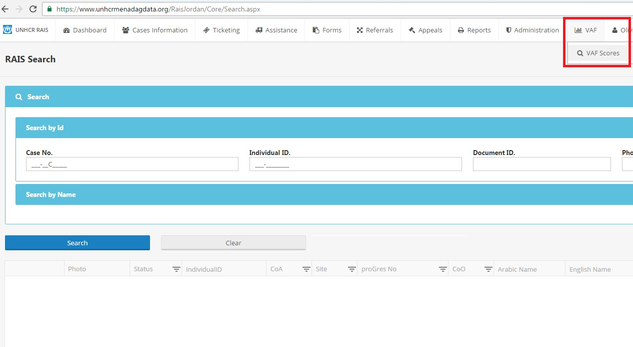
Notes:
Select module
*Please note that this module is only available to VAF Partners who have signed an MOU with UNHCR.
For more details on how to become a VAF partner please contact JORAMDAT@unhcr.org

Slide 5
Scenario: Organisation: ABC
Type of Intervention: Basic needs Cash intervention & No. of Cases to receive cash assistance: 500
Governorate/ District: Irbid; Ramtha and Bani Obeid (District selection will be available to cater to Orgs. areas of operation.)
Target Group: The most vulnerable Syrian refugee families that are socioeconomically vulnerable, have a high level of aid dependency, are food insecure and engaged in negative coping mechanisms.
Depending on the type of intervention your organization is responding to; the criteria in which is supplied by the donor or what other considerations you would like to include additionally as vulnerability factors. The VAF Module can be used to effectively improve eligibility, prioritization and targeting and used in such a way by allowing organizations to pick and choose their data based on their independent needs given the multi-faceted and multi-sectoral nature of the tool.
For example if organization ABC have been approved funding to provide 500 cases in Irbid with regular cash assistance for a period of 6 months, and although it is a Cash Based intervention, the target group doesn’t not have to be limited to prioritization through the Basic Needs Score (socioeconomic vulnerability) but additional scores can be used in unison / parallel to improve targeting. This enables assistance and services to reach cases that are the most vulnerable at a multitude of facets when additional criteria can be applied based on programmatic requirements. In this scenario Case B is the most vulnerable.
Case A Case B Case C
Basic Needs score: 4 Basic Needs score: 4 Basic Needs score: 3
Food Security score: 3 Food Security score: 4 Food Security score: 1
Welfare score: 2 Welfare score: 4 Welfare score: 2
Dependency: 2 Dependency: 4 Dependency: 2
Coping Strategies: 4 Coping Strategies: 4 Coping Strategies: 1
Notes:
It is up to the organization to selection which scores are appropriate based on their need.
Furthermore 2 things that also should be checked in parallel to this process:
Cross check to see if cases are receiving assistance from other partner organizations to remove likelihood of duplication (see next slide)
Ensure that beneficiary list is also sent to the UNHCR Cash Office

Slide 6
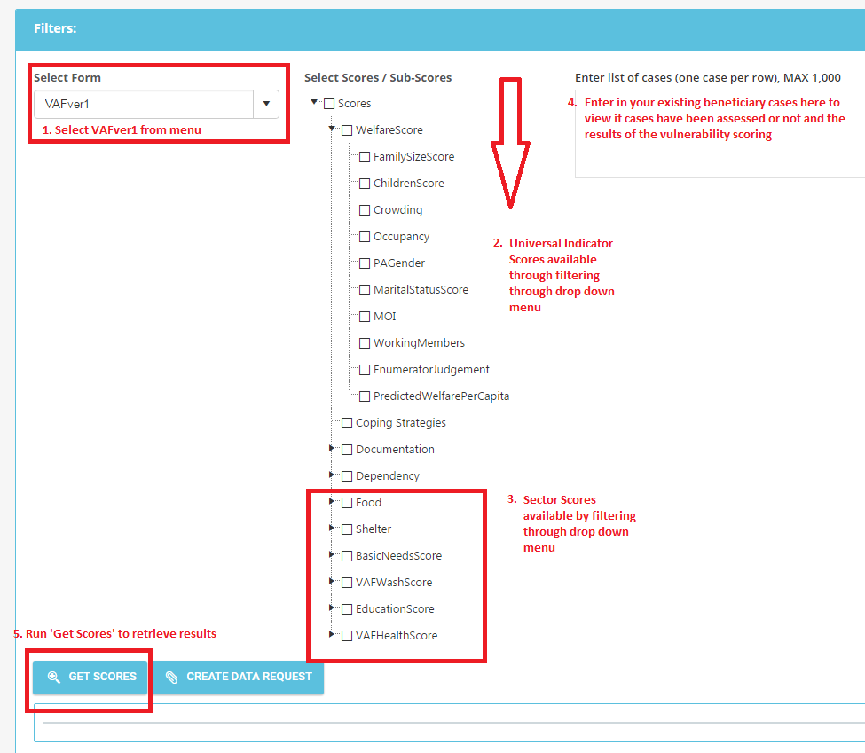
Search VAF Scores on existing data already collected based your own beneficiary lists
Notes:
Select Form: VAFver1 from drop down menu
Select Scores: Pick and choose your selection based on your programming objectives and can be one indicator or a combination based on your needs. i.e. Universal indicators: Predicted Welfare, Coping Strategies, Dependency Ratio, or Documentation. Sectors available: Food Security, Shelter, Basic Needs, WASH, Education and Health.
Enter list of cases (one case per row – maximum 1000 cases)
Get Scores: run selection above and scoring shall process and appear below for cases that have been assessed. If some cases have not appeared that means the case has not been assessed under the VAF.

Slide 7
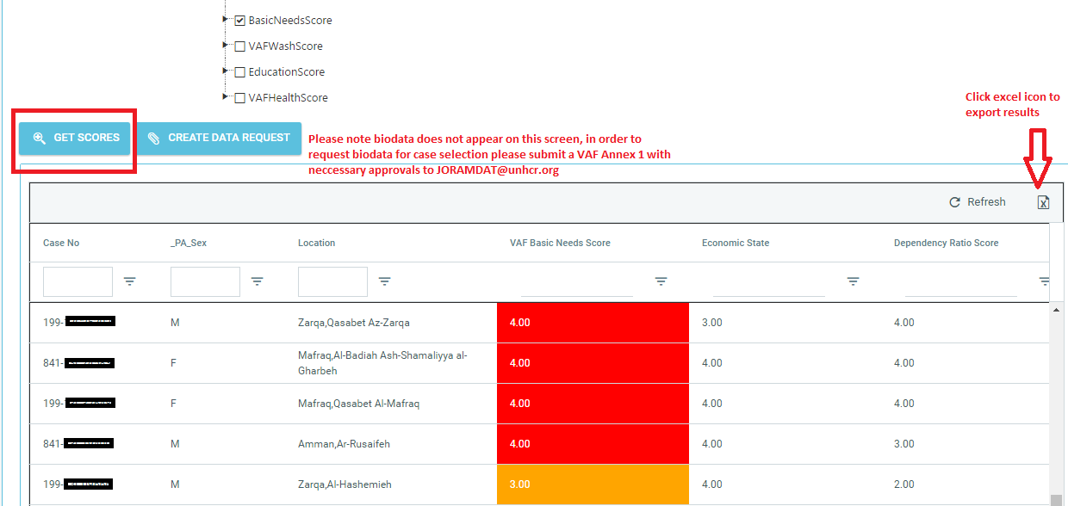

Slide 8
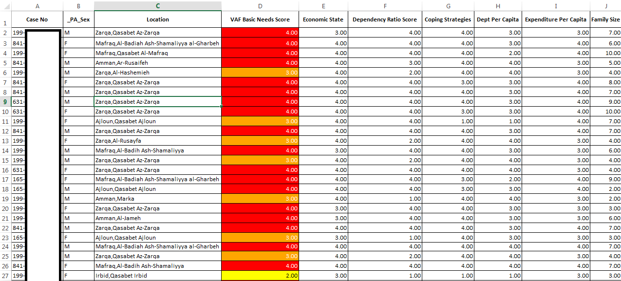
Excel export visualization
Notes:
Understanding Sector level indicators for programming prioritization and targeting:
For example the VAF basic needs score can be understood and interpreted by looking at the VAF Basic Needs Sector tree. All sector trees can be located here: http://data.unhcr.org/syrianrefugees/working_group.php?Page=Country&LocationId=107&Id=69
Sector tree provides you with the methodology for understanding the calculation of the scoring for each individual indicator, i.e. For Basic Needs, the individual indicators appear as above; Economic rate, Dependency Ratio score, Coping Strategies, Debt per capita, Expenditure per capita and family size which all contribute to the overall VAF Basic needs score.
In the above excel example you can see Basic Needs Scores range from 2, 3 and 4.
1 = low vulnerability
2 = moderate vulnerability
3 = high vulnerability
4 = severe vulnerability
Therefore generally for targeting and prioritization purposes, it is recommended to select cases which appear in the 3 -4 level categories which have higher vulnerability.

