Slide 1
Data sharing practices in the region
Interagency Tool for:
Assistance Master Coordination
JORDAN Mission
Cross-Checking assistance provision in bulk prior to distribution

Slide 2
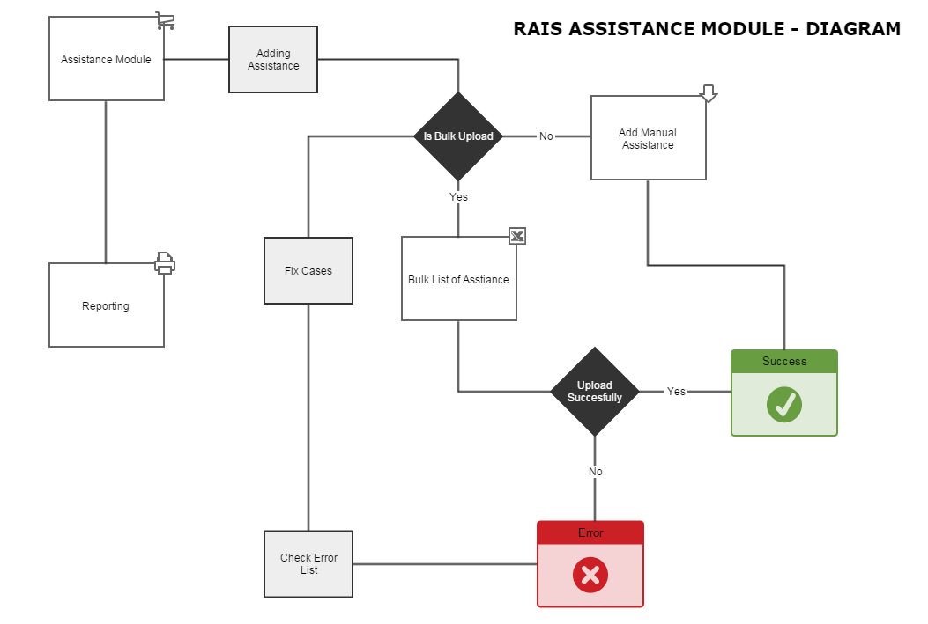
Notes:
RAIS Assistance Module Diagram

Slide 3
What is Assistance Master Coordination?
The Assistance Master Coordination module allows organisations to cross check the variety of different assistances, to ensure that another organization has not already provided assistance to your prospective beneficiaries.
If you do not have access to this module please contact DLJORAM-DataAnalysisG@unhcr.org

Slide 4
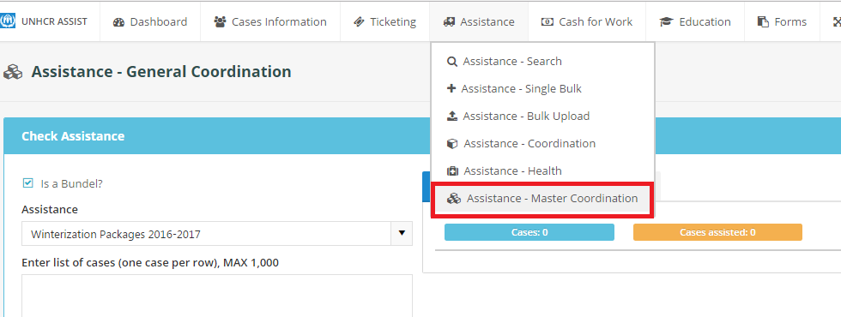
Assistance Master Coordination Module

Slide 5
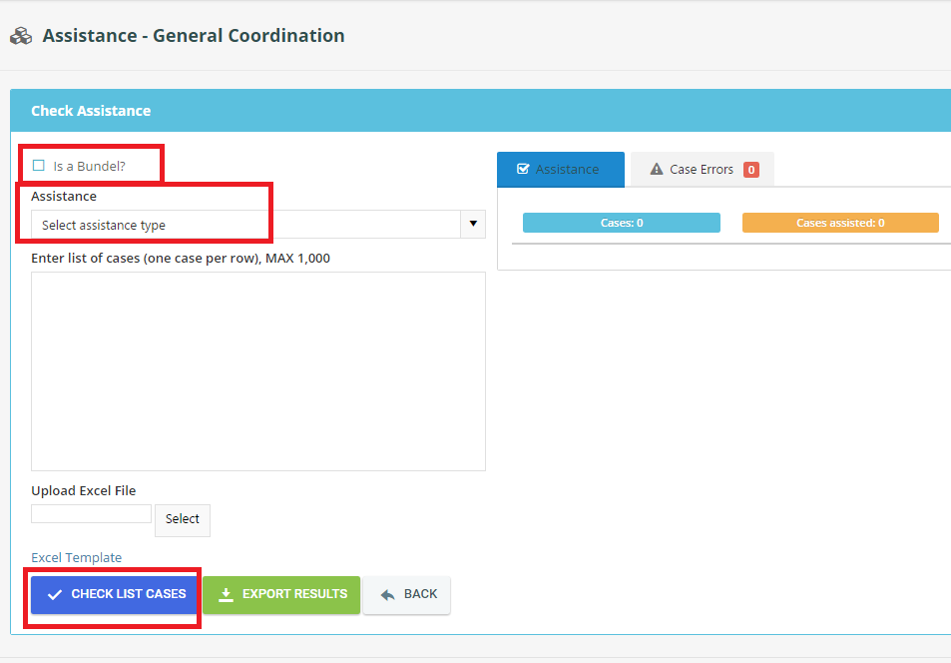
Untick – is this a bundle.
Select relevant assistance type for cross-checking
Copy and paste list of cases, maximum 1000 at a time
Click Check list cases below

Slide 6
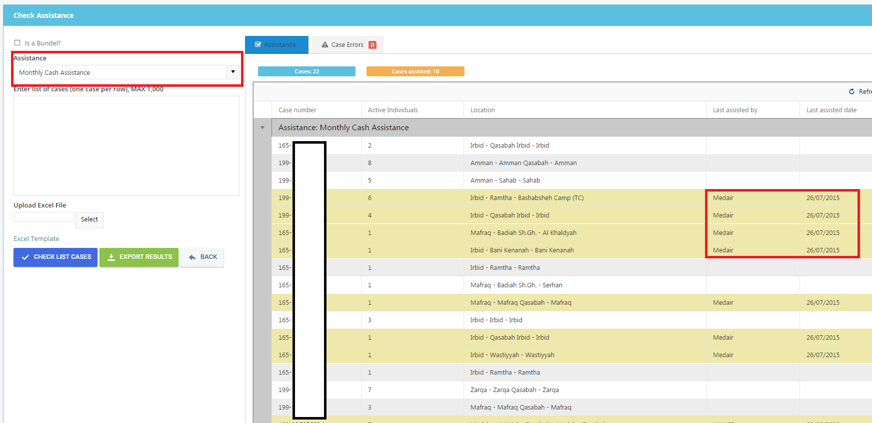
Understanding results:
Cases which appear in yellow below for example have received assistance from another organization and the date as to when they last received assistance is specified.
In this case because the Assistance type monthly cash assistance is being cross-checked, cases which appear in white have never received monthly cash assistance and are eligible to receive assistance.

Slide 7
Monthly Cash Assistance – the exception.
Although all assistance types can be checked using this module including regular monthly cash assistance, we still ask that for regular/ monthly cash assistance organizations must send their beneficiary lists monthly to the UNHCR Cash Office for cross-checking on the master list at DLJORAM-CBI@unhcr.org.
Data in RAIS is only as up to date as all the organizations using the system and feeding it information after they have completed distributions – it is therefore reliant on the data that is contributed by the organizations if it is not uploaded then it does create coordination issues. Therefore we request regular/ monthly cash assistance as the exception of all assistances is checked with the cash office monthly to remove likelihood of duplication.

Slide 8
What else can be checked here?
All cash, vouchers and NFI. Cross-checking cash however should be a first priority prior to distribution.
Cash for rent Unconditional cash assistance
Cash for documentation Winterization cash T1
Urgent cash assistance Winterization cash T2
Cash for health Vouchers etc. i.e. Gas refill
NFI and so forth.

