Slide 1
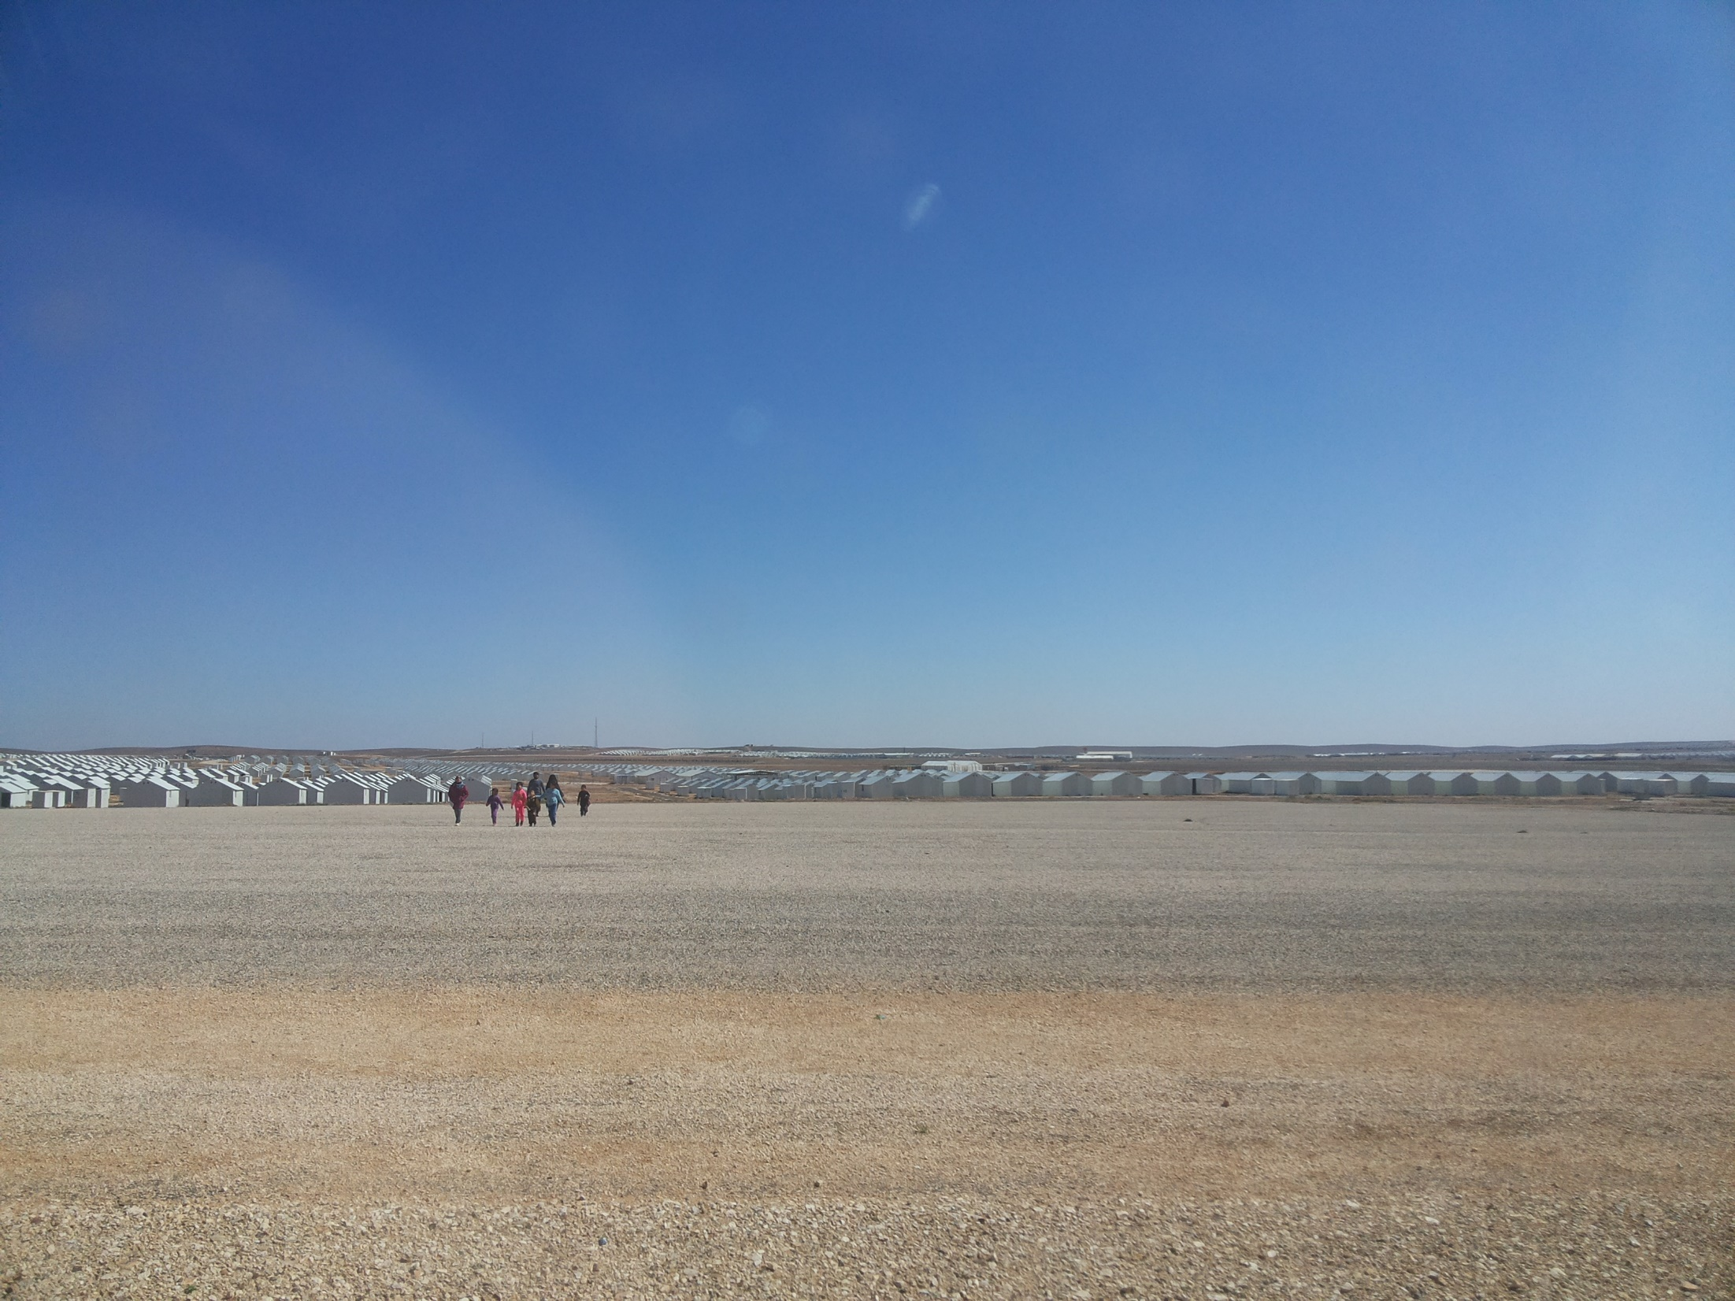
Mass Communications Assessment Azraq Camp
Presentation of Key Findings

Slide 2
Introduction / Background
From 20 - 30 December 2015 REACH, in collaboration with UNHCR, conducted a Mass Communications assessment in Azraq camp.
The primary objectives of this assessment were to identify:
Access to information and communication technologies (ICTs)
Access to information dissemination mechanisms and media sources
Barriers to accessing disseminated information and media sources
The primary information needs of the community
The usage of feedback and complaint mechanisms
Barriers to accessing feedback and complaint mechanisms
A variety of formal information dissemination channels and media campaigns exist to ensure that camp-wide assistance is distributed efficiently and that camp residents have access to accurate information regarding available services and opportunities.
Additionally in 2016, camp partners seek to provide increased access to ICTs and media sources through the installation of Wi-Fi hotspots in selected public spaces, and the introduction of electricity at the household level.
Notes:
Moreover, to further facilitate refugees’ access to information and communication between the refugee community and service provider, both general and service-specific feedback and complaint mechanisms have been established.
The assessment establishes a baseline of data, while also contributing to the collection of data at the country level through building upon findings from the June 2014 REACH-UNHCR mass communications assessment in Zaatari camp and the Jordanian host community.

Slide 3
Methodology
This assessment consisted of both quantitative and qualitative components:
Quantitative:
A sample of 368 households in each village were randomly selected for participation. Results are generalisable at the village level with a 95% confidence level and a 5% margin of error.
A team of Syrian incentive-based volunteers (IBVs) under the supervision of REACH data collection officers conducted the interviews using the Open Data Kit (ODK) collect application.
Qualitative:
Eight focus group discussions (FGDs) were conducted, consisting of 6-10 participants each.
Demographic breakdown of FGDs
 | Village 3 | Village 6
Male 16-30 years | 1 | 1
Male 30+ years | 1 | 1
Female 16-30 years | 1 | 1
Female 30+ years | 1 | 1
Notes:
Quantitative data:
Findings are generalizable at either the age or sex level with a 90% confidence level and a 5% margin of error.
The individual interviewed from each household was then selected through a random number generator built into Open Data Kit (ODK) collect. This function assigned numbers to all household members 16 years or older, then randomly selected one of these numbers to determine the household member who would participate in the interview.
Qualitative data:
The purpose of these focus groups was to attain a more nuanced understanding of information needs and barriers experienced by the refugee community, as well as to source suggestions from the community for improving formal information dissemination channels, access to media sources, and the quality of feedback mechanisms.
Data saturation was reached at the village, age, and sex levels.
15 key informant (KI) interviews were conducted during the data collection period following a preliminary analysis of the quantitative data, serving to contextualize findings.

Slide 4
DEMOGRAPHICS

Slide 5
Age and sex of respondents
The highest proportion of respondents were between 16 and 30 years old (43%), followed by 42% of respondents aged 31-45 years, 11% aged 46-60 years, and 4% over the age of 60.
Female respondents comprised a slightly larger proportion of the sample, with 59% female respondents and 41% male.
Age and sex of respondents included in the assessment
Male respondents (41%)
Female respondents (59%)
16-30
31-45
46-60
Over 60

Slide 6
Time of arrival to Azraq camp
Most respondents (24%) reported arriving to the camp October - December 2015, whereas the least (5%) reported arriving one year prior October and December 2014.
Over one-third (35%) of respondents reported arriving in the last six months.
Month and year of respondents’ arrival to Azraq camp
Village 6 has a larger proportion of newer arrivals to the camp than Village 3 - 44% of respondents who arrived between June and December 2015 reside in Village 3, compared with 56% of respondents who reside in Village 6.
Notes:
61% of respondents who arrived to Azraq camp between April and October 2014 reside in Village 3, whilst 39% reside in Village 6.

Slide 7
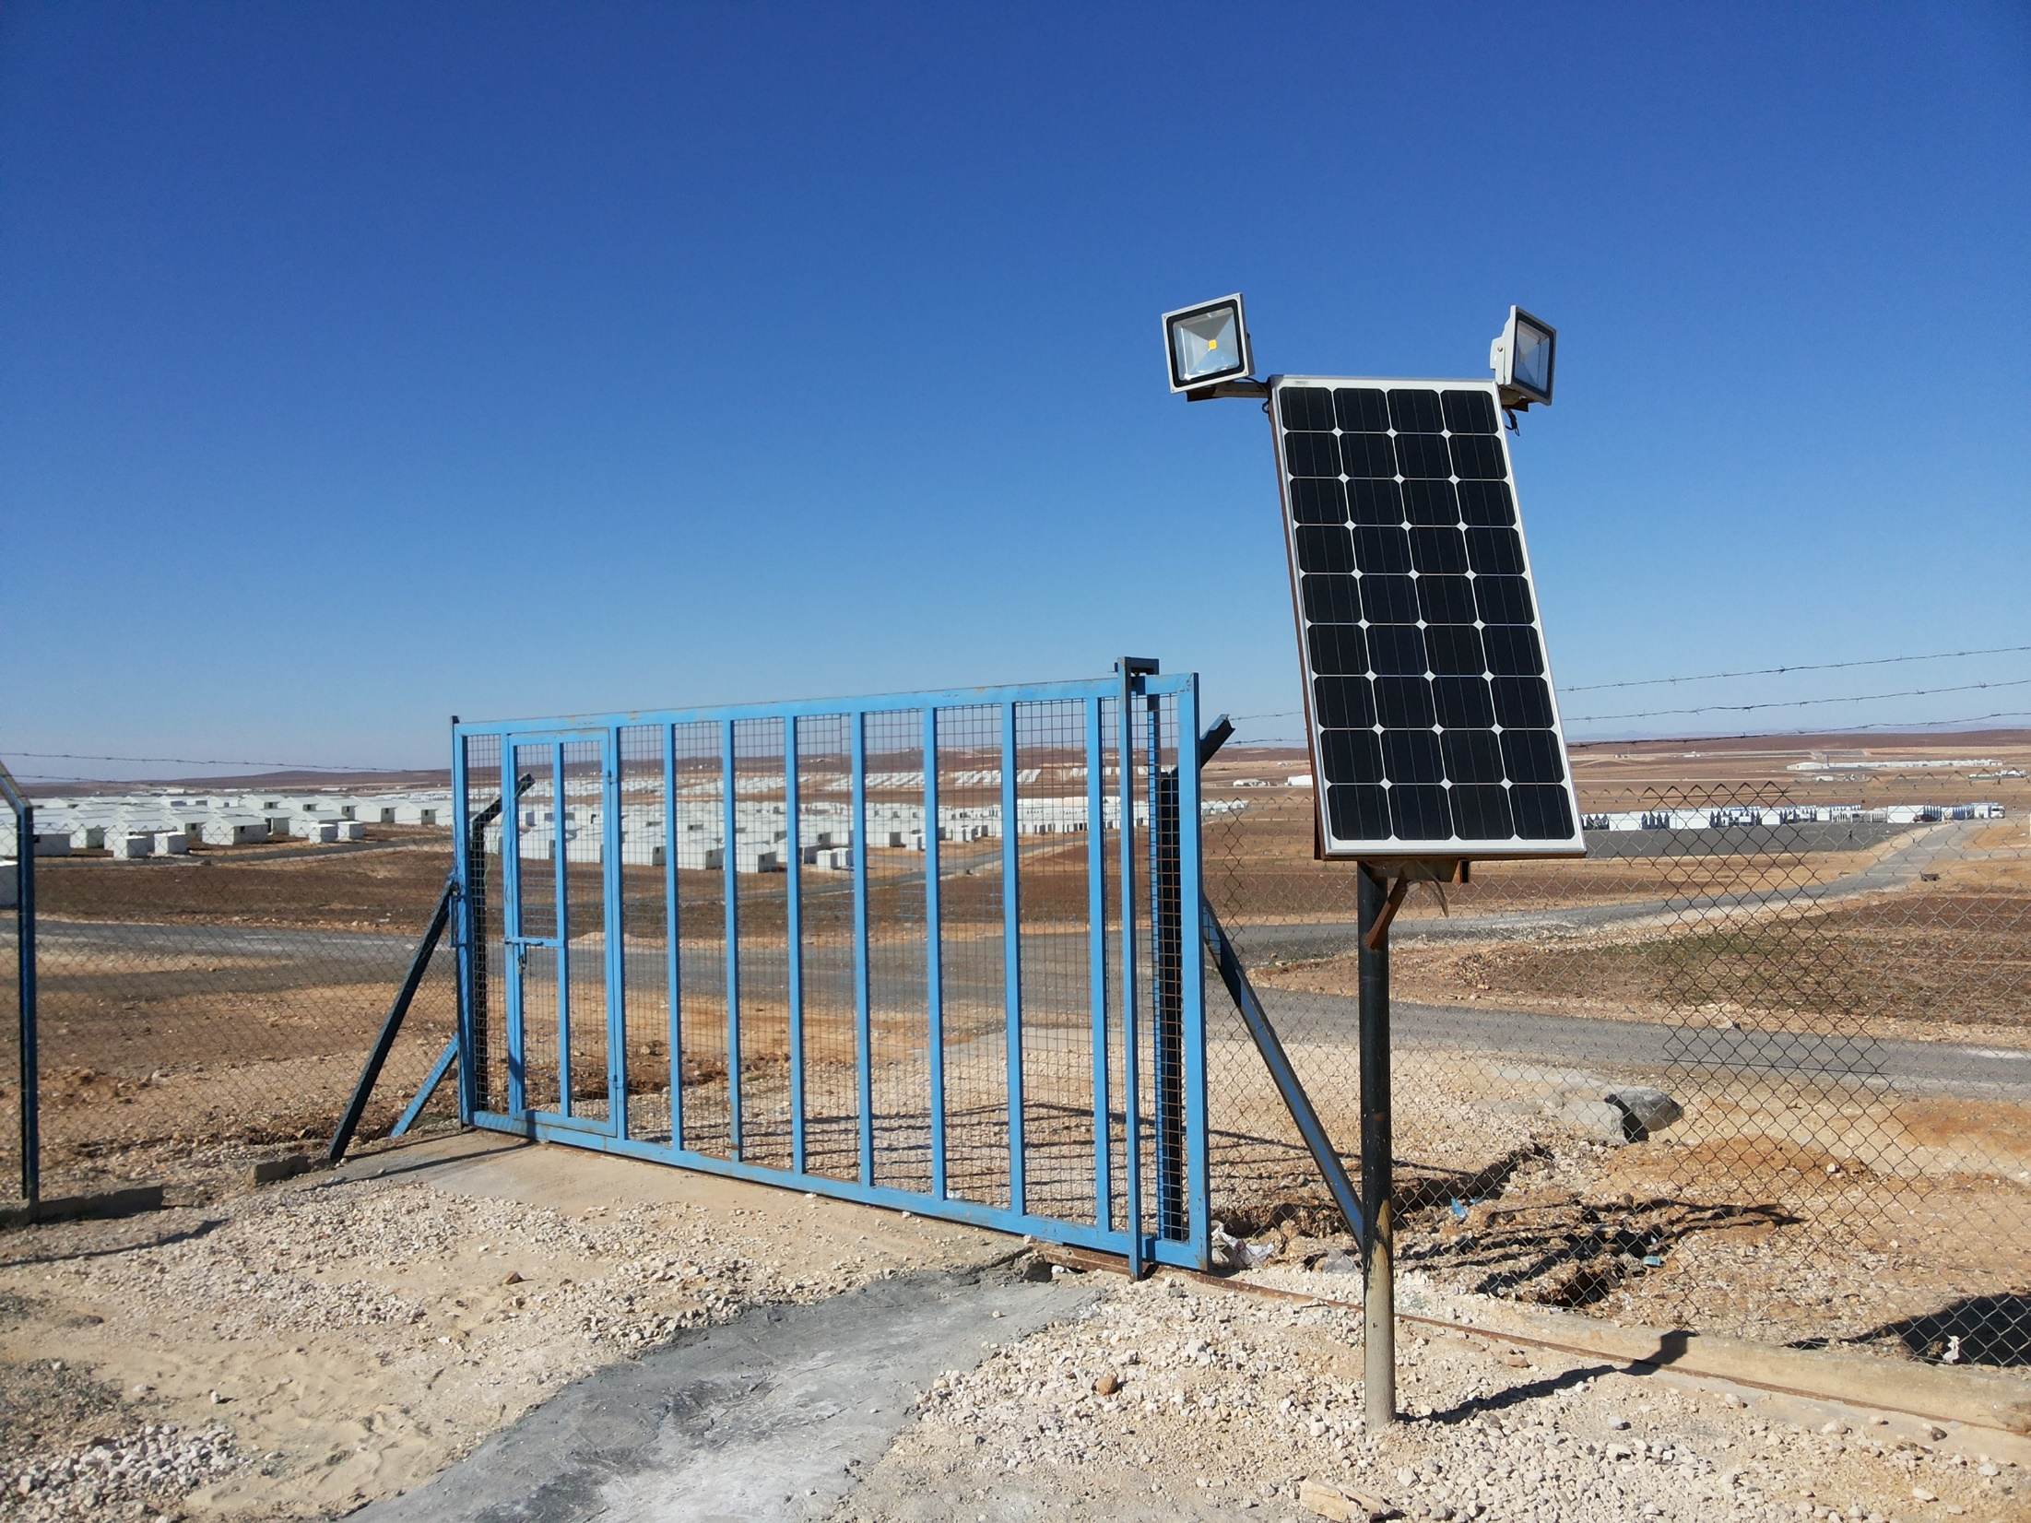
Access to ICTs

Slide 8
Literacy rates
The overall camp-wide literacy rate is 80%, and is highest amongst 16-30 years old (88%).
Residents over 60 had the lowest literacy rates, with 47% reporting themselves as illiterate
Village 3 residents (84%) report a higher literacy rate than Village 6 residents (76%).
Males refugees (87%) report a higher literacy rate than female refugees (75%) in the camp.
Reported literacy rate by age group
Notes:
In this assessment, literacy was defined as the ability to both read and write in Arabic and was self-reported by respondents.
Literacy at the camp level is lower than recent figures from Syria: overall adult literacy in Syria was 85.5% in 2013 and 86.4% in 2015, compared with 80% in Azraq camp
Higher rates of literacy amongst younger age groups may be reflective of greater access to education in Syria prior to the onset of the conflict, as compared with older generations .

Slide 9
Individual smart phone possession
58% of respondents reported that they possess a smart phone.
Respondents 16-30 years reported the highest rate of smart phone possession (66%) amongst all age groups.
Respondents from Village 3 (61%) reported smart phone possession at a slightly higher rate than Village 6 (56%).
Males (69%) reported smart phone possession at a higher rate than females (51%), suggesting potential gender-based limitations in access to communications technology.
Proportion of respondents in possession of a smart phone by sex and village of residence
Notes:
Village level differences may be explained in part by the higher rate of literacy in Village 3 than in Village 6 and more recent arrivals in Village 6 than Village 3 - as noted by KIs, newer arrivals to the camp are less likely to possess ICTs, as they may have recently arrived from Syria, or have not been present in the camp for an adequate period of time to pursue the acquisition of such items.
53% of female respondents who do not own a smart phone reported having access to a household member’s smart phone, compared with 34% of male respondents without a smart phone indicating this response. The gender difference in household level access to smart phones may suggest that female refugees are more reliant on using a male household member’s smart phone rather than possessing one themselves , potentially limiting the frequency of information access or the types of information accessed by females in the household. However, to better understand this relationship, there is a need for further exploration of the gender differences with regards to access to technology.

Slide 10
Household level ICT possession
87% of respondents report having access to either a smart or a non-smart phone within their household:
Indicates that in principle the majority of Azraq camp residents receiving camp services and assistance are able to receive disseminated information through SMS text messages.
ICTs possessed by households members of respondents
Smart phones are the most frequently cited ICTs that households in Azraq camp have access to (69%), followed by non-smart phones (31%).
Notes:
Overall the 78% of respondents reported having access to a smart phone, either through personal possession or through a household member
A lack of electricity at the household level is a key barrier to communication and to accessing information through ICTs. FGD participants explained that without electricity, refugees are unable to charge their mobile phones and tablets. As such they cannot consistently use them to communicate with relatives in Syria or elsewhere outside of the camp or to receive SMS text messages regarding camp services and assistance.
Further, a lack of electricity prevents the operation of televisions within households, thereby prohibiting using them to access news outlets. However UNHCR’s plan to provide every household in Azraq with electricity should minimise these access and communication barriers. Under this electricity scheme, each shelter in the camp will be allotted 1kWh per day of electricity, with further plans to install a solar plant in the camp in early 2016.
Respondents could choose multiple options to this question

Slide 11
Intended ICT acquisition
The vast majority (97%) of respondents cited televisions as the ICT that they would acquire, followed by smart phones (27%).
FGDs KI interviews showed that residents want televisions primarily to stay informed about the conflict in Syria followed by to obtain news about policy changes that may affect refugees in Jordan as well as Syrian refugees travelling to Europe and Canada for resettlement.
ICTs which respondents intend to acquire following the introduction of electricity to Azraq camp
Notes:
In anticipation of introducing electricity to the camp, respondents were asked to list the ICTs they intended to acquire following connection to the electrical network.
Respondents could choose multiple options

Slide 12
Access to internet sources
Over one-third (34%) of respondents reported that they had no access to the internet in the two months prior to the assessment, either inside or outside of the household. 66% of respondents reported having accessed the internet either inside or outside of their household.
Individuals who are able to access the internet do so on a consistent basis: of the 66% who reported accessing the internet either inside or outside of the household in the two months preceding the assessment, 80% reported accessing the internet one or more times a day.
Proportion of respondents with access to the internet in the two months preceding the assessment (October-November 2015)
Internet access inside household:
Internet access outside household:
Notes:
Only 10% of respondents reported that they had accessed the internet from sources outside of their household in the two months prior to the assessment.
Of the 10% of respondents using the internet externally, the vast majority (96%) cited friends, neighbours, and family inside the camp as their primary source and 74% cited this as their only source
95% of respondents who reported that they did not have access to a smart phone or tablet reported that they also did not access internet outside of the home. This suggests that household level ownership of a smart phone or tablet device is a prerequisite for using publicly available Wi-Fi, and as such, camp residents without these items are unable to use these services. To mitigate this technological barrier, camp partners offering Wi-Fi services should also consider providing internet-capable devices for public use within their facilities.

Slide 13
Preferred locations for Wi-Fi hotspots
In collaboration with NetHope, UNHCR is currently exploring the possibility of providing Wi-Fi hubs in public spaces across Azraq camp.
To guide the identification of locations for installing these Wi-Fi hotspots, FGD participants were asked to highlight optimal areas in the camp and the reasons why they were selected.
Overall findings indicate that:
Equal access to Wi-Fi hotspot for people living in different areas of the camp and for males and females is a primary point of consideration according to refugees
Points in the centre of villages or the camp were perceived to be best way to get equal access, as well as hotspots at locations frequently visited by everybody.
The key concerns regarding internet hotspots in the camp were disturbances to shelters in the close vicinity of hotspots due to gatherings of people using the internet, and the security of females who use the hotspots. To alleviate these concerns empty or open spaces and spaces next to NGO facilities were considered optimal for Wi-Fi hotspots.

Slide 14
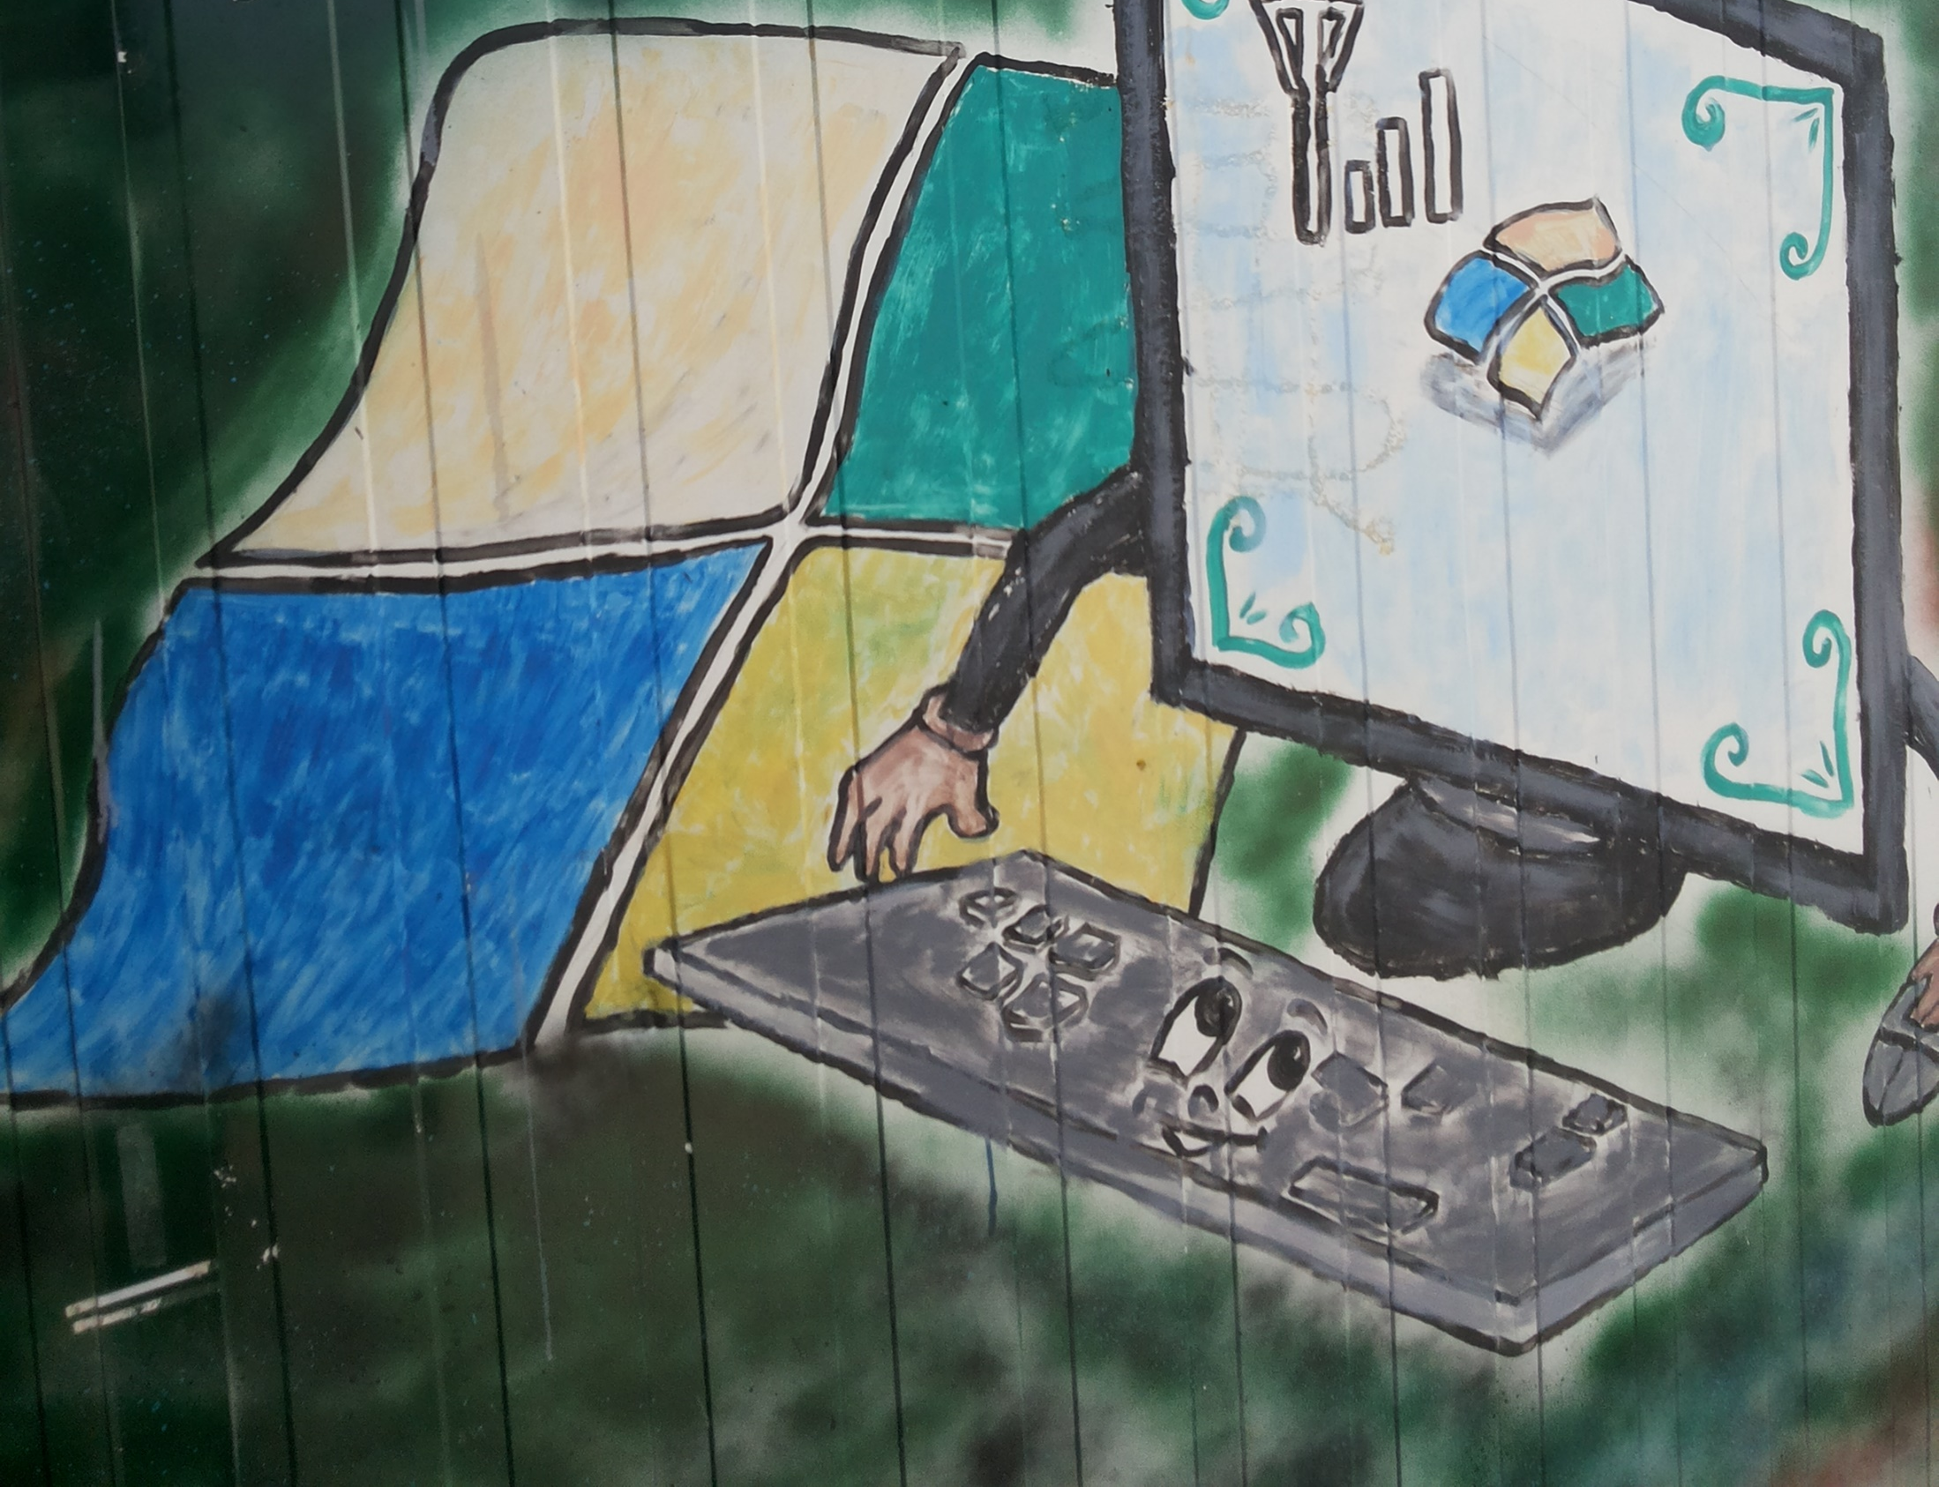
Access to media sources

Slide 15
Frequently used media sources
Social media platforms were cited as the first most frequently used media source (45%), reflective of Azraq camp residents’ greater access to smart phones in comparison with other forms of ICTs.
Of those who reported accessing media sources in the two months preceding the assessment, 64% used this media one or more times a day.
Primary most frequently used media sources used in the two months preceding the assessment (October-November 2015)
Although both survey respondents and FGD participants indicated that television media is the preferred source for multiple types of information, accessing this source is greatly inhibited until electricity is introduced to the camp.
Notes:
This finding indicates that for those refugees in Azraq camp who do have access to such sources, their access is consistent.
Beyond television usage, a lack of electricity may also adversely impact the number and variety of sources which refugees in the camp access on a consistent basis: 12% of respondents indicated that they did not access any media sources during the two months prior, and 32% of respondents indicated accessing only one media source.
FGD participants reiterated that without electricity, items such as smart phones and tablets cannot be charged, thereby limiting their use in accessing internet media. In addition to the barrier posed by electricity, KIs highlighted the fact that there have been many new arrivals to Azraq camp in the two months preceding the assessment, and as such, these households have not had the opportunity to acquire ICTs or an internet connection. This further serves to explain the percentage of respondents citing only one frequently used source or no sources at all.

Slide 16
Types of information accessed
92% of respondents reported country of origin as the main type of information that they accessed through media sources.
The second most frequently cited type of information accessed was news services (22%).
Types of information accessed through media sources
Notes:
FGDs revealed that Azraq camp residents use both social media and television to access information about Syria, as well as to stay informed of local news and perceptions towards refugees in the Jordanian host community. With respect to news about Syria, KIs elaborated that refugees in the camp seek information regarding broader issues at the country level, such as the status of a political solution, casualties resulting from air strikes, and shifts in territorial control between conflicting parties. To obtain this information, Al Arabiya, al Jazeera, and Syrian outlet Orient News were reported by KIs as trusted and credible channels. However, KIs note, they also seek community-level information, such as the safety of friends and family still in Syria, the state of their abandoned property and assets, whether any universities have reopened, the cost of living amidst the conflict, and general updates from the community such as marriages.
Additionally, FGDs indicated that resettlement and work opportunities are key areas where Azraq residents seek information through the internet and other media sources.
Respondents could choose multiple options

Slide 17
Trusted media sources
Television is the most trusted form of media reported, with 54% of respondents citing this as their first most trusted source, followed by social media (22%).
Social media was also ranked as a first least trusted source by 26%. KI interviews revealed that social media is often the only source available rather than the most trustworthy.
First most and least trusted media sources

Slide 18
Adequacy of access to media sources
The majority (71%) of respondents perceived access to media sources as either inadequate or very inadequate.
Only 9% of Village 6 respondents rated access to media as adequate, compared with 20% from Village 3.
Suggesting that Village 6 residents are less satisfied with access to media than Village 3 respondents.
Adequacy of access to media sources by village of residence
Notes:
36% of Village 6 respondents rated access as very inadequate, compared with 26% of respondents from Village 3

Slide 19
Reasons for perceived inadequacy
The lack of electricity at the household level is a key driver of perceptions of inadequate access to media sources with 96%, followed by a lack of financial means to purchase internet technology with 70%
Reasons for perceived inadequacy of access to media sources
Notes:
A higher proportion of Village 6 residents cited financial barriers than Village 3: 59% of respondents citing a lack of financial means are from Village 6, compared with 41% being from Village 3. This difference at the village level may be partly attributed to the fact that a higher proportion of Village 6 residents are newer arrivals. As such, they have fewer financial resources than those residents who are more established in the camp and are potentially engaging in income generating activities.
Respondents could choose multiple options

Slide 20
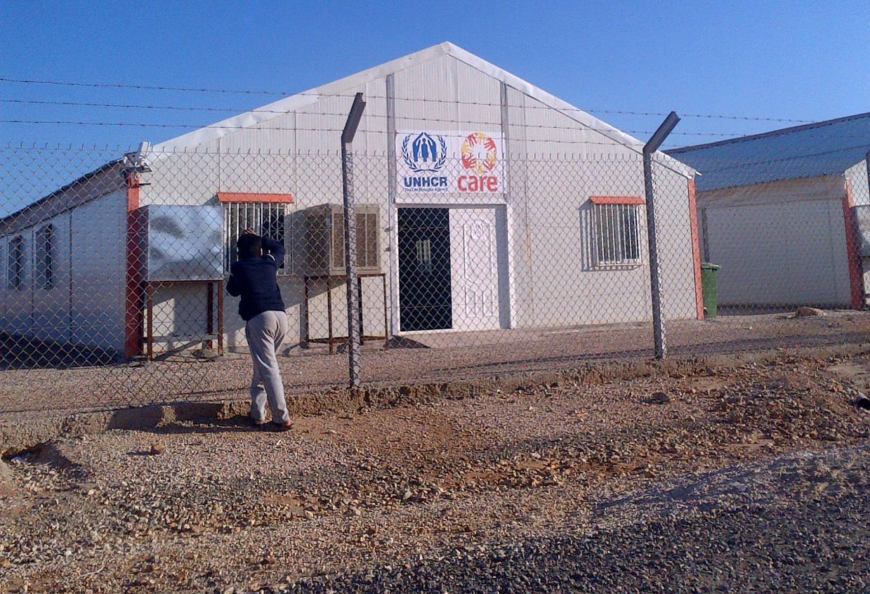
camp services information

Slide 21
Frequently used information sources (1)
36% of respondents reported friends, family, and neighbours as their most commonly used source of information in the camp, followed by 24% citing text messages and 23% citing leaflets.
37% of respondents aged 16-30 cited friends, family, and neighbours as the most commonly used information sources, compared with 47% of respondents aged over 60.
Most commonly used source for obtaining camp services and assistance information
Notes:
FGD participants expressed widespread usage and trust in SMS text messages to communicate information regarding aid distributions and other services in the camp, but stressed that the reach of these messages must be expanded to cover the entire community.
FGDs clarified that although word-of-mouth is a common method of obtaining general camp news and information, information regarding specific services and in particular aid distributions is also frequently accessed through formal channels such as posters in distribution centres, circulation of leaflets, and SMS messages.

Slide 22
Frequently used information sources (2)
FGDs indicated that informal channels are used in tandem with formal mediums, particularly when information is seen as difficult to obtain (e.g. status of electricity scheme, family reunification and UNHCR resettlement procedures).
Female respondents cited friends, families, and neighbours slightly more frequently than males (38% versus 33%)
Male FGD participants noted that female household members are more likely to obtain information through informal channels, as they are very active in their local communities, whereas males are often more present in public spaces around the camp.
However, participants also recognised the limitations of relying solely on informal channels, such as rumours and incomplete information.
These findings indicate that although informal channels are utilised by a significant portion of camp residents, it remains important that organisations in Azraq camp aim to meet the information needs of the majority of the population through formal dissemination mechanisms.
Notes:
To illustrate this point, FGDs noted that male refugees in the camp are more likely to obtain information from posters displayed in public spaces where women are less likely to go.

Slide 23
Frequently used sources by time of arrival
SMS text messages are cited as the most commonly used information source amongst the earliest arrivals to the camp: 35% of respondents who arrived between April and October 2014, whereas only 11% who arrived between May and December 2015 cited this source.
Most commonly used source for obtaining camp services and assistance information by date of arrival to Azraq camp
Notes:
These findings indicate that the discrepancy between high levels of trust in SMS texts compared with their relatively low reporting as a most commonly used source can be explained in part by a lack in universal dissemination.
Additionally, as with internet access, FGDs confirmed that the lack of electricity available in households and subsequent inability to keep mobile phones charged impacts the ability of SMS text to reach a significant segment of the camp population.

Slide 24
Most trusted versus most used sources
“Friends, family, and neighbours” was the most commonly reported first most trusted source (36%) whilst 31% of respondents cited this as their most frequently used.
27% of respondents cited text messages as a first most trusted source, whilst 24% cited this as their most frequently used source.
Most frequently used vs. first most trusted source of information regarding camp services and assistance
Overall, 75% of respondents ranked SMS text messages as either their first, second, or third most trusted information source, followed by leaflets (66%), and friends, family, and neighbours (49%).
Notes:
Respondents were asked to rank their first, second, and third most and least trusted sources for receiving information.
These findings indicate that the discrepancy between high levels of trust in SMS texts compared with their relatively low reporting as a most commonly used source can be explained in part by a lack in universal dissemination.
Additionally, as with internet access, FGDs confirmed that the lack of electricity available in households and subsequent inability to keep mobile phones charged impacts the ability of SMS text to reach a significant segment of the camp population.

Slide 25
Adequacy of access to information sources
For 12 of the 16 services assessed, a majority of respondents considered the level of access to information to be adequate or very adequate.
Food vouchers and e-cards, bread distributions, and safety and security were the three services with the highest ratings of adequacy (77% , 76% and 76%, respectively).
The Incentive Based Volunteer (IBV) scheme was the sector with the highest proportion of respondents expressing dissatisfaction with access to information, 55% of respondents indicated that access was either inadequate or very inadequate.
Proportion of respondents who rated information access as inadequate or very inadequate, by camp service
Notes:
Food vouchers/e-cards and bread distributions are two of the most regular and long-running distributions in the camp, which may in part be the reason behind this result.
Health and disability were the second and third most frequently cited camp services that participants rated as having inadequate or very inadequate levels of access to information.

Slide 26
Adequacy of information regarding IBV scheme
The primary reasons driving the perception of inadequacy was that the information available was insufficiently detailed (44%), followed by not receiving a response after asking for more information (40%).
Across all sex and age groups, FGD participants highlighted the need to know: which organisations are engaging refugees in IBV work, when IBV positions become available, application procedures, and the selection criteria for applicants.
A lack of trust in the selection process was expressed by both male and female participants, who highlighted a perception of nepotism with respect to the selection of IBVs.
Improved communication of IBV opportunities accompanied by the dissemination of detailed application and selection criteria therefore can combat the mistrust that is developing with the current levels of specific procedural information.
Notes:
It is important to note, however, that the IBV scheme is very popular in the camp, as the remuneration it offers can reduce the vulnerability of families. Therefore, a higher demand for IBV opportunities exists in comparison to the number of positions available, which may also contribute to overall perceptions of inadequacy in the refugee community regarding the amount of information available for this scheme.

Slide 27
Information gaps and needs
44% of respondents reported that there had been information that they were unable to access in the three months preceding the assessment that they deemed important to have access to.
Of the above 22% of respondents cited services for children, 17% reported family reunification with family living in Zaatari camp or the Jordanian host community, and 15% cited news about Syria as the types of information they were seeking.
Proportion of respondents who feel there are gaps in information access
Leaflets announcing upcoming ad hoc distributions
High traffic public facilities:
WASH centres
Sameh Mall
Mosques
Community mobilization teams
Community police
Preferred methods for information dissemination
Notes:
Formal resettlement processes to third countries was another commonly cited information gap amongst FGD participants. Perceptions amongst refugees in the camp are that information regarding these services are not disseminated through formal channels; as a result, FGD participants report the need to rely on rumours and word-of-mouth to obtain information such as the number of refugees who will be selected for resettlement, eligibility criteria, and selection criteria.
Another key information gap, which was highlighted across all sex and age groups in the FGDs, was the status of the camp-wide electricity scheme. As well as specific logistical details, such as the amount of electricity to be allotted per household and any restrictions in daily use, were also cited as areas in which camp residents would need more information.

Slide 28
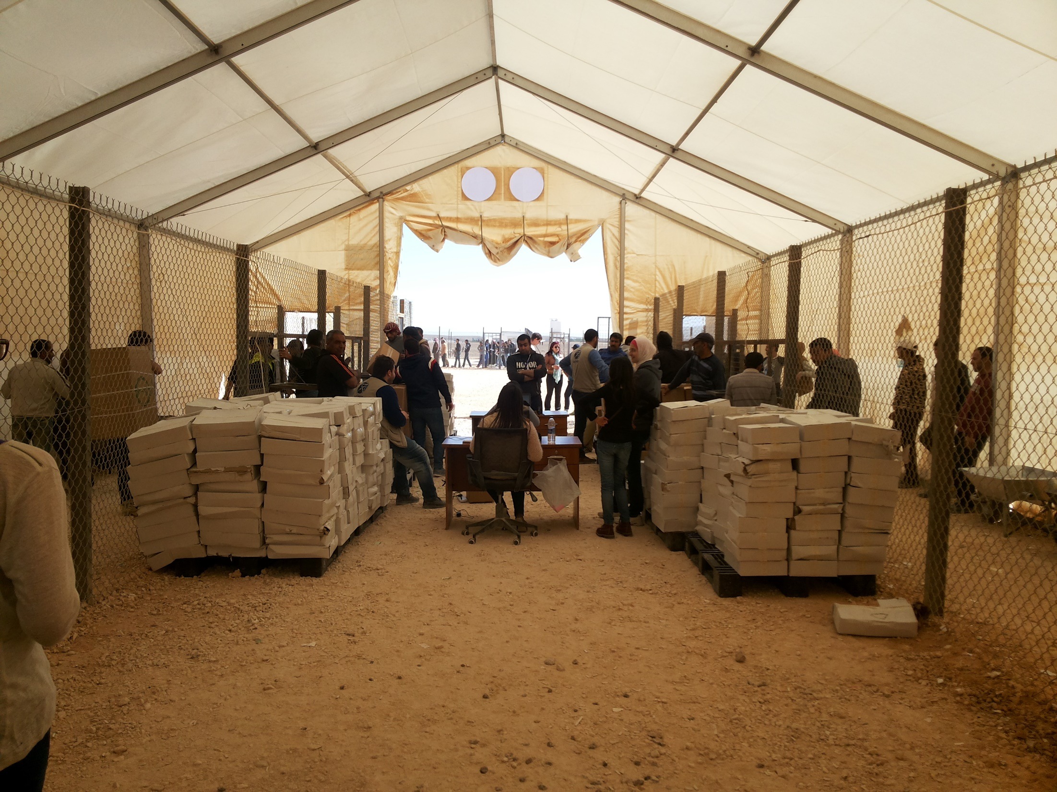
Feedback and complaint channels

Slide 29
Raising a question or complaint
Nearly half of respondents (49%) reported needing to ask a question or report a complaint to a humanitarian or government organisation in the camp in the three months preceding the assessment
Of those, 75% reported they submitted the question/feedback and 25% reported they did not.
% of respondents needing to raise a complaint/question, and of those, % of respondents who submitted them
Needed to submit feedback
Submitted feedback
Of those respondents who did not submit their question/complaint, 58% cited that they did not believe such action would have an effect, and 33% reported being unaware of the appropriate channel.
Notes:
The top three sectors which respondents had questions regarding were shelter (37%), incentive-based volunteering (IBV) opportunities (35%), and WASH (22%).

Slide 30
Primary feedback channels utilised
The majority (56%) of respondents cited community centre case managers as the primary channel through which their question or complaint was raised.
41% of respondents reported using designated complaint boxes in the camp to submit their question/complaint.
Primary channel through which feedback was submitted by respondents who submitted feedback in the three months preceding the assessment (September-December 2015)

Slide 31
Awareness of official feedback and complaint channels
Respondents reported similar levels of awareness of the following available feedback and complaint channels: complaint boxes in the camp (56%), case managers (56%), and community police (52%).
Conversely, only 10% of respondents reported being aware of the camp’s helpline as an available channel.
Feedback and complaint channels respondents report they are aware of
Notes:
These findings show that nearly half of the camp population is not aware of the primary channels for submitting questions, feedback, and complaints.
These findings underline the need for improved dissemination of information regarding available channels when refugees arrive to the camp, as well as awareness campaigns through both verbal and text-based mechanisms to ensure widespread knowledge.

Slide 32
Trusted feedback and complaint channels
Overall, community police were cited as the most trusted feedback and complaint channel, with 70% of respondents ranking this source as their first most trusted, followed by Humanitarian NGO and UN staff with 42%.
Feedback and complaint channels ranked as either first or second most trusted*
Despite high level of trust, only 14% of respondents needing to submit feedback indicated using community police. Conversely, complaint boxes and case managers were reported as the two most frequently used sources.
This discrepancy indicates that residents are reliant upon communicating questions and complaints through means viewed as most easily accessible rather than those seen as most effective.
Notes:
Percentages are an aggregation of respondents’ first and second most trusted channel and therefore total more than 100%.
5.6% of respondents reported ‘nothing’ as their first most trusted channel, indicating that 94.4% of respondents cited a first most trusted source. Therefore, that 28% ranked ‘nothing’ as either first or second is based primarily on having no second most trusted source.
KI interviews reinforced these perceptions regarding the community police, highlighting that they frequently engage with the refugee community, listen to their concerns, and support their needs when communicating with camp partners. KIs also highlighted that community police can serve to channel questions to the appropriate authorities when refugees.

Slide 33
Satisfaction with feedback and complaint channels
Overall, over half (53%) of respondents indicated being unsatisfied or very unsatisfied with available feedback and complaint channels.
The most frequently cited reason for this reported dissatisfaction was a lack of feedback on the complaints that had been logged (71%). Further, 67% of respondents indicated a lack of solutions provided in the feedback to the complaint.
Satisfaction with available feedback and complaint channels, by village of residence
Notes:
Village 6 reported being satisfied with available channels at a lower rate than Village 3, with 24% versus 30% indicating this response.

Slide 34
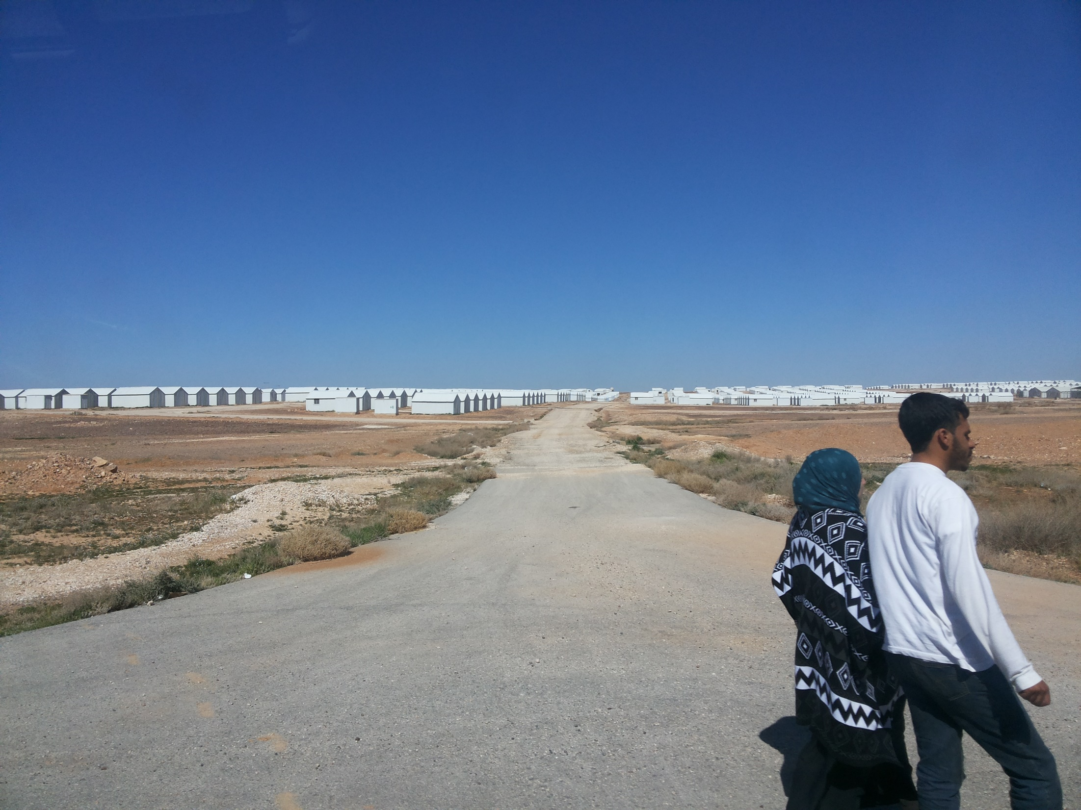
RECOMMENDATIONS

Slide 35
Recommendations
The following recommendations have been developed based on quantitative findings from the household survey and the feedback provided by Azraq camp residents who participated in focus group discussions:
Phone charging: Until the electricity network is extended to the household level, access to charging stations for mobile phones and other ICT items should be expanded in public spaces.
Access to televisions: The provision of public access to television in CARE community centres should be extended beyond one hour a day, and if possible multiple channels should be provided for viewing.
Wi-Fi hotspots: These should be installed in central locations in each village, so that they can be accessed by a maximum number of residents. These spaces should also be near well-known landmarks so that they are easy to locate, and in areas that female internet users perceive as safe to visit on their own.
SMS dissemination: As findings highlighted a lack of universal SMS text message dissemination to all camp residents, with a greater lack of dissemination amongst newer arrivals to the camp, CARE should revisit its list of beneficiaries who have registered mobile phone numbers and actively update this list to ensure it is inclusive and accurate.

Slide 36
Recommendations (2)
Feedback and complain channels: Responses to questions and complaints should include sufficiently detailed information that is easy to understand, as well as potential solutions to the issue raised. Further, improving follow-up procedures once questions and complaints are submitted is important to change perceptions of unresponsiveness amongst the refugee community.
Non-text based information dissemination: The dissemination of information regarding distributions, and other services in the camp should include non-texted based mechanisms in order to reach a wider demographic of beneficiaries, especially those who are illiterate or do not have access to phones
IBV opportunities: Efforts should be made to improve information dissemination regarding IBV opportunities. In addition it is also important to address perceptions of bias in selection processes by emphasizing the high demand for these opportunities and the mechanisms that are currently in place to prevent nepotism.
Notes:
As Village 6 has a higher proportion of residents who arrived in the six months preceding the assessment and a higher rate of illiteracy, these methods should especially target Village 6 residents.
Non-text based methods of information dissemination and feedback exchange can be especially useful for new arrivals to the camp who are both illiterate and who also have not formed social networks through which to obtain information about assistance and services.

Slide 37
Thank You
For further information regarding the Mass Communications assessment in Azraq Camp please contact:
Roxana Mullafiroze – REACH Assessment Officer
roxana.mullafiroze@reach-initiative.org
Gamal Yacout – UNHCR
yacout@unhcr.org

