Slide 1


National Livelihoods Working Group Meeting
MoSA – 7th floor
29 June 2017

Slide 2
Agenda
Welcome & introduction
Sector updates
a. Field Updates
b. Main takeaways of Private Sector Engagement workshop
c. LCRP M&E review
d. Key findings of Stabilization survey on Livelihoods
Presentation of LEADERS’ support to local initiatives for socio-economic development in Lebanon
Presentation of INTAJ I/II guidance papers by MC
AoB

Slide 3
Private Sector Engagement workshop
Lessons learnt event on 22nd June to take stock of partners’ work with the private sector – 40 participants.
Feedback: Good level of satisfaction: 4.3/5
4 main topics
  The role of PSE in bridging the gap between demand / supply side of labor (Facilitator: ILO)
  Access to market for MSMEs, especially in vulnerable areas (Facilitator: IRC)
  The role of corporate social responsibility and social entrepreneurship (Facilitator: Oxfam)
  Private sector engagement model and way forward (Facilitator: UNIDO)

Slide 4
PSE workshop
The role of PSE in bridging the gap between demand / supply side of labor
  Low level of engagement with the PS both at the programmatic and institutional levels.
  Priority: increase our support to local businesses (through coaching, training, investment, …) to develop longer term partnerships for increased profitability /productivity.
  At the institutional level, developing MoUs to provide a more structured, efficient & relevant framework for collaboration among stakeholders is key (notably between the Ch. of commerce and MoET).

Slide 5
PSE workshop
Access to market for MSMEs, especially in vulnerable areas
  Strong availability of resources to support MSMEs (i.e. online marketing tools, BDS, trainings…).
  The main challenge for vulnerable entrepreneurs is accessibility of market/services rather than availability.
  Improving market access implies to refine our knowledge of consumers’ preference (which is a time-consuming & costly process involving notably the utilization of regular field surveys).
  Priorities: 1) identifying and developing niche markets; 2) providing expertise to improve quality/marketing of strategic products; 3) deepening collab betw. PS & GoL to develop/implement export strategy.

Slide 6
PSE workshop
The role of corporate social responsibility and social entrepreneurship
  Lack of structured legal framework & of commonly agreed definition of SE & CSR.
  Partners should: 1) agree on a standardized set of criteria to measure social impact (KPIs…); 2) provide dedicated support to SE to develop sound business plans (financial sustainability); 3) strengthen link with GoL systems (including MoET SME strategy & MoSA new strategy).
  For GoL, focus should be on the provision of financial incentives (through tax breaks / low-interest loans…).
  Advocacy, education and awareness raising should be prioritized to promote ethical consumerism and fair trade.

Slide 7
PSE workshop
Private sector engagement model and way forward
  Macro-level: need to better link with GoL strategies (MoET SME Strategy / MoSA) and to develop public-private partnerships.
  Meso-level: need to engage bigger players as partners in the crisis response to facilitate linkages with smaller businesses → catalyst and facilitation role.
  Micro-level: facilitate access to key information and opportunities for small businesses.
Notes:
Next steps
Organization of similar events
MoET SME Forum on July 11th at BIEL (Beirut)
Setting up of a dedicated platform to strengthen linkages with the private sector
With support of 11 organizations (including OXFAM, ILO, IRC, LEADERS, Mercy Corps, UNIDO, ACTED and ALFANAR)
Development of guidelines on PSE to provide guidance to partners and harmonize practices
With the support of 8 organizations (including LEADERS, IRC, UNIDO, OXFAM, ALFANAR and UNDP).

Slide 8
LCRP MONITORING & EVALUATION REVIEW
Livelihoods

Slide 9
M&E FRAMEWORK
SO
Impact
Impact
Impact
Sector Outcome
Sector Outcome
Sector Outcome
Sector
Sector
Sector
Outcome
Output
Output
Financial info
Assumptions
Government data (CAS/line ministries)
Worldbank Economic study
VASyR
MICS
PA
HAUS
JMP
EIA
Perception surveys
UNHCR
Stability, UNDP
KAP
FTS
Lebanon Aid Management System
General surveys (e.g. VASYR)
Sector evaluation tools
(e.g. SGBV)
Log frames
Activity info:
Input / modalities
Output / progress

Slide 10
LCRP – M&E framework
4 Strategic Objectives
6 impact statements
Displaced persons from Syria and vulnerable populations live in a safe protective environment.
Livelihoods sector (decent work)
Immediate humanitarian needs of the most vulnerable populations are met.
Vulnerable populations have equitable access to quality basic services through national systems
Livelihoods sector (public work)
Mitigated deterioration in the economic condition of vulnerable populations.
Livelihoods sector
Social stability is strengthened in Lebanon
Mitigated environmental impact of the Syrian crisis.

Slide 11
Draft IS framework:
SO4 - Reinforce Lebanon’s economic, social and environmental stability
Mitigated deterioration in the economic condition of vulnerable populations
% reduction of the population below the poverty line
.
% of the population who has access to decent employment opportunities
LIVELIHOODS
FOOD SECURITY
1. AVAILABILITY: Ability to meet basic survival needs increased 2. FOOD ACCESS: food assistance and agricultural livelihoods.
EDUCATION
1- TVET
Notes:
The Livelihoods sector contributes to :
- SO4 “Reinforce Lebanon’s economic, social and environmental stability”:
Outcome 1: Employment and income generating opportunities enhanced (job creation through MSME support/VC development/public works)
Outcome 2: Workforce employability improved (provision of MBST, internships, OTJ trainings, career guidance services…)
Outcome 3: Policy development and enabling environment for job creation strengthened (decent work conditions improved ; policies, strategies & plans improving business environment)
11

Slide 12
Current Livelihoods Logframe
Outcome: Stimulate local economic development and market systems to create income-generating opportunities, reduce unemployment rates and protect vulnerable people, particularly youth and women, against risks and shocks.
Output 1.1: Capacity of the MSMEs sector to create jobs is improved.
Output 1.2: Competitive integrated value chains (VC) strengthened and upgraded
Output 1.3: Job creation is fostered in vulnerable areas through labour-intensive investments in productive public infrastructure and environmental assets
Output 1.4: Workforce employability improved
Output 1.5: Decent work conditions improved
Output 1.6: Policies, strategies and plans supporting job creation, MSMEs and livelihoods are set up to strengthen the business eco-system
Notes:
M&E consultant’s main observations on the current LH sector logframe:
1. The unique LH outcome is quite broad and imprecise.
It makes it difficult for the sector to measure/assess its impact under the crisis response.
2. There is quite a bit of confusion between the outcome and output-level indicators.
3. Important information is missing (including some baseline data & targets).

Slide 13
Proposed New LH sector logframe
Outcome 1 - Employment and income generating opportunities enhanced
Output 1.1: Capacity of the MSMEs sector to create jobs is improved
Outcome 2 – Workforce employability improved
Output 2.1: Vulnerable people provided with marketable skills
Outcome 3 – Policy development & enabling environment for job creation strengthened
Output 3.1: Decent work conditions improved
Output 3.2: Policies, strategies, plans set up to strengthen business ecosystem
Output 1.2: Competitive integrated VC strengthened and upgraded
Output 1.3: Job creation is fostered through labour-intensive investments
Output 2.2: Pathway to entrepreneurship and employment strengthened

Slide 14
Key findings of stabilization surveys
Quarterly survey
Throughout Lebanon
5,000 respondents
Random sampling with oversampling of 251 vulnerable localities.
Looking at social stability/tensions indicators but also at socio-economic vulnerability, relations with institutions, access to services.
Conducted by ARK

Slide 15
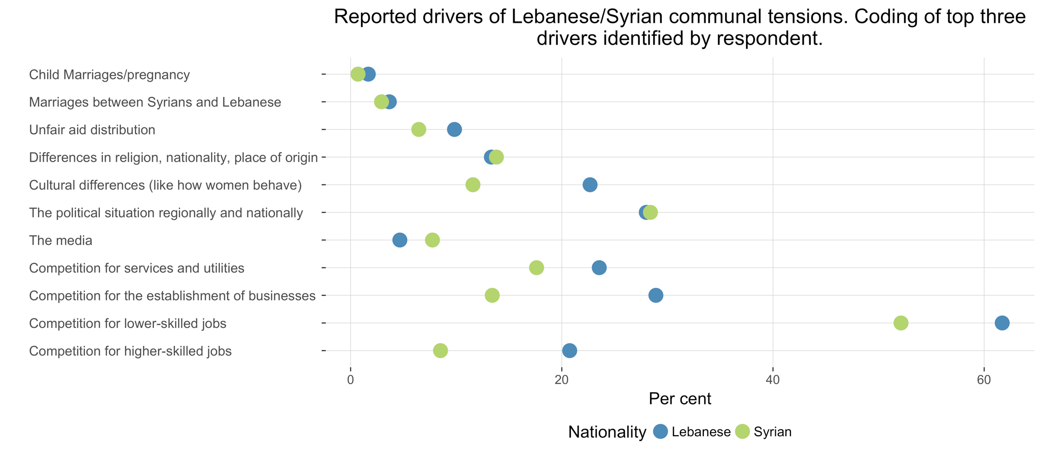
Early findings

Slide 16
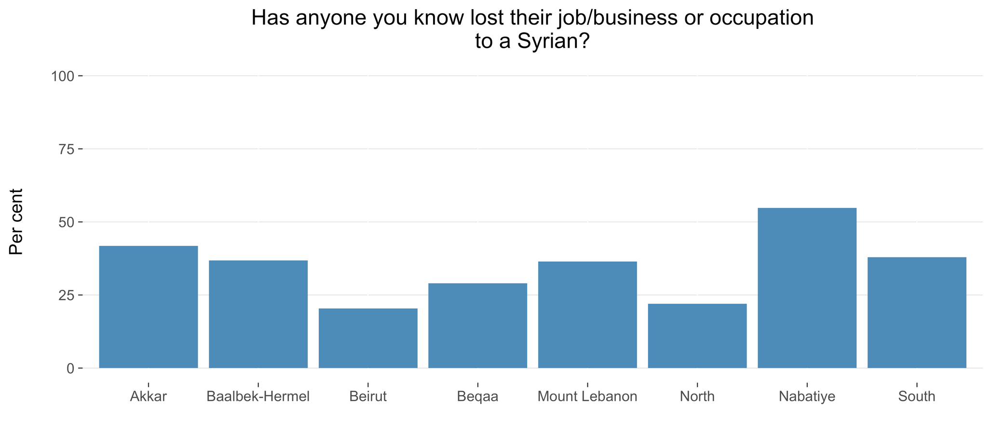
Early findings

Slide 17
Upcoming results relevant to livelihoods
Education level
Residency & registration status
Average monthly income pre HH
Employment status of each HH member
  Labour force participation
  Unemployment
Field/sectors of work per HH
Child Labour

Slide 18

The EU Trust Fund in Response for
the Syrian Crisis - The MADAD FUND

Slide 19


Slide 20
Placement in project services
Education
Skills
Preference
MARKET Analysis
Counseling
Action Plan
Trainings
Apprenticeships
On the Job training
Job referral

Slide 21
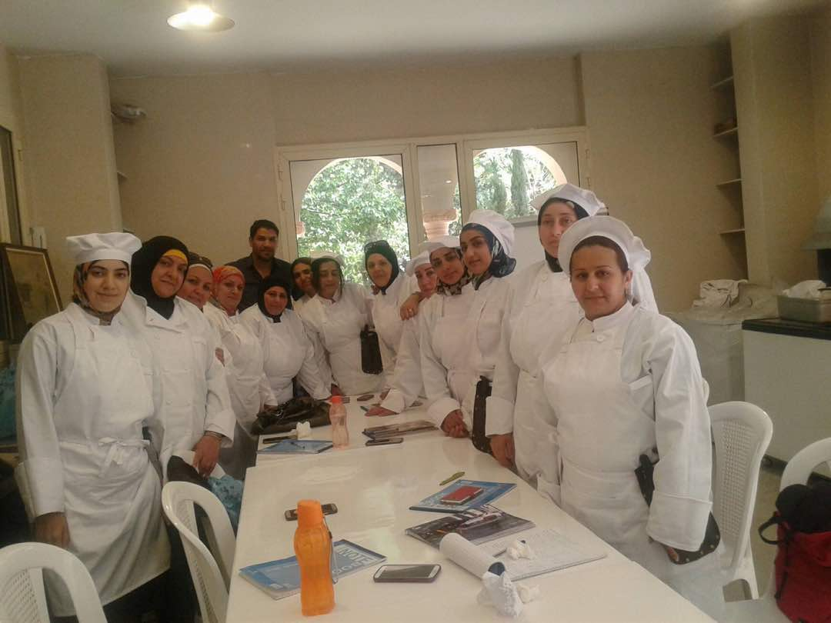

Slide 22
Vocational Training
VT Classes | Mechanics, Accounting, Sales and Customer Service, Line Cook, Photography, Secretary, Cell Repair and Clinical Assistant
Curricula Development | Sewing and tailoring, Steel fixer, Air conditioning, Dr. Assistant, Concrete carpenter, Machine Electrical (Industrial) and Agro-food processing (yet TBD)

Slide 23
Life and soft skills

Slide 24
On-the-job training
Apprenticeship
Job referrals

Slide 25
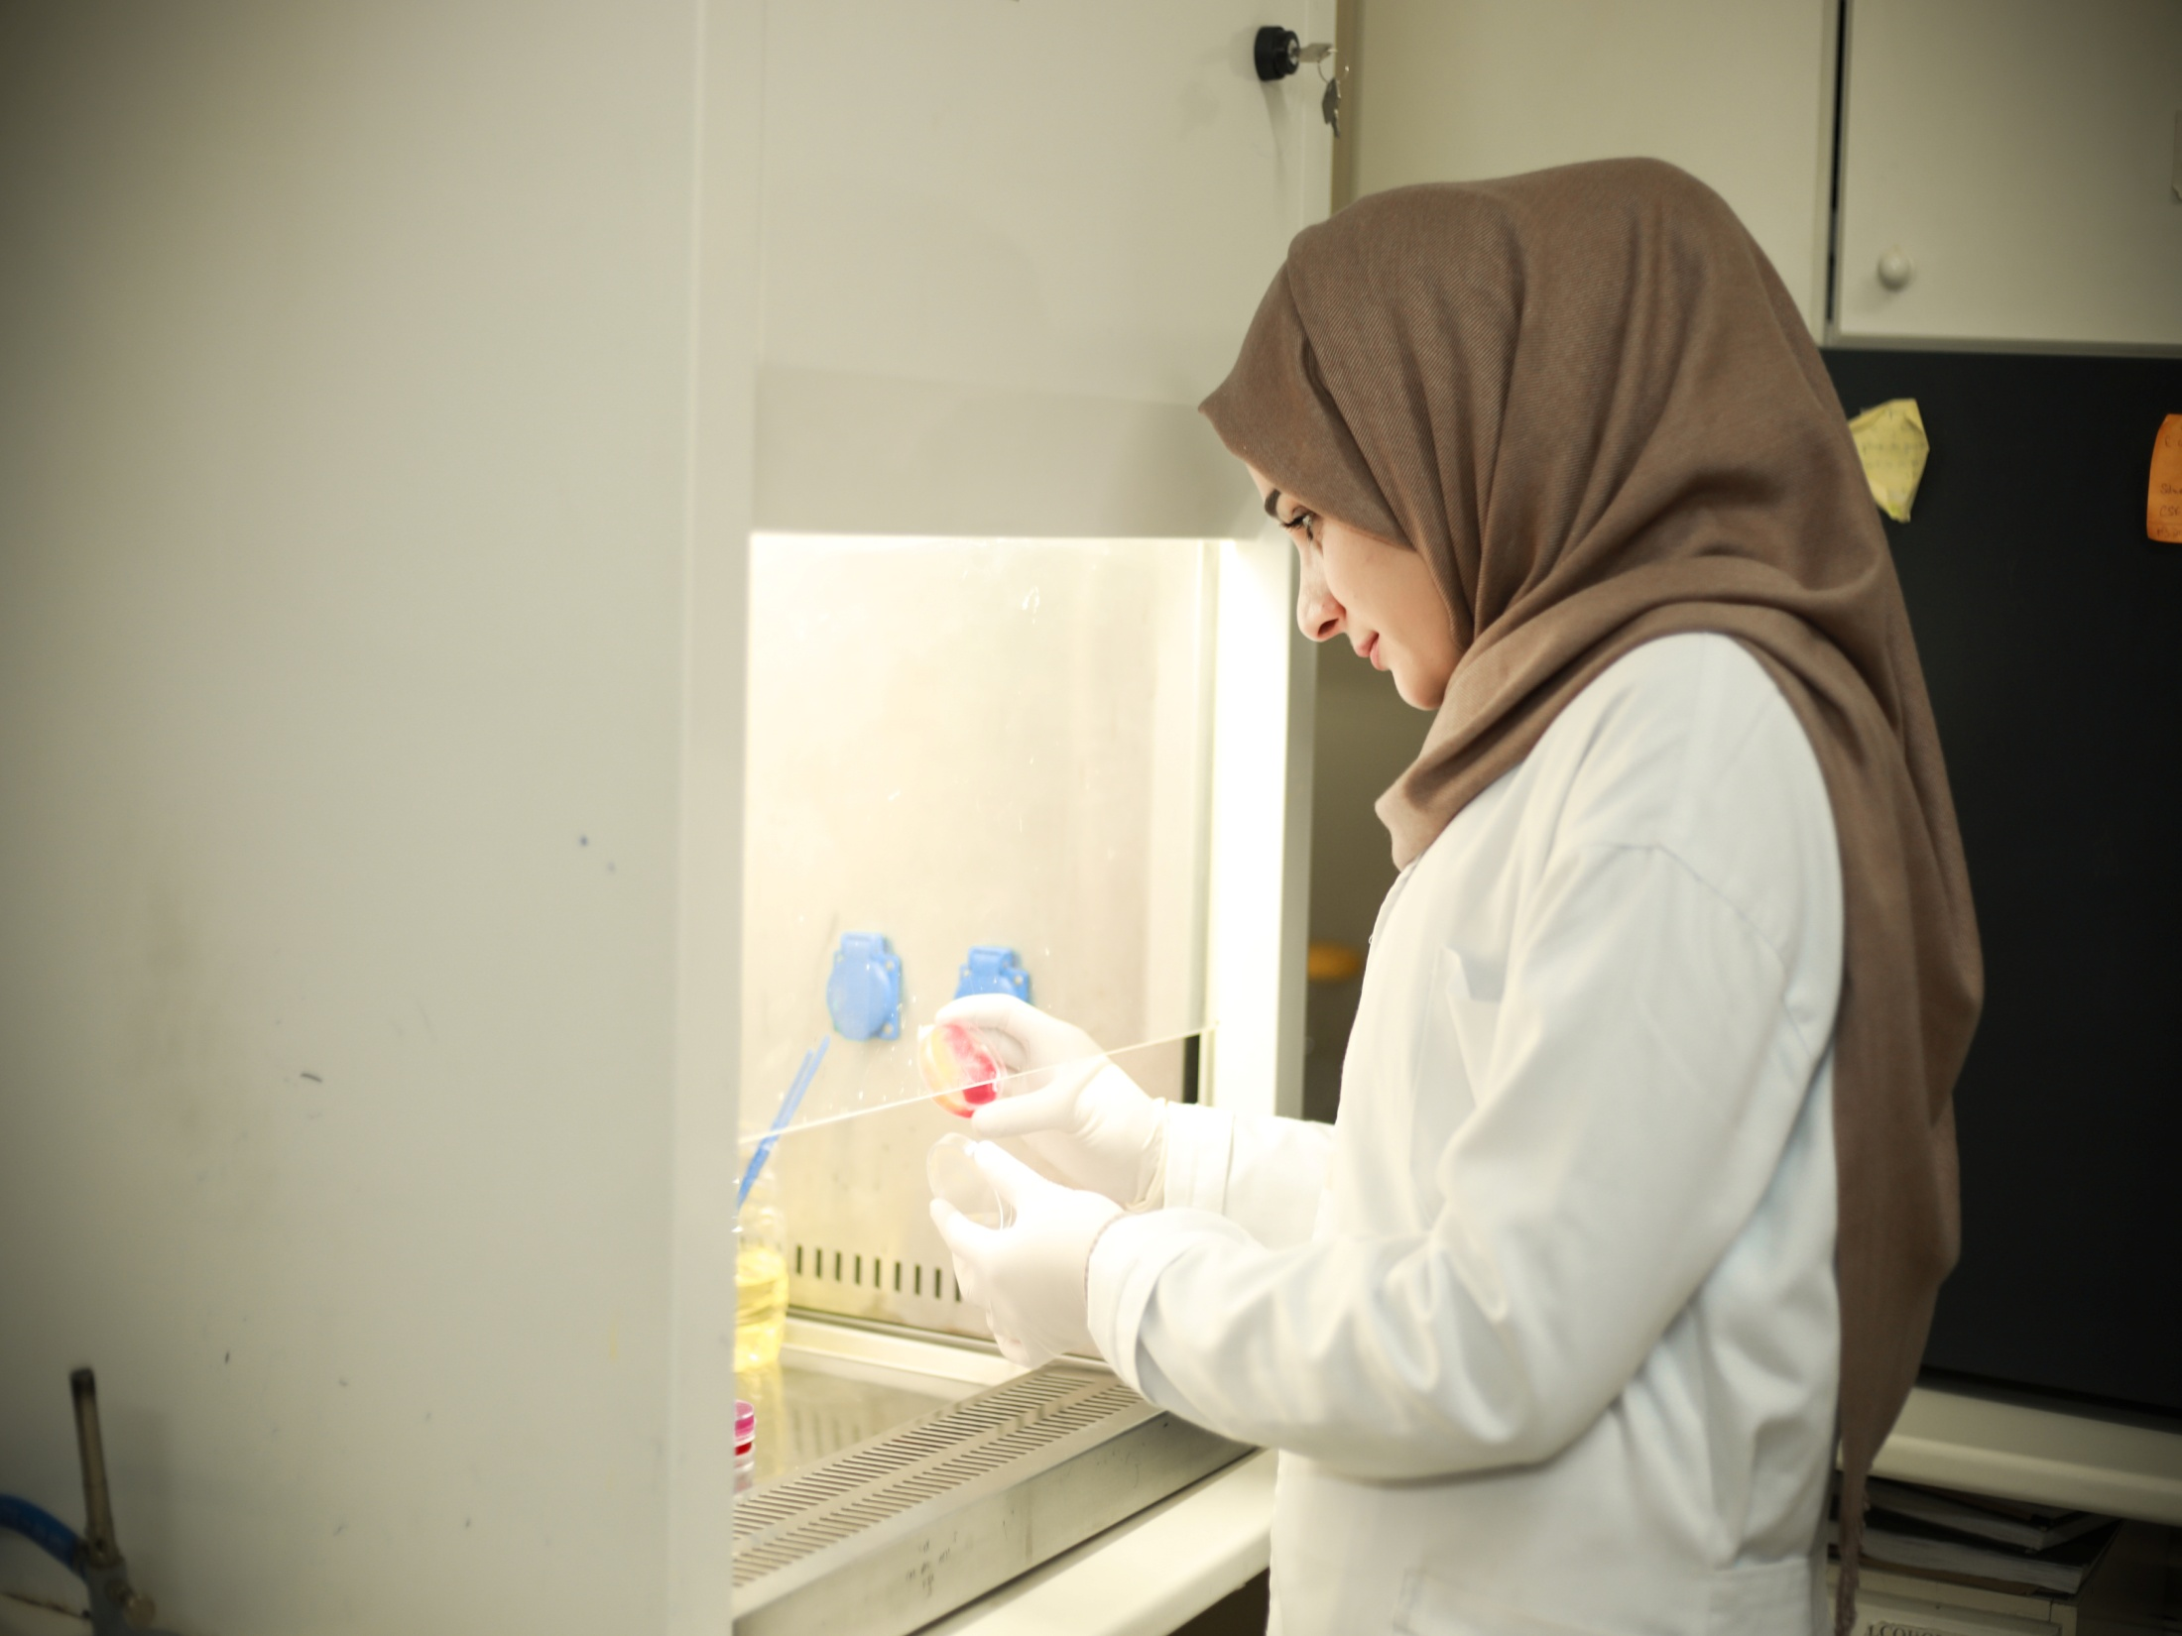

Slide 26
Business Development Services
MSE outreach and profiling + referrals
MSE profile review
Preliminary selection
Matching with potential service provider (SP)
In-depth assessment visits by SP
Consensus on priority needs
Training
Mentoring
Monitoring
Action learning
Adjustments

Slide 27
Business Development Services

Slide 28
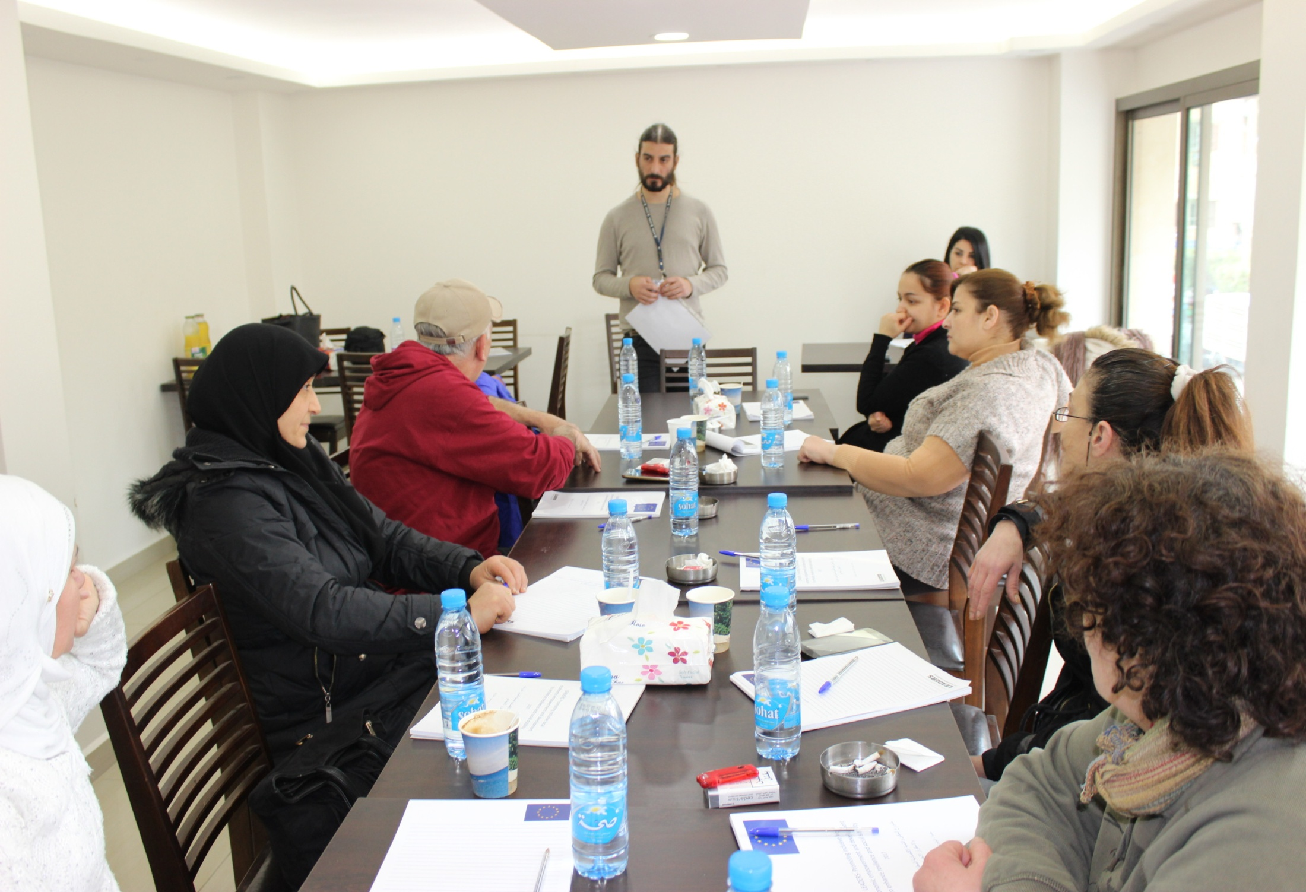

Slide 29
Dialogue Tables

Slide 30
Research
Skill Gap Analysis
Market Analysis
Analysis of the legal framework and minimum standards on access to work and working conditions
Inequalities research

Slide 32
The EU Trust Fund in Response for
the Syrian Crisis - The MADAD FUND

Slide 33
The EU Trust Fund in Response for
the Syrian Crisis - The MADAD FUND
Emerging Learning
-Enterprise definition can be problematic in Lebanon: segmentation depending on number of employees and/or turnover. These two often do not go hand in hand, especially when “small” enterprises are family-owned and have an established brand -> this required flexibility in matching with coaching providers.
-Using individual coaches is time-consuming and matching process can be costly for short-term projects. Their experience should not only be technical but should also include peer-to-peer coaching skills. This makes experienced private sector business consultants and coaches a suitable choice given their technical experience and technical skills.
-Private sector service providers possess the right kind of approaches to support bigger, more established enterprises.
-Private sector services are more costly, cost per beneficiary enterprise is high, and this needs to be factored in.
-For nano and micro enterprises especially, the gaps identified are often technical and managerial. This necessitates a two-pronged approach: focus on managerial skills of entrepreneur/business owner, as well as technical guidance and/or assistance.

Slide 34
The EU Trust Fund in Response for
the Syrian Crisis - The MADAD FUND
Emerging Learning
-A tailored market-driven coaching approach is necessary; it is more effective than set trainings.
-Financial support is not always a real need but it takes substantial time and effort to change the mentality of business owners.
-Multiple assessments need to take place; trust-building takes time, and business owners are not always aware of their problems or are not adept at articulating them. Needs must be agreed upon between coach and enterprise to guarantee buy-in and smooth implementation.
-Longer term interventions have higher effectiveness: ability to work on multiple levels over a longer period of time, refining coaching as an iterative process, adapting based on progress, growing financial capability of enterprises to support them in investing in their growth (cost-sharing and capital investment in the long-run.)
-Longer term interventions can also support the establishment or bolstering of local accountability or support mechanisms (with municipalities, Chambers of Commerce, etc...)

Slide 35
The EU Trust Fund in Response for
the Syrian Crisis - The MADAD FUND
Emerging Learning
-Rights-based approach: business support should always be coupled with awareness-raising around rights of employees, responsibilities of employers, and accountability at the workplace. Assistance to improve working conditions for employees at businesses that are willing can be considered ( improving setting, access to basic services, lighting, protective gear, etc..)
-A wide network of partners and allies is needed on a governorate and national level for advocacy on labor rights and access to labor.
-Legal registration is perceived as a cumbersome and costly process; medium and long term interventions can include awareness raising and legal assistance.

Slide 36
The EU Trust Fund in Response for
the Syrian Crisis - The MADAD FUND
Emerging findings
-Tailored coaching is needed; required refining of approach. Good reaction from beneficiaries. Individual attention makes the process smoother.
-Training of staff in parallel with coaching business owner increases efficacy of intervention.
-Businesses complain from price competition by Syrian firms and Syrian labor but still employ Syrians.
-Engagement of Chamber of Commerce is a complicated long-term process.
-Business planning, customer service, branding and marketing, and financial management are highly demanded.
-Enterprises rarely have proper financial records; they need help in setting internal systems no matter how simple.

Slide 37
The EU Trust Fund in Response for
the Syrian Crisis - The MADAD FUND
Geographical Differences
TRIPOLI: There is a high demand on youth employability (Internship Programme) due to the high youth unemployment and lack of local job creation. Tripoli is considered as a capital, the local urban population (including youth) would like to build their life within the vicinity of the city before taking alternative options which are either moving to Beirut or migrate.
When it comes to the MSME sector in Tripoli, and based on various studies and statistics, 95% of the economic units are under 5 employees and most of them work in the service/retailing sector. The artisanal and industrial sectors continue their decline. The economic/business entrepreneurs are on the defense. While they are interested in acquiring better management/business skills, they are more focusing on market access and the city commercial attraction. Their size creates a kind of resistance due their self-perception built on their own learning curve. There is a need to networking with the main economic stakeholders (Chamber of commerce, Unions, Banking Sector, Incubator, etc.)

Slide 38
Geographical Differences
The EU Trust Fund in Response for
the Syrian Crisis - The MADAD FUND
MOUNT LEBANON: The MSME sector in BMT is more complicated and benefits of the proximity of the heart of the Lebanese economy, which is the capital Beirut. They have a large margin of flexibility in comparison to Tripoli and are also more resilient to crisis and socio-economic changes. The prices policy as well as their margin of profits allow them to create safeguards and assure them more adaptability. The more the MSME in BMT receives support, they more will grow and create jobs. This growth has conditions and benefits not only to the local population. The main dilemma lied on the economic development Lebanese model. The more we go into this direction the more we are aggravating the gap between BMT and the rest of the regions.
As for the youth/women employability In BMT, our focus on the fresh graduated students is important and should be reinforced. The barriers to market and working world as well as the weak productivity of the fresh students, don’t facilitate the decision of the employer to hire them. The future direction should take into consideration the fact that we need to design a longer internship programme.

