Slide 1


National SoST Working group meeting
Ministry of Social Affairs, 5 May 2017

Slide 2
First Quarter Dashboard Results
National Working Group, 5 May 2017

Slide 3

Q1 SoST sector dashboard
Key findings
US$ 35 million in funding received so far (including carry over)
29 active partners (out of 51 appealing partners)
=> ACF, ACTED, ANERA, AVSI, Basmeh & Zeitooneh, CISP, Dorcas, Hilfswerk Austria International, Hoops Club, House of Peace, IOM, IRC, International Alert, Intersos, LOST, MARCH, MASAR, MSL, Mercy Corps, NRC, OXFAM, SAFADI,SCI, SFCG, SIF, Solidar, UN-Habitat, UNDP, WVI as well as UNHCR and UNICEF

Slide 4
Q1 SoST sector dashboard
Main highlights in Q1
Strong support to municipalities: 123 municipalities received direct capacity support and 66 already benefitted from the completion of tangible projects (worth 4,6 million USD) providing health, water and waste water services as well as other infrastructure support.
Strong increase in youth participation
Gaps in solid waste management projects
Geographic Gaps: Akkar, North and Bekaa are areas of concentration of partners’ activities. Nabatieh, on the other hand, is underserved by partners’ interventions even though some of the tensest areas are in Nabatieh.

Slide 5
Q1 SoST sector dashboard
Output 1.1 Support to Municipalities

Slide 6
Q1 SoST sector dashboard
Output 1.1 Support to Municipalities

Slide 7
Q1 SoST sector dashboard
Output 1.3. Local Capacity for Conflict Prevention
Notes:
Double-check achievements for 2016

Slide 8
Q1 SoST sector dashboard
Output 1.4. Youth Participation and empowerment strengthened
Notes:
Double-check achievements for 2016

Slide 9
Stabilization Monitoring System
National Working Group, 5 May 2017

Slide 10
LCRP & Stabilization
Integrated humanitarian & stabilization plan → the whole LCRP contributes to stabilization
Stabilization not defined as such but understood as increasing community resilience to mitigate risk of tension or conflict at the local level.

Slide 11
Stabilization monitoring
Why do we need it?: Six years into the crisis, and with more than 130 partners working in the LCRP response and delivering around $1,3 billion worth of humanitarian and stabilization programming we lack consolidated evidence to answer the following questions:
  Is Lebanon more stable than last year?
  Are inter-community tensions increasing/decreasing?
  Which areas in Lebanon are most tense?
  What are the main drivers of tensions?
  Are our interventions making a difference?

Slide 12
Stabilization monitoring
What is the goal?:
1) to evaluate the aggregate impact of the LCRP on social stability;
2) to inform programming and ensure conflict sensitivity of development interventions by taking into account the specific tension dynamics of each area
3) to trace the evolution of social stability over time to build an early warning system.

Slide 13
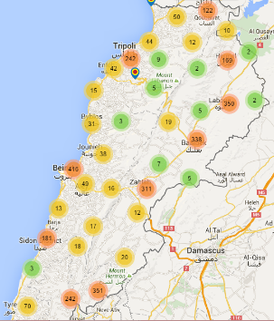
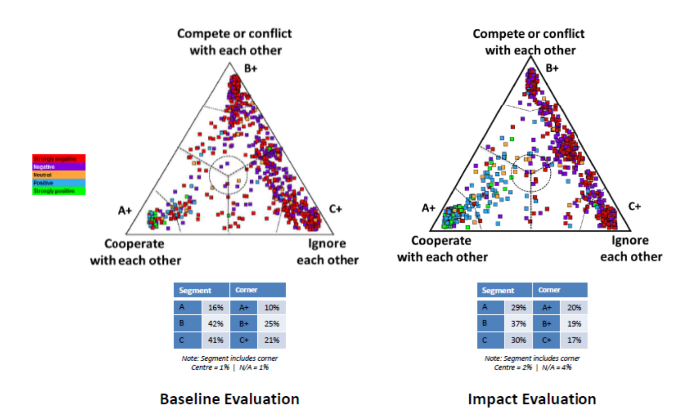
What do we have?
Vulnerability Map
Conflict incident mapping
http://civilsociety-centre.org/cap/map
Qualitative conflict analysis reports

Slide 14

Early Warning & Hotspot Analysis
Joint analysis and mapping from field working groups on sources of tensions in their areas of interventions
→ Disaggregation of information to the municipal level

Slide 15
Escalation of violence
Conflict events
(Lebanon Support Conflict Map)
Trigger
Sense of security and inter-group relations
Inter-community contact - Sense of safety and security - Concern over prolonged presence of refugees - Quality of relations between communities and level of prejudice - Propensity for collective action
Proximate
Trust in institutions & local community
Refugee population pressure (Vulnerability Map)
Basic needs and livelihoods
(Change in Socio-economic status and Access to services)
Capability and fairness of service provision
and international assistance
Evolving
Tension and resilience landscape
(history of conflict, pre-disposition to accept refugees)
Structural

Slide 16
The Stabilization Monitoring Survey
Who?:
ARK, UNDP and the Social Stability Sector
What?:
Quarterly national perception surveys on social tensions focusing on relationships between host communities and refugees
Analytical reports to test the impact of LCRP-related variables such as access to services and livelihoods on inter-community relationships
Where?:
Throughout Lebanon (Palestinian camps excluded)
Interview allocation: Beirut: 324, Mount Lebanon: 1380, Bekaa: 564, Baalbek-Hermel: 450, North: 696, Akkar: 486, South: 684
Notes:
The analysis will also compare tension levels between governorates, districts as well as between ‘urban’ and ‘rural’ areas. The data can then be enriched through incident mapping from Lebanon Support and the tension assessments provided by local partners at municipality level to identify ‘hot spots’ and ‘places to watch’.

Slide 17
The Social Stability Survey
How?:
Randomly selected sample with 5000 respondents
Most Vulnerable Localities are oversampled
Representative at governorate level for each survey and at district level after four waves
Mixed Data collectors (gender and nationality)
When?:
The first survey results are expected end of May 2017 with three more following (in July, October and January).

Slide 18
Methodology
& Sampling Frame

Slide 19
Benefits of stabilization monitoring
  Provides evidence to underpin results-based approach of LCRP and its impact
  Provide data to supports targeting and planning to optimise use of resources to deliver stability outcomes
  Promotes alignment of action among implementing partners.
  Promotes alignment of M&E approach and reduces number and fragmentation of assessments
  Limitations:
  Geographical level will be at best districts, not municipalities
  Quantitative data rather than qualitative ones.

Slide 20
Key Social Stability Trends 2017
Sense of insecurity and lack of interaction between communities are two key proximate causes of conflict.
Competition for jobs is perceived as the most important conflict driver between communities.
These perceptions increasingly manifest themselves in practice with an increase in protests against Syrian labour competition and closure of Syrian-owned shops in several municipalities across Lebanon since the beginning of 2017

Slide 21
Key Social Stability Trends 2017
4) Most community tensions are intra-Lebanese but there is a risk that they will be projected onto the Syrian presence when conflict incidents occur.
Examples: In Bekaa, the perception of Syrians as a security threat has been instrumentalized in family or land disputes. This involves amongst others giving false information to security forces about ‘suspicious Syrian activities’ leading to their evictions to harm their landlord or employer (Conflict Analysis Report March 2017)

Slide 22
Key Social Stability Trends 2017
5) Host Communities are often divided between those benefitting from the refugees’ presence and those who bear the brunt of increased resource and livelihood pressure:
Example: Khirbet Daoud and El Bire under the umbrella of the Dreib El Awsat union of municipality issued a statement in March 2017 threatening to evict their refugee population if the UN does not provide more infrastructure support within three months. Yet, the statement is contested in the community as many host community members benefit from the refugees’ presence through rent payment and cheap agricultural labour (Local Tension Mapping and Media Monitoring)

Slide 23
Key Social Stability Trends 2017
6) The refugee presence is increasingly being politicized and this will likely worsen with the upcoming parliamentary elections
Examples: Municipalities have threatened to evit refugees if they do not receive more aid (Khirbet Daoud, El Bire, Minyara) or to only accept new refugees if they receive particular support projects (Madjal Anjar)
It is not always clear to what extent labour competition related protests are orchestrated by the municipalities to receive more aid.

Slide 24
Key Social Stability Trends 2017
7) Contested municipal governance means that some areas are cut off most public services making them particularly vulnerable to tensions
Example: Mina-Hay el Tanak is an area for which Mina municipality denies responsibility thereby creating a local governance gap leaving its inhabitants without municipal services. Local governance gaps are often created where Syrians/stateless people occupy land adjacent to a village (e.g. Minyara, Enfeh)
The weakest municipalities also find it the most difficult to attract funding

Slide 25
Key Social Stability Trends 2017
8) Where host communities and refugees interact, relationships appear to be improving.
2016 USJ survey revealed that tolerance of Syrian refugees is highest in the Bekaa and the North where host communities and refugees tend to have more interactions.
Lebanese in 2016 had more contact with Syrians than in 2015 and somewhat more positive perceptions of them.
Presence of IS are usually a source of tensions: Tensions are not necessarily a question of the absolute number of refugees or the resident/refugee ratio but of their visibility and location

Slide 26
THANK YOU!

Slide 27



Lebanon Host Communities Support Project
Impact Analysis
5 May 2017

Slide 28
AGENDA
Research scope, timeline, and locations
Main findings by research theme
Recommendations for LHSP and Donors
Main findings and recommendation per municipality
Q&A

Slide 29
RESEARCH SCOPE
QUALITY OF SERVICES AND ACCESS TO SERVICES
PERCEIVED CAPACITY AND LEGITIMACY OF MUNICIPALITY
INTER-COMMUNITY
TENSIONS
LIKELIHOOD OF VIOLENCE AND INSTABILITY

Slide 30
RESEARCH TIMELINE
2014
2015
2016
2017
3 municipalities
Baseline research
+3 new municipalities, total of 6
2 rounds of research :
End line for 3
Baseline for 3 new municipalities
End line for all 6
6 municipalities
2 rounds of research
Additional impact analysis
+6 municipalities, a total of 12
2 rounds of research:
Baseline with 6 new municipalities
End line with 12 municipalities

Slide 31
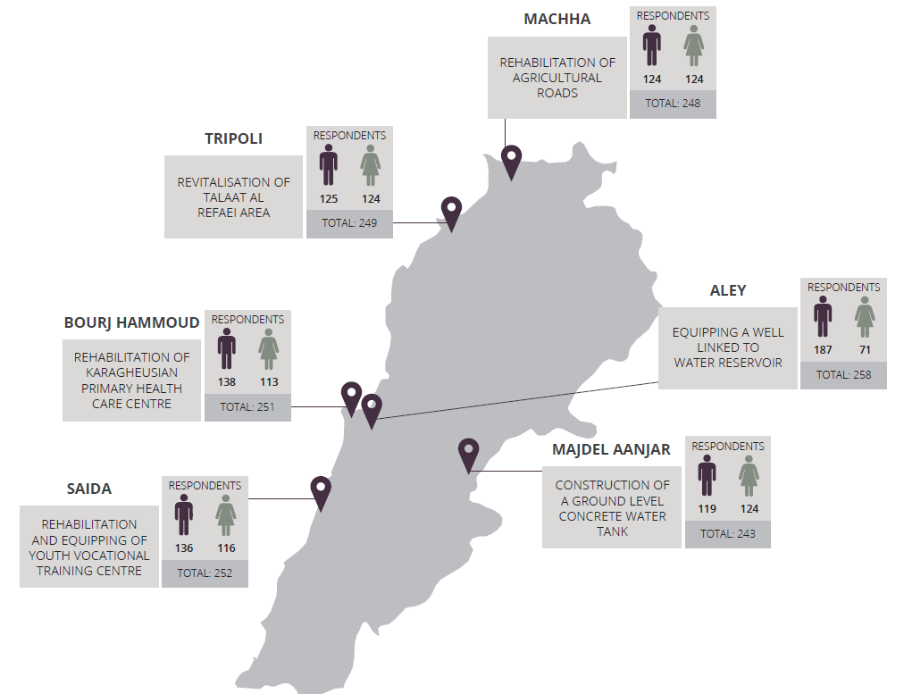
RESEARCH LOCATIONS
Notes:
Discuss identity of respondents and

Slide 32

METHODOLOGY
Mixed methods approach triangulating quantitative and qualitative data
1
“Micro-narratives” (stories) from respondents about their own direct experience in the area of the research.
WE ASK: Think about recent changes in your village and tell me about something that has happened to you personally, or to someone you know, as a result of these changes?
2
Quantitative questions in the survey intend to complement SenseMaker research. Questions on tension, optimism and knowledge and perceptions of specific projects will provide further insight on opinions and experiences within the municipality.
3
Key informant interviews during the data collection,
4
Focus group discussions following the data collection, to further explore findings.

Slide 33
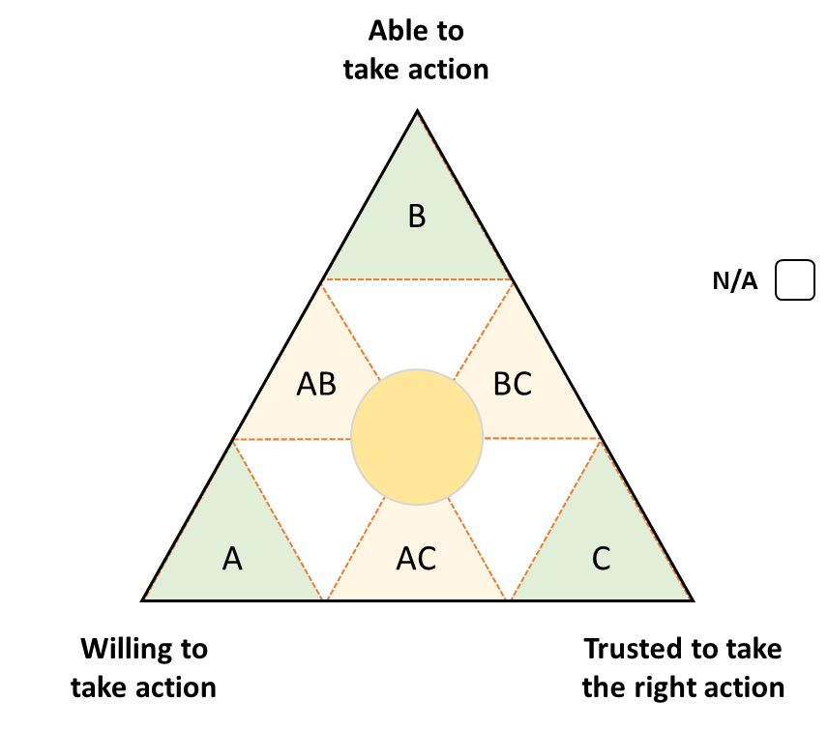
METHODOLOGY: HOW TO READ A TRIAD?
If the municipality is mentioned in the story, it was …
A | Willing to take action but neither able to take action nor trusted to take action.
AB | Willing and able to take action but not trusted to take the right action
B | Able to take action but neither willing to do so or trusted to take the right action.
BC | Able to take action and trusted to take the right action but not willing to do so.
C | Trusted to take the right action but neither willing nor able to do so.
AC | Willing to take action and trusted to take the right action but not able to do so
Centre | Willing to take action, able to take action and trusted to take action.

Slide 34
METHODOLOGY: NEW FOR 2017
Expansion to six new municipalities, now including Mt. Lebanon, in addition to the North, the South and the Bekaa. Projects funded not just by DFID, but by other donors.
Inclusion of Syrian refugees in each municipality.
Focus on confessional diversity among the municipalities.
Integration of quantitative questions in the survey intended to complement SenseMaker research. Questions on tension, optimism and knowledge and perceptions of specific projects will provide further insight on opinions and experiences within the municipality.
Inclusion of key informant interviews during the data collection, and focus group discussions following the data collection, to further explore findings.

Slide 35
RESULTS & RECOMMENDATIONS
Main themes in people’s stories
Service delivery
Municipal legitimacy
Social stability
General recommendations
Results and recommendations by municipality

Slide 36
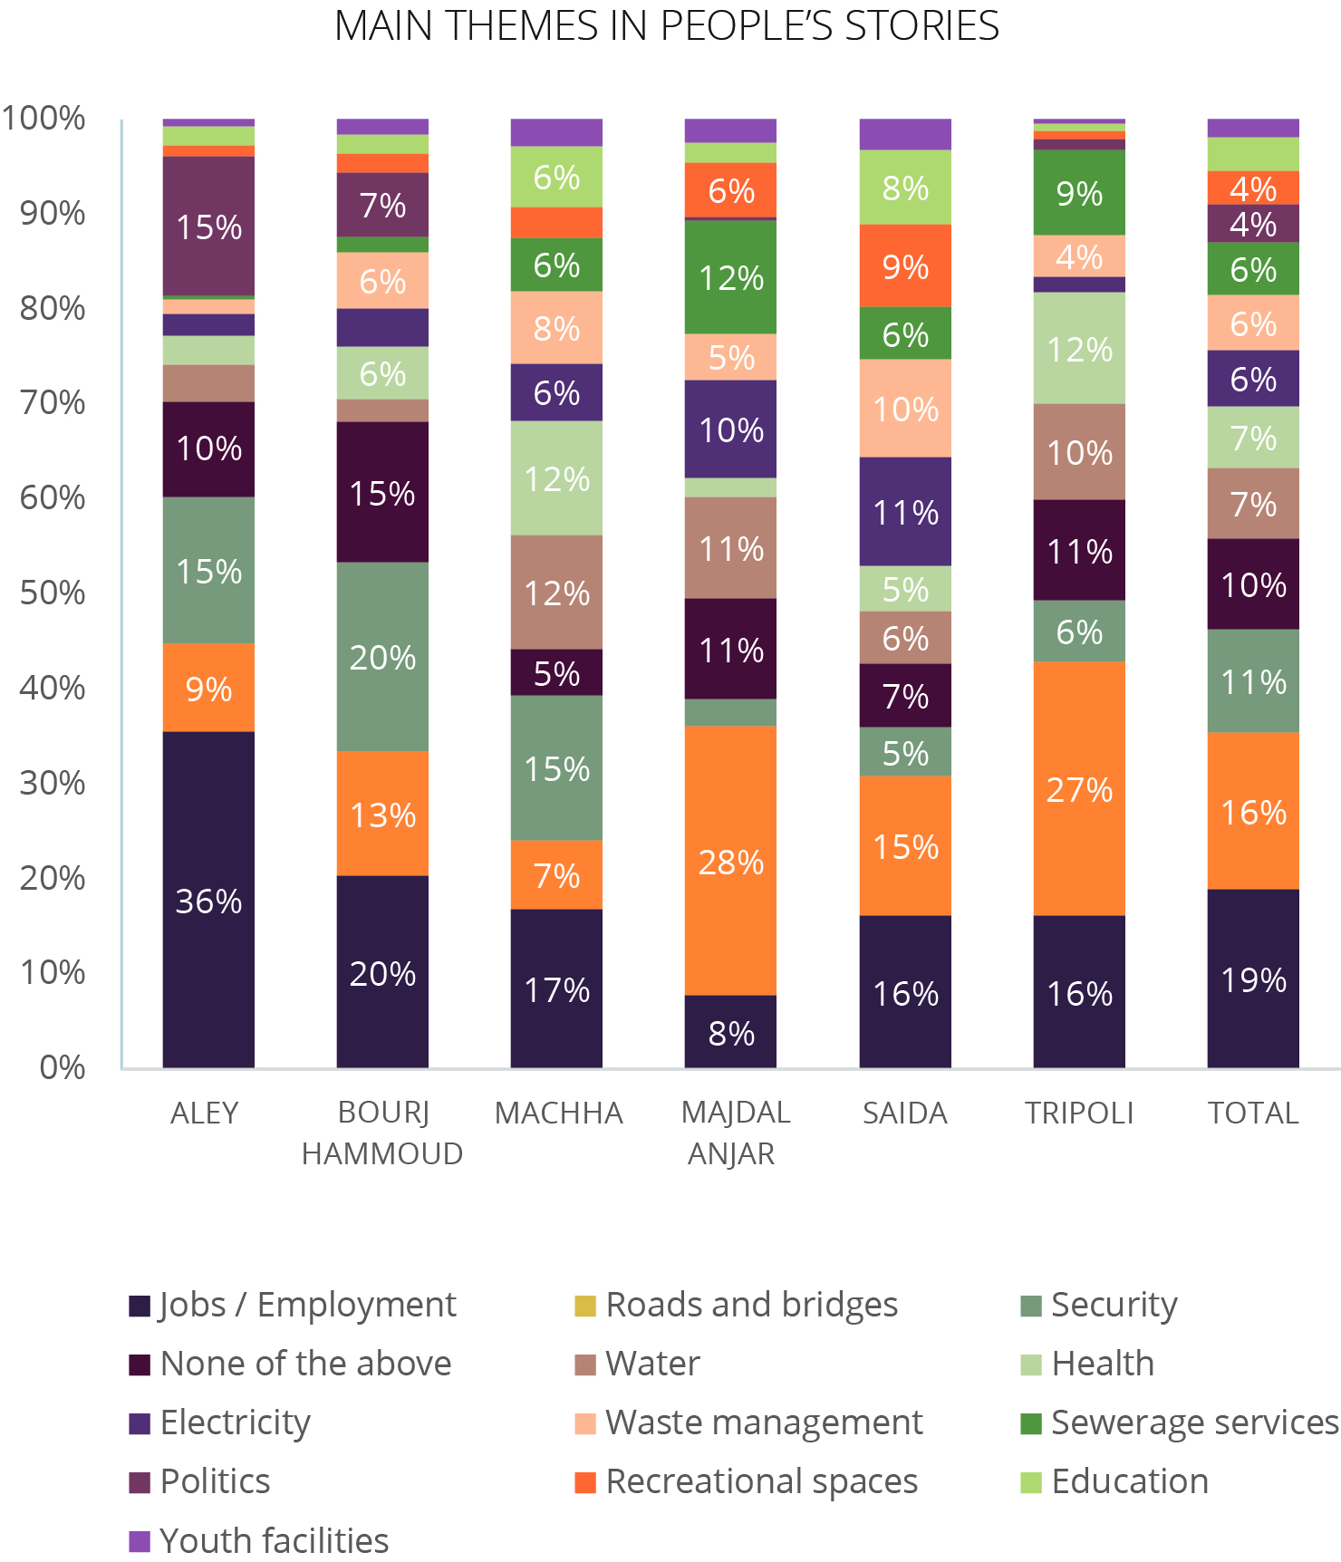
MAIN THEMES: What are people talking about?
65% of respondents talk about services 19% talk about jobs and employment 11% about security.
Jobs are the major concern for respondents across all municipalities. More stories discuss jobs than any other topic.
Refugees are mentioned in 40% of Lebanese stories about jobs
Within services, people talk the most about roads and bridges, followed by water and health services, and the least about youth facilities, education, and recreational spaces.

Slide 37
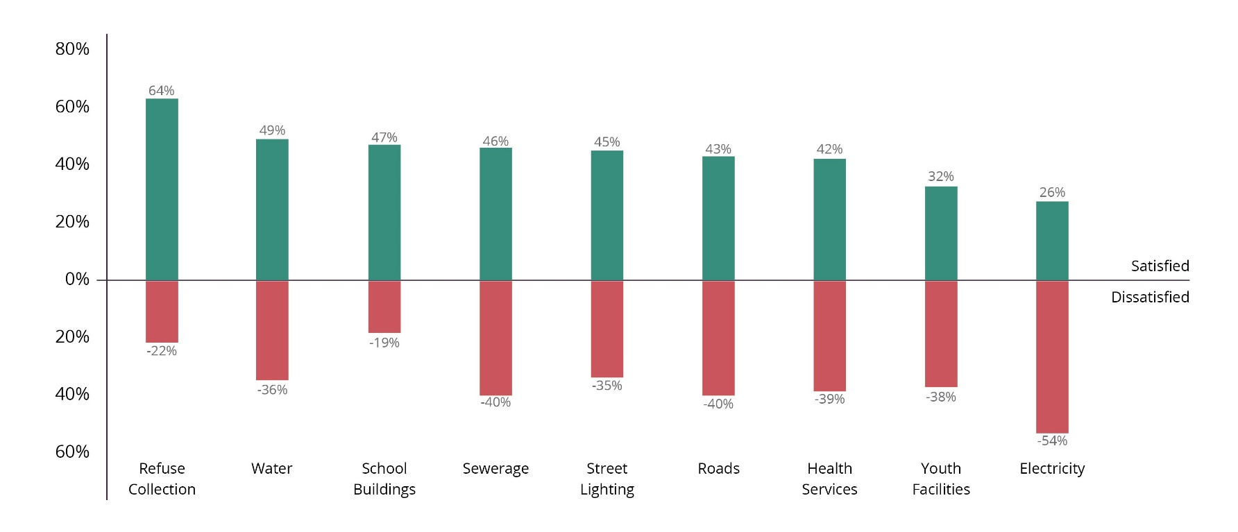
SERVICE DELIVERY: How satisfied are you with services ?
Respondents are most satisfied with refuse collection and least satisfied with electricity
Levels of satisfaction are similar between Lebanese and Syrians

Slide 38
LHSP PROJECTS : Are you aware of the LHSP project?
72% of respondents attributed projects to international organizations
38% to municipality
8% to MoSA

Slide 39
MUNICIPALITY: How strongly do you agree or disagree with the following statements?
Highest overall satisfaction
Lowest trust and largest disparity between trust and perception on resources
Highest trust in Aley

Slide 40
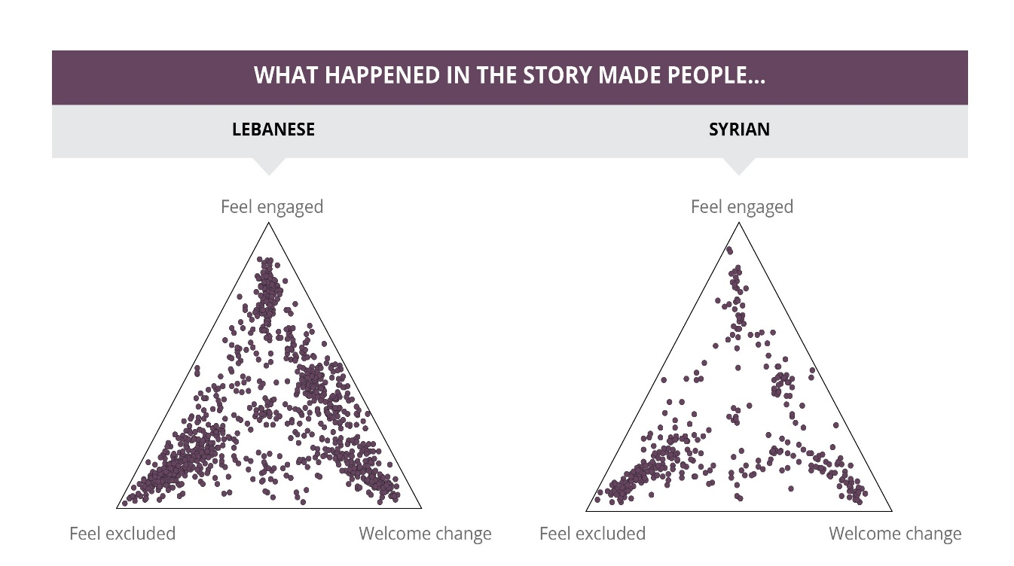
MUNICIPALITY: How engaged do people feel in municipal activities?
Many Lebanese welcome changes
Syrians feel much less engaged

Slide 41
MUNICIPALITY: What should the municipality do to improve planning and delivering services?
Disparities between municipalities

Slide 42
TENSIONS: How strongly do you agree with the following statements?
71% of respondents think tensions between Syrian and Lebanese are due to competition over low skill jobs
65% attribute Syrian Lebanese tensions to establishment of competing Syrian businesses
45% attribute Lebanese Lebanese tensions to competition over high skill jobs

Slide 43
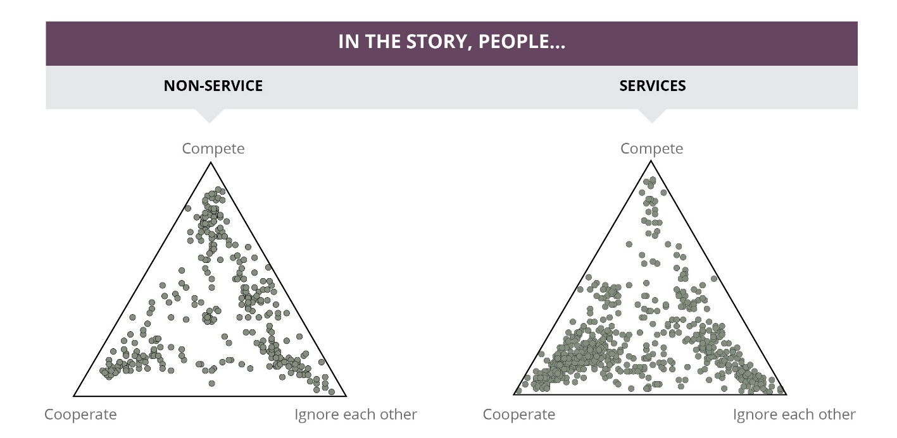
TENSIONS
Around 30% of people told stories largely about cooperation, 20% about ignoring each other and 10% about competing

Slide 44
RECOMMENDATIONS FOR LHSP
RECOMMENDATIONS FOR DONORS
Scale up outreach on LHSP projects.
To build trust in the municipality and improve understanding about the role the municipality and MoSA play in the design and implementation of projects
To strengthen the strategic communications approach with communities prior to and after project completion
To consider building on the outreach approach used by the municipality in Machha.
Develop new, conflict-sensitive livelihoods projects. However, consider the implications of such programming on intercommunal tensions, avoiding projects that may favour or appear to favour one group over the other.
Improve communication with communities regarding aid.
Despite the fact that both Lebanese and Syrian communities benefit from aid programmes, Lebanese respondents in the surveys and key informant interviews consistently state that Syrians alone are receiving aid.
Strengthened outreach on how Lebanese communities benefit from aid would help reduce tensions and improve relationships.
Engage Syrians and Lebanese in discussions on tensions and tension mitigation strategies.
In concert with local actors, municipalities should identify ways to bring together Syrians and Lebanese to develop strategies to reduce tensions within the framework of LHSP.
The MSS process should be expanded to all LHSP municipalities.

Slide 45
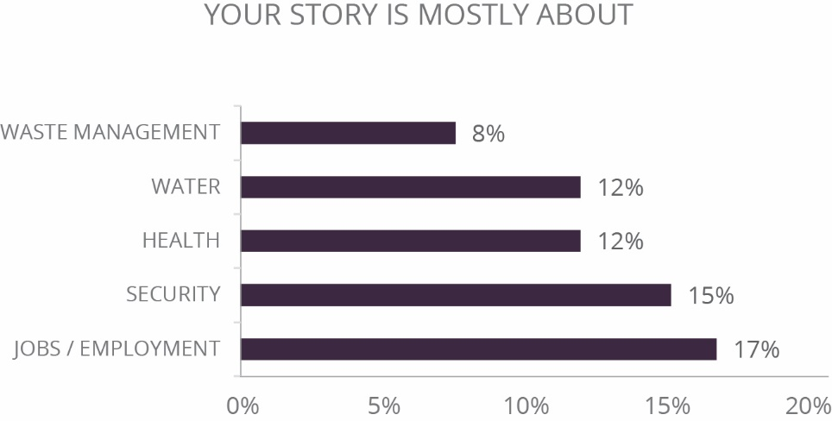
MACCHA
LHSP Project in Machha.
LHSP is upgrading three agricultural roads to connect agricultural areas to the main transportation routes. The project is also providing a backhoe loader to access agricultural areas.
83% of respondents are not aware of the LHSP project connecting the agriculture road to the main road. Most comments on roads are focused on roads in Machha. Only 1% of females are aware of the project; no Syrians are aware. 93% of respondents who are aware of the project believe it is having a positive impact. They credit international organisations and the municipality for the work.
People in Machha report high levels of tension and competition over scarce employment opportunities, both of which increase the risk of hostile confrontations
Involve men and women in peaceful dispute resolution in Machha.
Form working groups with both men and women to identify specific ways of reducing tensions and preventing violence between Lebanese and Syrians in Machha, while encouraging peaceful resolution of community issues.

Slide 46
TRIPOLI – ABOU SAMRA
LHSP Project in Tripoli
LHSP is revitalising the Talaat Al Refaei area in Tripoli Old City by upgrading the sidewalks and public spaces, providing lighting and waste bins and rehabilitating the facades of buildings on one side of the street.
95% of respondents are aware of the project. Many stories in the research discuss the project as well. 96% believe that it will have a positive impact on the community. When it comes to the implementation, 92% think it is done by INGOs and 17% attribute responsibility for it to the municipality.
‘The UN offered funds to renovate the old buildings in Talaat Al Refaei. They are painting houses and renovating buildings. It is beautiful.’ Lebanese male, 18–29, Tripoli
LHSP has nine other projects in different neighbourhoods of Tripoli.
People in Tripoli believe the municipality has sufficient resources but do not trust it to spend them on their behalf.
Increase community involvement in decision-making. In particular, the municipality should explain to communities how it spends resources and identifies projects through the Mapping of Risks and Resources (MRR) process, and engage communities through planning and outreach.

Slide 47
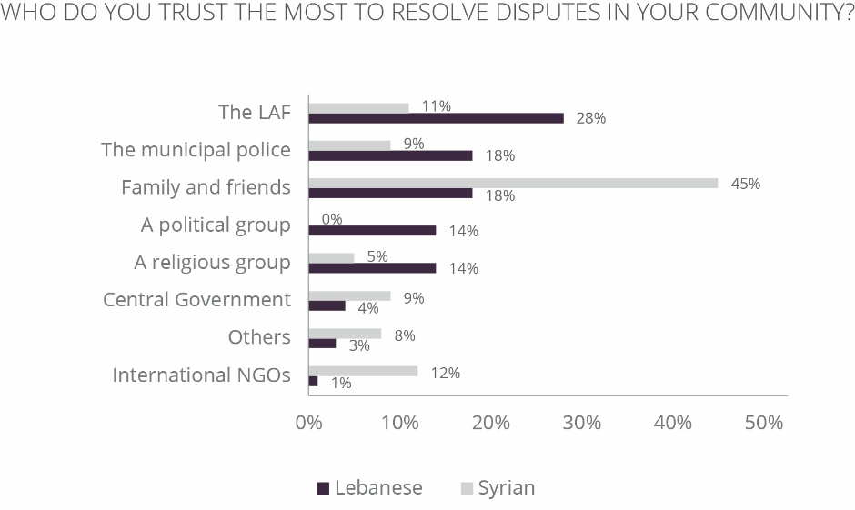
MAJDEL AANJAR
People in Majdel Aanjar are ignoring each other while tensions build between Lebanese and Syrians
Bring Majdel Aanjar residents together.
Although respondents do not report tensions as often as other communities, they also do not interact with one another. The municipality should therefore seek neutral opportunities to bring residents together through community parks and cultural activities aimed at promoting constructive interaction.
Build trust between Syrian residents and the municipality.

Slide 48
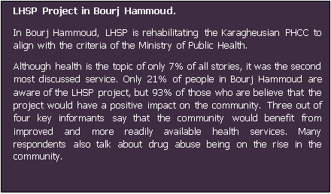
BOURJ HAMMOUD
People in Bourj Hammoud believe tensions between Lebanese and between Lebanese and Syrians can be reduced by addressing overcrowding and unemployment
Use the LHSP project in Bourj Hammoud to address a growing source of insecurity.
In Bourj Hammoud, consider combating rising drug use among the youth by including drug prevention and counselling through the Karagheusian project.
In addition, consider income generating and cultural activities as well as a youth centre, providing career counselling and volunteer programming to keep youth off the streets, reduce insecurity and increase feelings of engagement in the community.

Slide 49
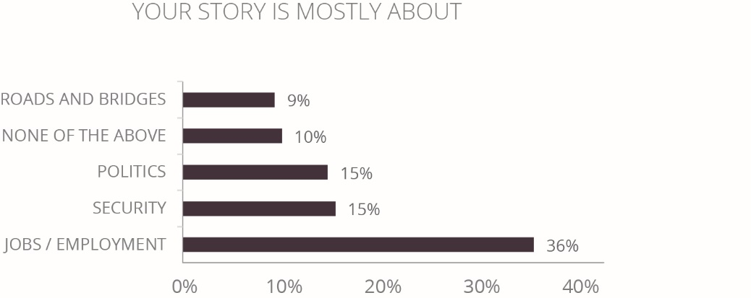
ALEY
LHSP Projects in Aley
In Aley, LHSP is equipping a well with the necessary water pumps, pipes and other materials to link it to the water reservoir in Aley.
Only 25% of the respondents are satisfied with the quality of water in Aley, which is the lowest percentage recorded compared with other municipalities.
13% of all respondents are aware of this project: most are Lebanese. 82% agree that the implementation of the project would have a positive impact on the local community. 71% think that the municipality is behind this project and 32% think that INGOS are implementing it.
LHSP is also rehabilitating and extending the storm water drainage canal in Aley.
People in Aley are not optimistic about the future, due to a lack of job prospects and poor relationships between Lebanese and Syrians
Rebuild the tourism industry in Aley and support tension-reduction projects.
Consider projects aimed at encouraging job growth and improving collaboration and interaction between Syrians and Lebanese to reduce feelings of hopelessness.

Slide 50
SAIDA
People in Saida appreciate the municipality’s efforts to deliver services but tensions are high within the Lebanese population
Address tensions in Saida through further collaborative programming. Support opportunities to promote interaction between Lebanese and Syrians in Saida community through small-scale projects, including the LHSP youth project. Hold regular events with key stakeholders to discuss tensions and develop community-owned responses. Engage women further in the planning and decision-making process of the municipality.

