Slide 1
Data sharing practices in the region
Interagency Tool for:
Vulnerability Scoring
VAF Module
JORDAN Mission
Notes:
*Please note that this module is only available to VAF Partners who have signed an MOU with UNHCR.
For more details on how to become a VAF partner please contact Olivia Cribb cribb@unhcr.org

Slide 2
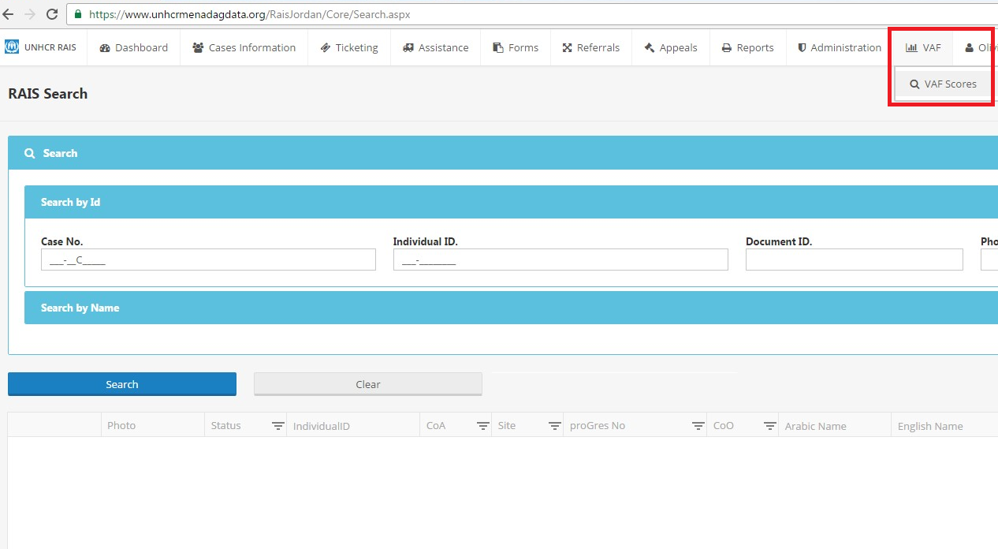
Notes:
Select module
*Please note that this module is only available to VAF Partners who have signed an MOU with UNHCR.
For more details on how to become a VAF partner please contact Olivia Cribb cribb@unhcr.org

Slide 3
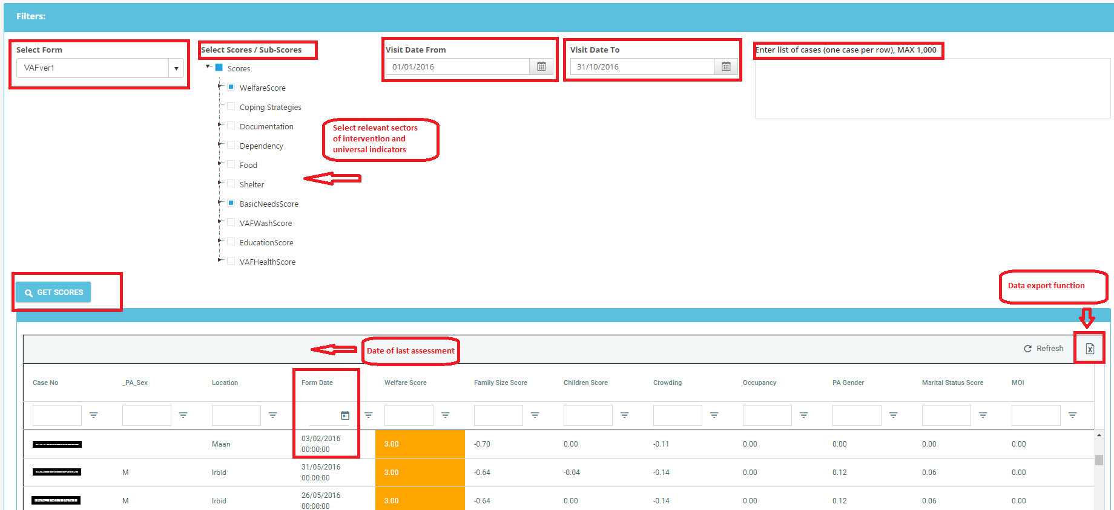
Notes:
Select Form: VAFver1
Select Scores / Sub-scores: Choose relevant Universal indicators: Welfare Score, Coping Strategies, Documentation and Dependency and Sector scores in relation to your area of intervention *many of the universal indicators are relevant as complementary data subsets to sector level interventions. For example: Basic needs score for cash interventions can be complemented by: welfare (re: welfare and ascertaining welfare vulnerability in relation to the case if they are above or below the Jordanian poverty line), coping strategies (whether a individuals within the case are resorting to negative coping strategies to , dependency and food security would also been seen as complementary indicators to establish vulnerability along with the selection of the Basic needs score.
Visit Date From and Visit Date to: only needs to be complete if relevant / looking for date specific case assessment
Enter list of cases: Maximum 1000 at any given time to avoid system timeout, cases can be copied and pasted from excel
Get scores
Form Date = date of last assessment
Excel icon far right enables you to export the data in excel format for easier access and use for case management/field work.

Slide 4
Scenario: Organisation: ABC
Type of Intervention: Basic needs Cash intervention
No. of Cases to receive cash assistance: 500
Governorate/ District: Irbid; Ramtha and Bani Obeid (District selection will be available to cater to Orgs. areas of operation.)
Depending on the type of intervention your organization is responding to; the criteria in which is supplied by the donor or what other considerations you would like to include additionally as vulnerability factors. The VAF Module can be used to effectively improve eligibility, prioritization and targeting and used in such a way by allowing organizations to pick and choose their data based on their independent needs given the multi-faceted and multi-sectoral nature of the tool.
For example if organization ABC have been approved funding to provide 500 cases in Irbid with regular cash assistance for a period of 6 months rather than explicitly limiting data selection to cases with high (3) or severe (4) vulnerability scores within Basic Needs; criteria can be expanded to improve prioritization for selection. This enables cash assistance to reach cases that are the most vulnerable additional criteria can be applied.
Based on results that the Score selection returns, as displayed in hypothetical scenario below: Case B, is more vulnerable than Case A and Case C, therefore similar profiles to those of Case B should be prioritized to receive assistance.
Case A Case B Case C
Basic Needs score: 4 Basic Needs score: 4 Basic Needs score: 3
Food Security score: 3 Food Security score: 4 Food Security score: 1
Welfare score: 2 Welfare score: 4 Welfare score: 2
Dependency: 2 Dependency: 4 Dependency: 2
Coping Strategies: 4 Coping Strategies: 4 Coping Strategies: 1
Notes:
It is up to the organization to selection which scores are appropriate based on their need.
Furthermore 2 things that also should be checked in parallel to this process are:
Cross check to see if cases are receiving assistance from other partner organizations to remove likelihood of duplication (see next slide)
Ensure that beneficiary list is also sent to the UNHCR Cash Office

Slide 5
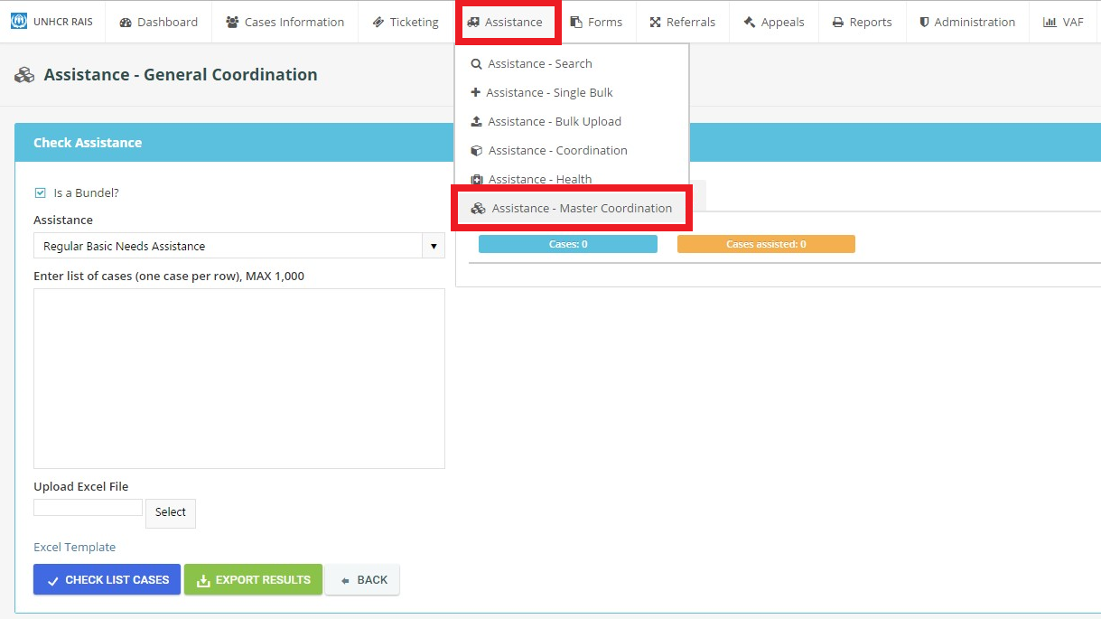
Cash Assistance Cross-Checking

Slide 6
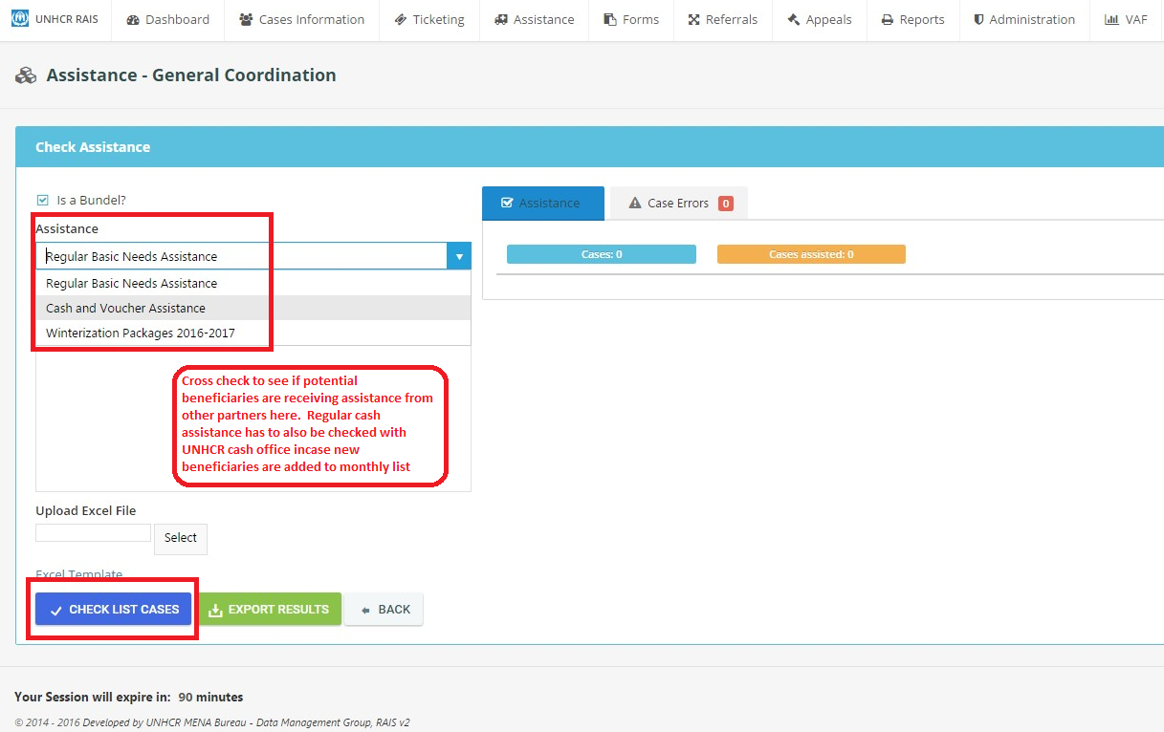
Notes:
Regular Cash Assistance = regular monthly cash assistance
Cash and voucher = All cash and voucher assistances, i.e. WFP cash assistance, UNICEF child cash grant, unconditional cash, urgent cash assistance, cash for rent, cash for health and so on.
To check 2015-2016 Winterization assistance deselect ‘Is a bundle’ and choose winter assistance type i.e. Winter Cash Tier 1 or Winter Cash Tier 2 to see what cases received last year to determine what cases shall receive this year (2016-2017 Winterization Period). I.e. Cases which received T1 Cash in 2015-2016, as per winterization standards cases should receive T2 Cash in 2016-2017 period and vice versa.

