Slide 1
The Campaign to End Statelessness
A Global Overview with Reference to West Africa

Slide 2
Who is stateless?
Stateless person: someone who is not considered as a national by any State under the operation of its law
At least 10 million people around the world
Most stateless persons have not crossed an international border
Many are of foreign ancestral origin
Most face denial of a range of human rights
In some situations, human rights abuses force stateless people to cross a border and become refugees, fall under UNHCR’s refugee protection mandate

Slide 3
UNHCR’s role
UNHCR given mandate from UN General Assembly in 1995 to work with States to
  Identify stateless persons – studies, census, surveys
  Prevent statelessness – law reform, changes to documentation procedures
  Reduce statelessness – nationality and documentation campaigns for stateless persons
  Protect stateless persons – status determination and rights granted to stateless persons

Slide 4
International law standards
International human rights law –States already have obligations
  Universal Declaration of Human Rights, Convention on the Rights of the Child, Convention for the Elimination of Discrimination against Women, African Charter on the Rights and Welfare of the Child
  Right to a nationality, right of children to acquire a nationality, non-discrimination on grounds of race, gender
  Most human rights also to be enjoyed by stateless persons

Slide 5
International law standards (II)
Two specialised treaties
  1954 Convention relating to the Status of Stateless Persons
    Defines who is stateless
    Rights and obligations of stateless persons
  1961 Convention on the Reduction of Statelessness
    Rules to be implemented in domestic nationality laws to prevent statelessness from occurring at birth or later in life

Slide 6
UNHCR’s Goal
To bring an end to statelessness within 10 years by resolving existing situations and preventing the emergence of new cases of statelessness.
An ambitious but realistic goal
  Endorsed by the UN General Assembly
  Governments decide who their nationals are so political will is essential.
  Many States have acted: In the last decade 4 million stateless people around the world acquired nationality
  Other States have pledged to act at UNHCR Ministerial Meeting in 2011 or in Human Rights Council’s Universal Periodic Review.

Slide 7
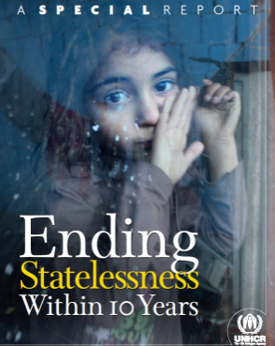

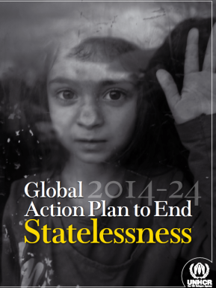
Before and after pictures - 2014
What is the problem?
Call to action
How can this be resolved?

Slide 8
Key Actions to End Statelessness in West Africa
Resolve existing situations of statelessness
  Nationality laws and procedures can be reformed so that stateless people with strong links to the country through birth or long term residence acquire the nationality automatically or by application
  Naturalisation is generally difficult for stateless persons in ECOWAS States. Cote d’Ivoire is currently implementing a declaration procedure for people with deep links
Ensure that no child is born stateless
  Safeguards need to be included in nationality laws so that children born stateless acquire the nationality of the country of birth (not all children born in the territory)
  Young children of unknown parents who are found in the territory need to be presumed to be nationals
  Several ECOWAS States lack these key safeguards

Slide 9
Key Actions to End Statelessness in West Africa (II)
3. Remove gender discrimination from nationality laws
  12 countries have granted equal rights to men and women to confer nationality to their children since 2004 - in ECOWAS Senegal reformed its law in 2013
  27 countries limit right of women to confer nationality to their children, including in ECOWAS
4. Ensure birth registration for the prevention of statelessness
  Birth registration is important for proving nationality as it shows parentage and place of birth
  Without birth registration, pastoralists, minority groups, border populations and other groups often face challenges to establish their nationality
  Though improving, birth registration rates remain low in many ECOWAS States

Slide 10
Key Actions to End Statelessness in West Africa (III)
5. Issue nationality documentation to those with entitlement to it
  Study show that people who qualify for nationality of ECOWAS States may be unable to acquire proof that they are nationals due to documentation requirements, costs
6. Accede to the UN Statelessness Conventions
  At the global level, 30 States have acceded to one or both UN Statelessness Conventions since 2011, including 7 in ECOWAS
  In ECOWAS, 9 are parties to the 1954 Convention, 8 to the 1961 Convention
7. Improve data on stateless populations
  UNHCR has data on 77 countries around the world
  Little information is available on stateless people in most ECOWAS States

