Slide 1


Improving Sanitation in Refugee Camps
Final Deliverable – Phase 1 Part 2
December 17, 2014 (updated May 2015)

Slide 2
Recap: Project Objectives
Project Objectives
  Understand the starting point – existing and potential "waste-to-value" solutions and business models for relevant camp contexts and their host communities
  – Focus on East Africa
  Assess the feasibility and impact of deploying alternative technologies, upgrading or revising existing technologies available now and the business models that could support them or off-set the cost of their operation in camp contexts
  Recommend specific companies and technologies (including local partners) that may be more suitable and sustainable for refugee camps
  Share findings from the analysis to inform decisions made by UNHCR and identify key stakeholders that will be critical to success in local contexts (e.g., local governments, key influencers, etc.)
Our field visits and focus was directed toward East Africa

Slide 3
Recap: Project Deliverables – Phase I
Project Objectives
Deliverable
Date Due
Situational analysis
  Segmentation of different camp archetypes with deep dive profiles of representative sites
  Identification of social / cultural factors the shift sanitation behavior
  Overview of current service provision models and technologies
  Quantitative assessment of existing solutions' product efficiency, environmental impact, and service delivery effectiveness (technical and financial viability)
Options assessment
  Overview of at least 5 resource recovery businesses that are potentially viable in refugee camp settings (i.e., generate products with high market or social returns)
  Profiles and financial projections of options, including key assumptions / enabling factors (e.g., a certain scale)
  Assessment of options against defined success metrics, incorporating both economic and social impact measures
November 21, 2014
December 19, 2014

Slide 4
Project timeline with camp visits positioned in the middle
Oct
Nov
Dec
Activity
13.
19.
26.
02.
09.
16.
23.
30.
07.
14.
Situational Assessment
10/13 - 11/21
Options Evaluation
11/22 - 12/19
Field Visits - Uganda
Field Visits - Ethiopia
Meetings
10/29
11/4
Geneva
12/9
Geneva
12/17

Slide 5
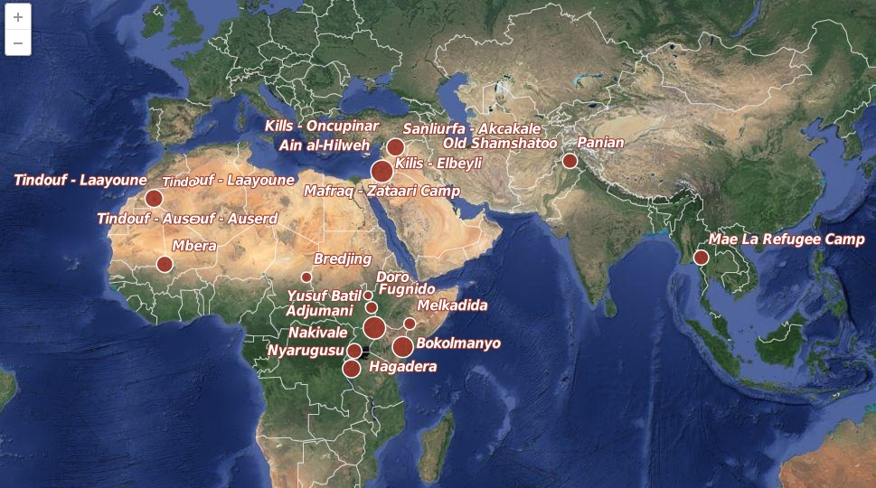

Focus has been placed on the resource-constrained settings in East Africa
Focus of the analysis with field visits to Uganda & Ethiopia
Source: data.unhcr.org locations mapped by BCG's GeoAnalytics team, largest 25 camps as of 2013

Slide 6
Phase I Findings

Slide 7
Executive summary (I)
UNHCR is looking to improve the sustainability of its services for refugees and support the surrounding communities, in the face of protracted refugee situations
  Sanitation + waste-to-value is one area that has the potential to positively support this goal
We reviewed the current portfolio of technologies for suitability in refugee camp contexts
We see opportunities to improve sanitation by selectively incorporating waste-to-value sanitation solutions, especially in situations where the traditional latrine is challenged
  Today, pit latrines are the most common solution as they are simple to construct, relatively inexpensive to build in suitable settings and typically do an acceptable job containing waste
  However, in areas where latrines are expensive to construct and have significant negative impacts, waste-to-value solutions (e.g., HH biogas, UDDTs) can provide more cost effective alternates and in a few circumstances may provide additional livelihood
  WTV solution benefits also include increased protection, access to energy and fertilizers
Selecting the right waste-to-value solution + service delivery model for a given camp is a highly specialized decision and requires a portfolio of solutions for UNHCR consideration
  We highlight the technologies that could be suitable for use in different refugee settings
  Additionally, we show that there are strong opportunities to engage both the refugees and host community in the installation, service and as needed collection of by-products /waste

Slide 8
Executive summary (II)
While the waste-to-value technologies are promising, additional testing of these solutions + delivery models is needed in refugee settlements to ensure robustness in camps
  Now, only a few pilots are looking at deploying waste-to-value solutions in refugee camps and these pilots are very small in scale (2-10 households) with the exception of UDDTs
  Technologies that rely strongly on collection models must be tested at large scale over a significant time scale to ensure that the model will hold-up as tolerance for failure is low
Additionally, to be able to install waste-to-value solutions, UNHCR will need to work with donors to build support to shift funding patterns to cover the higher initial capital costs
  In conversation with UNHCR, we understand that this will take significant effort as emergency donors may be reluctant to shift funds from traditional emergency approaches
  As such, additional non-traditional funders (eg. development funders) likely need to be engaged to help provide sufficient resources to allow for the shift in coverage models
The next steps we see for this work are to deepen the analyses on urban and peri-urban settings and prioritize the technologies to be piloted in East African camp settings

Slide 9
UNHCR shifting to more sustainable operations for refugees
Increasing number of simultaneous crises and protracted situations require practice changes
The new reality facing UNHCR and refugees today:
The number of simultaneous crises is increasing...but funding per capita is not keeping pace
Situations are increasingly protracted... unrealistic to expect resettlement and repatriation to offset influx
UNHCR's population of concern is more dispersed and heterogeneous...more specific approaches are needed
Today: Refugee camps managed with short-term, high-touch approaches
  Limited investment in start-up of camps
  Camp operations and budgeting planned on an annual basis; limited long-term planning
Future: Invest to enable long-term sustainability for refugee support
  Push for early integration with hosts
  "'Out of Camp Policy" moves away from camps to desegregation of refugees/hosts
  More of a "development" mindset

Slide 10

To execute this approach, UNHCR needs to support more sustainable settlements across 10 dimensions
Energy
Food
Water
The project is
focused on sanitation improvement using innovative waste-to-value (WTV) solutions and the role they can play in sustainability
Education
Sanitation
Health& Hygiene
Shelter
Protection
Environment
Livelihoods

Slide 11
Improved sanitation choices have the potential to benefit nearly all other dimensions of refugee life...
How does sanitation affect other sectors?
Increases crop yield fertilizer byproduct
Food
Water
Protects water sources, ensure efficient
use of water
Keeps kids in schools, keeps schools running
Education
Energy
Increases cooking fuel and electricity supply through byproducts
Sanitation
Reduces infectious diseases
Shelter
Health & Hygiene
Improves family home environment
Reduces exposure
to opportunities
for SGBV
Protection
Environment
Conserves land, reduces soil contamination
Livelihoods
Creates jobs around managing sanitation; supply labor & materials

Slide 12
Today, 6 types of sanitation solutions are in use at refugee camps, pit latrine variants are by far the most common
Most common
Very common
Pit latrines (backfilled when full)
Pour-flush to pit (backfilled when full)
Drop-hole to cesspit (drainable)
Urine-diverting dry toilets (UDDTs)
Pour-flush to cesspit (drainable)
Biogas production at household level
>95% of all existing sanitation solutions
Pilot phase or
micro-scale
Very rare

Slide 13
Short term solutions are less expensive than longer lived solutions on a per stance basis making them a popular choice
Expected lifetime | 2-3 yrs | 3-4 yrs | 10+ | 10+ | 10+ | 10+
Annual Op Expenses¹ | N/A | N/A² | ~$150 | N/A² | ~$35 | Expected high
XX
Cost per stance (USD)
2,000
1000
500
200
100
50
0
Short term solutions
1800
1300⁴
XX
1200³
Cost data unavailable, expected to be very high⁵
1000
1700
500
600
450
600
500
70
70
1
2
3
4
5
6
Pit Latrines
Pour-flush to pit
Drop-hole to cesspit (drainable)
UDDTs
Biogas at micro level
Pour-flush to cesspit (drainable)
1. Excludes cleaning and small maintenance 2. Requires consumables (i.e., ash) or additional water 3. Outlier cost for prefabricated latrines as part of emergency WASH kit. 4. Outlier cost for latrines fully supplied and constructed by implementing partner, e.g., PWD latrines in Dollo Ado 5. Costs include building and trucking full concrete tanks 80km, building full water-based sewage to tanks, monthly vacuum truck costs and local wastewater treatment plant. Source: UNHCR Kampala office, NCA, IMC, WVE, ADRA, UNHCR Addis Ababa office

Slide 14
Example: Pit latrine cost variance analysis
Slab
Slab support
Superstructure
Excavation
labor
Construction
labor
1200
Prefabricated superstructure & slab
Implementing partner (manual)
Implementing partner
450
Concrete dome slab
Corrugated iron sheets
Implementing partner (manual)
Implementing partner
Plastic slab
4 treated poles
Corrugated iron sheets
Implementing partner (excavator)
Implementing partner
280
1
260
Concrete dome slab
Local material
Household
Household
Pit
Latrines
Plastic slab
4 treated poles
Corrugated iron sheets
Implementing partner (manual)
Implementing partner
150
Plastic slab
4 treated poles
Corrugated iron sheets
Household
Implementing partner
Plastic slab
4 treated poles
Local material
Household
Household
70
Note: Additional pit lining is minimal cost when using local materials (sticks, mud bricks, stones, woven straw), and costs additional $480 when using concrete. Concrete superstructures, such as those used over institutional cesspits, cost additional $670 in materials and $300 in labor.
Source: financial data from ARC, WVE, ADRA, NCA, IMC, UNHCR.

Slide 15
Also, cheap pit latrines can have serious negative effects, especially related to environmental and health challenges
High porosity soil, or high water table:
High contamination
Low porosity soil or no groundwater sources:
Low contamination
Groundwater contamination
No hole cover or VIP structure:
High risk
Ventilated & screened (VIP) or hole covered w/ lid :
Low risk
Vector transmission
Built in flood plains w/o raising or buttressing:
High exposure
Built in flood plains but raised or buttressed:
Low exposure
Human exposure
1
Pit
Latrines
No hole cover or VIP structure:
Unpleasant smell
Ventilated & screened (VIP) or hole covered w/ lid :
Moderate smell
Smell & user experience
Shallow pit or unsupported pit walls (collapsing pit):
Excessive land used
Deep pit or
double-vault:
Little land used
Land consumption
Bare-bones options exclude the improvements that protect against these challenges
Improvements add extra cost

Slide 16
Overall, there are 7 primary challenges to providing effective sanitation for refugees today
  Rocky soils complicate pit digging and increase costs
  High water tables or sandy soils reduce latrine volume & lifetime
Physical conditions
Space conditions
  Select camp sites have limited plot space for household latrines
  Finite space in most situations to rebuild latrines after pits fill
Technical
Logistics
  Importing and assembling materials can be difficult and prone to delay
  Few local resources exist or are accessible
Behavior change
  For many, especially in Africa, open defecation is normal practice
  Shared latrines are hard to keep sanitary / clean
Social Good
Cultural diversity
  Some groups have entitlement problems; won't contribute in kind support
  Different religious / ethnic groups practice different cleansing practices
Engagement
  Limited opportunities for refugees to supplement income
  Host communities engaged infrequently in helping service sanitation needs
Financial
Short term focus
  Funding highly unpredictable; quick diminishment after initial phase
  Funding prioritized for short term needs vs. long term cost effectiveness
These factors lead to insufficient coverage, improper use and discontinuation of current solutions

Slide 17
Fortunately, we see 3 levers to address those challenges
Physical conditions
1
Change sanitation technologies; increase WTV
A portfolio of sanitation solutions are needed as no silver bullet exists
  Waste-to-value solutions are emerging as a class of technologies that have the potential to help address multiple challenges faced by UNHCR/Partners
  Most waste-to-value solutions have variants to suit household needs
  In some cases, the latrine may still be the preferred option given the low cost to construct and likely challenges frontloading emergency investment
Technical
Space conditions
Logistics
2
Behavior change
Engage refugees and hosts more actively
Limited engagement refugees and host community in sanitation today
  Select example camps (e.g., Nakivale) have shown strong engagement models
  Opportunity to increase the amount of ownership in the construction of facilities, operation of businesses to support that construction and resource recovery
  Given limitations on employment for refugees, plus difficulties in monetizing by-products, we expect UNCHR and partners to need to stimulate/fund business
Social Good
Cultural diversity
Engagement
3
Increase time horizon for investment decisions
  Invest early to install longer-lasting systems vs. items with 2-3 year lifetime
  Select less expensive emergency solutions; use remaining funds to jump-start permanent solution construction when people are move to homes
Financial
Short-term focus

Slide 18
Lever 1: Change sanitation technologies; leverage WTV
Physical conditions
1
Change sanitation technologies – increase WTV
A portfolio of sanitation solutions are needed as no silver bullet exists
  Waste-to-value solutions are emerging as a class of technologies that have the potential to help address multiple challenges faced by UNHCR/Partners
  Most waste-to-value solutions have variants to suit household needs
  In some cases, the latrine may still be the preferred option given the low cost to construct and likely challenges frontloading emergency investment
Technical
Space conditions
Logistics
2
Behavior change
Engage refugees and hosts more actively
Limited engagement refugees and host community in sanitation today
  Select example camps (e.g., Nakivale) have shown strong engagement models
  Opportunity to increase the amount of ownership in the construction of facilities, operation of businesses to support that construction and resource recovery
  Given limitations on employment for refugees, plus difficulties in monetizing by-products, we expect UNCHR and partners to need to stimulate/fund business
Social Good
Cultural diversity
Engagement
3
Increase time horizon for investment decisions
  Invest early to install longer-lasting systems vs. items with 2-3 year lifetime
  Select less expensive emergency solutions; use remaining funds to jump-start permanent solution construction when people are move to homes
Financial
Short-term focus

Slide 19
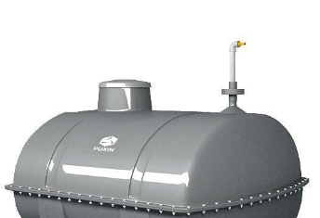

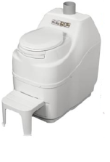
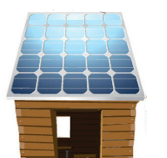

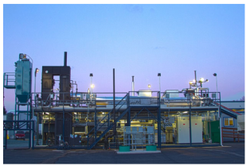
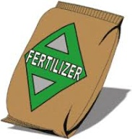

In the last decade a significant amount of innovation has been occurring in the space of sanitation and waste-to-value
1
Change sanitation technologies
Sanitation Innovation
New treatment solutions
New business / collection models
Miniaturized biogas
SMS dispatching for collection
Daily / weekly collection
Pay per use
toilets
Reinvented toilets
Waste
to
Value
Sale of byproducts
New processor technologies

Slide 20




Waste-to-value sanitation solutions can process human waste to yield four major types of byproducts...
1
Change sanitation technologies
Waste processing method
Byproducts that address refugee needs
Current solutions
Anaerobic Digestion¹
Biogas
(cooking, lighting)
All camps and all refugees need cooking fuel...
...Wood, kerosene, ethanol currently used for cooking...
...However, no single source can meet 100% of demand
Briquettes
(cooking)
Carbonization
Electricity
(lighting, charging mobile phones, pumps, infastructure)
Solar panels and lanterns are well-received by refugees...
...And the price of solar will decrease even further
Combustion
Not all populations practice agriculture...
...Even fewer camps have space for farming...
...Plus, fertilizer can't be moved far (too heavy to be efficient)
Fertilizer
(slurry, biochar, compost for agriculture)
Composting
1. Anaerobic digestion produces both biogas and fertilizer as byproducts, and produces as much fertilizer per kg of waste processed as composting methods.

Slide 21
...of which, biogas and briquettes are likely the most useful
Three factors create demand for cooking fuel across all types of camps
1
Change sanitation technologies
Fuel provisions are
insufficient and expensive
Firewood collection is dangerous & time-consuming
Few natural resources exist in regions of most camps
Kerosene or ethanol require constant external supply
  Fuel containers must be trucked or otherwise brought in to camp
  Price fluctuates with global/local politics and supply
  Government subsidies are decreasing
Fuels are not ideal cooking sources
  Kerosene gives food bad taste, does not burn hot enough
Firewood collection done by women and children
  Creates targets for SGBV
  Takes several hours per day
  Can keep children from school
Cutting trees or leaving camp may be illegal or prohibited
  Deforestation creates conflict with host community
  Legal purchase of firewood paid for in food provisions
  500 arrested/year in Bambasi
Camps often in undesirable or resource-depleted regions
  Relegation to desert (e.g., Zaatari, Azraq, Dadaab, Kakuma)
  Major deforestation occurs around camp (e.g., Nakivale)
Cannot rely on single source – portfolio is needed
WTV energy sources reduce need for firewood
Biogas and
briquettes require no
additional inputs
Demand for better sources of cooking fuel
is nearly universal

Slide 22

While innovative WTV solutions will not cover an entire household needs, it can contribute to renewable supplies
1
Change sanitation technologies
Maximum extractable value per HH per day
START WITH:
Equivalency
Wet fecal sludge
Anaerobic Digestion
0.2 m² biogas
~20% of daily household cooking⁽¹⁾
100m x 15m plot of farmland per year⁽²⁾⁽³⁾
Fertilizer w. 11 kg nitrogen per year
~1.5 kg/
household/
day
0.4 kg briquettes
~14% of daily household cooking
Carbonization
3.2 MJ or 0.9 kWh electricity
72 full Samsung Galaxy phones
60W bulb for 15 hrs
Dry fecal sludge
Combustion
~0.5 kg/
household/
day
Fertilizer w. 11 kg nitrogen per year
100 m x 15m plot of farmland per year⁽²⁾
Composting
1. 100% of cooking needs could be achieved with additional substrate from manure of 1-2 dairy cows, or 1 cow + 1.5kg organic waste/grass.
2. Assumes 6% Nitrogen content of dried fecal sludge (Resource Recovery through Wetlands, Herbert Aalbers, 1999) and 60-120 kg/Hectare for maize.
3. Anaerobic digestion slurry is better fertilizer than fresh fecal sludge; nitrogen content is the same but is in more usable form (ammonium); P, K, Mg, Ca contents are similar; pH is higher (LTC Bonten, "Bioslurry as a fertilizer"; C.N. Macharia, "Nitrogen Use Efficiency and Maize Yield."
Additional sources include: "Sustainable Recovery of Energy from Fecal Sludge in India," EAI & BMGF, 2011, p. 105; "Fuel potential of faecal sludge: calorific value results from Uganda, Ghana and Senegal" Journal of Water, Sanitation and Hygiene for Development, 2014; interview with Andrew Foote of Sanivation

Slide 23
We evaluated a longlist of technologies in the context of camps, then paired them with relevant business model
1
Change sanitation technologies
Longlist
  Emerging or existing technologies in development/emergency settings
  Innovative ecosan technologies
Shortlist
  Systems or components that appear viable in refugee context and offer advantage over current systems
Consider tech w/ business model
Eliminate technologies inappropriate for refugee settings
Consider tech with business model
Eliminate technologies that pose high risk in refugee settings, due to:
  High dependence on proprietary consumables
  High dependence on maintenance service
  Questionable reliability if technology is untested or still in prototype phase
... as well as those that are not cost-effective
  Extremely high-cost technologies that would limit coverage
  Those that pose no significant advantage over existing options
  Partial treatment that still requires a WWTP
Each technology considered alongside potential business or service models
Consider technology & business model pairings, based on:
  Cost and cost effectiveness
  Robustness & reliability
  Opportunity to create employment or sustainability
  Valuable byproducts created
Delineate appropriate contexts for each pairing based on advantages and limitations

Slide 24







Some technologies are systems that span the whole sanitation chain; some represent just one component
1
Change sanitation technologies
End-to-end system
Component
Component
Component
Toilet Interface &
Storage
Collection &
Transport
Processing &
Value Creation
Drop hole
Composting
Interface
No transport
(fully on-site system)
UDDT
Anaerobic Digestion
Pour-flush
Can be WTV
Prefabricated latrine
Carbonization
Superstructure
Corrugated iron sheets
Donkey or
push cart
Combustion
Local materials (live fence, mud brick, bamboo)
Closed pit (lined/unlined)
Chemical
Storage
Accessible pit (lined)
Other
Not WTV
Above-ground container
Vacuum
truck
All-in-one
No treatment
Single-use bags

Slide 25







76 systems or components evaluated, 27 considered viable for refugee camp contexts; of these, 5 selected for deep dive
1
Change sanitation technologies
Selected for deep dive
Long list
Short list
 |  |  |  |  |  | Short-listed generic designs: |  | Short-listed proprietary designs:
Composting¹ |  | 37 |  | 12 |  | Locally constructed UDDT, fossa alterna (double vault pit), effective microorganisms (EMOs) i.e. bacteria or worms |  | Aerosan, Otji Toilet, Sulabh Toilet, Tiger Toilet, Peepoo bags, X-runner Venture, Fresh Life Toilet (Sanergy)
Anaerobic digestion |  | 23 |  | 9 |  |  |  | (B)energy, SimGas, Ecofys, Felxi Plastic Bag, Safi Sana, Iko, Loowatt, MRC, DRDO
Carbonization |  | 3 |  | 1 |  |  |  | Sanivation
Combustion |  | 3 |  | 1 |  |  |  | Janicki Omni-Processor
Chemical |  | 1 |  | 0
Other |  | 5 |  | 0
No treatment² |  | 4 |  | 4 |  | Pit latrine variations (locally made slabs & superstructures) |  | Evenproducts (liner, slab, superstructure, etc.), SaTo insert, UNHCR Emergency WASH kit
 |  | 76 |  | 27
Composting¹
Anaerobic Digestion
Carbonization
Combustion
Chemical
Other
No treatment²
1. Includes treatments that are specifically aerobic digestion. 2. "No treatment" includes pit latrines and other systems where no form of waste processing is facilitated.

Slide 26
The following selection criteria were applied to the longlist of technologies in the context of refugee camps
1
Change sanitation technologies
Upfront investment cost – given that there are many partial or no treatment components below $1,000 and complete treatment systems below $2,000, use these as upper limits per household
Technology viability – technology has been developed beyond prototype phase and has demonstrated potential to scale
Size & transportability – on-site component is of reasonable size and is able to ship easily or be built / assembled locally
Flexibility & resilience – system can operate independent of energy or large water supply and is not dependent on externally supplied consumables
Value for money – technology offers significant improvement or unique advantages over similar lower-cost options and has long-term cost effectiveness
A
B
C
D
E

Slide 27



Criteria A: Upfront investment cost
12 technologies screened out due to high price
1
Change sanitation technologies
A
Assessment criteria:
Why cap initial costs?
Maximum capital cost (not including transportation & installation):
  Under $2,000 if full treatment system:
    System provides end-to-end solution and output needs no further treatment
  Under $1,000 if partial / no treatment:
    If only a component of system and additional treatment needed
      (e.g., a toilet interface)
  Limited liquidity:
    Finite funds available each year
  Quantity as well as quality
    Coverage and quick installation as important as user experience and cost effectiveness
Examples of solutions excluded
$1,140 USD for one toilet interface and requires separate composting treatment and urine treatment
$1,095 USD for one toilet interface, but requires separate composting treatment and urine treatment
$3,000 USD for one complete system with toilet interface, composting unit & storage

Slide 28
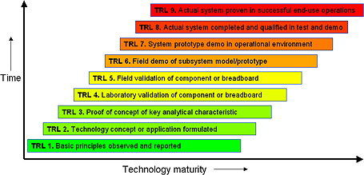


Criteria B: Technology viability
10 technologies screened out due to too early development phase
1
Change sanitation technologies
B
Assessment criteria
  Must be beyond prototype (TRL9)
    Camps do not have maintenance or backup capacity for tech. which require optimization or has high risk of breakdown
  Proven manufacturing process
    Well-established mfg. process minimizes prices and improves supply dependability
TRL Levels
Examples of solutions excluded
Caltech system still in prototype phase
Urine-diverting combustion toilet is still in research phase
TRL image source: http://www.quazoo.com/q/Technology_readiness_level

Slide 29
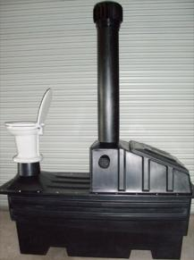
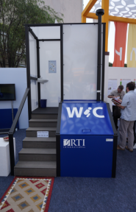


Criteria C: Suitable size or transportability
13 technologies screened out due to bulkiness or transport complications
1
Change sanitation technologies
C
Assessment criteria
Seat (for size comparison)
  Exclude systems with large amount of prefabricated components, due to:
    Transportation and assembly challenges
    Possible delays in installation or increased costs
  Qualify systems with large footprint:
    Large systems (e.g., above-ground biodigesters only work in rural spaces or camps with large plots)
Enviroloo
RTI Toilet
Examples of solutions excluded
Each toilet requires large plastic pre-fab tank, drying plate, vent-pipe and vent to be shipped and assembled on-site; beyond latrine structure, requires ~1.5 x 2.5 m for tank
RTI unit includes raised superstructure & steps, with pre-fab treatment system below. Complex transportation & assembly.

Slide 30
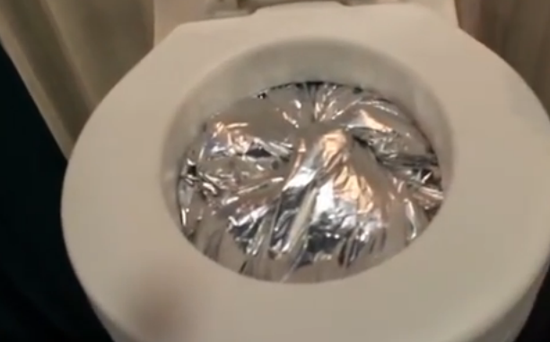
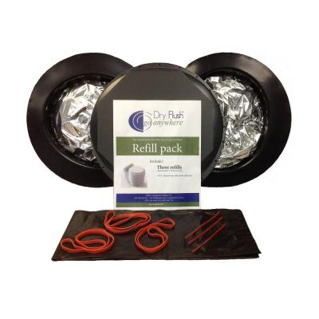


Criteria D: Flexibility & Resilience
6 technologies screened out due to inflexibility
1
Change sanitation technologies
D
Assessment criteria
  Accommodate likely household use:
    E.g, exclude those not resilient enough to support >8 people
  Mostly off-grid:
    Cannot depend on reliable supply of electricity or large additional water supply
  Independent of externally-supplied consumables:
    Dysfunctional if supply chain interrupted
Dry Flush toilet shown mid-flush & cartridges: toilet does not function without cartridge
Examples of solutions excluded
Dry Flush toilet uses plastic cartridge to contain excreta and electricity to "flush." If either electricity supply is shut off or camp runs out of cartridges, toilet cannot be used
Requires 4L of water to flush solids. Very few camps can provide an additional 4L/person/day.

Slide 31


Criteria E: Value for money
8 technologies screened out due to relative or long-term cost effectiveness
1
Change sanitation technologies
E
Assessment criteria
Composting
UDDT
EcoLoo
Composting
System
  Value for money:
    High cost tech. must demonstrate significant improvement over lower-cost tech in same category
  Lifetime costs:
    Compare total cost over reasonable lifetime for camp (5, 10, 20 years)
    Cannot assume >20 years due to uncertainty of conflict and sensitivities to host government
$
$$$
Both achieve the same outcome
Examples of solutions excluded
$1500-2000 USD all-in-one composting toilet offers little improvement over $600 UDDT
Concrete tank digester is more expensive than plastic plug-flow options, which are generally easier to build and function well in warm climates

Slide 32



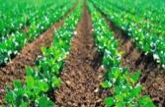

Of the short-listed technologies, each can be aligned against one of eleven system configurations
1
Change sanitation technologies
Toilet Interface &
Storage
Collection &
Transport
Processing &
Value Creation
Above-ground pour-flush
On-site biogas digester
Anaerobic Digestion
UDDT
Donkey or hand cart
Solar cooker & briquette presser
Carbonization
Lined latrine
Vacuum truck
Mini-plant
Combustion
Double vault (UDDT or regular)
On-site composting
Composting
Accessible container
Donkey or hand cart
Communal compost pit
Emergency phase only
Single-use bags
Donkey or hand cart
Communal compost pit
Pit latrine
Pit latrine + pour-flush insert
No treatment
Pit latrine + effective microorganisms
Pit latrine + liner
Emergency phase only
Pit latrine + prefab superstructure

Slide 33















Short-listed technologies were either branded innovations (22) or generic designs (4)
1
Change sanitation technologies
Examples; not comprehensive
Toilet Interface &
Storage
Collection &
Transport
Processing &
Value Creation
Anaerobic Digestion
Carbonization
Can be sourced locally
Combustion
Composting
No treatment
Overtime, expect branded innovation shortlisted will be subject to competition

Slide 34
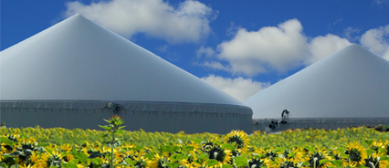
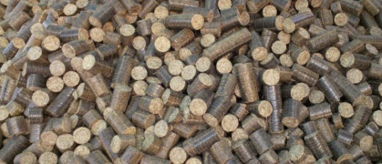
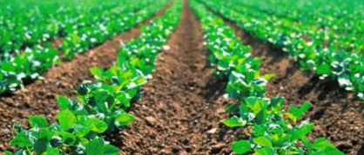

Upfront investment in most innovative solutions per stance higher than pit latrines with the exception of the UDDT & CP
1
Change sanitation technologies
Expected lifetime | 10+ | 20+ | 5 | 10+ | 20+
Annual Op Expenses | $30-35 | $2.50-10 | $20-60 | ~$5 | $30-40
Installation cost / stance (USD)
2,000
1000
500
200
100
50
0
Biogas
(Household)
Biogas (Institution)
Briquettes
Fertilizer
Combustion
1800
1000
900
Comparison pit latrine
800
Requires 2x weekly collection of household waste
800
450
550
600
400
190
200
70
40
HH-biogas¹
Institutional biogas²
UDDT & central processing³
UDDT & household processed waste⁴
Mechanical collection & central processing⁵
1. Cost data from Bambasi / Kule (B) energy concept 2. SimGas data 3. Sanivation pilot in Kakuma 4. UDDTs in Dolo Ado 5. Assumes 50K refugees / 10K households being serviced by OP

Slide 35





Each tech system offers unique set of non-financial benefits
As these become proven, camp managers could prioritize their main challenges and pair with tech.
1
Change sanitation technologies
Advantages
 |  | Reduces smell & flies | Above-ground (no pit req'd) | No re-building (minimizespace) | Extended lifetime of pit | Energy by-product | Fertilizer by-product | Accepts organic waste | Limited upfront capital needed
 | On-site biogas | 1
 | Compost w/ UDDT
 | Compost w/ DV drop pit |  |  |  |  |  |  |  | 3
 | Carbonize (to briquettes)
 | Collect & combust |  |  |  |  | 2
 | Pit latrine w/ pour-flush
 | Pit latrine w/ EMOs
 | Pit latrine w/ added lining
Only technologies for permanent systems evaluated
Anaerobic Digestion
Composting
Carbonization
Technologies
Combustion
No treatment
As we will discuss, most still need to be proven at scale
1. If pour-flush with water seal. 2. Electricity, not for cooking. 3. Build one pit latrine first, dig second pit later.

Slide 36
Example: Camps in which these challenges need to be addressed
1
Change sanitation technologies
Advantages
 | Reduces smell & flies | Above-ground (no pit req'd) | No re-building (minimizes space) | Extended lifetime of pit | Energy byproduct | Fertilizer byproduct | Accepts organic waste | Limited upfront capital needed
In cases where... | Beneficial everywhere | Pits are hard to dig and collapse easily | Plot size per household is small | Water table is high | Cooking fuel is scarce | Agriculture takes place among refugees or in the nearby local community | It lacks a well-functioning waste disposal system | Funding is limited
Camp examples | All camps | Rocky soil Hilaweyn Buramino Sandy soil Tindouf Bredjing Yusuf Batil Adjumani | Dollo Ado Yusuf Batil | Orunchinga Gambella | All camps, especially Dadaab Kakuma Dollo Ado Mbera Bredjing Tindouf | Most camps, e.g. Assosa Nakivale Kilis | Most camps | All camps
Source: BCG analysis based on camp visits, interviews with WASH camp staff at locations, global soil data, land coverage data (to identify cropland)

Slide 37
Lever 2: Engage refugees and hosts more actively
Physical conditions
1
Change sanitation technologies; increase WTV
A portfolio of sanitation solutions are needed as no silver bullet exists
  Waste-to-value solutions are emerging as a class of technologies that have the potential to help address multiple challenges faced by UNHCR/Partners
  Most waste-to-value solutions have variants to suit household needs
  In some cases, the latrine may still be the preferred option given the low cost to construct and likely challenges frontloading emergency investment
Technical
Space conditions
Logistics
2
Behavior change
Engage refugees and hosts more actively
Limited engagement of refugees and host community in sanitation today
  Select example camps (e.g., Nakivale) have shown strong engagement models
  Opportunity to increase the amount of ownership in the construction of facilities and operation of businesses to support construction and resource recovery
  Given limitations on employment for refugees and difficulties in monetizing by-products, we expect UNCHR and partners to need to stimulate/fund business
Social Good
Cultural diversity
Engagement
3
Increase time horizon for investment decisions
  Invest early to install longer-lasting systems vs. items with 2-3 year lifetime
  Select less expensive emergency solutions; use remaining funds to jump-start permanent solution construction when people are move to homes
Financial
Short-term focus

Slide 38
Refugee and host engagement achieved primarily through service delivery model in last two steps of sanitation chain
2
Engage refugees and hosts more actively
Focus area for service delivery models with refugee & host engagement
Toilet Interface &
Storage
Collection &
Transport
Processing &
Value Creation
Drop hole
Composting
Interface
No transport
(fully on-site system)
UDDT
Anaerobic Digestion
Pour-flush
Prefabricated latrine
Carbonization
Superstructure
Corrugated iron sheets
Donkey or
push cart
Combustion
Local materials (live fence, mud brick, bamboo)
Closed pit (lined/unlined)
Chemical
Storage
Accessible pit (lined)
Other
Above-ground container
Vacuum
truck
All-in-one
Single-use bags
No treatment

Slide 39

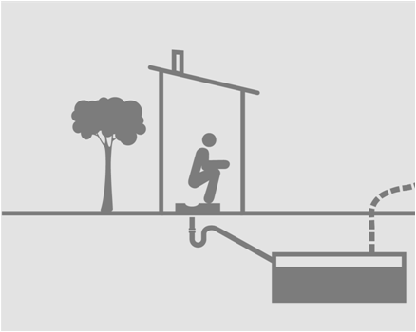

Pit latrines with bi-annual replacement most common today
Primary benefits are low initial cost, simplicity and household level applicability
2
Engage refugees and hosts more actively
Installation
Operation
Provide refugees with
  Tools to excavate pits
  Slab for the latrine
  Poles for building the superstructure
When latrines are filled after 2-3 years, a new latrine is excavated by refugees (in some cases)
Continued need for behavior change maintenance to ensure hygienic usage
No valuable by-product like biogas, briquettes or fertilizer
UNHCR or IP wash team
Limited benefits for & engagement with host community
Limited job creation or entrepreneurial opportunity for refugees or hosts

Slide 40


Deploying new sanitation approaches can reach beyond refugees to include the host community & government
2
Engage refugees and hosts more actively
Extending the circle beyond refugees...
...will create benefits for all actors
Refugees
  Access to improved sanitation and regained dignity
  Access to energy through valuable by-products (biogas, fertilizer, briquettes)
  Provision of in-camp employment and entrepreneurial opportunities
  Learning and capacity building
Expand needs addressed and provide opportunities
Refugees
Host community
  Access to better facilities, e.g. schools, health centers
  Access to additional income opportunities
  Access to by-products
  Access to improved sanitation
Provide development and economic opportunity
Host community
Address safety needs and political interest
Governments
  Less resource depletion (esp. deforestation)
  Fewer conflicts between host community and refugees leads to increased stability
Country & local
government

Slide 41
Calculating specific economics of service delivery models
2
Engage refugees and hosts more actively
We have outlined high level options for business models associated with different technologies. We did not calculate the specific economics of any one model, because they are HIGHLY context specific.
For example, the economics of these models are very sensitive to
  Fuel availability and price
  Economics of existing sanitation options e.g. engagement of refugees in current provision
  Presence or absence of additional fuel stock and flow between camp and host community
  Density of camp or settlement
In general, these models face a considerable challenge if expected to be self-sustaining
  As discussed for biogas, only up to 20% of average family cooking needs could theoretically be covered by the human waste of that family
  Finding additional fuel stock might cause resource conflicts with host communities
  Including margins of service providers and other running costs – i.e. collection models, commodity production etc. - likely undermines ability to fully recover costs, especially upfront costs
However, such models can contribute to reducing service costs for camp or settlement management
  Plus provide opportunities for value-added work, reduced dependence on outside fuel etc.
  Plus social and economic implications of reduced SGBV
  Plus less ground water contamination, which – where this is an issue – could reduce disease

Slide 42

























Example of the modeling challenge: High variability in industrial electricity prices across SSA country sample
2
Engage refugees and hosts more actively
Backup
Industrial price of electricity ($ / kWh)¹
Median = $0.09 / kWh
Burkina Faso
Chad
Cape Verde
Rwanda
Uganda
Kenya
Congo,
Dem Rep of
Senegal
Congo, Rep
Benin
Cote d’Ivoire
Madagascar
Niger
Cameroon
Namibia
Ghana
Nigeria
Tanzania
Ethiopia
Mozambique
Botswana
South Africa
Malawi
Zambia
Lesotho
Also see high variability in other fuels, fertilizer etc., making economics highly dependent on context
1. World Bank policy brief (2011)
Source: World Bank, BCG analysis

Slide 43
We have developed 5 example service delivery models
While energy costs might be reduced, biggest advantage is to improve stakeholder conditions
2
Engage refugees and hosts more actively
Financial sustainability a stretch but benefits to involved stakeholders
5 example service delivery models
Installation and operations, assumptions
  HH-level biogas
  Institutional biogas at a school
  Central collection + central processing with charcoal production
  Double-vault or UDDTs with HH-processed fertilizer
  Mechanical collection + central processing – Example the Janicki OP
  Technology and installation materials in most of the cases are provided by the manufacturer of the technology
  UNHCR or the Implementing Partners (IPs) are providing the capital for the upfront investment
  Installation and operation in most cases is handed over to the refugees who either receive an incentive payment or benefit from selling the by-product
  Models include opportunities to involve the host community and create a benefit to them
  Improved sanitation for the refugees and – if made accessible - for the host community as well
  Increased latrine life-time and potentially reduced life-time costs for UNHCR and IPs
  Creation of valuable by-products that can cover a portion, typically small, of the energy needs potentially reducing risks of SBGV, host community friction
  Job creation for refugees and/or the host community
  Reduced negative impact on the environment, ground water contamination and potentially disease
Note: while we annotate where energy costs may theoretically be reduced, in practice we are more optimistic regarding increased refugee benefits v. capturing cost savings because of the challenges with access to the additional feedstocks needed, in many cases, to strongly impact energy supply

Slide 44




Legend for the service delivery models
2
Engage refugees and hosts more actively
Involved stakeholders
Involved service streams
Installation of technology
Refugee HH or institution (shown with alternative to pit latrine)
Education & training
UNHCR and/or Implementing Partners
Different forms of transportation of material; context-specific
Monetary streams
Refugee-led enterprise (REE)
$$$
Installation costs
$
Operating income
Host community
Inputs
Valuable outputs
Animal manure
Energy
Manufacturers
Organic waste
Fertilizer
Briquettes

Slide 45
Overview service delivery model for HH-level biogas
Installation by manufacturer, operations by refugee energy enterprise, refugees & hosts benefit
2
Engage refugees and hosts more actively
Supplier of technology
B-Energy – though potential for more generic systems
Set up
Upfront investment
Covered by UNHCR or implementing partner
Installation of system
Groups of refugees "Refugee Energy Enterprise" (REE)
Compensation of refugee enterprise
Payment for the fertilizer that you get from slurry
For the refugee HH
<20% of their cooking needs are covered (more if you can supplement bio-digester feed stock), improved sanitation
Benefits
For UNHCR / IPs
If they were able to provide 100% of cooking energy at e.g. $10/month, able to reduce by 20% →$2/months → $24/year
For host community
May benefit from supplying add. feedstock for bio-digester and possibly fertilizer output; Dependent on program - access to biogas system and education on use
Viability and resource needs
Need implementation research to test reliability/acceptance/system optimization - Low contribution to absolute energy needs means very sensitive to sub-optimization. Important to understand access to additional feedstock, would flip equation if could supplement. Need to test robustness of systems - replacement costs could kill economics e.g. if bags have short half life. REE supervision needed.
Risks

Slide 46
Example service delivery model for HH-level biogas
Installation by manufacturer, operations by refugee energy enterprise, refugees & hosts benefit
2
Engage refugees and hosts more actively
Installation
Operation
Access to inputs must be tested; not all camps have cattle / sheep
Manufacturing
Refugee home
Country franchisee¹
Camp representative
Refugee energy enterprise (REE)²
$$$
$
Host community
UNHCR or IP wash team
Conditions where the system works
  Space for digester and bag available
  Animals close by to supplement human waste with donkey, cattle, goat manure
  Access to grass and other organic waste to supplement as needed
  Temporary & permanent setting possible as the system is transportable and durable enough to be moved
1. (B)energy used as an example, model could be applicable to other biogas systems as well 2. Depending on government restrictions and labor constraint the REE could also be run by the host community

Slide 47
Example service delivery model for HH-level biogas
Installation by manufacturer, operations by refugee energy enterprise, refugees & hosts benefit
2
Engage refugees and hosts more actively
Installation
Up to 4 HHs hooked up to one digester
Human and organic waste and animal manure go in digester
Use gas for cooking
Operation
Technical support for installation and service
Spread the idea of resource recovery
Train new households
Manufacturing
Refugee home
Country franchisee¹
Camp representative
Refugee energy enterprise (REE)²
Can also buy bio-digester
Benefits from the bulk delivery of biogas system and access to service reps
Trains a group of refugees to install and use biogas
Replacement parts onsite
Could be member of the host community
$$$
$
Communicates need to B-energy country franchisee and camp rep
Pays for digester, biogas bag, stove and replacement parts
Host community
Assesses need in villages
Work with village leadership to select families that are eligible to get biogas system
REE delivers slurry to host community
Receives payment
UNHCR or IP wash team
Conditions where the system works
  Space for digester and bag available
  Animals close by to supplement human waste with donkey, cattle, goat manure
  Access to grass and other organic waste to supplement as needed
  Temporary & permanent setting possible as the system is transportable and durable enough to be moved
1. (B)energy used as an example, model could be applicable to other biogas systems as well 2. Depending on government restrictions and labor constraint the REE could also be run by the host community

Slide 48
Overview service delivery model for institutional biogas
Leverage existing school management to run the large-scale biogas system
2
Engage refugees and hosts more actively
Supplier of technology
Sim Gas – though potential for other suppliers
Set up
Upfront investment
Covered by UNHCR or implementing partner
Installation of system
Likely as part of institution build/through supplier of technology
Compensation of refugee enterprise
Access to biogas for cooking possibly other energy uses. Or, if combined with HH programs, might supplement HH gas availability and provide revenue stream
For the refugee HH
Benefits at the community not HH level – ability to reduce cost of school meals, school garden benefits
Benefits
For UNHCR / IPs
Reduced cost of school meals/potentially other energy needs, improved school sanitation with halo benefits to community
For host community
Likely only if host community uses school or if bio-digester supplements feedstock from host bi-products
Viability and resource needs
Biogas systems can be highly sensitive to volume of inputs versus reactor size – art and science in managing them – so need plan for optimizing and ongoing management – important to understand why existing facilities unused.
Important to test models for compensating system "manager" – potential for over or under compensation. Supervision needed.
Risks

Slide 49
Example service delivery model for institutional biogas
Leverage existing school management to run the large-scale biogas system
2
Engage refugees and hosts more actively
Installation
Operation
Build school including bio-digester
Team of teacher, cook, and/or janitor (or entrepreneur²)
UNHCR or IP wash team & education facilities
  Manage the system
  In return, can use biogas for personal cooking
Students receive a meal cooked with biogas from digester
Send their kids to school, who also can eat there
Deliver and – jointly with WASH implementing partner – implement digesters
School sanitation
& energy club
Manage cleanliness of latrines & bring hygiene messages home¹
School garden
Host community
Learn farming
Conditions where the system works
  School with a sufficient number of students (>800)
  Stable school management and teacher, cook or janitor that could manage the system
  Sufficient space & ability to farm (less important)
  Need some access to water to flush & clean
1. Positive examples where seen at school in Nakivale, Uganda 2. If the implementing partner is willing to provide incentives the gas could be collected by entrepreneur who distributes it within or outside the camp

Slide 50
Overview service delivery model for central processing
Sanivation trains locals and refugees to manufacture container toilets and convert to charcoal
2
Engage refugees and hosts more actively
Supplier of technology
Sanivation – though potential for other suppliers
Set up
Upfront investment
Covered by UNHCR or implementing partner
Installation of system
Sanivation/other supplier with initial training of refugee enterprise, refugee enterprise then likely to cover HH training
Compensation of refugee enterprise
Share of briquette output
For the refugee HH
Improved sanitation, may get share of briquettes – though dependent on refugee enterprise dynamics e.g. REE members may get most benefit, may supply schools v. HH as community give-back
Benefits
For UNHCR / IPs
Improved sanitation management through lower latrine rebuild needs, reduced groundwater concerns/disease
For host community
Reduced need for latrine rebuilding, some potential upside from briquette sale/use, job creation for members of REE
Viability and resource needs
Sanitation systems based on constant, ongoing, collection are high risk in the refugee setting – would need to weigh consequences of disruption carefully, ensure acceptance of pickup etc.
Need to understand availability of sufficient co-substrate such as organic waste. REE supervision needed.
Risks

Slide 51
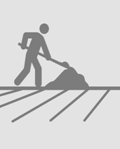
Example service delivery model for central processing
Sanivation trains locals and refugees to manufacture container toilets and convert to charcoal
2
Engage refugees and hosts more actively
Installation
Operation
  Trains to produce the toilets
Refugee energy enterprise¹
$$
Help build household
latrines
Collect waste
every couple of days
Charcoal dust or organic waste added
Incentive
$$
Briquettes
Central collection
of containers
Feces get dried
with sun and
a metal sheet
Manual production of charcoal briquettes
  Communicates need to Sanivation team and REE
  Pays for materials and replacement after 5 years
UNHCR or IP wash team
  For free if they helped with the collection of waste containers
  Can sell kerosene or wood ratio on the market
  Assesses need in villages
  Work with village leadership to select families that are eligible to get Sanivation toilets
Conditions where the system works
  Sufficient number of refugees that would be willing to engage in the collection of containers
  Acceptance to use and willingness to pay for biochar briquettes for cooking
  Sufficient supply of leftover charcoal dust and organic waste
1. Concept of a refugee enterprise that is responsible for emptying latrines has been proven in Nakivale

Slide 52
Overview service delivery model for HH processed waste
Donkey cart enterprise responsible for central collection of compost & link to host community
2
Engage refugees and hosts more actively
Supplier of technology
Suppliers of double vault latrines
Set up
Upfront investment
Covered by UNHCR or implementing partner
Installation of system
Need initial and likely some ongoing training of refugee enterprise
Compensation of refugee enterprise
Share of fertilizer sales or use
For the refugee HH
Improved sanitation, may get share of fertilizer revenue– though dependent on refugee enterprise dynamics e.g. REE members may get most benefit, may supply community facilities as give-back
Benefits
For UNHCR / IPs
Improved sanitation management through lower latrine rebuild needs, reduced groundwater concerns/disease
For host community
Reduced need for latrine rebuilding, some potential upside from fertilizer sale/use, job creation for members of REE
Viability and resource needs
Dependent on finding buyer for fertilizer – likely host communities in most circumstances – may be biases against the product origin. Refugee community acceptance of double vault systems and collection models also key. REE supervision needed e.g. to maintain periodic collection.
Risks

Slide 53
Example service delivery model for HH processed waste
Donkey cart enterprise responsible for central collection of compost & link to host community
2
Engage refugees and hosts more actively
Installation
Operation
$$$
Build the structure with locally- /refugee-made mud-bricks if available
UNHCR or IP wash team
Refugee energy enterprise¹
  Helps with mud-brick making & installation
  Collects from full chamber
  Can use donkey capacity for paid transportation jobs
Improved crop growth
In labor-constrained setting for refugees, host community can participate in the mud-brick making and installation of latrines
Fertilizer
E.g., double vault 1 chamber fills, when full, sits for 6 months, then emptied
If refugees with DV compost latrines do agriculture, they can use the fertilizer directly
Fertilizer
Refugee fields - improved crop growth & can sell residual on the informal market
Conditions where the system works
  Host community willing to buy fertilizer
  Refugees engage in agriculture
  Government approves refugee enterprise for mud-brick making, installation, collection and fertilizer sale → if not approved, opportunity to positively impact the host community
1. Non-monetary incentive have been proven in Dollo Ado with the donkey cart approach where the waste collector can use the donkey when he is not collecting trash and can make money of transport jobs

Slide 54
Overview of service delivery model for mechanical collection + central processing – Example the Janicki OP
2
Engage refugees and hosts more actively
Supplier of technology
e.g. Janicki OP– though potential for other suppliers
Set up
Upfront investment
Covered by UNHCR or implementing partner
Installation of system
Janicki/other supplier for processor – plus vacuum truck operations
Compensation of refugee enterprise
Unclear if this is a REE or host community enterprise – but if REE, share benefits of power supply in return for pickup and management services
For the refugee HH
Improved sanitation, may benefit from power supply
Benefits
For UNHCR / IPs
Improved sanitation management – potential for power supply
For host community
Host community versus refugees may run equipment and collection services – so could have employment and revenue benefits
Risks and challenges
Very expensive relative to most refugee settings therefore likely for special circumstances – see next page for concerns
Risks

Slide 55
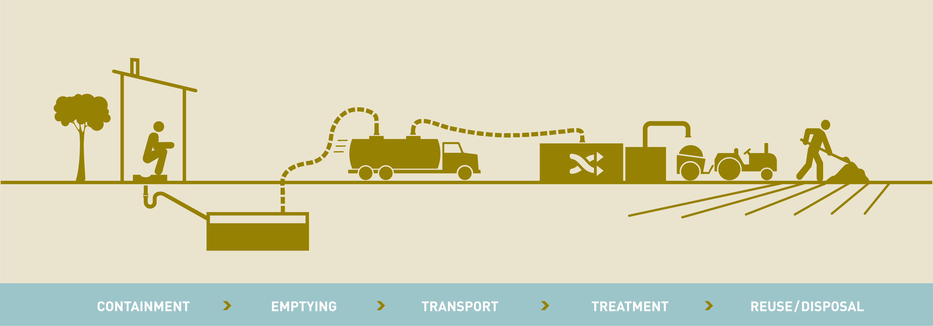
Service delivery model for mechanical collection + central processing – example the Janicki OP
2
Engage refugees and hosts more actively
Drainable pour-flush latrines provided by UNHCR and WASH IPs
Company run by locals empties latrines and collects & transports human waste with vacuum truck
Human waste and solid waste are combined in OP
Electricity generated at plant is channeled in camp grid
Collection of solid waste (high plastic content) continues with existing weekly collection model
Water (gardens) & ash (roads) used in camp
Unclear that there is a use case available today
Conditions where the system works
  Densely populated place like Azraq – Azraq challenged because UNICEF built a WWTP
  Human waster from at least ~50k people available (and supplemented with solid wastes)
  Large capital investment can be made ($1M) upfront; cost for operating expenses of collection & treatment
  Demand for grid based electricity (e.g., water pumping systems, street lights, etc)

Slide 56

Service delivery models offer a series of benefits for the refugees, host community and local government
2
Engage refugees and hosts more actively
Refugees
Host community
Government
Most relevant social benefits
Sanitation improvement | Access to cooking fuel | Economic opportunity | Skill building |  | Access to camp facilities | Economic opportunity | Access to by-product | Sanitation improvement |  | Environment (deforestation) | Improved relations
Baseline:
Pit latrine
✓
✓
Biogas
(Household)
✓
✓
✓
✓
✓
✓
✓
✓
✓
Biogas (Institution)
✓
✓
✓
✓
✓
✓
✓
Briquettes
✓
✓
✓
✓
✓
✓
✓
✓
✓
Fertilizer
✓
✓
✓
✓
✓
✓
Combustion
✓
✓
✓
✓
✓

Slide 57
WTV solution potential is exciting, but questions need to be addressed as techs & models are scaled in refugee settings
2
Engage refugees and hosts more actively
Outstanding questions
What is a realistic volume and mix of inputs (human waste, animal waste, organic matter) that a household can provide / collect? Can a useful amount of cooking fuel be captured?
Is the effluent from different designs (plug flow, fixed dome) safe for human exposure?
Are there viable models for the host community to supply gas to refugees?
Is institutional model viable in refugee setting where there is no monetization?
Anaerobic Digestion
Will enough people accept feces-based briquettes?
Can human waste be collected frequently enough to be useful?
Can fresh human waste be collected safely? What precautions & protocols are needed?
What backup sanitation exists if the collection method is interrupted?
Can the host community be included to increase scale?
Carbonization
Can human waste be efficiently collected at the minimum scale needed for combustion to be viable?
How do you ensure correct maintenance and skilled operation of a in a remote, volatile region? Will the manufacturer (i.e. Janicki) always need to operate?
How can the host community be included in the system to increase available substrate?
Combustion
Is fertilizer useful enough within a hand-deliverable region?
How long does it take for the compost to ensure it is safe enough for human exposure?
Are refugees or host community willing to pay or trade for fertilizer?
Can the system be made self-sustaining or will investment always be needed?
Composting

Slide 58
Lever 3: Increase time horizon for investment decisions
Physical conditions
1
Change sanitation technologies; increase WTV
A portfolio of sanitation solutions are needed as no silver bullet exists
  Waste-to-value solutions are emerging as a class of technologies that have the potential to help address multiple challenges faced by UNHCR/Partners
  Most waste-to-value solutions have variants to suit household needs
  In some cases, the latrine may still be the preferred option given the low cost to construct and likely challenges frontloading emergency investment
Technical
Space conditions
Logistics
2
Behavior change
Engage refugees and hosts more actively
Limited engagement refugees and host community in sanitation today
  Select example camps (e.g., Nakivale) have shown strong engagement models
  Opportunity to increase the amount of ownership in the construction of facilities, operation of businesses to support that construction and resource recovery
  Given limitations on employment for refugees, plus difficulties in monetizing by-products, we expect UNCHR and partners to need to stimulate/fund business
Social Good
Cultural diversity
Engagement
3
Increase time horizon for investment decisions
  Invest early to install longer-lasting systems vs. items with 2-3 year lifetime
  Select less expensive emergency solutions; use remaining funds to jump-start permanent solution construction when people are move to homes
Financial
Short-term focus

Slide 59
Today's refugee camps & settlements have long lifetimes...
Some camps follow a tradition lifecycle pattern; others more dependent on conflict outbreaks
3
Increase horizon for investment decisions
Tradition camp lifecycles – Average lifetime 17 years
Population
Hagadera
Dagahaley
Ifo
Nakivale
Bredjing
Growth
Steady State
Ramp-down
Camp lifecycles with fluctuating increases
Population
Kakuma
Fugnido
Adjumani¹
Sherkole
1. Adjumani = plus 50K in 2014
Source: UN population data base 2003-2013

Slide 60
... and as such, the initial attractiveness of the low cost latrine can be considerable given long-term replacement costs
3
Increase horizon for investment decisions
Example full camp cost: Latrine provision in Kule Ethiopia with 50K refugees (projected forward)
$K
800
5.8
6
Cumulative
installation
cost, $M
5.5
5.2
650
4.9
5
4.6
600
4.3
$100 per latrine / household, lifespan 2-3 years
4.0
4
3.7
3.4
Cumulative costs
3.1
Emergency
400
300
2.8
3
300
300
300
300
300
2.5
300
300
300
300
300
300
300
300
300
300
300
Wave 1 latrines
650
2.2
Wave 2 latrines
1.9
100
100
2
Wave 3 latrines
1.6
200
1.3
200
200
Wave 4 latrines
1.0
300
300
300
300
300
300
300
300
300
300
300
1
Wave 5 latrines
0.7
200
200
Wave 6 latrines
100
100
Wave 7 latrines
0
0
0
1
2
3
4
5
6
7
8
9
10
11
12
13
14
15
16
17
Years
30% | 60% | 75% | 75% | 75% | 75% | 75% | 75% | 75% | 75% | 75% | 75% | 75% | 75% | 75% | 75% | 75%
Coverage
What sounds like a low cost solution in the short term can become very costly over the lifecycle of a camp ($5.8M)
1. Based on Kule population data retrieved from data.unhcr.org Notes: on the emergency facilities - UNHCR WASH containers – see technology slides in appendix. Budget limit of 300K/annually for permanent solutions.

Slide 61
Of the WTV options small UDDT & central processing lowest cost, mechanical collection & central processing highest
3
Increase horizon for investment decisions
Cumulative - low
Investment - low
Operating - low
Cumulative - high
Investmet - high
Operating - high
HH-level biogas
Small UDDT & central processing
3rd
1st
$
Cum$
$
Cum$
1,500
1,500
1,500
1,500
996
996
1,059
1,059
1,121
982
1,000
809
809
871
871
934
934
1,000
1,000
802
862
922
1,000
585
585
647
647
710
682
742
500
398
398
460
460
522
522
500
500
371
431
500
191
251
311
196
218
241
264
287
309
64
86
109
132
0
62
62
62
62
62
0
0
0
0
1
2
3
4
5
6
7
8
9
10
0
1
2
3
4
5
6
7
8
9
10
UDDT & HH-level processing
Mechanical collection & central processing
2nd
4th
$
Cum$
$
Cum$
1,500
1,500
1,500
1,265
1,305
1,500
1,068
1,075
1,082
1,065
1,105
1,145
1,185
1,225
1,085
1,115
1,010
1,018
1,025
1,032
1,039
1,046
1,054
1,061
905
945
985
1,025
935
965
995
1,025
1,055
1,000
1,000
1,000
815
845
875
905
1,000
610
615
620
625
630
634
639
644
649
653
658
500
500
500
500
0
7
7
7
7
7
7
7
7
7
7
0
0
40
40
40
40
40
40
40
40
40
40
0
0
1
2
3
4
5
6
7
8
9
10
0
1
2
3
4
5
6
7
8
9
10
Still, the most cost effective solution will have to be evaluated on a camp level factoring in local conditions / materials
Source: Cost data collected from (B)energy, Sanivation, Dolo Ado UDDTs & Janicki

Slide 62
With the exception of Sanivation, all innovative solutions are more expensive than the basic pit latrine in the long-run
3
Increase horizon for investment decisions
$ cumulative cost
Janicki OP
Biogas HH
UDDT Dolo
Basic pit latrine
Sanivation
Note: Sanivation requires constant collection over lifetime to be successful
However, there are situations where the basic pit latrine is not a feasible option and there are important benefits beyond cost of alternatives – discussed in early sections
Note: As cost are shown in a range, here average between low and high cost case
Source: BCG Analysis

Slide 63
However, when soil conditions or water table height result in additional costs, HH biogas & UDDTs more sustainable
3
Increase horizon for investment decisions
$ cumulative cost
Time horizon of breakeven of biogas and UDDT to compost
Pit latrine with limited lifetime
Janicki OP
Pit latrine with machine excavation
Biogas HH
UDDT to compost
Basic pit latrine
Sanivation
Note: Sanivation requires constant collection over lifetime to be successful
Innovative options in a similar range, context-specific analysis required
Note: As cost are shown in a range, here average between low and high cost case
Source: BCG Analysis

Slide 64
Still, some of high upfront investment for the new solutions can partially be 'recovered' by the benefits of energy supply
3
Increase horizon for investment decisions
Example: (B)energy
Energy offsets 39% of installation and operating cost after 10 years...
...could close the gap compared to the basic pit latrine
$
$ cumulative cost
39%
0
1
2
3
4
5
6
7
8
9
10
Year
Year
Cumulative cost
Biogas HH
Cum. energy offset
Biogas incl. energy offset
Basic pit latrine
1. Installation cost based on (B)energy's Kule concept. Four HH share one digester. 2. Assumption that biogas can cover 20-30% of the daily cooking needs. Energy offset modeled based on Ethiopia's ethanol supply camps. Average of 20l/month per household and cost of $0.6/l. No savings for wood collection considered.

Slide 65
UDDT to briquettes – if collection system is stable, cost & offset can be even lower than the basic pit latrine
3
Increase horizon for investment decisions
Backup
Example: Sanivation
Energy offsets 22% of installation and operating cost after 10 years...
...falls even below latrine costs
$
$ cumulative cost
22%
0
1
2
3
4
5
6
7
8
9
10
Year
Year
Cumulative cost
Sanivation
Cum. energy offset
Sanivation incl. energy offset
Basic pit latrine
1. Installation cost based on Sanivation's Kakuma concept. 2. Assumption that briquettes can cover 10% of the daily cooking needs. Energy offset modeled based on Ethiopia's ethanol supply camps. Average of 20l/month per household and cost of $0.6/l. No savings for wood collection considered.

Slide 66


Still, for UNHCR to implement these innovative technologies + delivery models a change in funding approach is needed
3
Increase horizon for investment decisions
Funding today
Funding tomorrow
  High spend on the initial emergency phase on short-term solutions
    Interest from donors to fund these items
  Bias for low cost solutions regardless of their expected lifetime
    Helps stretch an annual budget further
  Sanitation seen only as a cost source with limited benefits beyond health
    Limited experimentation w/new models
  Traditional funds do not support the piloting of new approaches – funded by outside donors
  Donors plan and fund for the 10 year horizon initially leveraging sustainable and waste-to-value solutions
  Spend on the emergency solutions is minimized and the savings used on installation of sustainable options
  Sanitation seen as a space that can help solve issues seen in other sectors – Energy, SGBV, environment, etc
  Waste-to-value becomes a commonly used approach to build sustainable camps / settlements

Slide 67
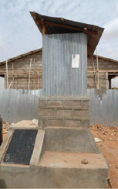

Overall, we believe that a series of combinations will be needed to match the needs of camps and availability of funds
3
Increase horizon for investment decisions
Progressive donors back sustainability
High-cost situation gives waste-to-value cost advantage
Extremely low resource settings limit flexibility
  Funders see the value in investing in WTV & sustainable tech even given higher costs
  Possibility to secure funding from other sectors – energy, SGBV, livelihoods
  Camp locations / context (e.g., rocky soil, unstable soil, etc) would make the use of pit latrines more expensive than the waste-to-value options
  Strong case can be made to funders to support new solutions w/better value
  Given camp lifecycle stage (eg, long established) local teams may not get extra capital to change systems
  Must leverage existing infrastructure but can improve user experience through retrofitting latrines
  Example: American Standard insert (cost $1.30)
Biogas
Briquettes
UDDT
Pour flush insert
Fertilizer
Note: Solutions for urban and peri-urban camps may differ

Slide 68
Next steps
Address any items raised in discussion today
Finalize supporting deep-dives on technologies, costs and advantages
Share final phase I findings with UNHCR team
  Interim findings shared / discussed last week in Geneva over 2 days

Slide 69
Appendix

Slide 70
Baseline Solutions – Deep Dive Assessment

Slide 71
6 categories of sanitation solutions in use at refugee camps, with versions of pit latrines the most common
Very common
Pit latrines (sealed when full)
Pour-flush to pit (sealed when full)
Drop-hole to cesspit (drainable)
Urine-diverting dry toilets (UDDTs)
Pour-flush to cesspit (drainable)
Biogas production at household level
>95% of all existing sanitation solutions
Pilot phase or
micro-scale
Very rare

Slide 72
Existing solutions have been assessed along 3 dimensions and will consider technical requirements
Option assessment
1
2
3
Financial feasibility
Social good
Usability & Ease of implementation
Employment created
Environmental impact
Improved health outcomes
Benefits to the host community
Change of social norms / habit
Training / education
Required business model to implement
Initial investment
Operational costs
Revenues
Paid employees vs. volunteers for cleaning
Maintenance
Quick construction needed
Initial investment comes from UNHCR / partners and not individuals – more cash available
Byproduct
Sanitation service
Fertilizer
Water
Gas
Unpredictability or high fluctuation in number of users
Minimal operating costs – emergency funds often cover initial investment, but quickly decrease
Any by-product will replace another UNHCR expense
Paying for sanitation unlikely in camps
Technical requirements

Slide 73
Cost range of most prevalent sanitation solutions in camps
Emergency ready-to-go WASH containers
100% built by IP
Ex: Gambella, Ethiopia
100% built and supplied by IP
Ex: PWD latrines in Dollo Ado
Cost per stance (USD)
2,000
1000
500
200
100
50
0
100% built and supplied by IP
Fully lined pit latrines w/ drainage access
Permanent superstructure (concrete, CIS)
Ex: Institutional latrines in Nakivale
1800
100% built and supplied by IP
Excavator used
CIS walls & roofs
Ex: Kule 2, Ethiopia
1300
1200
100% built and supplied by IP
Made of CIS
Ex: off-set HH latrines in Dollo Ado
1700
500
450
Refugee excavates
IP builds structure & provides materials
Refugees construct
IP provides basic kit (plastic slab, poles, exc. kit)
Ex: Somali villages in Nakivale, Uganda
100% built by refugee HH
Local materials for superstructure
IP provides basic kit (plastic slab, poles, exc. kit)
Ex: Nakivale, Uganda
70
70
1
2
3
Pit
Latrines
Pour-flush to pit
Drop-hole to cesspit
(drainable)
Source: UNHCR Kampala office, NCA, IMC, WVE, ADRA, UNHCR Addis Ababa office

Slide 74
Short term solutions are less expensive than longer lived solutions on a per stance basis making them a popular choice
Expected lifetime | 2-3 yrs | 3-4 yrs | 10+ | 10+ | 10+ | 10+
Annual Op Expenses¹ | N/A | N/A² | ~$150 | N/A² | ~$35 | Expected high
XX
Cost per stance (USD)
2,000
1000
500
200
100
50
0
Short term solutions
1800
1300⁴
XX
1200³
Cost data unavailable, expected to be very high⁵
1000
1700
500
600
450
600
500
70
70
1
2
3
4
5
6
Pit Latrines
Pour-flush to pit
Drop-hole to cesspit (drainable)
UDDTs
Biogas at micro level
Pour-flush to cesspit (drainable)
1. Excludes cleaning and small maintenance 2. Requires consumables (i.e., ash) or additional water 3. Outlier cost for prefabricated latrines as part of emergency WASH kit. 4. Outlier cost for latrines fully supplied and constructed by implementing partner, e.g., PWD latrines in Dollo Ado 5. Costs include building and trucking full concrete tanks 80km, building full water-based sewage to tanks, monthly vacuum truck costs and local wastewater treatment plant. Source: UNHCR Kampala office, NCA, IMC, WVE, ADRA, UNHCR Addis Ababa office

Slide 75
Upgraded materials and additional labor creates wide cost range of $70 – 450 for pit latrines
Slab
Slab support
Superstructure
Excavation
labor
Construction
labor
1200
Prefabricated superstructure & slab
Implementing partner (manual)
Implementing partner
450
Concrete dome slab
Corrugated iron sheets
Implementing partner (manual)
Implementing partner
Plastic slab
4 treated poles
Corrugated iron sheets
Implementing partner (excavator)
Implementing partner
280
1
260
Concrete dome slab
Local material
Household
Household
Pit
Latrines
Plastic slab
4 treated poles
Corrugated iron sheets
Implementing partner (manual)
Implementing partner
150
Plastic slab
4 treated poles
Corrugated iron sheets
Household
Implementing partner
Plastic slab
4 treated poles
Local material
Household
Household
70
Note: Additional pit lining is minimal cost when using local materials (sticks, mud bricks, stones, woven straw), and costs additional $480 when using concrete. Concrete superstructures, such as those used over institutional cesspits, cost additional $670 in materials and $300 in labor.
Source: financial data from ARC, WVE, ADRA, NCA, IMC, UNHCR.

Slide 76
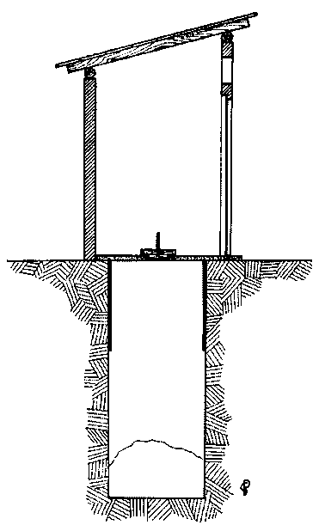
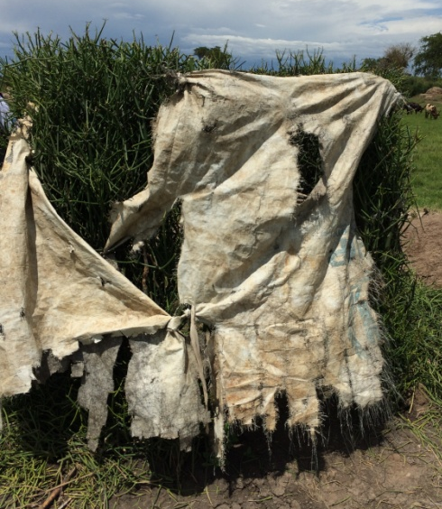
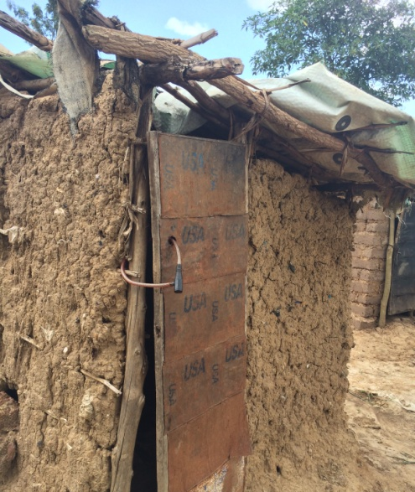
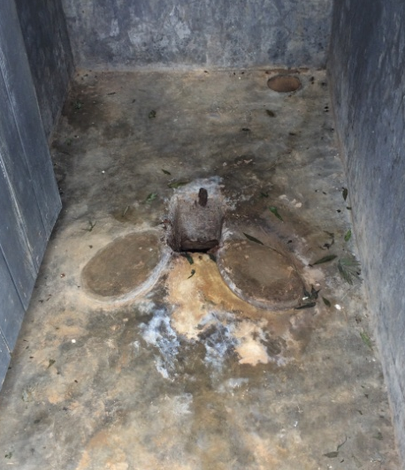
Pit latrines
1
Structure
  Unlined or partially lined pit; base left unlined
  Reinforced concrete or plastic slab with opening into drop hole
  Improvised superstructure (live fence, sticks & mud, corrugated iron, plastic sheeting)
  Optional roof
  For VIP latrine: fully walled with ventilation pipe & mesh
Maintenance
  Daily cleaning with soap and water
  Monthly inspection
  Repairs as needed
Expected lifetime: 1-3 yrs
Existing service model
  Communal latrines always fully constructed by IPs
  HH Option 1: Slabs and supporting poles are provided to HHs, who have to dig and construct their own (Uganda)
  HH Option 2: Excavation done by refugees, but structures are constructed by implementing partners (Ethiopia)
  HH Option 3: If rocky, IPs use mechanized excavator and also do full construction
  In both options: when latrine is full, pit is backfilled and sealed and slab/superstructure is recycled
  UNHCR aims for >80% HH coverage
Note: Focuses on use of technology specifically in refugee camp setting

Slide 77
Pit latrines
1
Common, used at HH and communal level
Financial Assessment
Social Good¹
Ease of Implementation
Costs per stance
Construction
  Quick to construct; refugees can construct themselves
  Wide range of usable materials
  Can only dig as deep as water table, may be ~1m in cases
Behavior change
  Accepts dry and some wet cleansing materials
  People abuse by throwing trash in
  Excess water (e.g., from shower) may collapse pit
  May smell or attract flies; need to teach people to use
Longevity
  Short lifetime (can be <1 year)
Increased usage & uptake
Improved health outcomes
Employment
Environmental sustainability
Camp self-sufficiency
Improved host relationship
$
Higher cost from paid construction
High end
Low end
One-time implementation costs
10 year cost of sanitation
Technical limitations
  Requires soft, diggable soil and ideally water table at least ~5m below ground
  New land required for each new latrine after one fills up
  Strict location: latrine must be >30m from water sources
1. See detail slide for specific effects

Slide 78
Pit latrines: Deep dive on social good
1
Increased usage & uptake | Prevention of SGBV if proper facilities are given to HH Can be easily provided at the household level
Improved health outcomes | Containment of excreta compared to open defecation Reduced vector transmission (especially for VIP)
Employment | Limited
Environmental sustainability | Minimal
Camp self-sufficiency | Minimal
Improved host relation | None

Slide 79
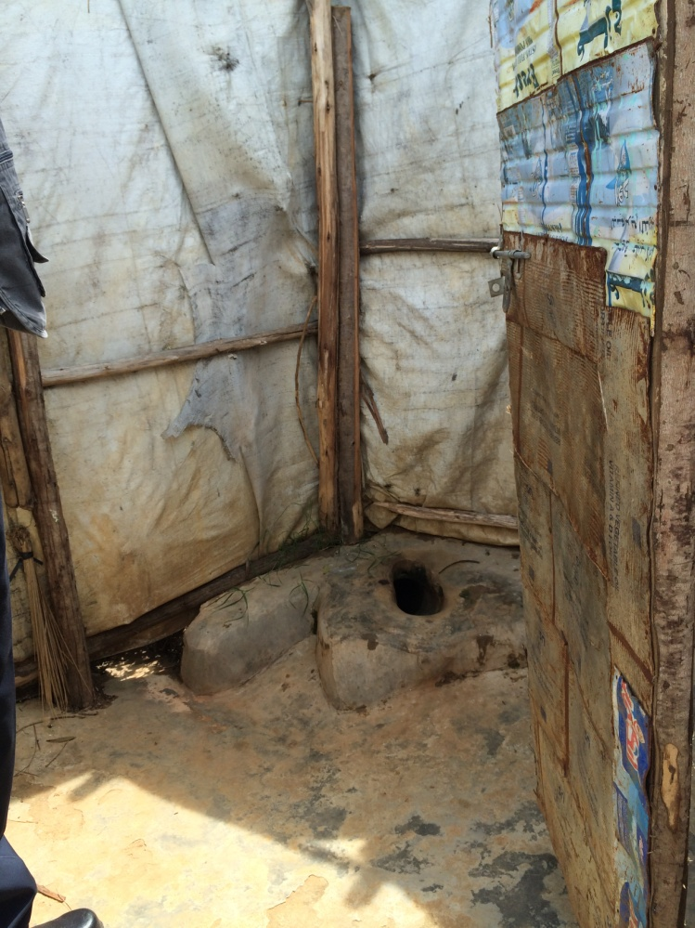
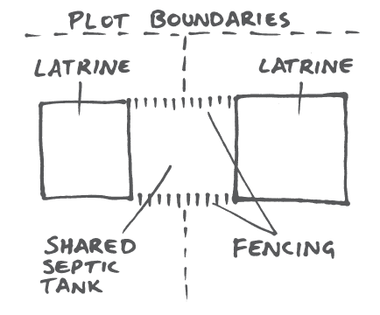
Pour-flush to pit
2
Structure
  Latrine has pour-flush interface (usually with water seal) that connects to unlined pit
  Multiple latrines may connect to same pit (e.g., Somali HH population) or may have one latrine with twin vaults (e.g., Dollo Ado communal and HH pour flush latrines)
Maintenance
  Requires 0.5-3L of water per use to flush materials
  If twin vault style, functional pipe must switch every 2 years, and processed pit must be emptied after drying
Expected lifetime: ~5 years with supersize communal pits (10m³ +; 10+ years if twin vaults are alternated & emptied
Existing service model
  Option 1: HHs cooperate and dig a larger, centralized pit; IP provides slab and minimum materials
  Option 2: HHs dig individual pits, IP constructs
  Option 3: IP excavates and fully constructs latrine
Note: Focuses on use of technology specifically in refugee camp setting

Slide 80
Pour-flush to pit
2
Common, used at HH and communal level; prevalent in Somali population
Financial Assessment
Social Good¹
Ease of Implementation
Costs per stance
Construction
  Pit should be large (up to 7-10m deep if shared between many HH)
  Individual latrines connect via pipe
Behavior change
  Generally well-received because of limited smell with "u-bend" pipe
  Have to train HH to use appropriately & supply water
  Accepts both wash & wipe refugee
  Trash cannot be thrown in
Longevity
  If pit is large enough with sufficient leaching, can last ~5 years
  "Empty-able" pits can be re-used
  No trash increases lifespan of pits (up to 25% of basic latrine= trash)
Increased usage & uptake
Improved health outcomes
Employment
Environmental sustainability
Camp self-sufficiency
Improved host relationship
$
High end
Low end
One-time implementation costs
10 year cost of sanitation²
Technical limitations
  Requires soft, diggable soil and ideally water table at least ~5m below ground
  New land required for each new latrine after one fills up (if not empty-able)
  Strict location: latrine must be >30m from water sources
1. See detail slide for specific effects 2. Assumes pit is sealed when full, but some pits (such as offset pits in Dollo Ado) can be emptied as if compost. Assumes 5 year lifetime

Slide 81
Pour-flush to pit: Deep dive on social good
2
Increased usage & uptake | Prevention of SGBV if proper facilities are given Can be easily provided at the household level No smell, no flies Supports washer and wipers w/o behavior change
Improved health outcomes | Containment of excreta Reduced vector transmission
Employment | Minimal
Environmental sustainability | Minimal
Camp self-sufficiency | Medium
Improved host relation | Minimal

Slide 82
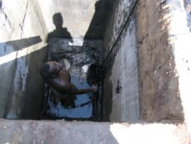
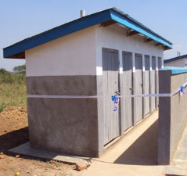
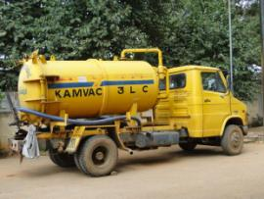
Drop-hole to cesspit (drainable)
3
Structure
  Pit fully lined w/ concrete, likely at least 3m deep
  More sturdy and permanent superstructure, usually with roof (walls made of concrete / brick)
  Multiple stances for communal settings
  Pit needs to be accessible from outside
Maintenance
  Daily cleaning with soap and water
  Monthly inspection, repairs as needed
  Regular emptying (3-6 months on average)
Existing service models:
  Almost always in communal / institutional setting
  Latrine is constructed by contractor and casual laborers who are paid either incentives or full wages
  Cleaning done by students or institutional staff
  When full, latrine is emptied:
    Manually, by de-sludgers with buckets
    Vacuumed by commercial extractor trucks
  Sludge is disposed either
    Adjacent to latrine, above-ground In municipal waste treatment facilities or at a WTV solution (not yet seen in field)
Expected lifetime: 3-10 yrs
Note: Focuses on use of technology specifically in refugee camp setting

Slide 83
Drop-hole to cesspit (drainable)
Common in institutions (schools, health clinics, reception centers); also at HHs in Shire due to lack of space
3
Financial Assessment
Social Good¹
Ease of Implementation
Costs per stance
Operation & maintenance
  Requires labor and $ to empty, often not a desirable job (but still high cost)
  Manual emptying can be hazardous to health; PPE can help protect workers
  Reusable; frequency of emptying depends on usage, volume and removed volume
Processing
  Waste may be dumped next to latrine – but is not sanitary
  If done at WWTP, requires transport and dumping fees
  Waste sometimes illegally dumped in fields / rivers
Increased usage & uptake
Improved health outcomes
Employment
Environmental sustainability
Camp self-sufficiency
Improved host relationship
$
High end
Low end
*
One-time implementation costs
10 year cost of sanitation²
Technical limitations
  Same as basic pit latrines, plus:
  Latrine needs to be mechanically or manually accessible
* depends on disposal location. 1. See detail slide for specific effects 2. Assumes emptying 3x per year, for 26m³ per 4-stance latrine, at 20,000 UGX ($7.30) per cubic meter

Slide 84
Drop-hole to cesspit (drainable): Deep dive on social good
3
Increased usage & uptake | Reduced smell if using VIP structure Prevention of SGBV if facilities are given close to institutions (most common placement) Works well at institutional centers to prevent OD
Improved health outcomes | Containment of excreta Reduction of vector transmission
Employment | May create jobs for emptying, transport and treatment of waste
Environmental sustainability | Reduced land usage as latrine does not need moved every 2-3 years when full
Camp self-sufficiency | Relies on local FSTP, WWTP or other for waste to be processed properly
Improved host relation | May create jobs for local community around collection, transport and treatment of waste

Slide 85
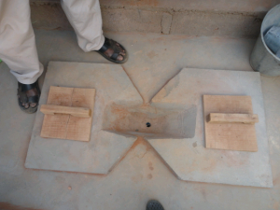
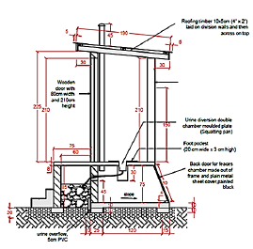
UDDTs (compostable)
4
Structure
  Can be above-ground; saves challenge of digging in rock / difficult and high water levels
  Toilet seat diverts urine away from solids - urine goes to outward chamber, solids to pit below; needs separate washing drain
  Can be single or double vault
Maintenance
  Daily cleaning required
  Ash or woodchips must be added to pit each time to raise pH
  Fully dried solids can be easily removed
  No water needed for flush
When latrine is full...
  Warm, dry, alkaline conditions stabilize fecal sludge & minimize volume
  Treated waste is safe to handle and used as fertilizer
Expected lifetime: 10+ yrs
Note: Focuses on use of technology specifically in refugee camp setting

Slide 86
UDDTs (compostable)
4
Pilot in Dollo Ado, Ethiopia (OXFAM)
Financial Assessment
Social Good¹
Ease of Implementation
Costs per stance
Construction
  Simple to build
  Can be built above-ground
  Must use right pipe sizes
Behavior change
  Requires training
  Benefits require strict adherence to protocol – may require CDC testing of solids
  Cannot accept grey water
  Ash, etc. must be used
  Might be hard to get people to use dry cakes as fertilizer
Longevity
  Long lifetime (~30 yrs)
Increased usage & uptake
Improved health outcomes
Employment
Environmental sustainability
Camp self-sufficiency
Improved host relationship
$
High end
Low end
One-time implementation costs
10 year cost of sanitation²
Technical limitations
  Good for water-constrained environments
  Good for rocky soil where it is hard to dig
  Dry, hot climate is preferred
1. See detail slide for specific effects. Note: Cost assumes ash is a free resource for users

Slide 87
Deep dive on social good
4
Increased usage & uptake | No smell, no flies (only if used properly) Prevention of SGBV if proper facilities are given at HH
Improved health outcomes | Containment of excreta Prevention of vector transmission
Employment | Minimal after initial construction
Environmental sustainability | Reduced land usage Low likelihood of contamination as solids are treated on site
Camp self-sufficiency | High; ones latrine is built is should be maintained by the family and not need additional investment
Improved host relation | Limited

Slide 88
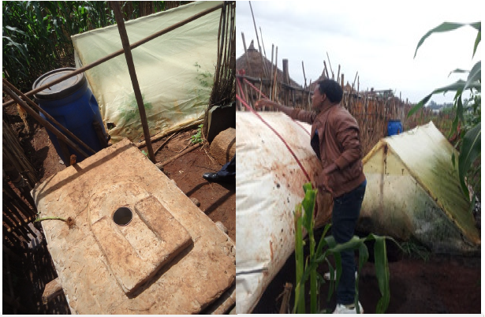
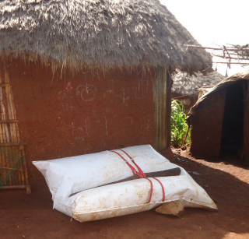
Bio-digester: biogas production at household level
5
2 separate pieces: digester & backpack
  Soft-shell digester (2x6m) is placed inside a greenhouse above-ground, with connections to latrine and substrate belly
  Biogas backpack is flexible, gas tight balloon equipped with body straps and ball valve
  Balloon can be directly connected to digester and filled
  Balloon then transported and connected to stove, and weighted down to pressurize
System is flexible & transportable
  Both pieces can be moved, and production can happen anywhere
  Digester can absorb wastewater, animal manure, organic waste, bio-matter (optimized with mix)
Byproduct
  Produces cooking fuel
  If used optimally, system produces ~2-3 Backpacks per day (w/ 3 HH)
  Takes 3-4 hrs to fill each backpack
  Each HH uses ~1 pack per day
Expected lifetime: 10+ yrs
Digester (in greenhouse) is hooked up near latrine
Backpack connected to digester and filled with gas
Backpack is laid down, connected to stove through mud wall

Slide 89
Bio-digester: biogas production at household level
5
Pilot in Bambasi, Ethiopia (NRC)¹
Financial Assessment
Social Good²
Ease of Implementation
Costs per stance
Construction
  Minimal digging; mostly above-ground
  Location is flexible for both digester and fuel use
  Can be paired with many types of toilet interfaces (wet or dry)
Behavior change
  Requires minimal training to operate bio-digester
  Can accommodate animal waste
  Max energy retrieved from fresh waste; requires daily operation
Longevity
  Long lifetime (estimated10 yrs)
  Repair materials available on market
Increased usage & uptake
Improved health outcomes
Employment
Environmental sustainability
Camp self-sufficiency
Improved host relationship
$
High end
Low end
One-time implementation costs
10 year cost of sanitation²
Technical limitations
  Requires minimum liquid proportion; may necessitate significant additional water
  Requires access to additional substrate (animal waste, organic waste, bio-matter)
  For cooking, compatible fuel-based cooking stoves are required
1. Also, household biogas plants in Millennium Villages, Uganda. 2. See detail slide for specific effects

Slide 90
Bio-digester: Deep dive on social good
5
Increased usage & uptake | Depends on type of toilet; pour flush likely to be best Can also absorb animal feces (e.g., cattle waste) Understanding of full value chain incentivizes usage
Improved health outcomes | Reduced water contamination & vector transmission
Employment | Creation of respectable jobs producing/selling fuel Frees time from collecting firewood to income-generating activities; reduced SGBV also Reduced dependency on camp operators Potential micro-business around digester management / biogas sales and operations / maintenance Lamps may extend period of productivity into evening
Environmental sustainability | Reduced land usage (through reduced deforestation and fewer new latrines) Reduced fuel usage (onsite; minimal transport required)
Camp self-sufficiency | Resilience to supply chain interruptions of fuel Improved self-sustainability for homes
Improved host relation | Reduced tension around firewood usage Increase in business transactions

Slide 91
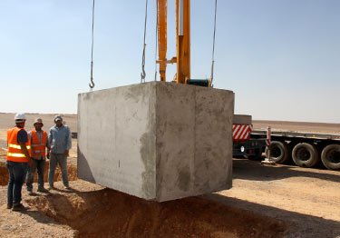
Pour-flush to cesspit (drainable)
6
Structure
  Pour-flush toilet drains to communal cesspit (~5-15 stances / tank)
  Cesspit is fully sealed, with access for emptying.
  Can be made from:
    Concrete-lined pit (could be up to 7-10m deep)
    Pre-cast concrete tank
    Pre-molded plastic tank
Maintenance
  Daily cleaning of toilets
  Need water to flush
  Tanks emptied every ~25 days by desludging trucks
  Waste taken to water treatment facility
Requires nearby WWTP or other treatment sites
Requires more up-front investment and planning than camps usually can provide
No known examples in East Africa – only Azraq
Expected lifetime: 10+ yrs
Note: Focuses on use of technology specifically in refugee camp setting

Slide 92
Pour-flush to cesspit (drainable)
6
Azraq, Jordan
Social Good¹
Ease of Implementation
Increased usage & uptake
Improved health outcomes
Employment
Environmental sustainability
Camp self-sufficiency
Improved host relationship
Construction
  Material of tank (plastic or concrete) will drive costs higher than other options
  Toilet interface needs water supply to flush
  Piping required for water supply / connection to cesspit
Behavior change
  Must use flush system
Operation & maintenance
  Requires further treatment / access to WWTP
  Frequent emptying required
Technical limitations
  Requires water to flush; toilets must be near cesspits
  Cesspit needs to be deliverable and installed in the ground
  Requires frequent access to empty cesspits
1. See detail slide for specific effects

Slide 93
Deep dive on social good
6
Increased usage & uptake | Reduced smell through water seal Prevention of SGBV if proper facilities are given at HH
Improved health outcomes | Containment of excreta Prevention of vector transmission
Employment | Creates jobs around cesspit emptying and further downstream treatment
Environmental sustainability | Reduced land usage at household Change of waste being illegally dumped in environment
Camp self-sufficiency | Relies on additional treatment from host Unclear who pays for emptying in the long-term
Improved host relation | Minimal

Slide 94
Technology Prioritization Deep-Dive

Slide 95
Backup: Detail of all 27 short-listed technologies (I/III)
Category of Waste Processing | Toilet System | Provider and Original Country/Region | Description of technology (& current service model, if applicable) | Cost (if available)
Anaerobic Digestion | Loowatt Toilet System | Loowatt Ltd, UK | Excreta covered with biodegradable film and used for producing biogas; in pilot stage; Biodegradable bag sealing technology paired with anaerobic digestion, thermophili aerobic composting and vermicomposting | $1,500 to $2,000 for toilet, digester & composting site
Anaerobic Digestion | Mohan Rail Components Bio Toilet System | Mohan Rail Components Pvt. Ltd, India | Flush toilets connected to bio-digester | $550 for digester; $1,300 with front end
Anaerobic Digestion | DRDO Biotoilet | DRDO | Anaerobic biotank with microbes and secondary treatment bed; produces biogas and 80% water reuse. | $700 for HH
Anaerobic Digestion | Biogas backpack | (B)energy | Plastic bag digester, paired with tarp bakcpack for gas holder. All above ground and connected to latrine. For HH or HH cluster use. | $500-600 USD
Anaerobic Digestion | Flexi Biogas Digester |  | Plastic bag digester | $500-775 for digester w/o latrine
Anaerobic Digestion | Plastic bag digester | Ecofys | Plastic bag digester
Anaerobic Digestion | Simgas digester |  | Hard plastic tank digester - mostly underground; modified fixed dome
Anaerobic Digestion | Safi Sana Service Blocks | Safi Sana | Pour flush toilets, collected and used to produce biogas; converted to electricity and sold back to grid; transport by local entrepreneurs
Anaerobic Digestion | Iko Toilet | Ecotact, Nairobi | Low-flush UDT on public land, built by Ecotact and operated by them for 5 years, then transferred to gov.
Carbonization | Toilet to Charcoal Briquettes | Sanivation | UDDT collection service, carbonized with solar energy and compressed with charcoal dust into briquettes | $50 for toilet interface
Combustion | Omni-Processor | Janicki Industries | 300 kW heat and power plant that uses fecal sludge and solid waste to produce energy and generate electricity | $500k-750k per unit; estimated $0.015-0.03 per user per day

Slide 96
Backup: Detail of all 27 short-listed technologies (II/III)
Category of Waste Processing | Toilet System | Provider and Original Country/Region | Description of technology (& current service model, if applicable) | Cost (if available)
Composting | Otji Toilet | Clay House Project | Waterless toilet with a natural dehydration; includes UDDT interface, superstructure, underground bins & concrete tank | $973 ($650 w/o installation)
Composting | Sulabh International Pit Toilet System | Sulabh International Social Service Organization, India | Standard pour-flush latrine with alternating vaults; biogas model also avaiable | $35 – 600 (based on volume & materials)
Composting | Tiger Toilet System | London School of Hygiene and Tropical Medicine, UK | Urine-diversion flush with two-stage composting (by tiger worms and aerobic bacteria respectively); 6 month trial beginning in 2014 in India, Uganda and Myanmar (rural, peri-urban, displaced persons camp) with 10 HHs in each country | $200
Composting | Biofil Toilet System | Biological Filters and Composters Ltd., Ghana | Low flush toilet with bio-digestion and filtration. Uses bacteria & worms to degrade fecal matter, filters liquids to bottom of digester, other biodegradable solids are decomposed; can be above or belowground depending on water table; works in all soil/rock conditions | $600-1,000
Composting | Aerosan | Andrew Larsen | Enhanced passive ventilation and passive heating for dewatering; high degree of drying achieved; subsequent high-temperature compost | $250
Composting | Aerobic Biologic Toilet | Stone India | Multichambered aerobic digestion tank to turn wastewater into nonpathogenic neutral water | $650 – 1,950
Composting | Peepoo bags | Peepoople |  | $0.05 / user / day
Composting | Locally constructed UDDT |  | Encompasses many types of UDDTs - anything made locally or assembled with mostly local materials
Composting | Fresh Life Toilet | Sanergy | UDDT collection service to compost | $500/toilet; $100/ yr for service
Composting | Fossa alterna | No brand | Generic term for double vault alternating latrine (drop pit or pour flush)
Composting | EMOs | No specific brand | SMH/Water Traid is one example | ~$30/kg of bacteria
Composting | X-runner Venture | X-runner Venture, Peru | UDDT toilets rented to HHs, who sign up for collection service. Biodegradable liner/bag used to transport.

Slide 97
Backup: Detail of all 27 short-listed technologies (III/III)
Category of Waste Processing | Toilet System | Provider and Original Country/Region | Description of technology (& current service model, if applicable) | Cost (if available)
No treatment | Emergency WASH Kits | UNHCR | Prefab latrine superstructure, pit must still be dug | 650 / latrine (or, 2100 if full costs included)
No treatment | Evenlatrines & Latrine components | Evenproducts | Prefab raised latrines or components thereof
No treatment | Pit latrine (all variations) | Everywhere | Standard pit latrine - lined or partially lined, various types of superstructure, various types of slabs
No treatment | SaTo Latrine Pan | American Standard | Latrine slab insert to add on pour-flush capability | $1.50 per insert

Slide 98
Backup: Technologies eliminated due to high upfront investment or lifetime operational costs
A
Toilet System | Provider / Country | Description | Reason for elimination
Aquatron Hybrid Toilet System | Aquatron International AB | Liquid and solids separator | $1,018 USD for separator – waste still needs further treatment
Biolan Naturum | Biolan Oy, Finland | Urine-diverting dry composting toilet with a manual rotating drum; bulking material added for better use | $3,160 USD for one toilet
Clivus Multrum | Clivus Multrum, Inc. | Dry or low flush toilet; additional electricity for composting | $3,000 USD for 2 full-time users
Compus Toilet | NatSol, UK | Urine-diverting dry composting toilet; bulking material added for better use | $1,200 USD for 8 full time users, biodegradable liners req'd
Ecodomeo Dry Toilet | Ecodomeo, France | Composting toilet with manual mechanical device to separate solids and liquids; earthworms for better composting; additional electricity for ventilation | $2,200 USD to $2,600 USD for a toilet
ECOJOHN Waterless Composting Toilet | Global Inventive Industries, INC, USA. | Dry composting toilet with excreta heated; high additional energy needed | $1,095 USD for a toilet, requires heating and biodegradable bag
Envirolet Composting Toilet | Sancor Industries Ltd, Canada | Dry composting toilet; aerobic microbes and peat moss added periodically for better composting; optional electricity for better composting | $2,300 USD for a toilet, requires strict user compliance
IntaquaTec Toilet | Intaqua AG, Germany | Urine-diverting toilet with recycled flush water; additional electricity for recycling | $39,000 USD to $109,000 USD for up to 4 toilets and 4 urinals
Separett Villa | Separett AB, Sweden | Urine-diverting dry toilet with an exchangeable container; soil added for better composting, additional electricity for composting | $1,140 USD – waste requires further composting
ECOJOHN Waterless Incinerating Toilet | Global Inventive Industries, INC., USA | Dry toilet with all excreta incinerated; high energy needed | $3,995 USD for one toilet
Landwasher Water-Free Toilet | Beijing Landwasher Science & Technology Development Co., Ltd, China. | Flush toilet with intelligent control system; urine treated and recycled as flushing lotion; special chemicals added for urine treating; additional electricity for mixing | $3,000 USD, requires proprietary liquid consumable
Cesspits/Septic Tanks | Zaatari, Azraq | Fully lined pits paired with pour flush that are emptied once per month and taken to WWTP; requires flush | Requires additional WWTP/ processor + cement lining of tank

Slide 99
Backup: Technologies eliminated due to technology viability
B
Toilet System | Provider /Orig. Country | Description | Reason for elimination (if applicable)
NUS Urine-Diverting Combustion Toilet | National University of Singapore, Singapore | Urine-diversion flush toilet; excreta combusted/dried with vapor collected, condensed and purified; in concept stage | Technology is too early (still in prototype phase); extremely large footprint with hand-operated vacuum pump
UDDT-Based Semi-Centralized Composting System | University of Science and Technology Beijing | Large-scale dry composting toilet system using solar energy and recovering the energy from waste; in concept stage | Technology is too early (still in concept phase); still requires digging 2m into ground
Product Recovery from Source Separated Human Urine and Feces | University of Science and Technology Beijing | Urine diversion flush toilet; the waste used for producing biogas; in concept stage | Technology is too early (still in concept phase)
Diversion for safe sanitation (Blue diversion toilet) | EAWAG/EOOS, Switzerland | Urine-diverting toilet with recycled flush water; additional electricity for recycling; downstream process under research | Technology is too early; can only process 1.5 L of liquid per hour
RTI Toilet | Research Triangle Institute (RTI) | Mechanical separation of solids & liquids; disinfect liquid waste; dry and burn solid waste through solar energy, natural air drafts & heat to create stored energy | Technology is too early (pilot still 2-3 years out), any solid waste other than paper would cause it to seize up
Loughborough Toilet | Loughborough University | Low-flush system; hydrothermal carbonization (high temp, high pressure); also accepts solid waste; generates water, electricity & fertilizer | Technology is too early; concerns about breakdown in various settings
Biochar Reactor | Climate Foundation | Dries and carbonizes waste into biochar to use as fuel or fertilizer | Still in trial phase
Nano Membrane Toilet | Cranfield University | Separation through sedimentation; separated solids collected in bag; water recovery through vaporization; energy needed through hand or bicycle crank | Still in testing and design phase; uses biodegradable membrane consumables; up to 10 users; needs electricity; sticks or stones could cause breakdown
Caltech System | California Institute of Technology | Flush toilet to electrochemical reactor; breaks down water and human waste into fertilizer and hydrogen, which could be paired with hydrogen fuel cells with water re-used for flushing (160L required to initiate system); uses solar energy but backup power recommended | Technology is still early; requires external backup electricity for solar panel; addt'l industrial salt is needed; 160L of water needed to initiate system
Bulk Consolidation Containers (BCCs) | Sanergy / GOAL | Lightweight, modular tansfer stations for single-use bags; still in concept phase | Still in concept phase

Slide 100
Backup: Technologies eliminated due to large size or transportation challenge
C
Toilet System | Provider /Orig. Country | Description | Reason for elimination (if applicable)
EnviroLoo Toilet | EnviroLoo | Waterless toilet with a natural dehydration design | Too large or difficult to transport/construct locally
Kazubaloo | WooWoo, UK | Waterless toilet with a natural dehydration design | Too large or difficult to transport/construct locally
Alfa Next Gen Bio Toilet System | Alfa Next Gen Tech India Pvt. Ltd, India | Flush toilets connected to bio-digester | Prefab structure makes it too large and difficult to transport; more simple and locally made digesters exist
Banka Bio Digester Toilet System | Banka Bioloo Pvt Ltd, India | Flush toilets connected to five-stage bio-digester | 5 tank digester is too large
Boitech India Eco Friendly Toilet System | Biotech India, India | Flush toilets connected to bio-digester with pre-charged media | Too large or difficult to transport/construct locally
CBS Technologies Pvt. Ltd. | CBS Technologies Pvt. Ltd, India | Flush toilets connected to bio-digester with some media; night soil degradation occurs; optional electricity for better use | Too large or difficult to transport/construct locally
ENBIOLET Conserve Toilet System | Stone Biotech Pvt. Limited, India | Flush toilets connected to a five-stage bio-digester via a flapper valve | Too large or difficult to transport/construct locally
Eram Scientific E-Toilet System | Eram Scientific Solutions Pvt. Ltd, India | Flush toilets connected to bio-digester | Large and permanent digester design, on-site incinerator not cost effective
Flotech Engineering Bio Toilet System | Flotech Engineering & Trading Services, India | Flush toilets connected to bio-digester with some media | Large and permanent digester design; other designs available for less and easier to maintain
Go Green Solution Bio Toilet System | Go Green Solution Pvt. Ltd, India | Flush toilets connected to bio-digester with some media | Large and permanent digester design; other designs available for less and easier to maintain
Rail Tech Bio Toilet System | Rail Tech, India | Flush toilets connected to bio-digester with some media | Large and permanent digester design; other designs available for less and easier to maintain
Total Resource recovery Toilet System By SCOPE | Society for Community Organization and Peoples Education (SCOPE), India | Flush toilets connected to bio-digester | Large and permanent digester design; other designs available for less and easier to maintain
Wockhardt Foundation Bio Toilet System | Wockhardt Foundation, India | Flush toilets connected to bio-digester with some media | Large and permanent digester design; other designs available for less and easier to maintain

Slide 101
Backup: Technologies eliminated due to inability to flex
D
Toilet System | Provider /Orig. Country | Description | Reason for elimination (if applicable)
Dry Flush Toilet | Dry Flush LLC, USA | Plastic cartridge with a twisting mechanism to wrap human excreta; additional electricity for "flush" | Dependent on proprietary cartridges; filled cartridges must still be disposed or incinerated and are not biodegradable; requires 12V electricity
Nature's Head Toilet | Nature's Head Inc, USA | Urine-diverting dry toilet with manual rotating mechanism; solid waste composted | Inability to flex - low volume storage and requires user agitation each time; Cost - $900 USD for just interface & storage
Dubbletten Urine Diversion Toilet | BB Innovation & CO AB, Sweden | Using different volume of water for urine and feces; solid waste composted | Inability to flex - requires 4L to flush solids; Cost - $900 USD for just interface & storage
Biolet 10 Waterless Toilet | BioLet Toilet Systems, Inc | Dry composting toilet; BioLet Starter Mix added for composting | Inability to flex - requires continuous electricity; only intended for 4 users; cost is $1,800 USD
Bio-Lux Toilet | Seiwa Denko Co., Ltd, Japan | Dry composting toilet; additional electricity for composting | Inability to flex - requires electricity; needs further treatment at WWTP
EcoFlush Urine Separating Toilet | Wostman Ecology AB, Sweden | Urine diversion low flush toilet; solid waste composted | Requires cesspit and flush system, and municipal waste services

Slide 102
Backup: Technologies eliminated due to low value for money
E
Toilet System | Provider /Orig. Country | Description | Reason for elimination (if applicable)
SRG Bio Toilet System | SRG International Pvt. Limited, India | Flush toilets connected to bio-digester with some media in digester tank | Not cost effective - prefab structure intended for permanent use
EcoLoo Composting System | EcoLoo AB, Sweden | Dry composting toilet; special bacteria needed for composting | $1,500 to $2,000 USD for one toilet; too similar to much more basic/cheap technologies
EcoSan Waterless Toilet System | G-Trade International C.C., South Africa | A waterless toilet system with excreta conveyed into a bag outside and stored; optional electrical fan for ventilation | $780 USD for one toilet, with no significant advantage over UDDT; too similar to much more basic/cheap technologies
SaniToa Toilet | Separett AB, Sweden | Dry composting toilet; bulking material added for better use | $105 USD for bowl, bucket & biodegradable bag; same technology available for <50 USD (i.e., Sanivation's ChooPoa)
Sun-Mar Composting Toilet System | Sun-Mar Corp, USA | Dry composting toilet; optional electricity for better composting | $1,600 USD; same thing can be accomplished with double vault UDDT
MoSan Toilet | Mona Mijthab, Bangladesh | Urine-diverting dry toilet; the waste used for producing biogas | Rejected in Sanivation pilot in favor of ChooPoa; basically, prefab seat that could be made locally for less
IIT Kanpur Zero Discharge Toilet System | Department of Civil Engineering Indian Institute of Technology, India | Flush toilet with solid/liquid separator; liquid waste for filtration; solid waste for composting | $850 USD; not enough incremental improvement over UDDT
Symphony Dry Toilet | Symphony Environmental Ltd, UK ' | Dry composting toilet with biodegradable bin liner; special "dry litters" added for composting | .05 USD/use; biodegradable bin liner and wood pellets required, too similar to much more basic technologies

Slide 103
Recommended Solutions – Deep Dive Assessment

Slide 104
11 system configurations mapped to camp life-cycle phases
Following slides have detail on costs, technologies and select brand examples
Emergency
Maintenance & care
Development
T₀
Growth
Steady State
Ramp Down or
Permanent Settlement
1
Stop-gap solutions
1a
Single-use bags & collection
1b
WASH kits
2
New sustainable end-to-end systems
2a
2b
2c
2d
2f
Biogas system (household or institutional)
UDDT & compost
UDDT & briquettes
Compost latrines
(e.g., double vault)
Collect & Combust (Janicki OP)
3
Incremental improvements for legacy systems
Basic pit latrine
Waste-to-value solutions
3a
3b
3c
Retrofitted slabs
(Pour-flush or UDDT)
Effective micro-organisms (EMOs)
Improved pit lining
Variations on pit latrines
Source: BCG analysis

Slide 105
Single-use bags & collection
1a
Financial Assessment
Social Good & Non-Financial Benefits
Costs per household¹
Improved usage & user experience |  | Substantial behavior change & training req'd, both for those used to open defecation & latrine usage Good supplement to latrines for nighttime use or elderly because it can be used in-house
Improved health outcomes |  | If used correctly, contains pathogens However, high likelihood of misuse by discarding afterwards which may lead to human exposure
Employment |  | Employment could be created around distribution and collection of bags
Environmental sustainability |  | Bag & waste are 100% biodegradable
Camp self-sufficiency |  | System depends completely on importation of bags from manufacturers
Improved host relationship |  | No impact on host community Bags can not be created locally
$
728
High end
Low end
30
30
One-time implementation costs
10 year cost of sanitation
Technical limitations
  Bags with urea or other chemicals may be delayed at customs
1. Examples PeePooBag: $0.03 per bag, 1 bag per day for 5 people using the bags. Low end not considering any cost for collection

Slide 106




Select examples: Bag-based systems
1a
Stand-alone urea bags
Single-use, self-sanitizing, fully biodegradable
Good night-time solution
Urea lining inactivates pathogens within 4 weeks
Funnel-shape and lining makes it hygienic to use
Can be paired with stand or curtain to increase ease of use
Each bag is $0.03 (1/person/day)²
Chemicals could cause delay at customs – would want to pre-stock to ensure supply
Toilet with sealing bags
Toilet lined with biodegradable bags to seal feces
Sealing mechanism is the size of a shoebox, can be fitted into any type of toilet
Bags can then be fed to any type of digester
Biogas converted to electricity through generator, used for mobile phones and hot water
Bags are not cost-effective in the long-term – could bags and digester be considered separately?
Bulk Consolidation Containers
Goal: Easily deployable and user-friendly bags central collection stations that can safely contain & transport waste
Purpose is to reduce fill-up rate of household containers
Stations envisioned as lightweight, modular, boxes where bags or containers could be deposited
18 month project in Africa
Exploring bio/chemical additives, bacteria, archaea and enzymes
For emergency,
short-term use only
In development
1. http://www.humanitarianinnovation.org/blog/GOAL/introducing-faecal-sludge-management-system 2. http://www.peepoople.com/information/faq/
Note: Evenproducts also makes personal emergency toilet kits

Slide 107
Prefabricated latrines ("Rapid latrines")
1b
Financial Assessment
Social Good & Non-Financial Benefits
Costs per household¹
Improved usage & user experience |  | Latrines can be deployed very quickly, sensitizing refugees at arrival, when messages most effective
Improved health outcomes |  | Containment is the same as regular pit latrines – depends on soil leaching properties and water sources
Employment |  | Casual labor needed to dig pits and install prefab latrines (would never be done at HH level)
Environmental sustainability |  | Large amount of plastic / corrugated iron imported and transported far distances (increasing costs) Still need to re-dig pits when latrine is full
Camp self-sufficiency |  | System depends completely on kit importation; subject to delays at customs No off-site treatment needed
Improved host relationship |  | Host community may feel slighted if prefabricated latrine structures are viewed as nicer than locally available latrines
$
N/A
One-time implementation costs
10 year cost of sanitation
Technical limitations
  Ground conditions still need to allow pit digging to reasonable depth w/o collapsing
1. WASH kits latrines cost 65K that include 100 latrines that should be used by 5000 people, each latrine used by 50 people

Slide 108



Select examples: Prefabricated latrines ("Rapid latrines")
1b
All are for emergency, short-term use only
Container-sized WASH kits
Each container designed to serve 5,000 people (in reality, often covers 4-5x as much)
Each kit contains: water treatment unit, 100 latrines, buckets, soap, etc.
Each kit costs ~$210k, $65k of which is latrine-related ($650 per latrine, not including pit digging)
Kits stored across world to be deployed in emergencies
Has faced delays of several months due to chemicals in kit
Latrine Components & Sets
Individual components:
  Evenlatrine (superstructure)
  Evenliner (corr .PVC pit liner)
    Increases wall support
    Can allow deeper pits or prevent collapse
  Squatting plates (also works with Monarflex & Nag Magic)
Evenwaste Raised Latrine –
  Complete kit, designed for draining by pumping
Emergency Sanitation Kit
RFP for design of complete WASH kits, no local materials needed, released Nov 2013
Includes trench latrines, superstructure & raised latrines
Lifetime of 12 months
Target cost of $150 without superstructure, or $240 with
Project is collaboration b/t Oxfam GB, WASTE & IFRC
In development
1. http://www.humanitarianinnovation.org/blog/GOAL/introducing-faecal-sludge-management-system

Slide 109
Biogas system (household or institutional)
2a
Financial Assessment
Social Good & Non-Financial Benefits
Costs per stance¹
Improved usage & user experience |  | HH motivated to use latrine to get output HH can understand system if above-ground
Improved health outcomes |  | Improved containment of human/animal waste Less smoky cooking (vs wood), better for health
Employment |  | Entrepreneurship to produce / distribute gas Construction / installation creates jobs Time from firewood collection freed for other productive tasks (primarily women, children)
Environmental sustainability |  | Biogas offsets wood or fossil fuels needed Slurry produced is excellent fertilizer (better than manure) Less greenhouse gases released because methane is burned cleanly
Camp self-sufficiency |  | Treats waste and produces energy with no additional input from outside the camp Processing done on-site @ HH level
Improved host relationship |  | Reduces local deforestation and illegal exit of camp by reduced need for firewood Biogas could be used in shared schools, etc.
$K
4.00
3.8
3.75
3.50
3.25
3.00
2.75
2.50
2.25
3.1
High end
2.00
1.8
1.75
1.50
1.25
1.4
1.00
0.75
0.50
0.7
Low end
0.25
0.4
0.00
One-time implementation costs
10 year cost of sanitation
Technical limitations
Slurry still needs to be tested for safety
  Requires minimum space of of 1.5m x 6m for digester
  Depending on substrate added, might require additional water input
1. Low end is HH-level low and high end is institution high-end

Slide 110
Digesters come in two main types, with plug-flow tubular more appropriate for refugee camp settings
2a
Fixed-Dome or Floating Drum
(Concrete or Brick)
Plug-Flow Tubular
(Plastic bag or tank)
Permanent installation in ground
  Land ownership must be secure
  Temperature is stable & warmer if in cool climate (but cooler if in warm climate)
Substrate added in batches in one chamber
  Retention time varies– not all pathogens will be killed
  Larger avg retention time – larger chamber needed
Significant time/skill required to construct
  Made of concrete or bricks, design is complex
  Takes days/weeks to professionally construct
Operations are obscured
  User cannot see if process is working and may abandon if not functioning
  Output is hard to measure; input not adjusted accordingly
Structure lasts 20+ years
  Difficult to break
  Few replacement parts expected
Usually built above-ground or in trench
  In hot climates, this accelerates digestion
  Greenhouse traps heat, stabilizes temp b/t day/night
Substrate is added and "pushed through"
  Minimum retention time is guaranteed – important for pathogenic human waste
  Shorter avg retention time -smaller chamber needed
Can be installed in <1 day with minimal labor
  No skill needed to install, lower labor costs
  Quick to deploy
Exposed equipment is easy to understand
  User can understand and monitor
  Fixes are easy to identify and perform
  User can learn and adapt input to optimize performance & yield
Structure lasts 5-10 years, more prone to breaking
  Plastic may deteriorate & become brittle
  Children, animals, accidents may puncture plastic
  Replacement parts needed, but are cheap and easy to install (i.e, iron on plastic patch, replace cheap tent)

Slide 111

Select examples: Biogas systems (household or institutional)
2a
Pilot at Bambasi
Backpack Digester
Plastic bag plug-flow
Accepts wide type and volume of substrate (feces, manure, food waste, grass)
Plug-flow; 15 day min. retention
Plastic bag & greenhouse all above-ground
Cost is ~$350, plus latrines and piping. Extra backpack is ~$55
Bulk purchasing possible
Quick to set up (few hours)
Operations in Ethiopia, Chile
6 months into Bambasi pilot – highly positive user reviews; neighbors want the same technology
Flexi Biogas Digester
Prefabricated PVC tarpulin bag
Accepts wide type and volume of substrate (feces, manure, food waste, grass)
Digester is connected to kitchen by piping
3 month minimum retention time
$500 – 775 for digester depending on size (5 person HH to commercial use)
10 kg and transportable by bike
GesiShamba System
Human waste digesters tested in schools; also, manure digesters for rural households
Polyethylene tubular fixed-dome, with floating drum gas tank
Customer needs to dig 1.6m pit
Modular capacity, with components from 2m³ – 20m³
6,000 USD includes: 30m³ tank, stove, training, installation, (transport, service extra) – serves 800 students for 10 hrs/day
Many compatible stoves, incl. institutional 3-burner
Factories in Tanzania, Kenya
Technology to pair digester with biodegradable bags is feasible
1. BMGF WP6
http://www.ecofys.com/files/files/ecofys%20plastic%20bag%20digester%20-%20march%202011.pdf

Slide 112
UDDTs to compost
2b
Financial Assessment
Social Good & Non-Financial Benefits
Costs per stance¹
Improved usage & user experience |  | User training req'd to use properly (diff from drop-pit latrines); more work for anal washers Smell removal makes experience more pleasant Some interfaces block trash disposal
Improved health outcomes |  | Human waste treated and made safe to handle in shorter period than mixed compost (~6 mo, assuming warm, alkaline condition) PPE/ training req'd to prevent emptying exposure
Employment |  | Casual employment created to empty latrines Construction requires some skilled labor
Environmental sustainability |  | Urine can be diluted & used as fertilizer (only local use – too heavy to transport Dried feces can be treated to make fertilizer
Camp self-sufficiency |  | Can usually be constructed on-site with local / regional materials All treatment done on-site; no outside material needed
Improved host relationship |  | Host community may feel slighted if UDDTs are nicer than local latrine solutions
$
1,082
1,010
High end
Low end
One-time implementation costs
10 year cost of sanitation
Technical limitations
  Ash or woodchips required to help raise pH (alkaline)
1. Based on Dolo Ado cost information for UDDT and central collection

Slide 113
Select examples: UDDTs to compost
2b
Not branded
Locally constructed UDDT
  UDDT (raised or slightly below-ground) constructed with superstructure, usually concrete
  Interface has two separate holes for urine / feces; feces collected beneath, urine diverted to separate container or to ground away from latrine
  Dried feces must be collected every ~6 mo; heat and alkaline environment kill pathogens
  Many interface options exist: concrete cast in mold, plastic slab (e.g., Nag Magic), seated toilet (i.e. Choopoa)
Otji Toilet
Special Otji bowl separates urine & feces through liquid adherence to walls; solids dried further
No special training needed to use (unlike traditional UDDT)
80% effective at diverting urine, enough to reduce smell
Manually emptied & transported to WWTP for further processing
Costs = 650 USD w/o installation; 12 USD/year¹
Design does not prevent trash; trash will ruin compost
Sanergy Collection
  Franchisees operate public UDDT toilets, prefabricated by Sanergy; charge $0.05/use
  Franchisee pays $500 for toilet, $100/year for service
  Sanergy collects waste daily and transports to central treatment
  Central processing: sawdust & EMOs added to produce fertilizer, which is sold to farmers
1. High cost due to high material prices in Namibia; may be lower elsewhere

Slide 114
UDDTs to briquettes
2c
Financial Assessment
Social Good & Non-Financial Benefits
Costs per stance¹
Improved usage & user experience |  | User training req'd to use properly (diff from drop-pit latrines) Smell removal makes experience more pleasant Some interfaces block trash disposal Flexible location of toilet because of small size
Improved health outcomes |  | Briquettes burn with less smoke than wood PPE and training for collection required
Employment |  | Dependable employment required to collect waste, run processing center, distribute briquettes Construction requires some skilled labor Time from firewood collection freed for other productive tasks (primarily women, children)
Environmental sustainability |  | Reduces deforestation Burns cleanly, with fewer greenhouse gases
Camp self-sufficiency |  | Both toilet and treatment center can usually be constructed on-site with simple materials (concrete, barrels, etc.); all treatment done on-site Reduced dependency on external fuel sources
Improved host relationship |  | Host community could participate in model However, hosts may resent extra energy source if they profit from selling firewood or other fuel
$
982
High end
Low end
41
One-time implementation costs
10 year cost of sanitation
Technical limitations
  Requires sun, heat & extra charcoal dust/ash
1. Based on Sanivation central collection model

Slide 115
Double vault compost pits
2d
Financial Assessment
Social Good & Non-Financial Benefits
Costs per stance
Improved usage & user experience |  | Same behavior and usage as pit latrines Better coverage may be achieved because HHs do not have to re-build latrines
Improved health outcomes |  | Minimum retention period must be achieved to ensure pit re-use is safe
Employment |  | Minimal additional construction or operation needed beyond pit latrines
Environmental sustainability |  | Uses less land than pit latrines
Camp self-sufficiency |  | All treatment done on-site No or few additional materials needed beyond that for pit latrines
Improved host relationship |  | N/A
$
High end
Low end
One-time implementation costs
10 year cost of sanitation
Technical limitations
  Twice as much land needed (vs. single pit latrines), but does not have to be re-built
1. See detail slide for specific effects

Slide 116
Collect & Combust (Janicki OP)
2e
Financial Assessment
Social Good & Non-Financial Benefits
Costs per 10ppl²
Improved usage & user experience |  | Flexible interface (drop-pit, pour-flush, UDDT) Regular emptying may keep latrines more functional and pleasant to use
Improved health outcomes |  | Correct collection protocol must be followed to prevent exposure
Employment |  | Significant, regular employment will be needed for collection, operation & security Excess electricity may improve access to lighting, mobile phones, computers, etc.
Environmental sustainability |  | Outputs are electricity, water & ash Also consumes solid waste (trash)
Camp self-sufficiency |  | OP produces enough electricity to run itself Gasoline needed if vacuum trucks used
Improved host relationship |  | Would likely need to service host community to gain necessary scale of inputs
$
1,305
High end
905
Low end
One-time implementation costs
10 year cost of sanitation
Technical limitations
  Collection requires latrines to be accessible & drainable
  Remote operation requires internet connection
1. See detail slide for specific effects 2. Assumes $1M installation cost for 20y lifetime → here 10 years = $500K for a camp with 50K refugees, results in $100/refugee. Additionally $200 for a drainable latrine. Annual expenses $300K, allocated over 50K refugees.

Slide 117

Select examples: "UDDTs & briquettes," "double-vault compost pits," and "collection & combust"
2c
2d
2e
Pilot at Kakuma
Not branded
UDDTs to Briquettes
Closed loop sanitation service
  HHs given small UDDT toilet
  Sanivation collects waste 2-3x / wk by hand carts
  Waste is treated with solar heat, combined with charcoal dust to form briquette
  Briquettes are distributed
1 year presence in Kakuma camp – initial pilot concluded
Minimum density required for hand collection to be efficient
Fossa Alterna
(double-vault compost pits)
Very simple technology – side-by-side pits, with one used at a time
Pit filled when full, superstructure redirected to other pit
Filled pit can be dug out and reused after 2-3 years
Omni-Processer
  Drainable latrines pumped out by vacuum truck; combined centrally with solid waste
  Omni-processor dries and burns human and solid waste to generate electricity
  Generates 0.16 kWh / user / day, plus water and fertilizer
  Sized for ~46k users
  Capital costs $750k; operating costs is $.015-.03 / user / day

Slide 118
Select examples: Add-ons
3a
3b
3c
Multiple brands
SaTo insret
Pour-flush trapdoor insert that can be retrofitted onto pit latrine
Retail price point of $1.50
Produced locally in Bangladesh
Second grant to develop solution for water-scarce environment
Effective Microorganisms (EMOs)
Bacteria or red worms
Proven effectiveness in removing or reducing odor
No controlled studies on volume reduction in situ have been performed
Theory: Works better with less urine and less paper-based material; may need to alkalize before applying
Proof of volume reduction will be needed before recommendation
Pit liners
Modular corrugated PVC liner to support pits
Could be used to support deeper pits in sandy soils
However, reduces liquid leaching so may increase fill rate

Slide 119
Backup: Decision tree to help select best household option
Easy to dig?
Yes
Stable?
Yes
Low water table?
Yes
Water available?
No
Machine excavation
No
Pit lining
No
Increased replacement frequency
Cost work-around > cost-benefit above-ground?
No
Cost work-around > cost-benefit above-ground?
No
Cost work-around > cost-benefit above-ground?
No
Yes
Above-ground solution
Variation for one or the other driven by need for by-product and cost of substitutes as well as local differences of material and labor cost
Large camp & densely populated?
No
Benefits of biogas > add. cost of system?
Yes
Yes
No
Yes
No
Central collection and treatment (e.g. Janicki OP)
Shared biogas digester
Shared raised UDDTs
Depending on plot area and space available (min. 150 sqm for HH-level)
Shared pour-flush
Shared pit latrine
HH-level biogas digester (e.g. B-energy)
HH-level raised UDDTs (e.g. EcoSan)
HH-level pour-flush
HH-level pit latrine
  + Compost
  + Briquettes
  + Compost
Innovative solutions
Existing sanitation solutions
Geo-physical data from camp segmentation
Calculated based on cost & benefit analysis
Note: Drainable cesspits excluded here as not common in Africa (only Azraq and require frequent emptying without benefits)
Innovative solutions
Existing solutions

Slide 120
Backup: Decision tree to help select best institutional option
Easy to dig?
Yes
Stable?
Yes
Low water table?
Yes
Water available?
No
Machine excavation
No
Pit lining
No
Increased replacement frequency
Cost work-around > cost-benefit above-ground?
No
Cost work-around > cost-benefit above-ground?
No
Cost work-around > cost-benefit above-ground?
No
Yes
Above-ground solution
Variation for one or the other driven by need for by-product and cost of substitutes as well as local differences of material and labor cost
Large camp & densely populated?
No
Benefits of biogas > add. cost of system?
Yes
Yes
No
Central collection and treatment (e.g. Janicki OP)
Institutional biogas digester (e.g. SIMgas, Sanergy)
Communal raised UDDTs (e.g. Otij)
Communal pour-flush pit latrines
Communal pit latrine
  + Compost
  + Briquettes
  + Compost
Innovative solutions
Existing sanitation solutions
Geo-physical data from camp segmentation
Calculated based on cost & benefit analysis
Note: Drainable cesspits excluded here as not common in Africa (only Azraq and require frequent emptying without benefits)
Innovative solutions
Existing solutions

Slide 121
Camp Archetypes – Deep Dive Assessment

Slide 122
Camp segmentation based on three factors
Camp Archetypes
Social Context
I
II
III
Management &
life-cycle stages
Exogenous factors
Social / cultural considerations
Managed vs. non-managed camps
  Managed camps go through 5 phases:
    T₀
    Growth
    Steady state
    Permanent settlement
    Ramp down
External factors camp management has limited influence on:
  Environment
  Remoteness of camp
  Density within camp
Factors (some influenceable) that need to be considered when choosing a solution:
  Cultural traditions and sanitation practices
    e.g. open defecation, wash, wipe, etc.
  Economic activity and type of livelihoods
    Farmers vs. merchants
  Social hierarchy and cohesion
    Refugee-run sanitation management possible?
  Partner relations

Slide 123
Globally, refugee accommodations can be separated in 3 major categories with varying ability to impact sanitation
I
Camps by type of accommodation
Implications for sanitation
%
100
928
32M
0%
1%
1%
1%
Reception/ transit camp
  Managed by UNHCR and its partners
  Primarily focus of camp segmentation
Collective center
Planned/ managed camp
  Limited direct influence in a non-managed setting
    Majority of individual accommodation are refugees dispersed in countries
    Some select individual accommodation locations suitable for sanitation pilots (e.g. Nakivale, Uganda)
    Self-settled camps in Somalia or Sudan not actively managed due to high risk for UNHCR staff in conflict zones, however could be tackled with turn-key solutions that don't require active management
80
Individual accommodation
60
40
Self-settled camp
  No influence
    Unknown location and characteristics
    Estimates of refugee population in countries like Colombia, Myanmar, Iraq, or South Sudan
20
Undefined
0
By camp/region
By population
Source: UNHCR Global trends end of 2013 database, table 15.

Slide 124
Camp segmentation baseline drawn from major conflict zones globally and includes 1.8M registered refugees
I
Region/conflict zone | Country | Camp | Population in '000
East and Horn of Africa - Somalia | Ethiopia | Dollo Ado | 199
 | Kenya | Kakuma | 129
 |  | Dadaab | 409
East and Horn of Africa - Sudan | Chad | Bredjing | 40
 | Ethiopia | Fugnido | 34
 |  | Assosa | 42
 | South Sudan | Doro | 47
 |  | Yusuf Batil | 39
 | Uganda | Adjumani | 95
East and Horn of Africa - DRC | Uganda | Nakivale | 60
 | Tanzania | Nyarugusu | 69
Western Sahara | Algeria | Tindouf | 90
Mali | Mauritania | Mbera | 66
Afghanistan | Pakistan | Panian | 56
 |  | Old Shamshatoo | 53
Syria | Jordan | Zataari | 145
 | Turkey | Akcakale | 70
 |  | Elbeyli | 37
Palestine | Lebanon | Ain al-Hilweh | 120
Myanmar | Thailand | Mae La | 44
Global baseline |  | Total | 1,845
Source: UNHCR Global Trends report 2013

Slide 125
Camp lifecycle phases defined by inflow of refugees and funding and resulting in different needs
I
$, refugee population
Refugees
Limited control over funds but some latitude through active fundraising and/or allocation of funds
Very limited control over number of refugees arriving when a crisis strikes
Funding
time
T₀
Growth
Steady State
Ramp down
or
permanent settlement
Emergency
Maintenance & care
Development
Source: BCG analysis

Slide 126
Refugee camps can be segmented in 6 archetypes based on their management and life-cycle stage
I
Planned / managed camps
6
Non-managed camps
1
2
3
4
Individual accommodation
  Progressed formerly managed camps or
  Refugees that stay with relatives or are able to afford proper housing
T₀
  Camps are still in planning, high flexibility for camp layout, restrictions by external factors
  First refugees arrive at camp, high uncertainty about inflow of refugees
  High international attention and funding inflow
Growth
  Inflow of refugees increasing
  Funding still available
  Settlement starts, people get comfortable, install satellite dishes, internet, speakers
  Set- up of small shops
Steady State
  Population inflow stabilized
  Funding is slowing down
  Increased self-sufficient livelihood building by refugees
Permanent settlement
  Settled refugees will remain for the foreseeable future – limited plans for re-settlement
5
Self-settled camps
  Limited service provided to camps
  No focus on sanitation
  Mostly prevalent in Sudan and Somalia where the security situation doesn't allow active UNHCR intervention
Ramp down
  Refugees return to their country or get resettled
  Infrastructure maintenance / service discontinued
Emergency
Maintenance & care
Development
Source: BCG analysis, anecdotal evidence from refugee camp reports, e.g. http://www.tunisia-live.net/2011/10/05/the-life-cycle-of-a-refugee-camp-along-the-tunisia-libya-border

Slide 127
Sanitation management is facing different challenges across archetypes
I
Archetype
Major challenges
Implications for sanitation
1
T₀
  High uncertainty regarding population inflow
  High uncertainty about funding level & timing
  Identify availability of land and infrastructure options
  If possible, tie construction of latrines to shelter, fundraise for and build as a package (1 house, 1 latrine)
2
Growth
  High population growth rates result in scarcity of infrastructure / major overuse
  Increased funding inflow but not always tied to capacity to implement with same speed
  If needed, implement easy and quick-to-set up sanitation solutions to avoid disease outbreaks as refugees arrive at the camp
  Simultaneously, use relatively high resource availability (compared to later stages) to invest in sustainable technologies
  Establish behavioral sanitation norms on arrival (at the reception centers)
  If there are already stabilized refugees, engage as hygiene promoters
3
Steady state
  Infrastructure still catching up with population
  Funding / resources begins to reduce
  Space might become a challenge in camps
  Leverage the more stabilized population for sanitation management and community mobilization at large
  On institutional level, develop management models for waste-to-value solutions (e.g. biogas) to ensure service & maintenance of communal latrines
4
Permanent settlement
  Unclear relationship with host community and property rights; minimal refugee incomes
  Typical development question on how to improve sanitation, higher potential to household-level investments or service payment for sanitation in select spots
  Offer camp services to host community (e.g., access to schools with latrines)
5
Ramp-down
  Refugees resettle or return to home country
  Uncertainty about use of existing technology
  Limited need for new toilet installations by partners; refugees responsible
  Major concern is how to leave the environment clean and how to hand over facilities to the host community so that they will be used and maintained
6
Non-managed
  Little influence of UNHCR
  Not much control over services provided
  Not recommended for waste-to-value investments but potentially interesting for turn-key solutions

Slide 128
Environment, remoteness and density within camp help to segment sub-types to narrow down sanitation solutions
II
Vegetation
Wood available
Demand for byproducts
  Cooking material
  Water
Risk of flooding of latrines
Agricultural activity
Environment
Wetness
Precipitation
Water table
Soil characteristics
  How easy or difficult is it to dig pits / tanks
  What is the risk of groundwater pollution
Firmness, porosity, erosion
External factors
Roads accessible
Existing active supply chain
Remoteness
Distance to next city >100K
Travel time
Ability to
  Collect and safely dispose waste
  Supply consumables
  Engage workers
Population density around camp
Available local skills
Density within camp¹
Plot size available to household
Space to build new technology
How much space can a technology take up and space for new latrines
Density of latrines
Households served
What volume does a latrine need to cover (1 HH, more)
1. Less relevant for T₀ archetype because some degree of decision making for density, though constraint by space provided by local government and number of refugees arriving
Source: BCG analysis

Slide 129
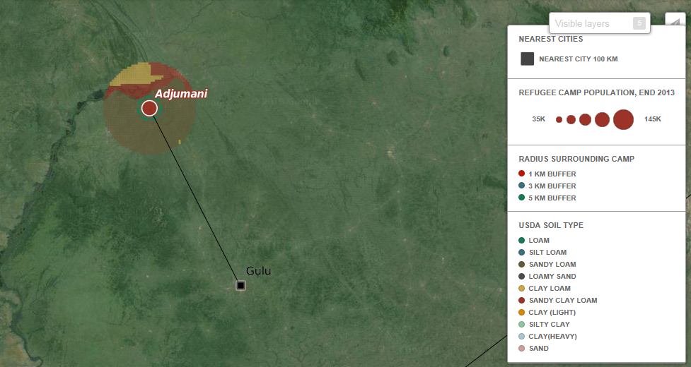
BCG GeoAnalytics used to consider macro-level data to help understand the external factors
II

Slide 130
Social context being considered for the camps as well
III
Sanitation behavior
Cultural traditions and sanitation practices
Native sanitation options
  Type of anal cleansing materials used and wetness of input
  Tendency to misuse or abuse sanitation technology; need to provide alternatives for wastewater, shower water or trash
  Receptiveness to changing behavior (e.g., switching from open defecation to latrines)
  Volume of animal waste or trash that is produced
Existing trash management
Agricultural practices
Clear hierarchy and leadership
  Sense of entitlement or expectation for provisions
  Individual vs. communal motivations
  Short term vs. long term mindset
  Political structure to persuade and enable social change
  Receptiveness to WASH training
Social context
Social hierarchy and cohesion
Level of conflict in the camp
Relationship with host community
Level and types of commerce
  Market for by-products
  Incentive payments vs. volunteer work
  Employable population for skilled jobs vs. unskilled
  Refugee bring in capital / remittances
  Government pressure to hire local population vs. refugees
Economic activity and types of livelihood
Existing jobs for refugees
Resources: Capital, skill sets, education
Quality of implementing partners
  Amount of funding brought in by implementing partners
  Efficiency of partner operations
  Freedom provided by government
Partner relations
Support by local government
Source: BCG analysis

Slide 131
Largest refugee camps can be categorized along archetypes and complexity of sanitation provision
T₀
Growth
Steady State
Permanent settlement
Ramp down
1
2
3
4
5
6
Zataari
Tindouf
Dadaab
Sanliurfa - Akcakale
Kilis
Dadaab - Kambioos
Dollo Ado
Mbera
A: Mega-Camps
Panian
Old Shamshatoo
Kakuma
Increasing complexity of sanitation provision
Ain al-Hilweh
Yusuf Batil
Bredjing
Adjumani
Doro
Mae La
B: Emerging challenges
C: Stable settlements
No reach
Fugnido
Sherkole
Tsore
Bambasi
Tongo
Nyarugusu
Nakivale
Somalia
Sudan / South Sudan
DRC
Western Sahara
Mali
Afghanistan
Syria
Palestine
Myanmar
Size = population
Planned / managed camps
Non-managed camps
Source: BCG analysis, UNHCR population data, interviews with UNHCR staff and implementing partners, geo-physical information

Slide 132
Archetype 3A – Steady state mega-camp: Dollo Ado
Extensive camp with scarce natural resources and challenging
I
Camp management
Lifecycle
Additional context
  High involvement of UNHCR in managing the 5 camps
  Camps were founded between 2009 and 2011
  High inflow recently, but stabilizing
  Predominantly Somali population (Sunni Muslim)
Archetype
II
Resource availability
Need for byproducts (relatively to other camps)
  Extremely dry, arid region with sparse vegetation
  Constraint camp area with relatively small plot sizes ranging from 180 to 225 m2 which limits ability to have household-level latrines and re-dig latrines
  Some integration with the host community might allow for trade opportunity
  Soil conditions are rocky in some of the camps which requires machinery to excavate pits
  Next city is about 500km away so access to a central treatment plant is unlikely
  Water: High
    Low precipitation throughout the year (3-126 mm/month) – pumped, piped water system in place
  Fuel: High
    2-7% tree coverage, depending on camp
  Fertilizer: Limited
    Though agriculture of the host community close by Bokolmanyo, little vegetation in general
Subtypes
III
Cultural traditions and san. practices
Social hierarchy and cohesion
Economic activity and types of livelihood
  Traditionally 'Washers' which results in need for additional water
  5 separate camps with about 40,000 refugees each
  Strongly self-organized into more or less powerful clans
  Remittances inflow in the camp
  Pastoralists (livestock herding: goats, camels, cows, sheep and donkeys); professionals from Mogadishu
  Culturally, very eager to create businesses
  Some ability to engage volunteers and incentive workers in creative business models, e.g. the donkey cart trash collector who uses free capacity for providing paid transportation service in return for taking care of the donkey
Social context
Source: Geo-data, interviews with Dollo Ado wash officer, camp fact sheets

Slide 133
Archetype 2C – Growing stable settlement: Bambasi/Tongo
New settlement with access to key resources
I
Camp management
Lifecycle
Additional context
  UNHCR in partnership with ARRA (Ethiopian government) are running the camp operations and coordinate implementing partners
  Bambasi founded in 2011, Tongo in 2012
  Arrivals have been slowing down, new camp (Tsore) is in planning
  Predominantly Blue Nile Sudanese fleeing from the South Sudan – Sudan boarder conflict
Archetype
II
Resource availability
Need for byproducts (relatively to other camps)
  Fairly lush vegetation mostly trees, herbaceous and cropland
  Plot size of 300m2 allows for household-level latrines
  Some integration with the host community might allow for trade opportunity
  Soil conditions are very favorable for easy to excavate pits that unlikely collapse
  Next city is about 500km away so access to a central treatment plant is unlikely
  Water: Low
    Medium precipitation between 5mm in driest month to 196 in wettest, many water points with piped water installed
  Fuel: Medium - high
    14-18% tree coverage
  Fertilizer: High
    Agriculture both in the fields outside of the camp as well as inside the plots
Subtypes
III
Cultural traditions and san. practices
Social hierarchy and cohesion
Economic activity and types of livelihood
  Wipers
  Innovative hand washing facilities were placed in households
  Overwhelmingly clean latrines
  Very homogenous group of inhabitants
  Elected central committee which disseminates information
  High willingness to engage with community activities and take on responsibility for cleaning
  Some market activity
Social context
Source: Geo-data, in person interviews with UNHCR staff and implementing partners as well as observations during BCG mission in November 2014

Slide 134
Archetype 4C – Permanent stable settlement: Nakivale
Permanent settlement in a fairly resource constraint setting
I
Camp management
Lifecycle
Additional context
  While listed as individual accommodation in UNHCR reporting, high involvement of the UNHCR and other government and NGOs
  As of 2014, 60K refugees living in three camp locations
  Has been around since 1958 – predominantly permanent settlement
  Continuously new caseloads arriving
  Refugees mostly Congolese (30K), Somali (10K), Rwandan (9K), Burundian (8K)
Archetype
II
Resource availability
Need for byproducts (relatively to other camps)
  185 km² space for 3 zones – sparsely populated
  Labor for facility management and education potentially available as quite integrated with 35K population around the camp
  Pit latrines might likely to be wet which increases risk of overflowing latrines
  Fairly low bulk density and soil texture 'clay loam' that it's fairly easy to dig a hole
  Next large city 37km away: Mbarara with ~100K inhabitants suggests that it's possible to access water treatment
  Water: Limited
    High precipitation throughout the year (48-274mm/month)
  Fuel: Limited (relatively to other locations)
    20-30% tree coverage
  Fertilizer: Limited
    According to macro data little farmland in place (mostly trees), but camp level micro data suggests agricultural activity
Subtypes
III
Cultural traditions and san. practices
Social hierarchy and cohesion
Economic activity and types of livelihood
  Eclectic mix of nationalities, Somalis use water, other nationalities wipe
  Mostly, the camps appears as very clean and hygienic
  79 villages
  Developed social structure as individual stay duration is fairly low
  Integrated with host community who also benefits from water, education, health and nutrition programs in the settlement
  Business between nationalities going on, e.g. Congolese are hired by Somalis to fetch water
Social context
Source: Geo-data, in person interviews and observations during BCG mission in November 2014, UNHCR Nakivale Fact sheet 2014

